Slide 1
Geology 5660/6660
Applied Geophysics
19 Apr 2023
Final Project
Final Project Assignment
Benson Park-n-Ride Data
Due 5:00 pm, Thur May 4
© A.R. Lowry 2023

Slide 2
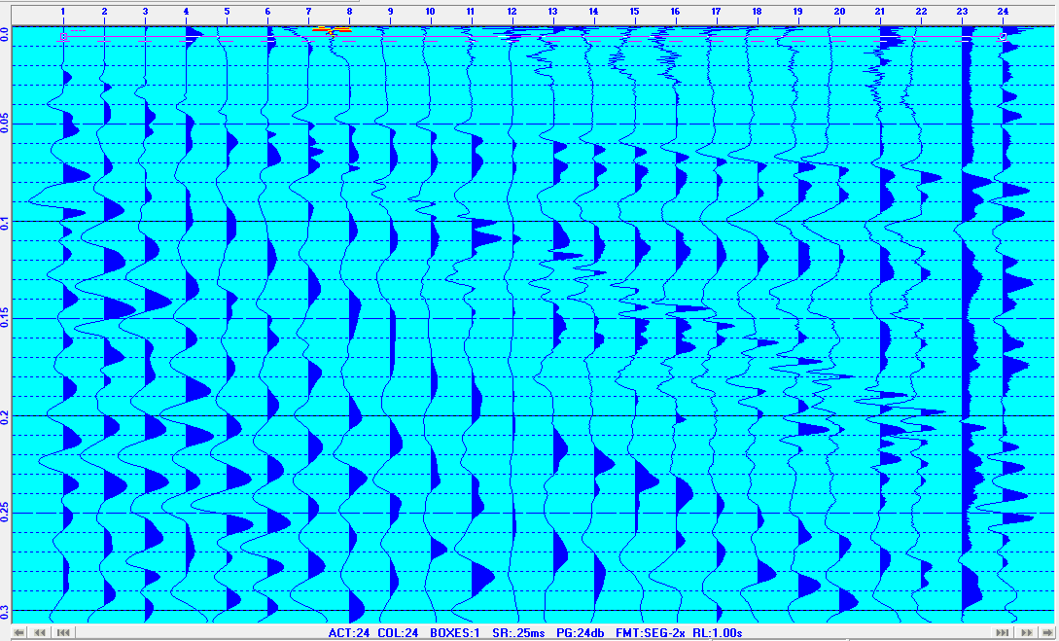
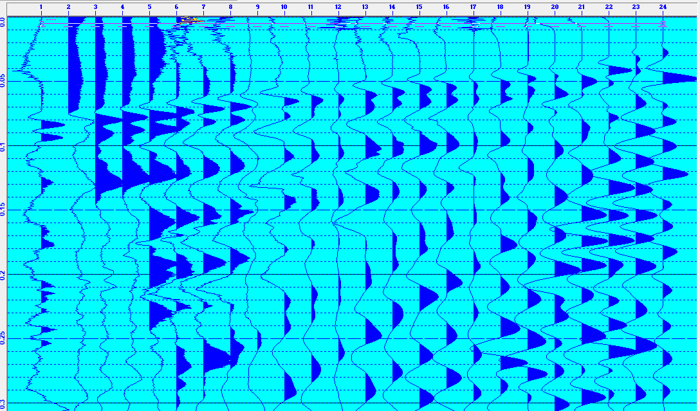
Benson Park-n-Ride Project Assignment
Part I: Seismic Investigation
Data files are on the course website! You’ll want to use the RAS
software (which should be installed on most windows computers
in the Oldham room) to redisplay and pick the first arrivals from
individual traces of the data. Picks are saved in ascii text files!
E to W (Forward)
W to E (Reverse)

Slide 3
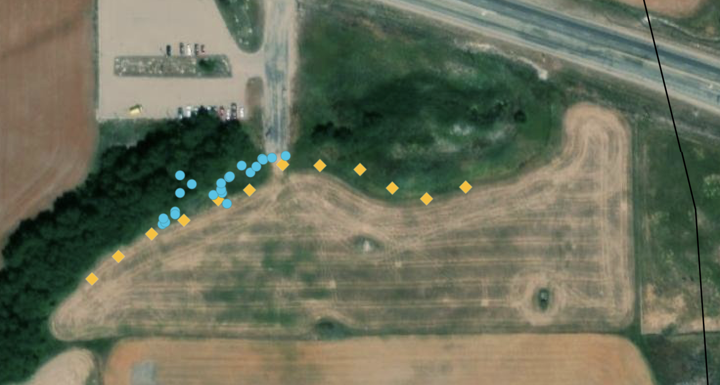
Benson Park-n-Ride Project Assignment
Part I: Seismic Investigation (Continued)
(I.1) Pick first arrivals for each record. I recommend looking at both
forward and reverse sections (remembering reciprocity!) before
finalizing & modeling your picks. Remember that you don’t need
to populate every pick in Refract… Model only the picks you are
confident in!
(I.2) Model the data in Refract. Your project report should
include screenshots of all four of the Refract windows for
completeness.
(I.2.i) The GPS positions are too
scattered to be reliable, but given
curvature evident in Amanda’s
satellite image, how might errors
in distances from the shots effect
your velocity model?

Slide 4
Benson Park-n-Ride Project Assignment
Part I: Seismic Investigation Continued
(I.3.i) Is there unequivocal evidence for dip on the layer interfaces
generating your arrivals?
(I.3.ii) If the model has a “dipping” layer, is the dip consistent with
what you’d expect at this location?
(I.3.iii) Is there misfit in your best-fitting model of your picks that
can’t be reduced by changing the model parameters?
(I.3.iv) If so, how might you interpret that misfit?
(I.3.v) Use ray theory and a simple calculation of how a velocity
change within your top layer might produce the observed misfit.

Slide 5
Benson Park-n-Ride Project Assignment
Part I: Seismic Investigation Continued
(I.4) If we crossed the West Cache fault trace, our target would
have travel-times somewhere on a spectrum between a layer
over a vertical contact and an offset layer boundary:
There are no Xcel spreadsheet models of these in the Burger
codes, but I’ve created one (on the website; E-W_Seismic.xlsx).
m = 1/V₂
m = 1/V₂
m = 1/V₃
m = 1/V₂
m = 1/V₃
m = 1/V₂
m = 1/V₂
m = 1/V₂
m = 1/V₁
m = 1/V₁
m = 1/V₁
m = 1/V₁
V₁ = 500 m/s
B
V₁ = 500 m/s
A
z
V₂ = 2000 m/s
V₃ = 1000 m/s
V₂ = 2000 m/s

Slide 6
Benson Park-n-Ride Project Assignment
Part I: Seismic Investigation Continued
(I.4) Use the spreadsheet to model both “fault-like” cases. Start out
using the parameters for V₁, thickness & V₂ from your Refract
model; then vary all five parameters as needed to improve the fit.
(I.4.i) Which of the three models is most successful (given RMS)?
(I.4.ii) Do your fault model residuals suggest anything else?
m = 1/V₂
m = 1/V₂
m = 1/V₃
m = 1/V₂
m = 1/V₃
m = 1/V₂
m = 1/V₂
m = 1/V₂
m = 1/V₁
m = 1/V₁
m = 1/V₁
m = 1/V₁
V₁ = 500 m/s
B
V₁ = 500 m/s
A
z
V₂ = 2000 m/s
V₃ = 1000 m/s
V₂ = 2000 m/s

Slide 7
Benson Park-n-Ride Project
Part II: Magnetic Data Investigation
(II) Download the Excel spreadsheet from the website. The file
contains all raw data in the upper left region, and the corrected
and averaged data (along with uncertainties) can be found in
the upper right.
(II.1) Find (and report!) the vertical components of the WMM at
the four extremal (N, E, S, W-most) points in the profile.
(Amanda did not include elevations but assume a constant
value of 1380 m). Does it make sense to
correct for variations in the WMM along
this profile? Why or why not?
(III.2) If you think there is good reason to correct
for WMM, add those values to column W (after subtracting the
WMM Z component at site 13) and calculate corrected
anomalies in column X. Then plot the corrected and
uncorrected anomalies in a single plot. Does the reduction
improve the scatter, or make it worse?

Slide 8
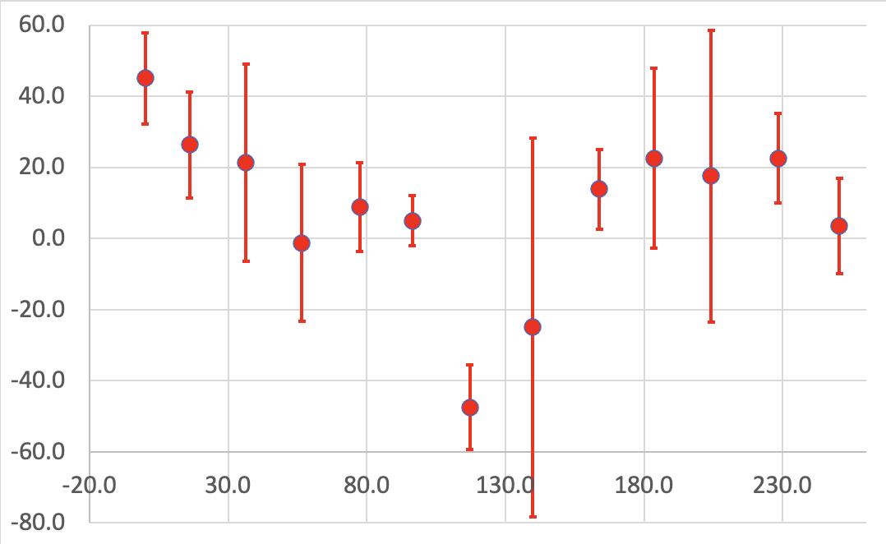
Benson Park-n-Ride Project
Part II: Magnetic Data Investigation
(Note:
Profile
distance is
positive-~E;
zero is at the
westernmost
stake near
the end of
the field)
ΔH (γ)
Profile Distance (m)

Slide 9
Benson Park-n-Ride Project Assignment
Part II: Magnetic Investigation (Continued)
(II.3) Model the data as a simple four-vertex polygon
using GravMag. (Your write-up should include images of all
windows). We measured the vertical field anomaly, so you
need to set to “Vertical Field” for the RMS misfit options in
the data window! Also you need to estimate azimuth of the
profile (which you can do using info in Xcel). In preferences,
check “Use uncertainties” & “Enter magnetic field”. All of
these (azm, main field, etc) should be reported in your write-up.
Does the anomaly from a simple induced-magnetization
polygon look similar to the measurements?
(II.4) Systematically vary the magnetic susceptibility, polygon
position, & shape (and remanent magnetization, if you can
make a case for why this might matter) to minimize the misfit.
(II.5) Does your best-fit model support the idea that this is real
signal caused by subsurface properties? Why or why not?

Slide 10
Benson Park-n-Ride Project Assignment
Part III: DC Resistivity Investigation
(III.1) Of course, we didn’t get much from our resistivity
investigation… But we did make a couple of measurements before
it shut down due to low battery. Unfortunately these were not
saved to a file, but from memory, the first measurement was
about 10.6 Ω-m (with 24 m a-spacing), and the second was
11.1 Ω-m (21 m a-spacing with the near current electrode at the
easternmost electrode).
Compare these to measurements from apparent resistivity
pseudosections for some of the past class project results we
discussed in class (e.g., Paradise, West Cache Fault). What do
these measurements imply about the lithology of our site?

Slide 11
Dayton-Oxford Fault Project
Part IV: Synthesis
Now, from the combination of all of the data (and your
visual observations of the site, and any additional
resources you have that pertain to the problem:
(IV.1) What (if anything) do the combined measurements
tell us about the site that we could not glean from one
type of geophysical measurement alone?
(IV.2) What is your final combined interpretation of the
subsurface at the field site? Does it match your
expectations of what you thought we’d find before
you worked up the data?
(IV.3) One reason we chose this location is that the
surface trace of the West Cache fault is mapped
near here (presumably interpolating between surface
mapped exposures). Do you think we found possible
evidence of the fault, and why or why not?

