Slide 1
Geology 5660/6660
Applied Geophysics
1 Apr 2024
Last Time: Magnetic Methods
• A magnetic anomaly is the (vector) perturbation of
the external (core) magnetic field’s vector magnitude (H_{E})
by crustal magnetization
• Magnetic field strength decays as 1/r³
• Total intensity of magnetization:
where remanent magnetization I_{R} is in the direction
of H_{E} at the time of magnetization… i.e., when the rocks
cooled through their Curie temperature
• Must know strength & direction of the Earth’s
main field to model source geometries and
susceptibility contrasts!
For Wed 3 Apr: Burger 450-493 (§7.4-7.7)
© A.R. Lowry 2008-2024

Slide 2
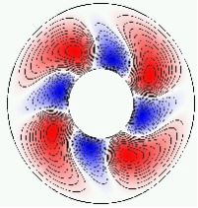
The Earth’s Main Field (Core Field) :
Earth’s main field is generated by convection of Earth’s
fluid Ni-Fe outer core. As the solid inner
core cools & grows, released heat drives
thermo-chemical convection. Movement of
charge within the electrically-conductive
molten iron produces electric currents
which in turn generate a magnetic field.
Rotation of the Earth → Coriolis forces which cause a
Magnetohydrodynamic Dynamo Effect, in which
magnetic fields organize in a way that amplifies the current
flow. Positive feedbacks are self-stabilizing & produce a very
large, predominantly dipolar magnetic field (with smaller
higher-order terms).

Slide 3
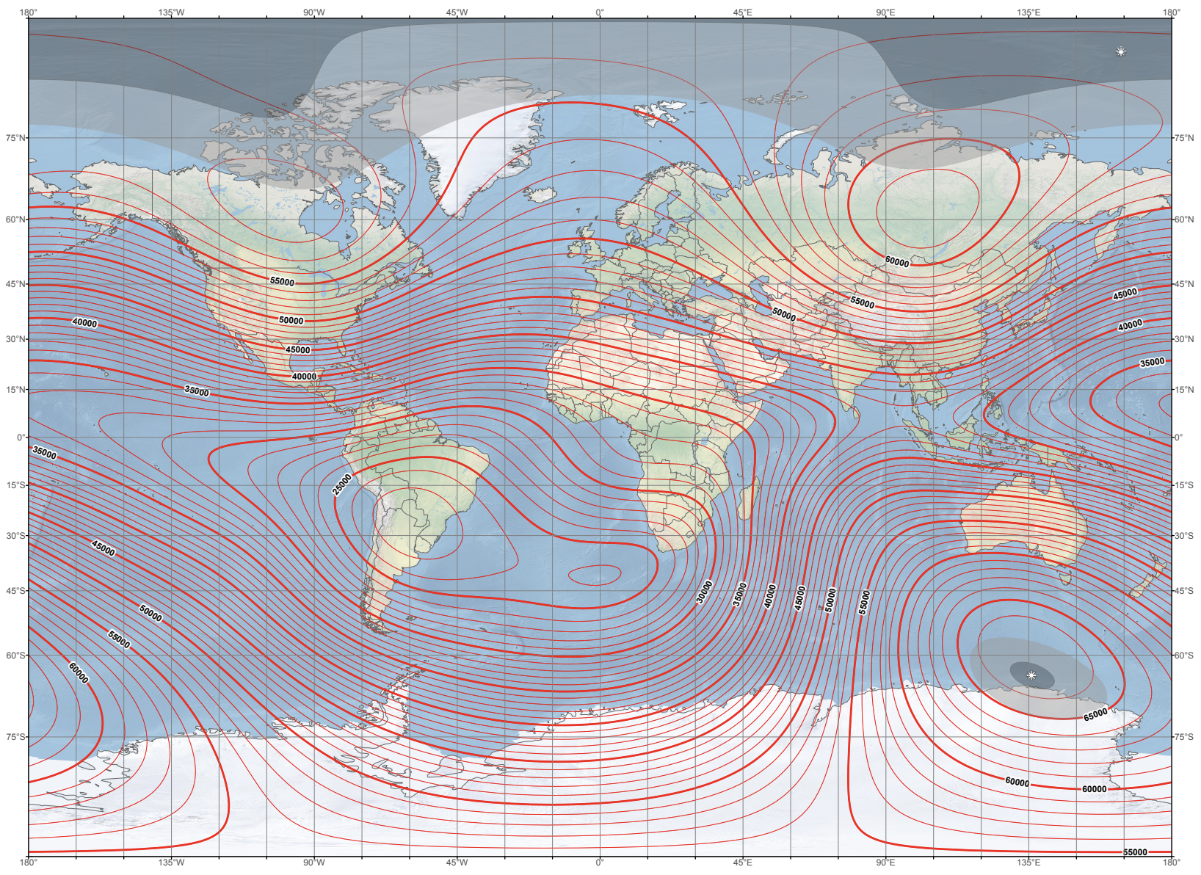
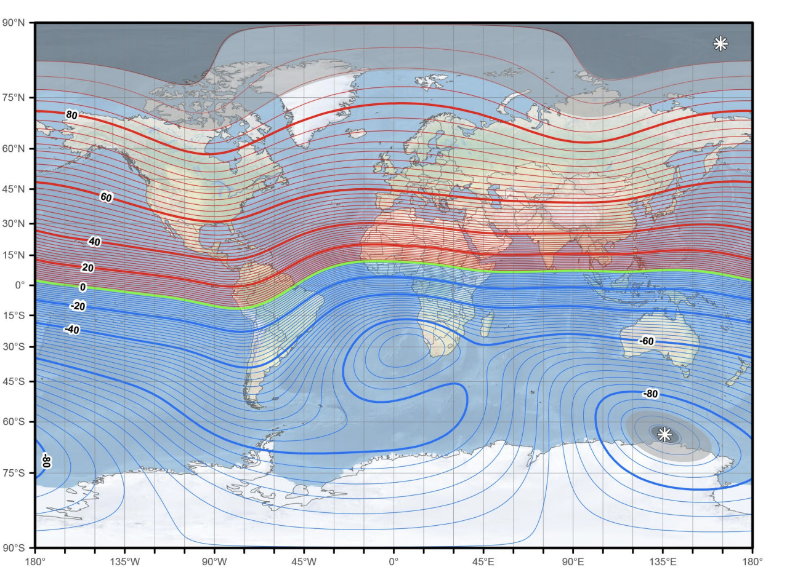
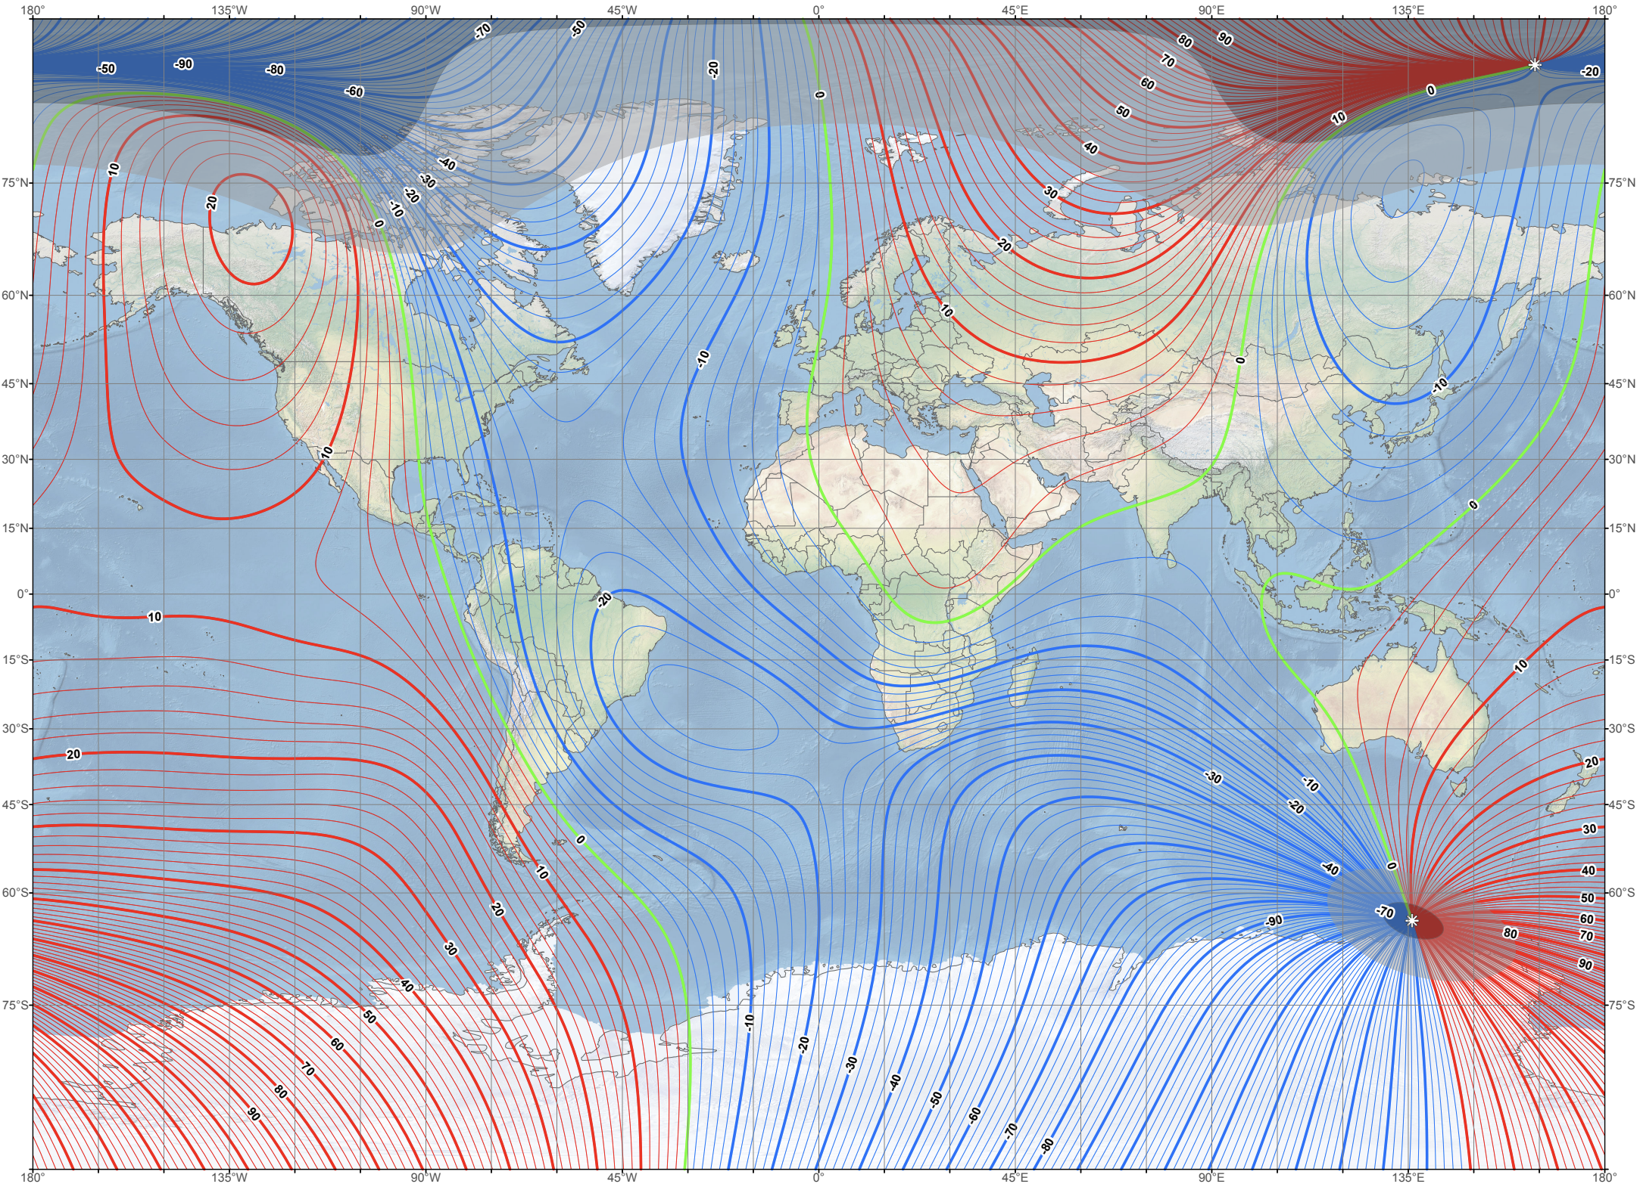

World magnetic model 2020
The core-generated magnetic field is
a vector quantity so it has
magnitude and direction. Most
often described by:
intensity H_{E} (i.e., magnitude)
inclination i (∠ from horiz)
declination d (∠ from true N)
These vary depending on location
on Earth’s surface, and also
change nonlinearly with time!
Intensity H_{E} varies from ~25k nT
at equator to ~65k nT at poles
Here blue is negative (i is positive
downward)
H_{E}
i
d

Slide 4
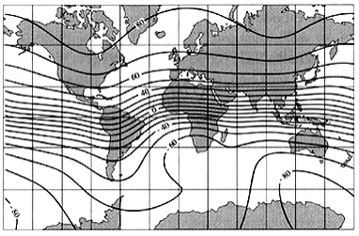
Can also express vector where are
geographical North, East, Up directions. Then
intensity
inclination i is the angle of field direction from
horizontal (positive downward):
declination d is
angle (positive
clockwise) from
true north to
magnetic north:
IGRF Inclination 1995

Slide 5
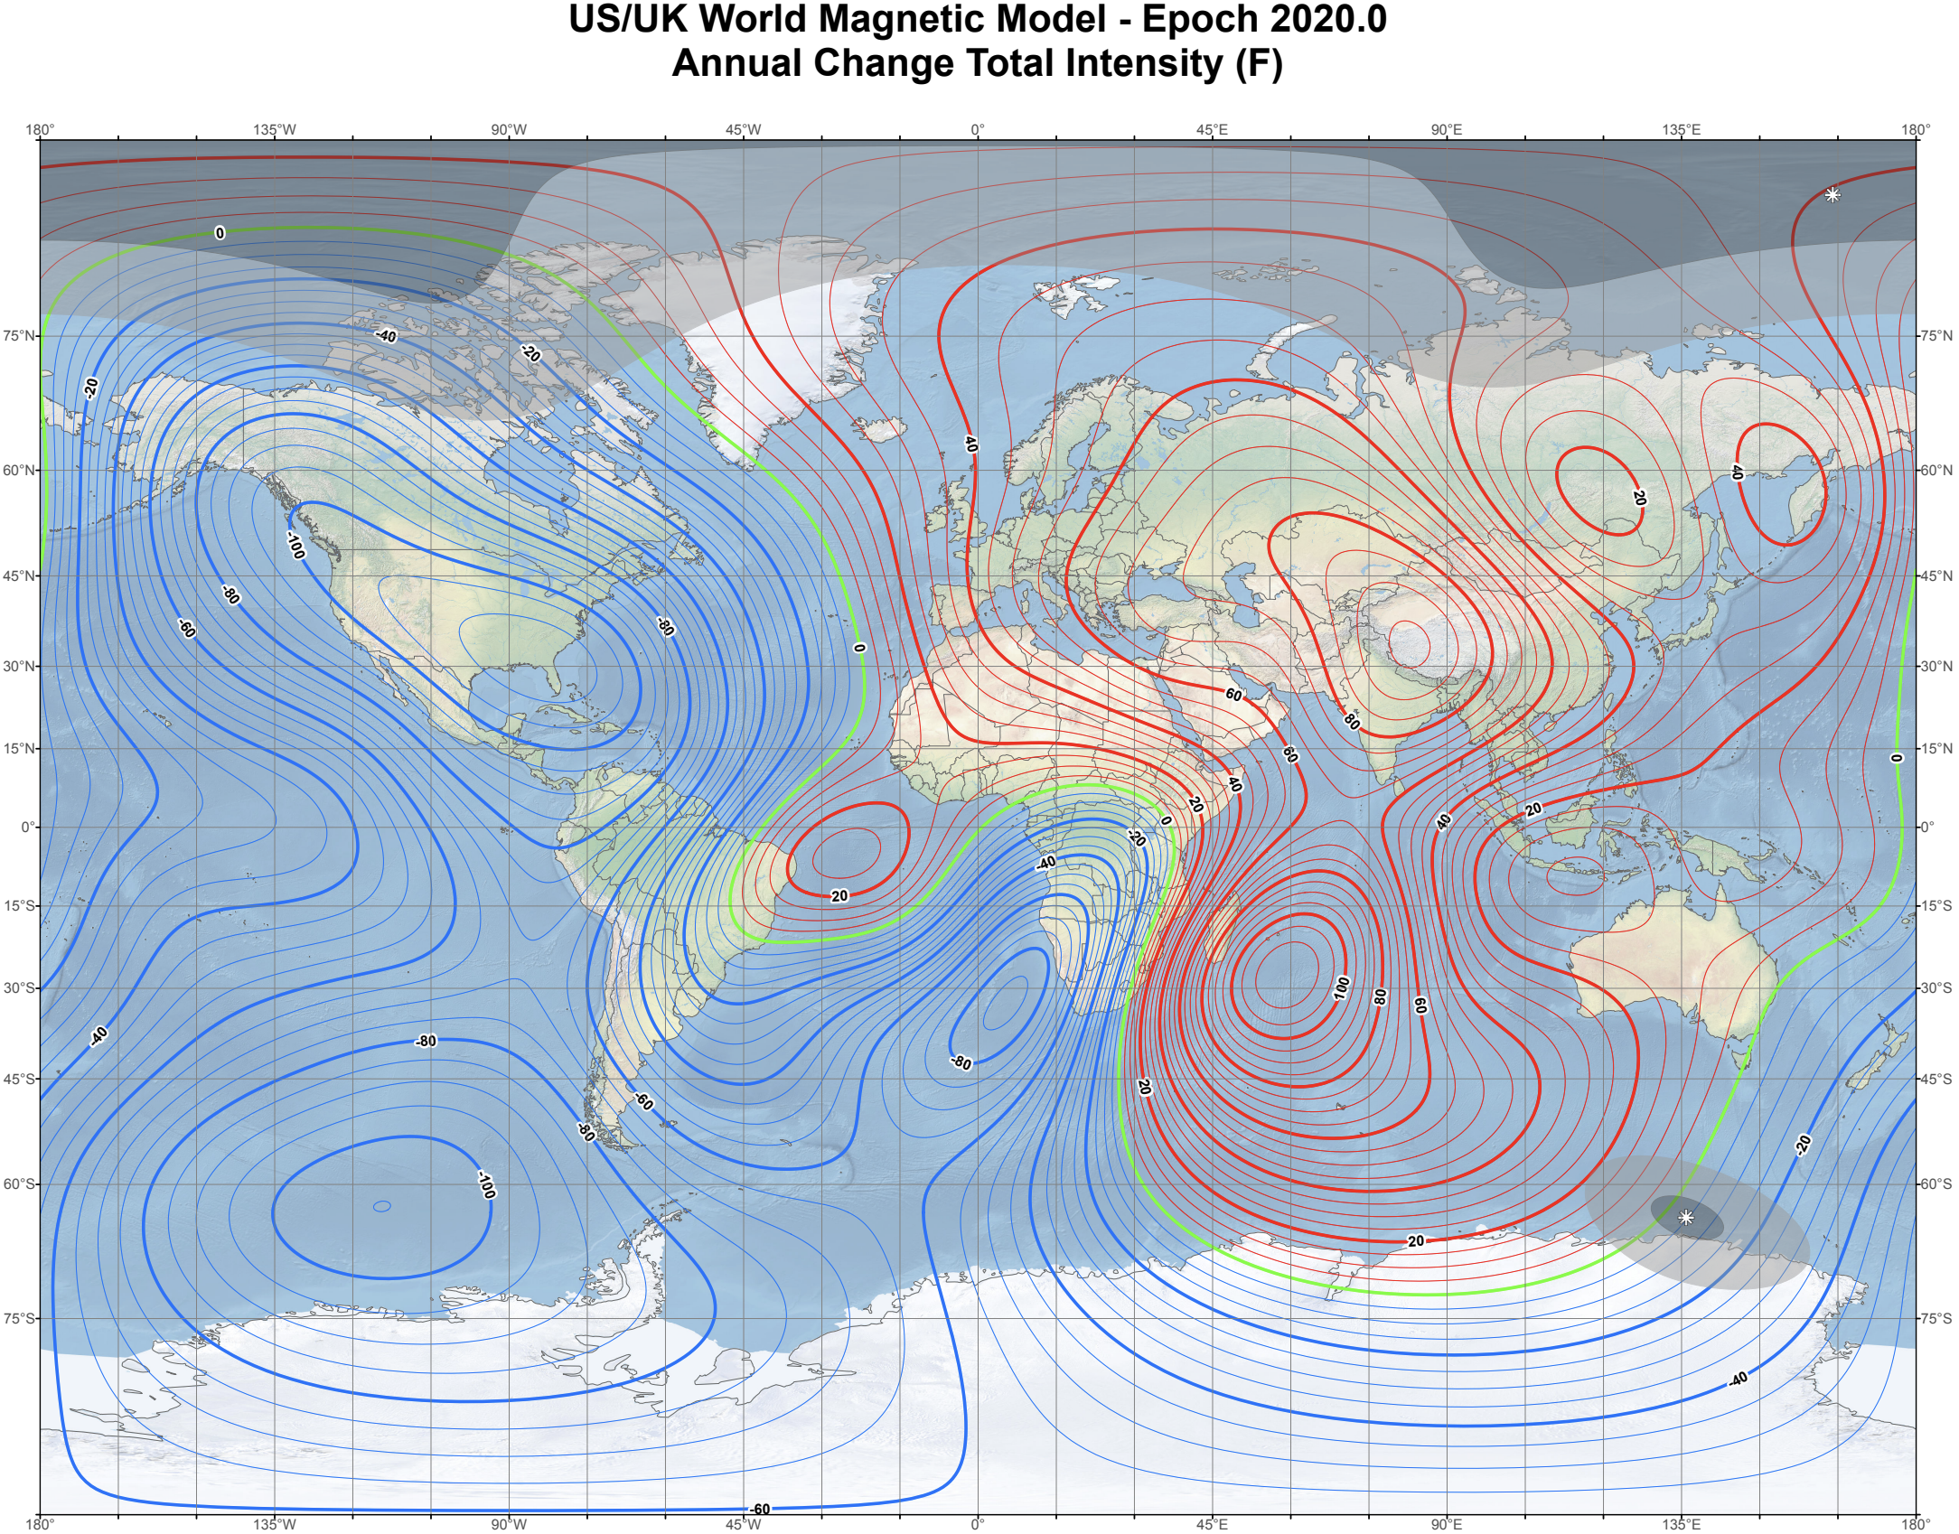
Because the field is constantly changing, important to know the
time of measurement for reduction to anomaly…

Slide 6
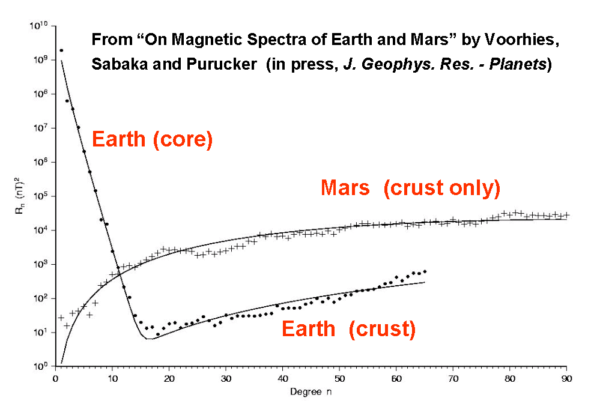
Problem: If both Earth’s main field and crustal field are
determined from measurements, how do we separate them?
Recall n is the number of wavelengths for a cosine to make it around the Earth’s circumference!
Aside: Modern Earth’s magnetic field is monitored by satellite (so is truly global) but this also entails a complicated process of separation from geomagnetic interactions with solar flux (“space weather”)
Voorhies et al. (2002) JGR-Planets
Core field dominates long wavelengths (small n of spherical
harmonics). We describe core field only out to n = 14–15
where it dominates the total field.

Slide 7
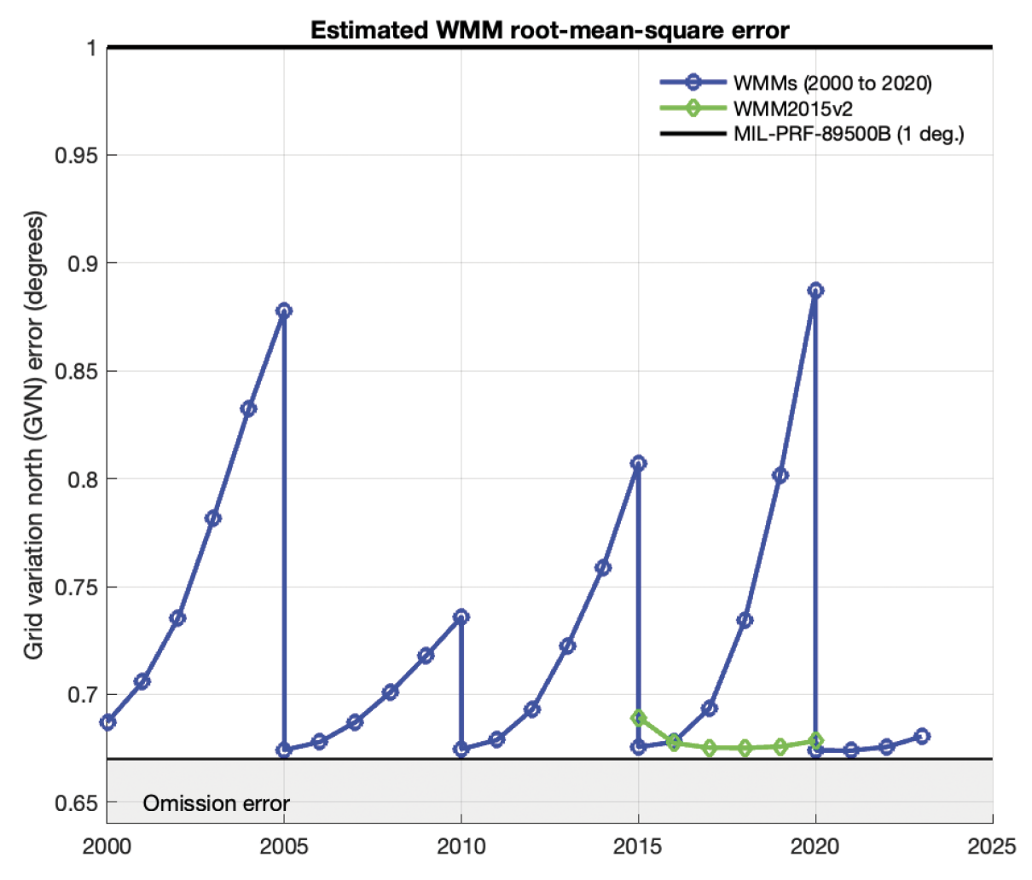
And the (predictive) model is revised using magsat data about
once every five years!

Slide 8
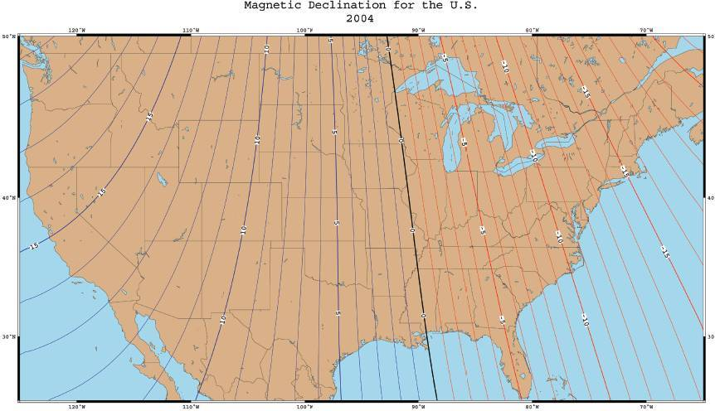
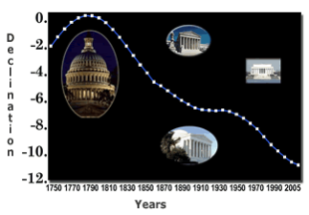
Aside: Changes originally (and still) recorded at surface magnetic observatories including a long record in Washington DC!
Westward drift of “non-dipole” field
(& precession of magnetic about
rotation pole) ⇒ declination
changes relatively rapidly

Slide 9
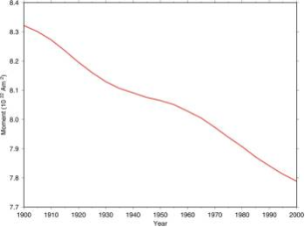
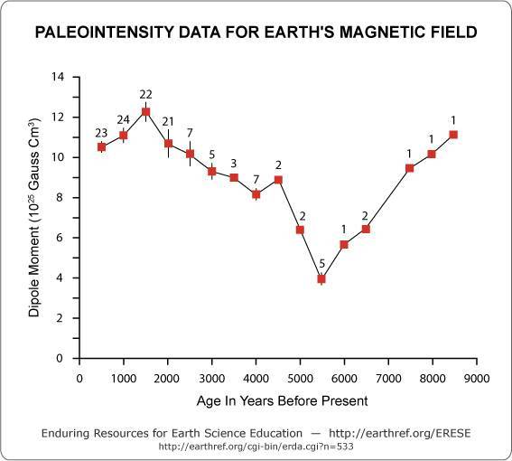
Intensity of Earth’s total dipole
field changes more significantly
on longer timescales… Paleointensity
measurements are very noisy
but they and models of the core
dynamo suggest field is strong
immediately after a reversal &
weakens (~ exponential decay)
for some period to near zero,
then jumps to high value…
Reversal may or not accompany
the jump. This “sawtooth”
pattern has led some to suggest
that Earth will experience a
reversal in the next ~2000 years
(but it’s not linear or predictable).

Slide 10
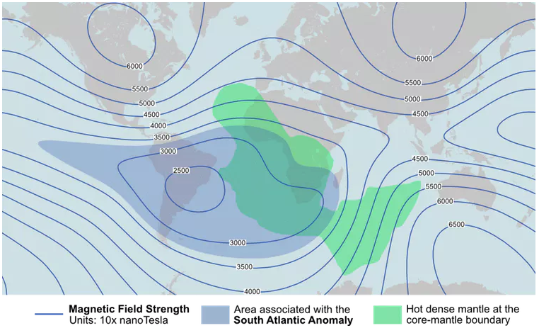
Rapid weakening of already-low H_{E} in the South Atlantic is locally
reversed at the core-mantle boundary! Thought to relate to heat
exchange there; may presage a reversal?

Slide 11
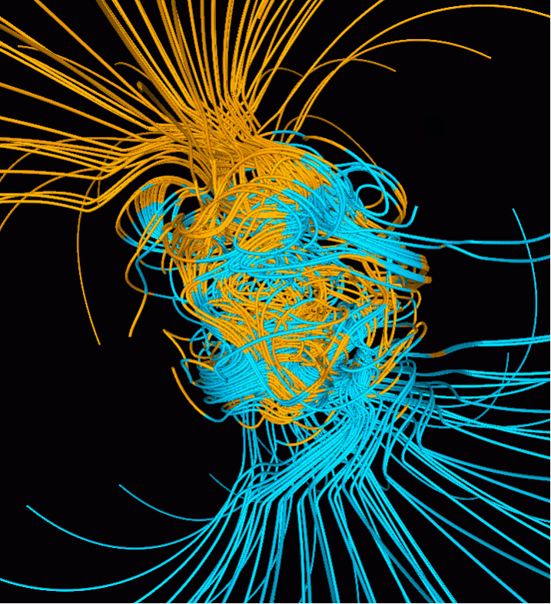
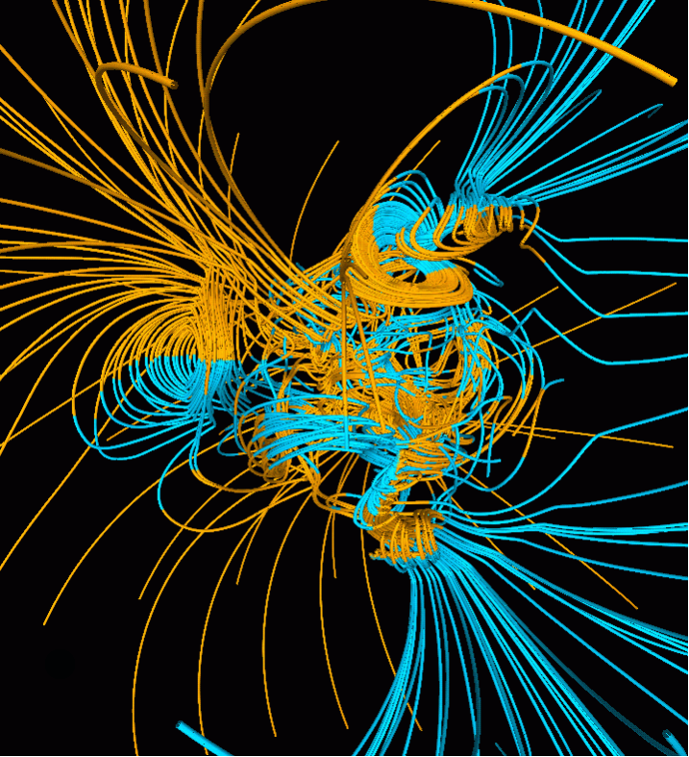
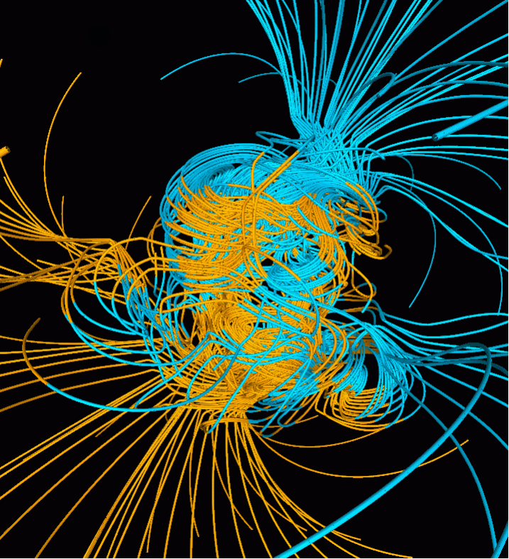
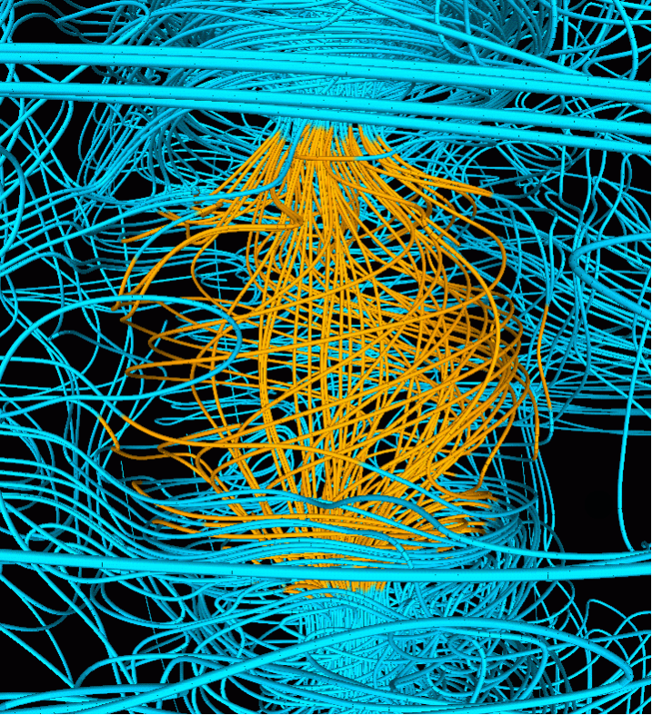
500 yrs before
reversal
mid-reversal
500 yrs after
reversal
Glatzmeier modeling revealed:
Solid inner core magnetized opposite main
field; forced to rotate by applied torque
⇒ precession (~0.2°/yr for real Earth)
Inner core stabilizes field dipole; long time
required to diffuse outer core field to inner
core controls reversal timescale

Slide 12
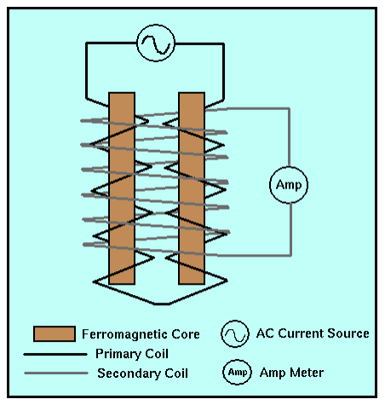
Measurement:
Fluxgate
magnetometer:
Wire coils wound in
opposite directions;
these cancel &
produce zero current
in secondary coil
in absence of external
magnetic field, but
if aligned with a field,
one core reinforces,
other counteracts
external field resulting
in a current.
Gives intensity in the
orientation of the
coils.
(Direction?)

Slide 13
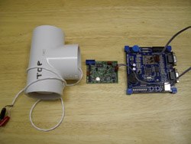
Measurement:
Proton precession
magnetometer:
Bottle containing a hydrogen-rich
fluid (distilled water or hydrocarbon)
is surrounded by a wire coil. Current
through the coil produces a strong
magnetic field; protons (H⁺) align
with the field… Current is shut off & as protons realign with
the ambient magnetic field, they precess at a frequency
determined by magnetic field strength (0.042576 Hz/nT).
So, measure frequency of the induced AC current and
convert to a total field strength.
(Lots of other types but these two are most commonly used
for terrestrial geophysics!)

Slide 14
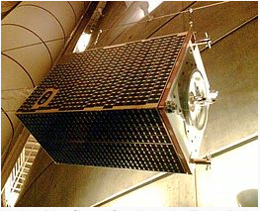

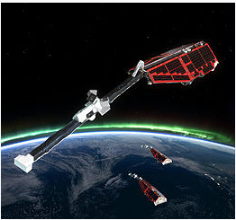
Measurement:
Satellite missions including Ørsted, Champ
and most recently Swarm included
three-component oriented fluxgate
magnetometers to measure all three
components of the magnetic field, to
characterize the time-varying core-derived
main field, crustal magnetization and
magnetospheric (space weather)
phenomena…
Typically combined with other instruments
for measuring space-weather interactions,
charge, lower atmospheric phenomena,
and in Swarm’s case 3D mantle electrical
conductivity!
Ørsted
Champ
Swarm

