Slide 1
Geology 5660/6660
Applied Geophysics
2 Feb 2024
Last time: Zoeppritz’ equations and AVO
• Zoeppritz’ equations give amplitudes of reflections and
refractions that vary with angle of incidence at a boundary
• Amplitude vs offset (AVO) uses reflection amplitudes
at different offsets (hence different i₀) to infer properties
The Refraction Method:
• For a single horizontal layer over a halfspace,
observed travel-times for direct and refracted arrivals:
give the velocities and layer thickness from t = m_{i} x + b_{i} as:
Read for Mon 5 Feb: Burger 106-141 (§3.7-3.11)
© A.R. Lowry 2008-2024

Slide 2
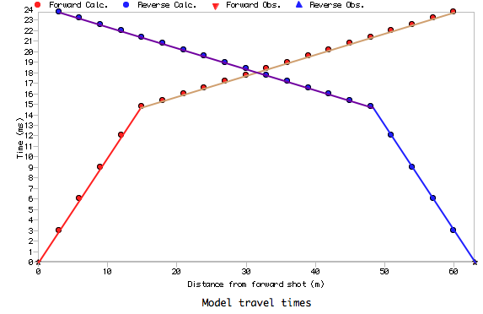
x_{co}
Direct arrival
h
a
V₁
i_{c}
Refracted arrival
b
V₂
Practical note: This works for a horizontal interface, and then
only if there are enough geophones before & after the
crossover distance x_{co} (where arrival times for the direct
& refracted arrival are the
same) to solve for
equations of the two
lines:
or
x_{co}

Slide 3
Spatial sampling is key to getting accurate estimates
of thickness: Must have multiple geophones that sample
each layer. Since we don’t know the structure when
designing the experiment, this means lots of closely-
spaced geophones… Where “close” is determined by
minimum expected thickness and maximum expected
velocity difference!

Slide 4
Direct arrival
h
a
V₁
i_{c}
Refracted arrival
b = x_{c}/2
V₂
Another term that crops up in refraction studies is the
critical distance = the horizontal distance traveled in
layer 1 by the ray having critical angle i_{c} (i.e., x_{c} = 2b).
In situations where we have some approximate idea of the
range of thicknesses & velocities we might expect to find,
calculating the crossover and critical distances inform
experiment design (i.e., how many geophones to use,
offset & spacing).

Slide 5
Direct arrival
h₁
V₁
i₁
h₂
V₂
Refracted arrival
V₃
For multiple layers we take advantage of Snell’s Law:
Via similar algebra & geometry to the one-layer case,
or, generalizing to n-layers:

Slide 6
Recall that your 2nd lab assignment asks for two crossover
distances (between the direct arrival and the first refraction,
and between the first refraction and the second refraction). We’ve
already derived the equation for the first of these, and the
equation for the second can be found similarly: We require that
If we recall that these are the equations of lines with slopes (m₂, m₃)
and intercepts (b₂, b₃), a simplified way to write the solution is:
$$x_{co}=\frac{b_{3}−b_{2}}{m_{2}−m_{3}}$$
1

Slide 7
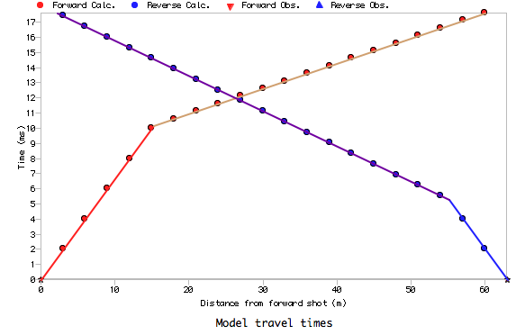
Direct arrival
V₁
h
i_{c}
Refracted arrival
V₂
?

Slide 8
Direct arrival
h_{d}
V₁
h_{u}
i_{c}
α
Refracted arrival
V₂
t_{ud}
Refraction from a dipping
interface:
Now thickness changes with
offset, so slope is no longer
= inverse of layer velocity.
Refer to as “apparent
velocity ”, and this is why
we reverse our shots!
m_{u}
t_{0u}
t_{dd}
m_{d}
t_{0d}
After some trig & algebra, we get:

Slide 9
Like before, we have the observed travel-times and want to
know the model parameters. We know V₁ from the direct
arrival, & we can show that the slopes are:
then we can solve for velocity V₂:
⇒
and angle α:
The normal thicknesses use intercept times t_{0u}, t_{0d}:
(Can get vertical distance from shot to top of layer by dividing
h_{d} or h_{u} by cos α).

