Slide 1
Geology 5660/6660
Applied Geophysics
2 Feb 2026
Last time: AVO
• Amplitude vs offset (AVO) uses reflection amplitudes
at different offsets (hence different i₀) to infer properties
The Refraction Method:
• For a single horizontal layer over a halfspace,
observed travel-times for direct and refracted arrivals:
give the velocities and layer thickness from t = m_{i} x + b_{i} as:
Read for Wed 4 Feb: Burger 106-141 (§3.7-3.11)
© A.R. Lowry 2008-2026

Slide 2
Last time continued: The Refraction Method:
• The crossover distance x_{co} can be used
in experiment design, to ensure adequate
geophone sampling:
• For an n-layer Earth:

Slide 3
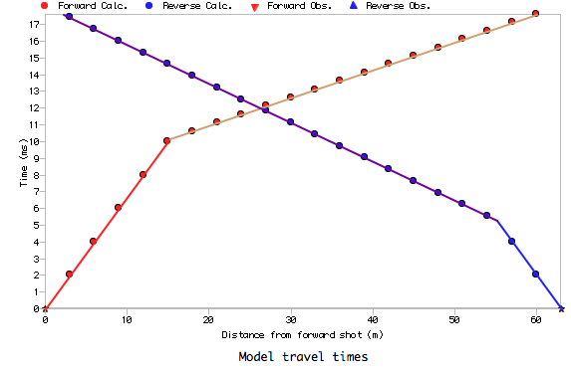
Direct arrival
V₁
h
i_{c}
Refracted arrival
V₂
?

Slide 4
Direct arrival
h_{d}
V₁
h_{u}
i_{c}
α
Refracted arrival
V₂
t_{ud}
Refraction from a dipping
interface:
Now thickness changes with
offset, so slope is no longer
= inverse of layer velocity.
Refer to as “apparent
velocity ”, and this is why
we reverse our shots!
m_{u}
t_{0u}
t_{dd}
m_{d}
t_{0d}
After some trig & algebra, we get:

Slide 5
Like before, we have the observed travel-times and want to
know the model parameters. We know V₁ from the direct
arrival, & we can show that the slopes are:
then we can solve for i_{c} & thus velocity V₂:
⇒
and angle α:
The normal thicknesses use intercept times t_{0u}, t_{0d}:
(Can get vertical distance from shot to top of layer by dividing
h_{d} or h_{u} by cos α).

Slide 6
Aside: Solving for parameters in this way is a simple form of
inversion of the data:
Most geophysical (& geological, & other) problems can be
expressed as:
observations (d) = some function of parameters (m), or
(where the arrow denotes plural: a vector). In the refraction
examples thus far, the model parameters (m) would
include velocities (V_{i}), thicknesses (h_{i}), and dips (α_{i}).
Inverse theory, in which we seek to find
is a very important part of geophysics!
Note here that F(•) is a physical model of the relationship of observations to parameters (which makes assumptions about the medium!)

Slide 7
Equations for multiple dipping layers can be derived using
a similar (if slightly more algebraically complicated) approach
to that we used for the multiple horizontal layer case [Adachi]:
Here,
d_{i} are angles
of incidence
minus α_{i}
and u_{i} are
angles plus
α_{i}... i.e.,
angles from
the raypath
to the
vertical!
u₁
d₁
V₁
z_{u1}
i₁
V₂
d₂
α₂
V₃
u₂
z_{u2}
i₂
α₃
(And these are the equations used in the modeling code Refract…)

Slide 8
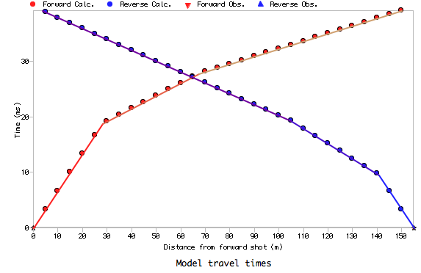
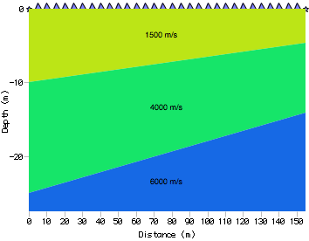

Slide 9
Some Limitations of the Refraction Method:
It does not get returns from low velocity layers.
This means that not only does your best-fitting model
not include the low velocity layer, but also estimates
of the depth to top of all subsequent layers will be
overestimated.
Thin layers may be aliased by geophone spacing,
& in some cases will be missed regardless of spacing!
As with the low velocity layer, this won’t affect velocity
estimates for lower layers but will affect depth (in this
case depth is underestimated).

Slide 10
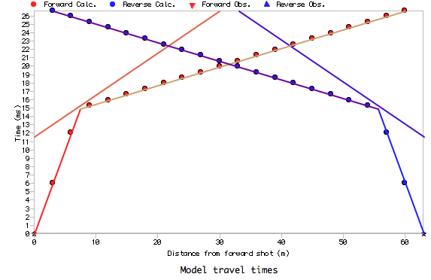
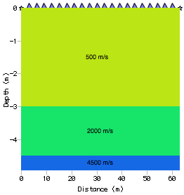
:-\
Is this
real?

Slide 11
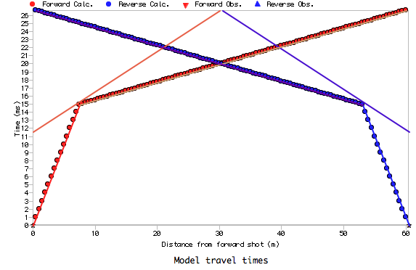

Slide 12
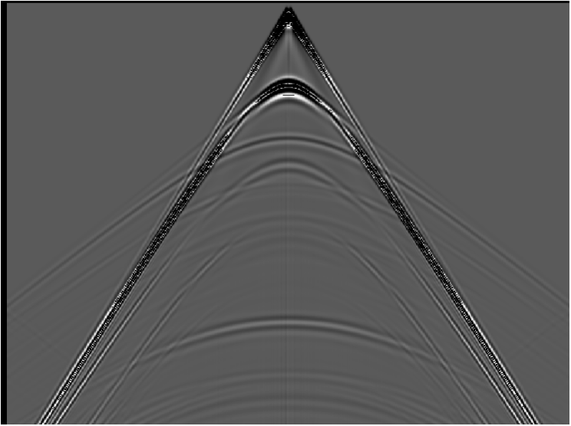
water
Example for
a synthetic
seismogram
shale
gas sand
shale
(Note however that just because the refraction
isn’t the first arrival, doesn’t mean it isn’t there!)

Slide 13
What if velocity changes within layers?
V₁ = 2000 m/s
V₂ = 1000 m/s
m = 1/V₁
m = 1/V₂
m = 1/V₂
m = 1/V₁

Slide 14
V₁ = 500 m/s
V₂ = 2000 m/s
V₃ = 1000 m/s
m = 1/V₂
m = 1/V₃
m = 1/V₃
m = 1/V₂
m = 1/V₁
m = 1/V₁

Slide 15
What if the layer interface is not planar?
B
V₁ = 500 m/s
A
z
V₂ = 2000 m/s
m = 1/V₂
m = 1/V₂
m = 1/V₂
m = 1/V₂
m = 1/V₁
m = 1/V₁

