Slide 1
Geology 5660/6660
Applied Geophysics
3 Apr 2024
Last Time: Earth’s Main Magnetic Field
• Earth’s Main Field derives from its “core dynamo”…
convective flow of Ni-Fe outer core + coriolis forces (→ +
feedback) → electrical current flow → magnetic field
(→ + feedback) + crystalline Fe inner core
(→ + feedback)
• Mostly dipolar, oriented ~ (and precesses around) Earth’s
rotation axis; varies nonlinearly over time…
• Express the vector field at a point as either intensity H_{E},
inclination i, declination d or local H_{x}, H_{y}, H_{z} (N,E,U)
cartesian components:
For Fri 4 Apr: Burger 450-493 (§7.4-7.7)
© A.R. Lowry 2008-2024

Slide 2
Last Time Continued: Magnetic Measurements
• Distinguish Main Field from crustal sources by scale: spatial
wavelengths > 2500 km (spherical harmonic degree n < 16)
dominated by core dynamo; smaller scales are mostly crustal.
• Instrumentation:
→ Fluxgate magnetometer: Measures field intensity
in the direction of orientation of the coils
→ Proton precession magnetometer: Measures
intensity of the total field

Slide 3
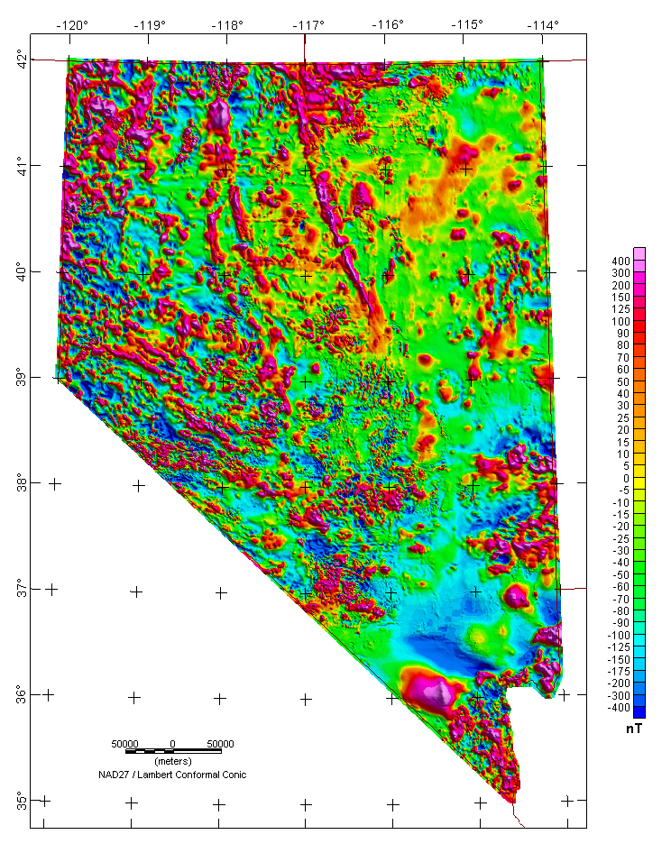
Many regions also have
aeromag measurements
(e.g., magnetic anomalies
over Nevada… USGS has
now flown the entire
conterminous United
States).
Most magnetic anomaly
maps on scales < 500
km use magnetometer
data collected by flying an
airplane in a grid pattern
over the target region

Slide 4
Data Reduction (for surface measurements):
Remove/avoid all metal objects when collecting data!!!
Keep magnetometer high off the ground; face a uniform direction to
reduce “noise”
Sensitive to variations in ionosphere, magnetosphere: Perform
looping and correct for drift; avoid measurement during solar storms!
Correct for elevation if > a few hundred m (~0.03 nT/m)
Horizontal position correction: Use WMM if latitude change is > a few
hundred m (correction here ~6 nT/km)
From https://www.ngdc.noaa.gov/geomag/calculators/magcalc.shtml#igrfwmm
Component Field Value Secular Variation
Declination 10.9892 degrees -0.095 °/year
Inclination 66.471 degrees -0.0311 °/year
Horizontal Intensity 20578.1 nT -16.6 nT/year
North Component (x) 20200.8 nT -9.8 nT/year
East Component (y) 3922.7 nT -36.7 nT/year
Vertical Intensity (z) 47207.1 nT -108.0 nT/year
Total Intensity 51497.3 nT -105.6 nT/year

Slide 5
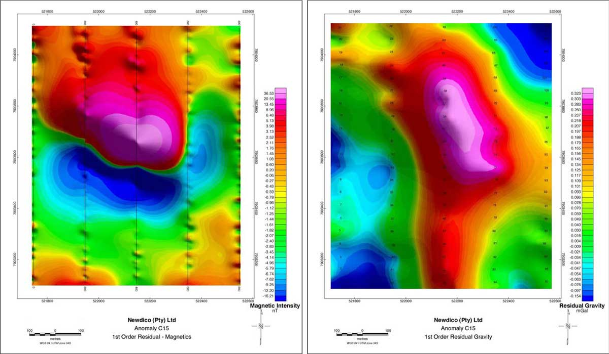
Commonly use in combination with gravity, e.g. this kimberlite
prospect in Botswana

Slide 6
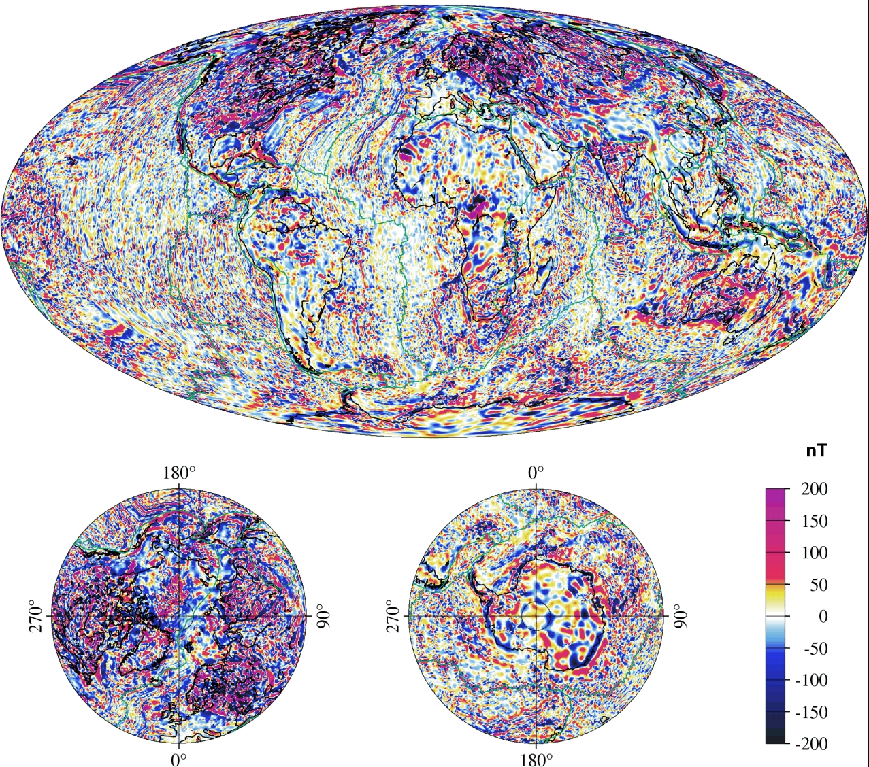
Satellite
measurements
of induced +
remanent
magnetization of
the Earth’s crust
(scalar total field
anomaly relative
to Earth’s main,
i.e. core, field)
NGDC-720

Slide 7
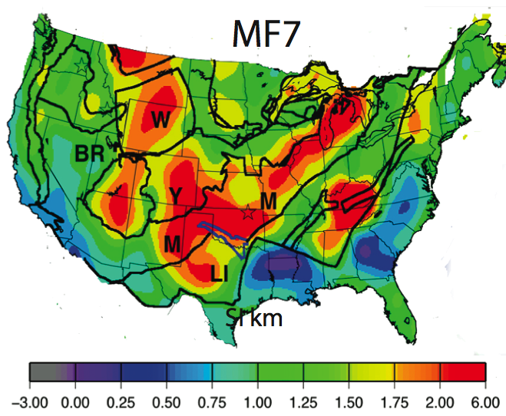

Satellite data are more self-consistent and useful for
regional-scale tectonics studies– Here depth-integrated
magnetic susceptibility shows strong relationships to
Proterozoic accretion history of the mid-continent.

Slide 8
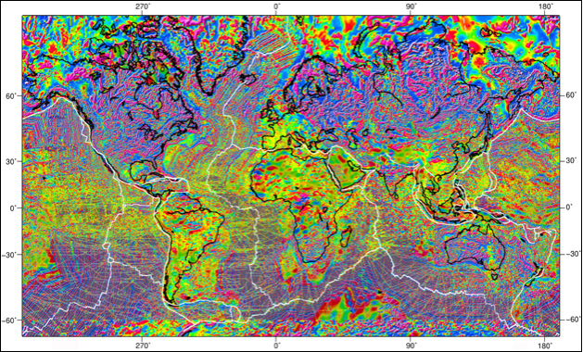
A combination of global aeromag and CHAMP satellite crustal
magnetic anomalies… Note merging problems! A challenge…

Slide 9
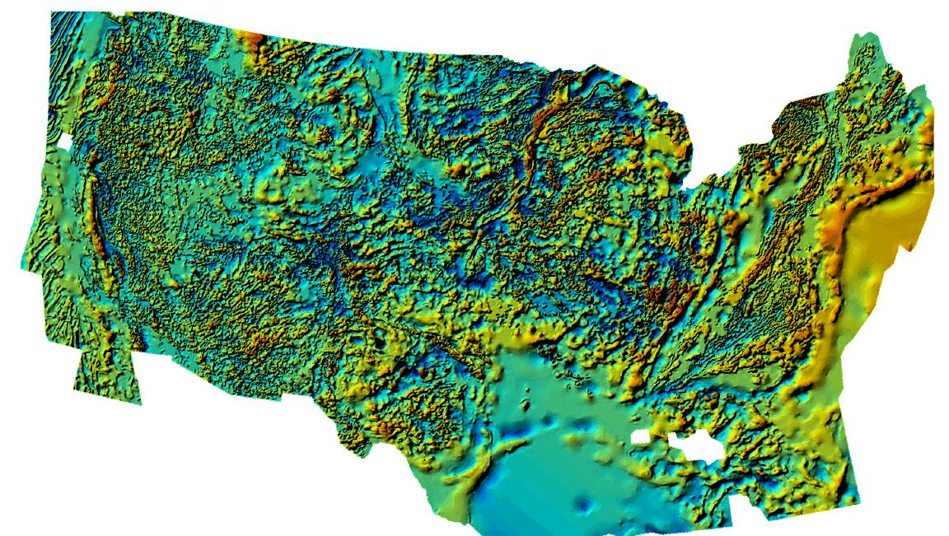
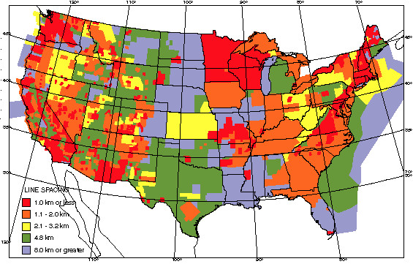
Conterminous US aeromag merge is better… But
data line sampling varies!

Slide 10
Modeling Magnetic Anomalies:
Poisson’s equation for magnetism (analogous to gravity) is:
where is magnetic field, a is magnetic potential,
μ is magnetic permeability,
is dipole moment per unit volume
If we assume a magnetic “monopole” (i.e., -m part of the
dipole is so far away we can ignore it) at the origin, then
the potential (A is cross-sectional area)
and

Slide 11
If we define the x direction as toward magnetic north, then
the total-field magnetic anomaly (difference from the
magnitude of the main field) is a scalar that can be
expressed as:
(where i is inclination)
A = 0.5 m²
k = 0.003
H_{E} = 55000 nT
i = 70°
H_{T}
H^{z}_{A}
H^{x}_{A}
H^{z}_{A}
i = 0°
H_{T}
H^{x}_{A}

Slide 12
For a dipole, the magnetic field is the sum of anomalies
generated by the positive and negative “monopoles”:
P
z_{n}
φ₁
r_{n}
φ₂
–m
z_{p}
r_{p}
L
+m
(Dipole inclination 120°;
depth to –m is 5 m;
length of dipole 15 m)
A = 0.5 m²
k = 0.003
H_{E} = 55000 nT
i = 70°
H_{T}
H^{z}_{A}
H^{x}_{A}

Slide 13
i = 90°
A = 0.5 m²
k = 0.003
H_{E} = 55000 nT
i = 60°
Here, ZA is the vertical component anomaly; HA is horizontal; and FAT is the total field anomaly (magnitude)
i = 30°
i = 0°

