Slide 1
Geology 5660/6660
Applied Geophysics
3 Apr 2026
Last Time: Earth’s Main Magnetic Field
• Earth’s Main Field derives from its “core dynamo”…
convective flow of Ni-Fe outer core + coriolis forces (→ +
feedback) → electrical current flow → magnetic field
(→ + feedback) + crystalline Fe inner core
(→ + feedback)
• Mostly dipolar, oriented ~ (and precesses around) Earth’s
rotation axis; varies nonlinearly over time…
• Express the vector field at a point as either intensity H_{E},
inclination i, declination d or local H_{x}, H_{y}, H_{z} (N,E,U)
cartesian components:
Read for Mon 6 Apr: Burger 450-493 (§7.4–7.7)
© A.R. Lowry 2008-2026

Slide 2
Last Time Continued: Magnetic Method
• Distinguish Main Field from crustal sources by scale: spatial
wavelengths > 2500 km (spherical harmonic degree n < 16)
dominated by core dynamo; smaller scales are mostly crustal.

Slide 3
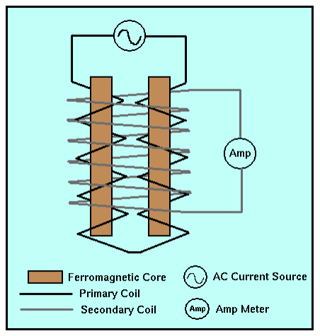
Measurement:
Fluxgate
magnetometer:
Wire coils wound in
opposite directions;
these cancel &
produce zero current
in secondary coil
in absence of external
magnetic field, but
if aligned with a field,
one core reinforces,
other counteracts
external field resulting
in a current.
Gives intensity in the
orientation of the
coils.
(Direction?)

Slide 4
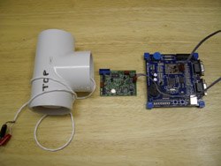
Measurement:
Proton precession
magnetometer:
Bottle containing a hydrogen-rich
fluid (distilled water or hydrocarbon)
is surrounded by a wire coil. Current
through the coil produces a strong
magnetic field; protons (H⁺) align
with the field… Current is shut off & as protons realign with
the ambient magnetic field, they precess at a frequency
determined by magnetic field strength (0.042576 Hz/nT).
So, measure frequency of the induced AC current and
convert to a total field strength.
(Lots of other types but these two are most commonly used
for terrestrial geophysics!)

Slide 5
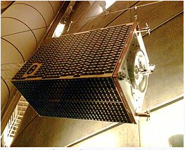
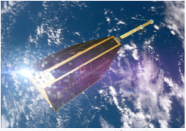
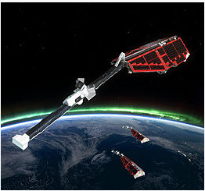
Measurement:
Satellite missions including Ørsted, Champ
and most recently Swarm included
three-component oriented fluxgate
magnetometers to measure all three
components of the magnetic field, to
characterize the time-varying core-derived
main field, crustal magnetization and
magnetospheric (space weather)
phenomena…
Typically combined with other instruments
for measuring space-weather interactions,
charge, lower atmospheric phenomena,
and in Swarm’s case 3D mantle electrical
conductivity!
Ørsted
Champ
Swarm

Slide 6
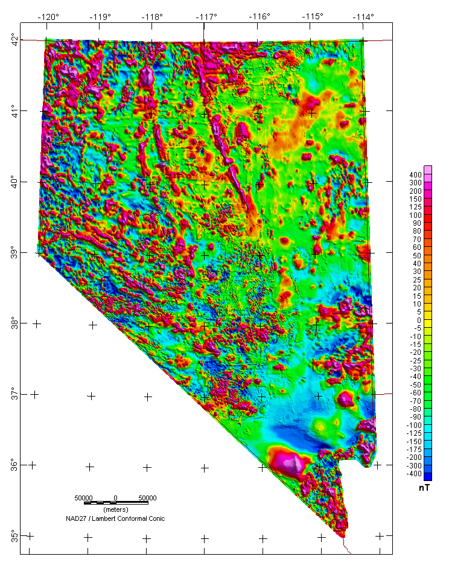
Many regions also have
aeromag measurements
(e.g., magnetic anomaly
map of Nevada… USGS
has now flown the entire
conterminous United
States).
Most magnetic anomaly
maps on scales < 500
km use magnetometer
data collected by flying an
airplane in a grid pattern
over the target region

Slide 7
Data Reduction (for surface measurements):
Remove/avoid all metal objects when collecting data!!!
Keep magnetometer high off the ground; face a uniform direction to
reduce “noise”
Sensitive to variations in ionosphere, magnetosphere: Perform
looping and correct for drift; avoid measurement during solar storms!
Correct for elevation if > a few hundred m (~0.03 nT/m)
Horizontal position correction: Use WMM if latitude change is > a few
hundred m (correction here ~6 nT/km)
From https://www.ngdc.noaa.gov/geomag/calculators/magcalc.shtml#igrfwmm
Component Field Value Secular Variation
Declination 10.9892 degrees -0.095 °/year
Inclination 66.471 degrees -0.0311 °/year
Horizontal Intensity 20578.1 nT -16.6 nT/year
North Component (x) 20200.8 nT -9.8 nT/year
East Component (y) 3922.7 nT -36.7 nT/year
Vertical Intensity (z) 47207.1 nT -108.0 nT/year
Total Intensity 51497.3 nT -105.6 nT/year

Slide 8
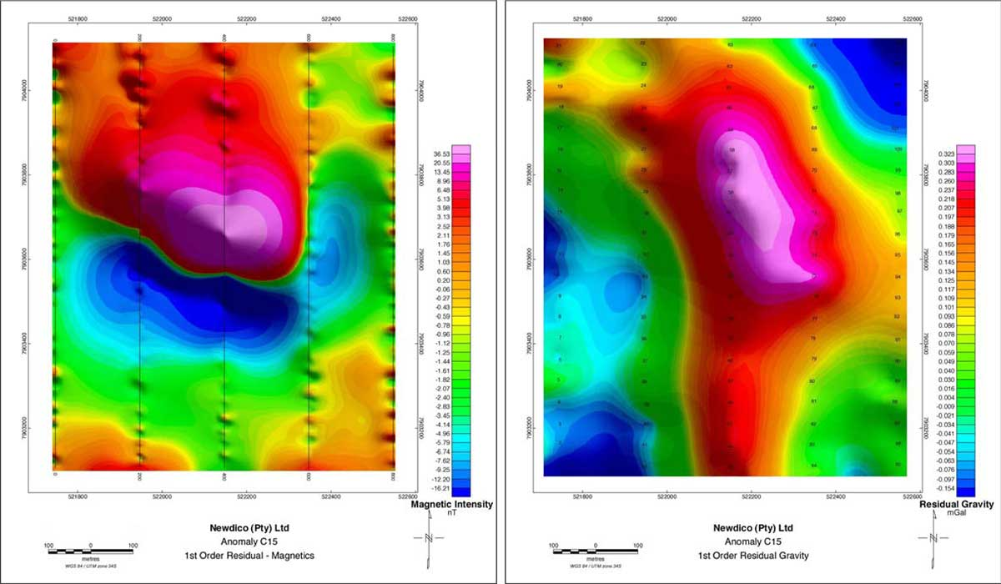
Commonly use in combination with gravity, e.g. this kimberlite
prospect in Botswana

Slide 9
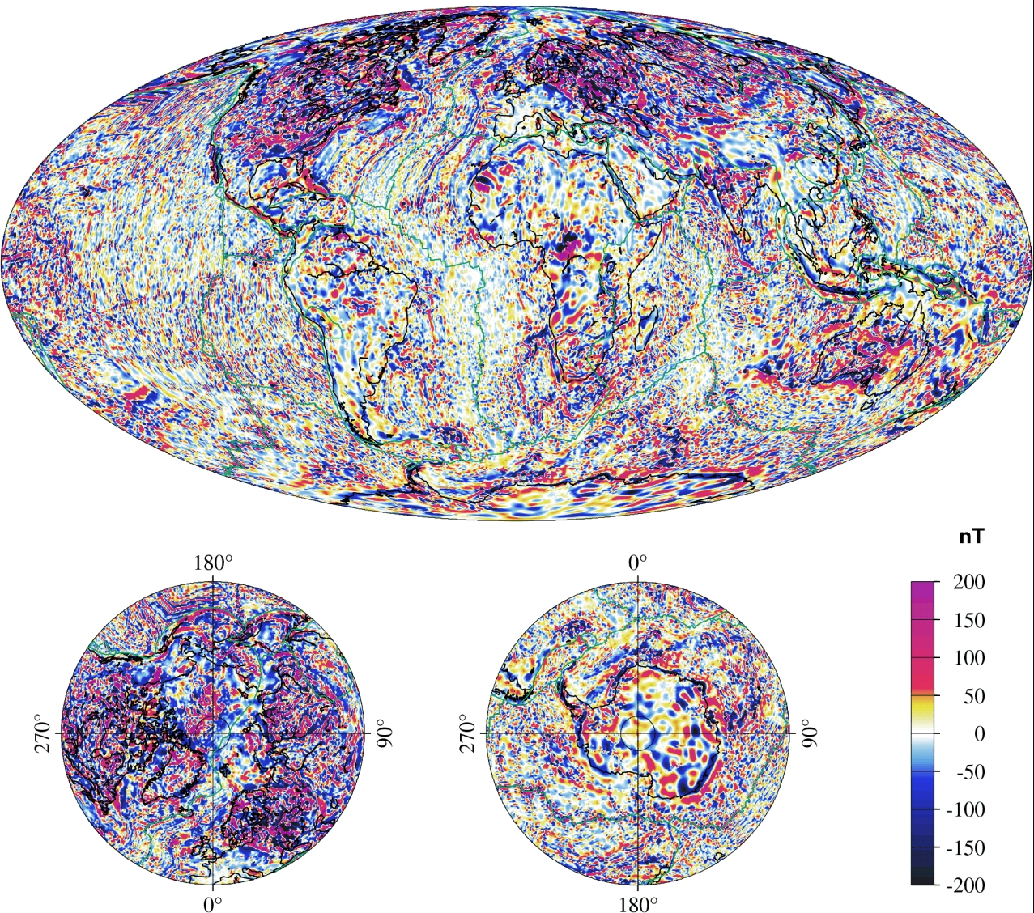
Satellite
measurements
of induced +
remanent
magnetization of
the Earth’s crust
(scalar total field
anomaly relative
to Earth’s main,
i.e. core, field)
NGDC-720

Slide 10
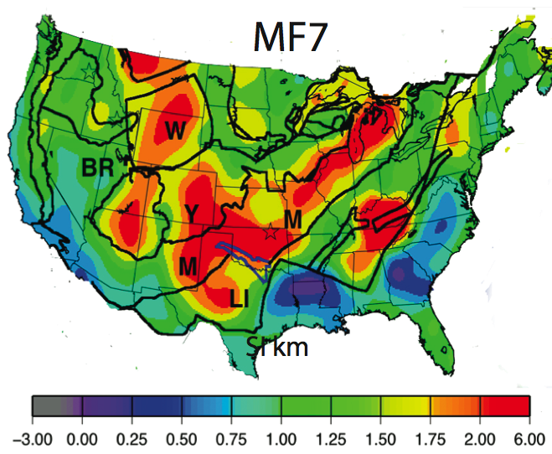

Satellite data are more self-consistent and useful for
regional-scale tectonics studies– Here depth-integrated
magnetic susceptibility shows strong relationships to
Proterozoic accretion history of the mid-continent.

Slide 11
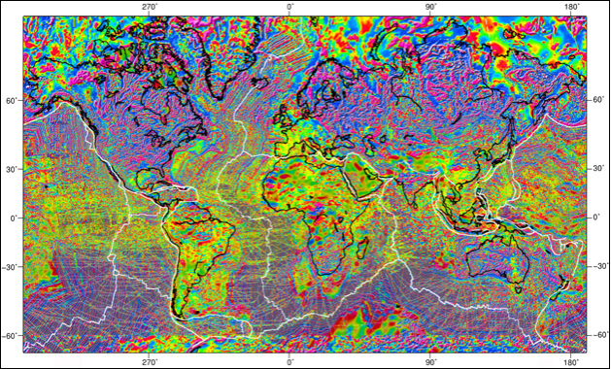
A combination of global aeromag and CHAMP satellite crustal
magnetic anomalies… Note merging problems! A challenge…

Slide 12
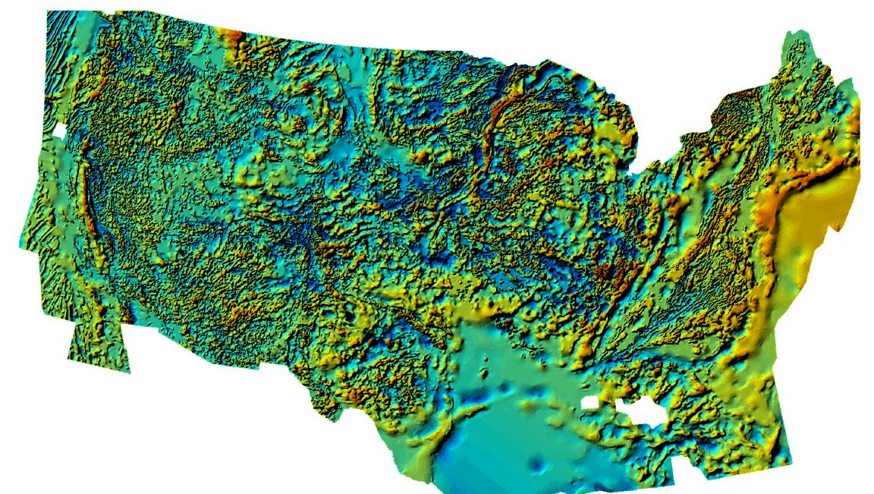
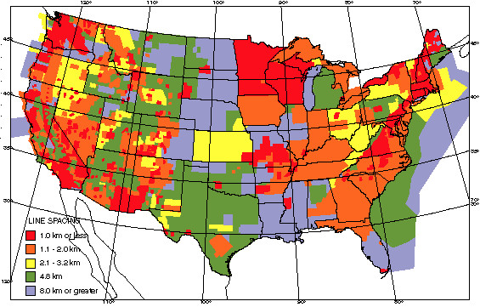
Conterminous US aeromag merge is better… But
data line sampling varies!

