Slide 1
Geology 5660/6660
Applied Geophysics
4 Feb 2026
Last time: The Refraction Method:
• Single Dipping Layer Boundary:
→ Requires reversed profile to separate dip from velocity
→ Travel-times going “up-dip” (ud) and “down-dip” (dd) are:
→ Can calculate velocities, dip angle α, & thickness:
• Multiple dipping layer boundaries can be modeled
using the Adachi equations (which are used by the modeling
code Refract) but inverting parameters from line fits would be
less straightforward!
Read for Fri 6 Feb: Burger 149-167 (§4-4.1)
© A.R. Lowry 2008-2026

Slide 2
Last time Continued: Refraction Method:
• Limitations of the Refraction Method:
→ Do not get returns from low velocity layers
→ Can alias or miss entirely thin layers
Deeper layer thicknesses are overestimated for the
first case; underestimated for the second
• Refraction in Non-Ideal Media:
• Velocity changes within layers can be distinguished by
similar slopes (forward & reversed) over same locales

Slide 3
What if the layer interface is not planar?
B
V₁ = 500 m/s
A
z
V₂ = 2000 m/s
m = 1/V₂
m = 1/V₂
m = 1/V₂
m = 1/V₂
m = 1/V₁
m = 1/V₁

Slide 4
B
V₁ = 500 m/s
A
z
V₂ = 2000 m/s
Basically have a difference in the intercept times on one
part of the geophone string relative to the other:
But slopes are like those of a layer over a halfspace
(except near the step, where arrivals are diffuse)

Slide 5
Refraction from an irregular surface: Delay-Time Method
y
E
G
h_{E}
V₁
A
B
V₂
Define delay time τ as the time the ray traveled in layer 1
along a “slant path”, less the time it would have taken to
travel the horizontal distance (AB) at velocity V₂. The
total delay time τ_{EG} traveling from E to G (or G to E) is
where t_{R} is total travel time. Delay time under E is
(For a horizontal layer, this is half of the “time intercept” on
our t–x plots!)

Slide 6
Using trigonometry and Snell’s law for the critical angle,
We can’t measure τ directly, but with reversed shots:
E
H
G
h_{E}
V₁
A
B
V₂
τ_{H} from E ≈ τ_{H} from G, and

Slide 7
Refraction from an irregular surface: Delay-Time Method
y
x
E
H
G
V₁
V₂
Problem however: to get h_{H} from τ_{H}, we need to know V₂!
But we can also expect:
(⇒ a line with slope 2/V₂!)

Slide 8
1
i
2
V₁
V₂
Sometimes also called the “plus-minus method”:
Plot t_{1i}–t_{2i} vs x_{i} for SP1, SP2 and all geophones i. Calculate
V₂ from slope m of the line fit (V₂ = 2/m).
At each geophone i, calculate thickness as

Slide 9
The Reflection Seismic Method:
Consider a single horizontal layer over a half-space, with
layer thickness h₁ and velocity V₁:
x/2
V₁
h₁
The travel-time for a reflected wave to a geophone at a
distance x from the shot is given by:

Slide 10
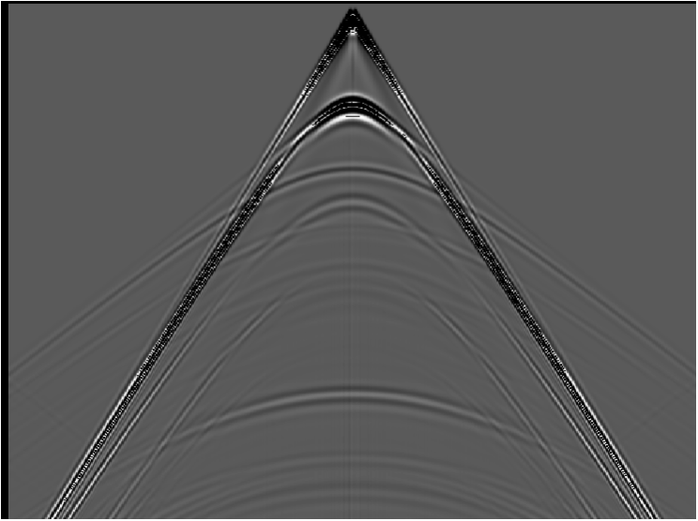
The Reflection Seismic Method:
Hyperbola:
The travel-time for a reflection
corresponds to the equation of a
hyperbola. If we re-write:
intercept = b;
asymptote m = b/a
water
shale
gas sand
shale
This implies an
intercept at 2h₁/V₁
and asymptotes
with slope ±1/V₁
±x/V₁

