Slide 1
Geology 5660/6660
Applied Geophysics
4 Feb 2026
(Lab 3)
This Week’s Lab:
• Review Lab 1
• Lab 3: Modeling seismic refractions
(Refract & Xcel)
Due 18 Feb at 2:30 pm
© A.R. Lowry 2008-2026

Slide 2
Your lab assignment (due at 2:30 pm on 30 Jan):
• Download the Benson Park-n-Ride (3-m forward and reverse)
data files from the course website
• Using the RAS-24 picking software, pick the travel-times at
each of the 24 geophones for both the forward and reverse
lines. (For this, you may either use the PCs in the Oldham
room computer lab, assuming they still have the software
installed, or you can download the software zipfile provided on
the Canvas page and try to install it on your own PC).
• In a plotting software of your choice (e.g., Xcel or Matlab),
plot time versus distance from the source for both the
forward and reverse experiments, and answer each of the
questions posed on the following slide:

Slide 3
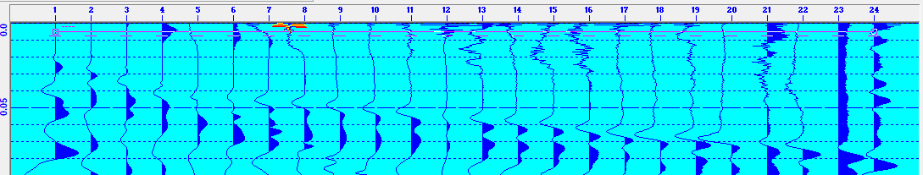
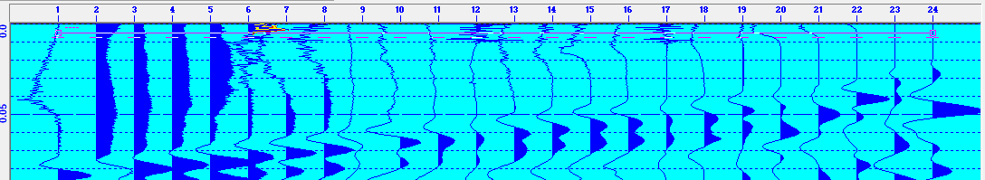
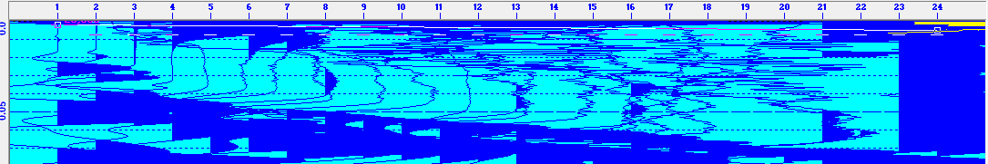
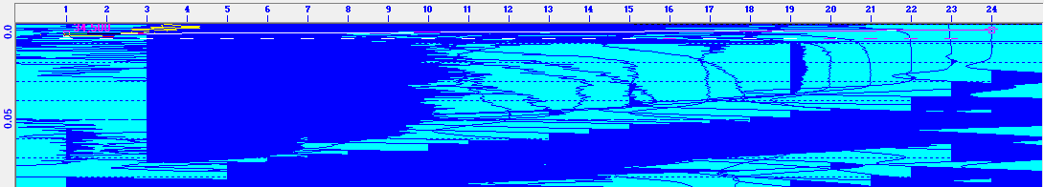
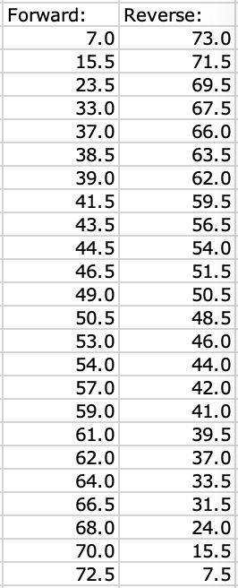
• Using the RAS-24 picking software, pick the travel-times at
each of the 24 geophones for both the forward and reverse
lines.
The first arrivals in both directions are all negative, and occur at roughly the
red bars shown above. It’s important to carefully select the first moment the
trace deviates from the noise! The nearest ~3-4 traces must be blown up to
high magnification to see the direct arrival (velocity ~380 m/s), which is much
smaller amplitude than the Rayleigh wave arriving at ~180 m/s. Once the
issue of the small direct arrivals is recognized, however, it is fairly easy to
pick all traces (including the most distant traces where noise from vehicles
and other sources is larger relative to the signal). My best estimate of the
first arrival picks is given at left.

Slide 4
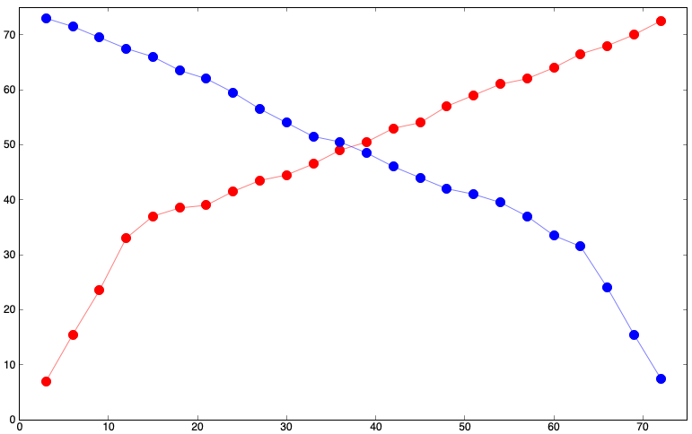
• In a plotting software of your choice (e.g., Xcel or Matlab),
plot time versus distance from the source for both the
forward and reverse experiments, and answer each of the
questions posed on the following slide:
Travel-time (ms)
Distance (m)

Slide 5
Look carefully at your first arrival picks.
a. How many different “straight lines” can you distinguish
in the plots of travel-time vs distance?
b. What range of geophones corresponds to each straight
line?
1.a. There are two “lines” in both
the forward and reverse profiles.
(One might argue for more, but
those may be just errors in
picks!)
1.b. On the Forward profile, one
line includes geophones 1–4
and the other 4–24; on the
Reverse profile, one includes
21–24 and the other geophones
1–21.
Travel-time (ms)
Distance (m)

Slide 6
c. What travel path would you interpret each straight line
to represent?
1.c. The “lines” nearest the
source, with steeper slope,
are the direct arrival, and
further lines with more
horizontal slope are a
refraction from the top of a
faster layer underneath.
Travel-time (ms)
Distance (m)

Slide 7
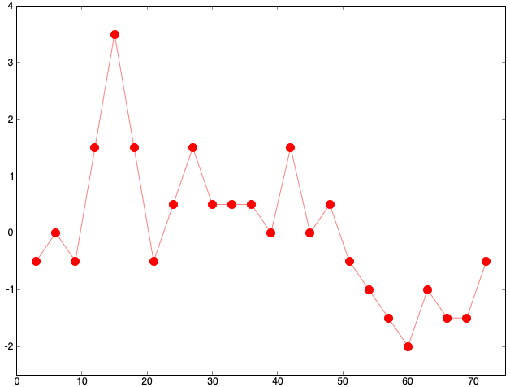
(2) a. Are the travel-times exactly the same in both directions?
b. What might that imply about the subsurface beneath the
survey?
2.a. There are small differences in
travel-time for geophones at
identical distances from forward
and reverse sources.
2.b. One might interpret these as
errors in measurements of travel-
time or distance, but picks should
be accurate to ~ 0.5 ms, and these
are systematic in that differences
are mostly positive from 16–48 m
and negative from 51–72 m. So,
these may also reflect differences
in velocity or thickness of the upper
layer or velocity of the lower layer!
F Minus R Travel-time Difference (ms)
Distance (m)

Slide 8
Lab 3: Modeling Refraction Data

Slide 9
Your lab assignment (due at 2:30pm on 18 Feb):
0. Install the Burger et al software on a pc/laptop you use.
1. Using Refract, model the travel-times for the picks given on
slide 3 of this powerpoint. Be sure to test a range of different
parameters for the velocity of the two layers and thickness of
the upper layer, and your lab write-up should discuss your
results for the best possible model (i.e., the model
parameters that give a minimum RMS misfit between the
model prediction and the measured travel-times!) Your lab
report should include screenshots of all four of the Refract
windows (Model, Data, Plot, and Cross-section windows)
for completeness. The RMS misfit is shown in the Data
window!

Slide 10
A note on using Refract (& any other code or
method):
The goal of any modeling exercise is to match the model
predictions to the data as closely as possible. This
means you should check (repeatedly!!!) whether another
model with slightly different parameters gives a better
fit to the data, before accepting a model as “correct”!
The RMS misfit of your model will be the final arbiter
of whether or not your model is a likely representation of
the subsurface structure.
Always include the RMS misfit of the model
to the data in any write-ups of labs for this
class in which you model real data!!!

Slide 11
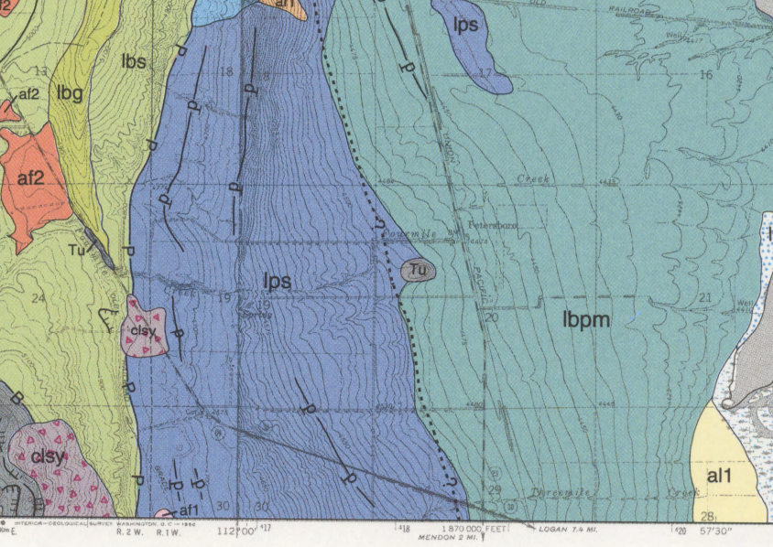
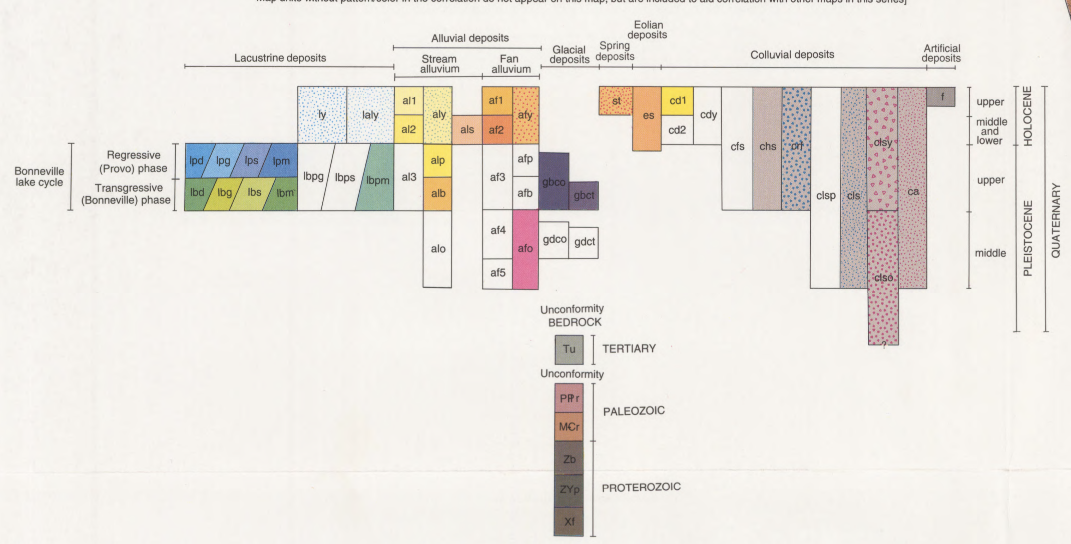
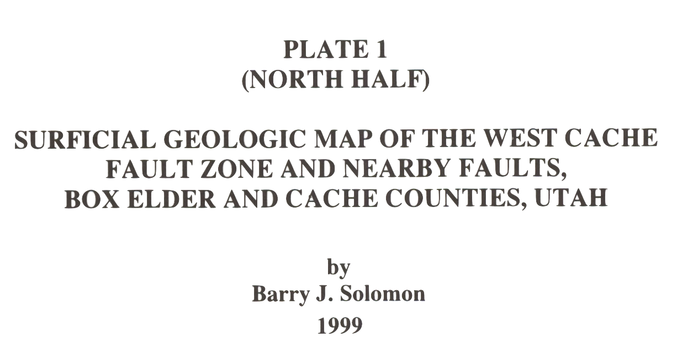
Background for the Benson Park-n-Ride site: Our motivation was to assess whether
we could find evidence for an inferred location of the West Cache Fault. Inspection at
the site showed the surface layer is a soil with fairly high clay content. Geologic
mapping near the location (circled above, from Solomon [1999]) suggests the surface
deposits are Provo lacustrine sand and silts (lps), and interprets the West Cache fault
(dashed w/ question marks, indicating the fault is not mapped based on observational
evidence there) as approximately following the contact with Provo/Bonneville lacustrine
silts and clays (lbpm). It is worth noting that only one recent offset of the WCF has been
dated after Lake Bonneville dropped to the Provo level. We placed our seismic
profile about 100 m west of the mapped fault “guess” (because further east was muddy
and still snow-covered!)

Slide 12
Lab 3 Continued
Your write-up should address the following:
(1.a) Is there unequivocal evidence for dip on the layer interface(s)
generating your arrivals?
(1.b) If the model has a “dipping” layer, is the dip consistent with
the thickness change you’d expect at this location if it were offset
by the WCF? (Note the forward shot was on the East side of the
profile!)
(1.c) Is there misfit in your best-fitting model of the picks that
can’t be reduced by changing the model parameters?
(1.d) If so, how might you interpret that misfit?

Slide 13
Lab 3 Continued
(2) If we crossed the West Cache fault trace, our target would
have travel-times somewhere on a spectrum between a layer
over a vertical contact and an offset layer boundary:
There are no Xcel spreadsheet models of these among the Burger
codes, but I’ve created one (on the website; E-W_Seismic.xlsx).
m = 1/V₂
m = 1/V₂
m = 1/V₃
m = 1/V₂
m = 1/V₃
m = 1/V₂
m = 1/V₂
m = 1/V₂
m = 1/V₁
m = 1/V₁
m = 1/V₁
m = 1/V₁
V₁ = 500 m/s
B
V₁ = 500 m/s
A
z
V₂ = 2000 m/s
V₃ = 1000 m/s
V₂ = 2000 m/s

Slide 14
Lab 3 Continued
Use the spreadsheet to model both “fault-like” cases. Start out
using the parameters for V₁, thickness & V₂ from your Refract
model; then vary all five parameters as needed to improve the fit.
(2.a) Which of the three models is most successful (i.e., which has
the smallest RMS misfit)?
Be sure to include screenshots of your spreadsheet models (params,
data, RMS misfits, and plots!
m = 1/V₂
m = 1/V₂
m = 1/V₃
m = 1/V₂
m = 1/V₃
m = 1/V₂
m = 1/V₂
m = 1/V₂
m = 1/V₁
m = 1/V₁
m = 1/V₁
m = 1/V₁
V₁ = 500 m/s
B
V₁ = 500 m/s
A
z
V₂ = 2000 m/s
V₃ = 1000 m/s
V₂ = 2000 m/s

