Slide 1
Geology 5660/6660
Applied Geophysics
4 Mar 2026
Last Time: Ground Penetrating Radar (GPR)
• Radar = electromagnetic radiation (light) in the
50-1000 MHz (radio) frequency band
→ Governed by the wave equation (⇒ similar to seismic!)
→ Source & receiver are dipole antennae
→ Signal is a single pulse
→ Processing & display analogous to seismic section
→ High frequency ⇒ high resolution (but also...)
→ High attenuation
→ Images variations in electromagnetic impedance Z
Read for Mon 16 Mar: Burger 349-378 (§6.1-6.4)
© A.R. Lowry 2008-2026

Slide 2
Last Time continued: Ground Penetrating Radar
• Radar reflections image variations in Dielectric permittivity
(real part ε = permittivity)
→ 3-40 for most Earth materials;
→ higher when H₂O &/or clay present
• Radar attenuation similar to seismic: where:
→ higher for clay, silt, brines; limits imaging to upper few m
• Velocity is not estimated (rather depth is approx. from ~V)
→ (but can be estimated from
NMO or diffraction moveout!!!)

Slide 3
Reminder:
Friday 6 March is Exam I!
Bring:
• (nonprogrammable) calculator,
• pencil,
• single sheet of paper/3x5 card with
10 most important equations

Slide 4
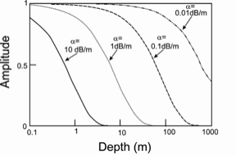
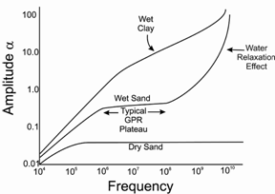
Skin depth, or
depth of penetration,
is ~ 1/α. Hence main
applications are in
archaeology,
environmental,
engineering
site investigation…
Also used for
cavity detection
and other very
near-surface
applications
GPR
freqs

Slide 5
Frequency-dependence
of the attenuation results
in dispersion: High
frequencies attenuate
more rapidly; pulse
appears to “broaden”
and the phase is delayed:
GPR
freqs
This yields a lower velocity
(because V is partly
imaginary!).

Slide 6
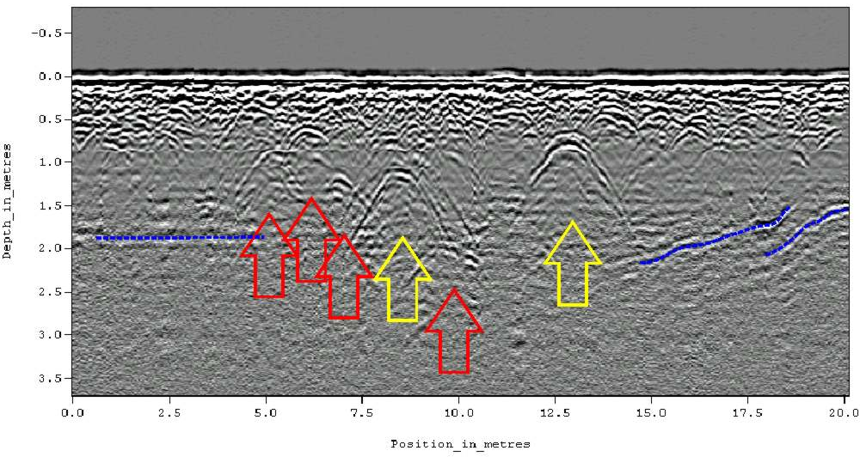
“Black-box” processing is simplistic so see some of the same
features observed in low-level (brute stack) seismic processing:
(Not real depth!
This is scaled twtt)
(From a centuries-old cemetery in Alabama…)

Slide 7
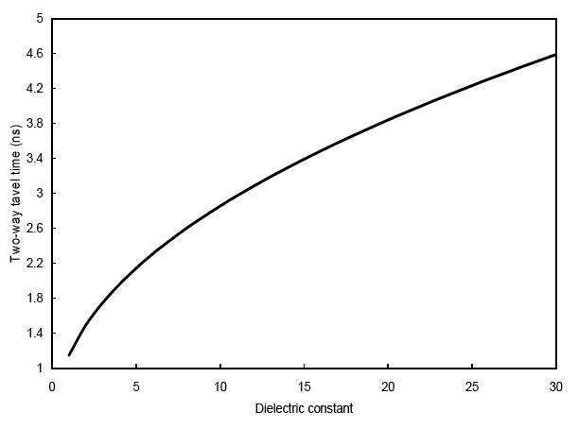
Assuming a constant velocity can introduce a factor of ~2
scale error in converting velocity to depth! (But one could
reduce velocity scaling error if ε were calculated from, e.g.,
NMO or travel-time amplitude decay)…

Slide 8
Alternatively can use moveout on Diffractions:
x
x_{g}
V₁
h₁
r_{s}
h₂
The equations are the same as they were for seismic, but since
GPR is (usually) zero offset, x_{s} = x_{g}! Thus

Slide 9
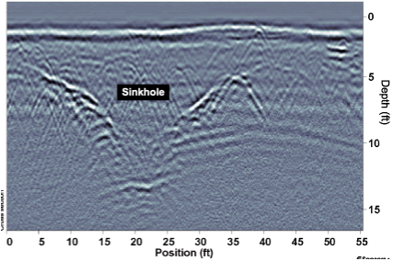

Slide 10
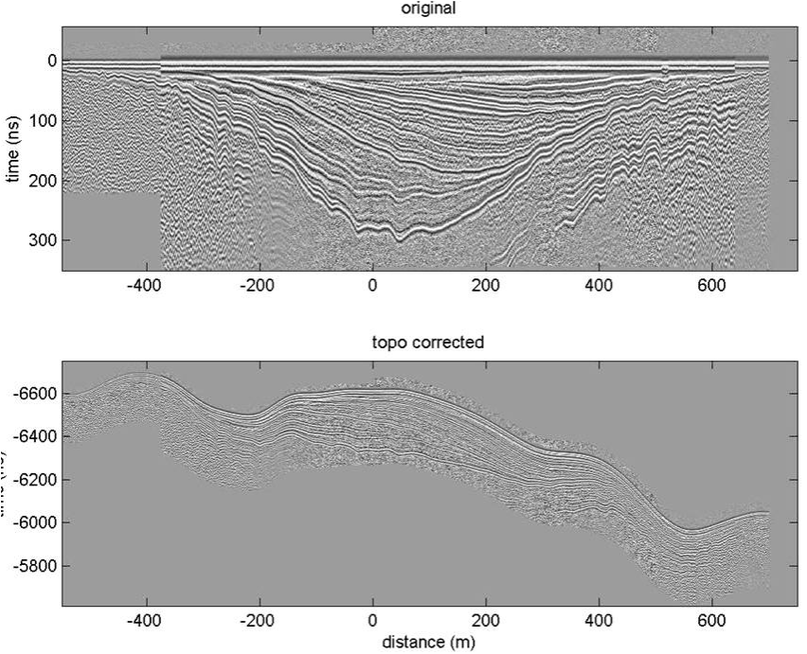
Some of the data processing steps are similar to seismic but
lack some
tools (such
as refraction
velocity
analysis).
Commonly
do static
corrections
for elevation,
some filtering,
automatic
gain control;
much less
common
to migrate.

