Slide 1
Geology 5660/6660
Applied Geophysics
4 Mar 2026
Review Labs 2 & 3
© A.R. Lowry 2008-2026

Slide 2
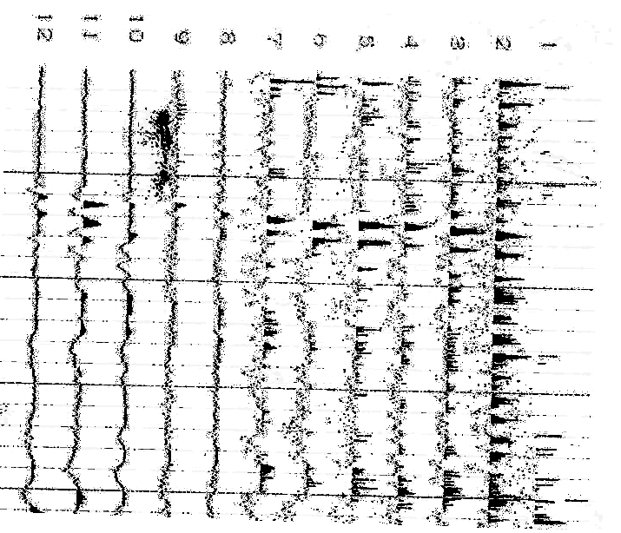
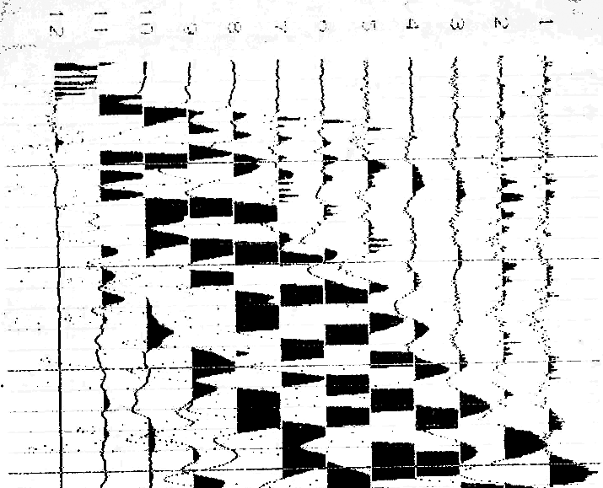
0.01 s
0.02 s
0.03 s
0.04 s
0.05 s
The seismic data above were collected on a farm near Gosport, IN. The
faint lines demark 0.01 s intervals; darker lines are at 0.05 s. The
geophones were placed at distances of (0,4,8,12,16,20,26,32,38,44,50
56,62,68,74,80,86,92,96,100,104,108,112,116) m from the source.

Slide 3
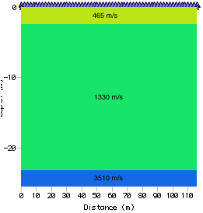
Lab 2: Attenuation, Gosport Indiana
0.01 s
0.02 s
0.03 s
0.04 s
0.05 s
The seismic data were used to create the
1D velocity model at right (with layer 1
thickness h = 2.3 m, layer 2 h = 20.6 m).
(1)a. Calculate the crossover distances
between the direct arrival and layer 1,
and between layer 2 and layer 3. (1)b.
Estimate the frequency, f, for a first arrival
from each of the three layers.

Slide 4
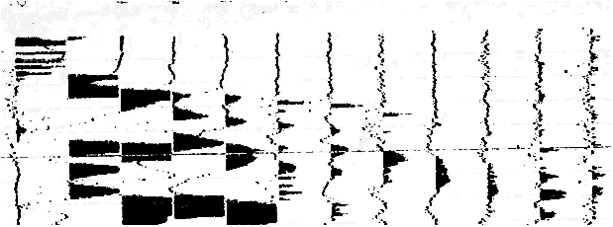
Hints: For f, helps to blow up to large scale; more accurate if you create
and use a ruler…
Subtleties: The direct arrival (geophones 11L-12L) is difficult to see on
this plot in order to pick a frequency, and geophone 10L (third from the
source) is probably an interference pattern between the direct and first
refraction arrivals. However I did not penalize anyone for using that to
estimate frequency, and I allowed a broad range of frequency estimates
for the direct arrival.

Slide 5
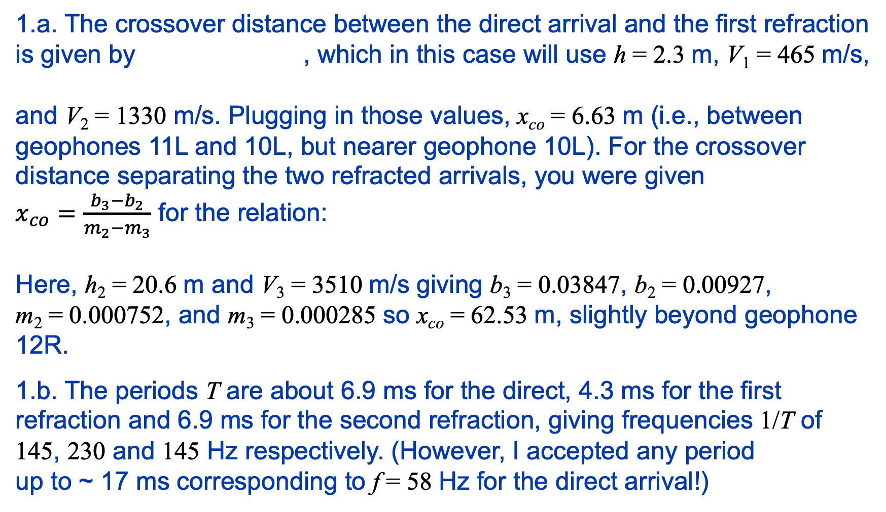
1.a. The crossover distance between the direct arrival and the first refraction
is given by , which in this case will use h = 2.3 m, V₁ = 465 m/s,
and V₂ = 1330 m/s. Plugging in those values, x_{co} = 6.63 m (i.e., between
geophones 11L and 10L, but nearer geophone 10L). For the crossover
distance separating the two refracted arrivals, you were given
$x_{co}=\frac{b_{3}−b_{2}}{m_{2}−m_{3}}$ for the relation:
Here, h₂ = 20.6 m and V₃ = 3510 m/s giving b₃ = 0.03847, b₂ = 0.00927,
m₂ = 0.000752, and m₃ = 0.000285 so x_{co} = 62.53 m, slightly beyond geophone
12R.
1.b. The periods T are about 6.9 ms for the direct, 4.3 ms for the first
refraction and 6.9 ms for the second refraction, giving frequencies 1/T of
145, 230 and 145 Hz respectively. (However, I accepted any period
up to ~ 17 ms corresponding to f = 58 Hz for the direct arrival!)
1

Slide 6
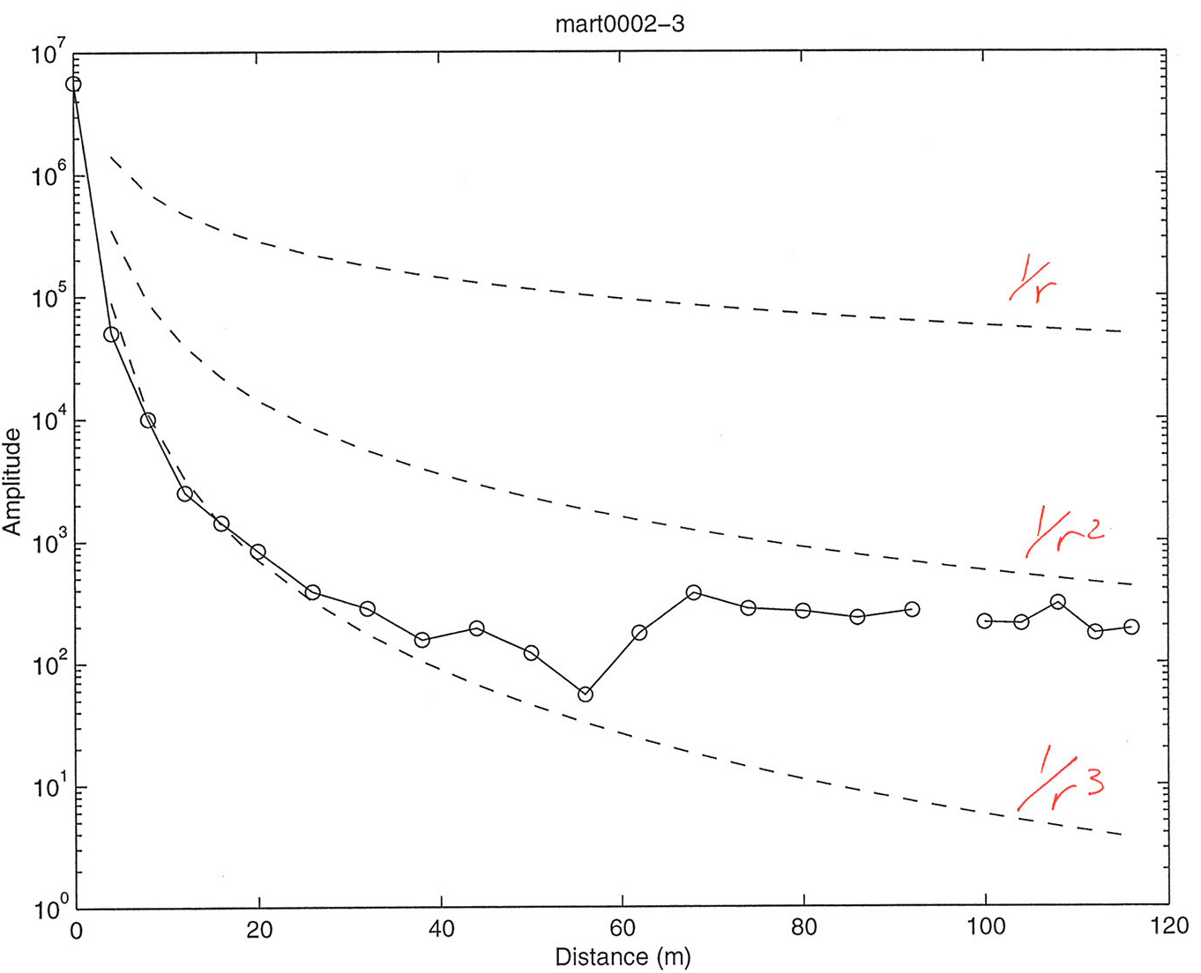
Lab 2: Amplitudes from observations
The amplitudes of each first arrival were measured and are shown below.
(2)a. Are these amplitudes consistent with what you might expect given
the crossover distances? Why or why not?
The amplitudes are given to you
in an Xcel spreadsheet on the
course website. (2)b. In column
D of the spreadsheet, calculate
the geometrical spreading for
each arrival, assuming A₀ is the
amplitude required to get the
observed amplitude at the
distance r of the first (nearest to
the source) geophone that
measures a first arrival from a
given layer.

Slide 7
The amplitudes of each first arrival were measured and are shown below.
(2)a. Are these amplitudes consistent with what you might expect given
the crossover distances? Why or why not?
Amplitudes of multipath arrivals near crossover distances!
2.a. The amplitude patterns do show
a strong pattern of variations
consistent with the interpretation that
amplitudes between crossovers reflect
different arrivals with different travel
paths. Neglecting amplitudes nearest
the crossover distances, which are
clearly “outliers” reflecting multipath
effects, amplitude change is < 1/r³ for
the direct arrival, > 1/r³ for the first
refraction, and > 1/r² for the second
refraction!
X
X

Slide 8
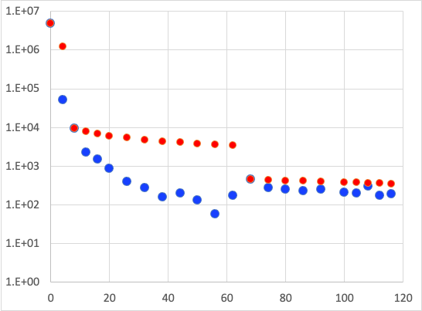
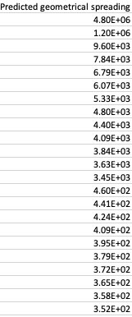
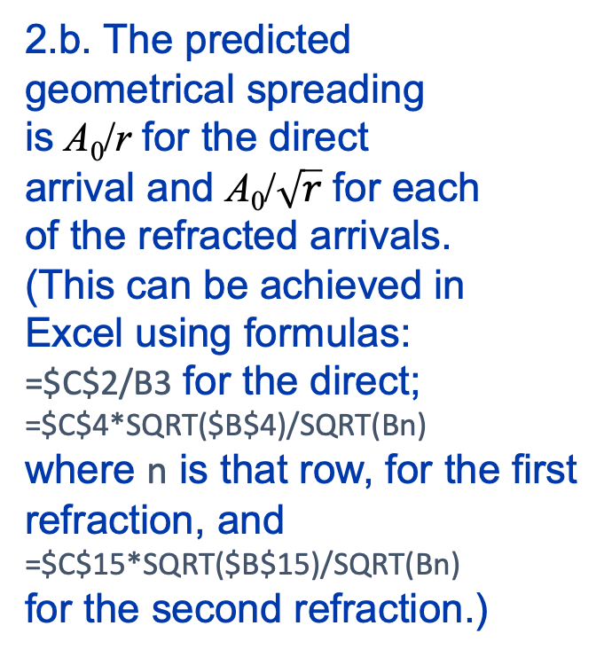
Lab 2: Amplitudes from observations
2.b. The predicted
geometrical spreading
is A₀/r for the direct
arrival and A₀/$\sqrt{r}$ for each
of the refracted arrivals.
(This can be achieved in
Excel using formulas:
=$C$2/B3 for the direct;
=$C$4*SQRT($B$4)/SQRT(Bn)
where n is that row, for the first
refraction, and
=$C$15*SQRT($B$15)/SQRT(Bn)
for the second refraction.)
The plot above appears to show that the amplitude decrease expected from geometrical
spreading is much less than what we observe. It also hints that the quality factor for the
first and second layers is less than that of the third layer!

Slide 9
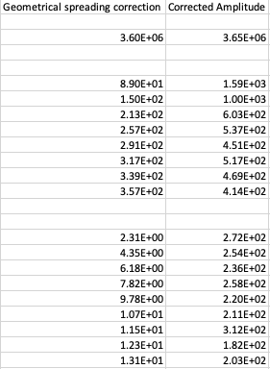
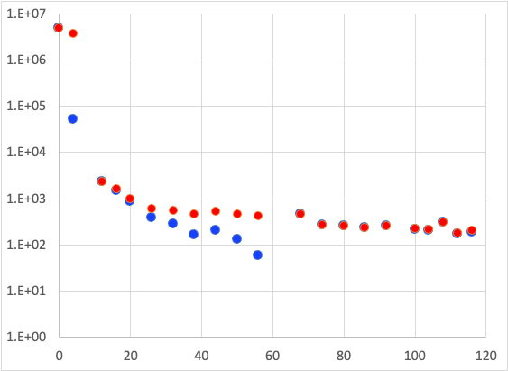
(2)c. In column E, calculate a correction for the amplitudes for the effects of
geometrical spreading. For the direct arrival (layer 1) correction, use
to calculate the correction; for layers n (= 2, 3) use
(2)d. In column f, add the
geometrical spreading
correction to the original
amplitude to get an approximate
“plane wave” amplitude.
After correcting for geometrical
spreading, the amplitude changes
are much smaller for all but the
layer 3 arrivals, and it is much less
obvious that the attenuation
effects are significantly different
for different layers.

Slide 10
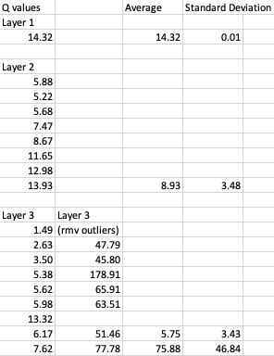
Formulae used e.g. =-3.141569*145*(B3-$B$2)/(465*LN(F3/$C$2)) for
Layer 1; =-3.141569*230*(B6-$B$5)/(1330*LN(F6/$C$5)) for Layer 2; and
=-3.141569*145*(B16-$B$15)/(3510*LN(F16/$C$15)) for Layer 3. I also
calculated Layer 3 values without using the geophones at
68 and 108 m, as these arguably might be
outlier amplitudes…
Outliers?
Then, recognizing that
→
Use linear regression of the
corrected amplitudes to estimate
the P-wave attenuation Q for
each layer!
And average!

Slide 11
You should include plots of your model and your data, and don’t
forget to discuss the RMS misfit! Plotting can be done in Xcel,
Matlab, or whatever else you feel comfortable with, but
remember that the plot image must be ported into a single-
document write-up of the lab.
(d) Assuming that both the velocity structure and your
attenuation estimates are correct, look through your text (and
whatever other literature you may be able to find, but be sure
to include references!) for examples of soils/sediments/rocks
that match your estimates of V_{P} and Q_{P}. Does the combination
of these two properties reduce the ambiguities in possible
interpretations? What interpretation of the data would make
the most geological sense given the location (farm country
near the terminus of Laurentide glaciation)?

Slide 12
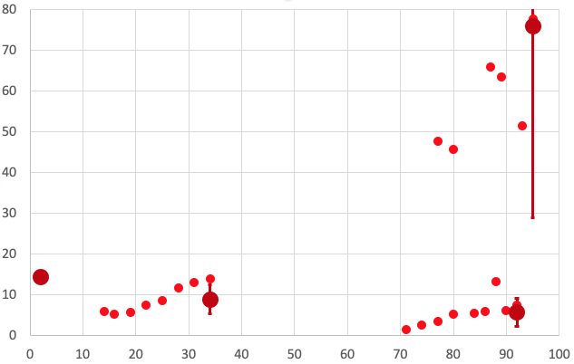
The best estimates of P-wave quality factor Q for each layer, after averaging, are
14.3 for Layer 1, 8.9 ± 3.5 for Layer 2, and 5.8 ± 3.4 for Layer 3 (or alternatively,
76 ± 47 for Layer 3 if we believe that the solution with outliers removed is better!)
Q
Mean distance (m)

Slide 13
2.d. The “optimal” seismic model has an upper layer with velocity 465 m/s and
Q_{P} = 14.3; second layer V_{P} = 1330 m/s and Q_{P} = 8.9, and third layer with V_{P} = 3510 m/s
and Q_{P} ambiguous (5.8 if we use all amplitudes, 76 if we suspect the highest
amplitudes involve multipath).
1
2
3
465
145
14.3
V = 1330 m/s
f = 230 Hz
Q = 8.9 ± 3.5
V = 3510 m/s
f = 145 Hz
Q = 5.8 ± 3.4
(Q = 76 ± 47)
X
X
(X)
(X)

Slide 14
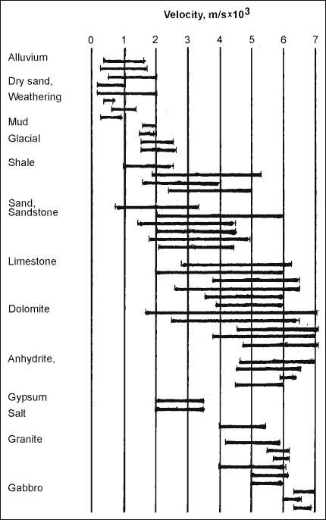
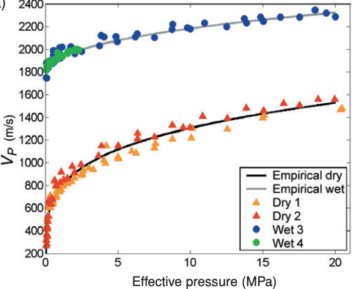
The velocities are consistent with a wide
range of possibilities but Layer 1 is likely
dry soil, alluvium or dry sand; Layer 2 could
be the same material as Layer 1 (but below
the water table) or a change to a different
type of alluvium or shale; and Layer 3 may
be shale, sandstone, limestone or dolomite.
A change in velocity from V_{P} = 400–800 to
V_{P} = 1200–2200 is very typical of the water
table!
Crustal Rocks
1
2
3
Prasad et al. (Near Surface Geophysics, 2005)

Slide 15
Measurements of Q are much harder to find,
but generally Q_{P} of saturated unconsolidated
materials are less than for dry materials (and
soil Q_{P} = 2–20 is consistent with our
measurements within errors), so interpretation
of the layer 1–2 boundary (Q_{P} = 14/9) as the
water table within silty soil is also supported
by the attenuation properties. An even lower
attenuation coefficient (Q_{P} = 6) in layer 3
is puzzling (if we expect consolidated rocks to
attenuate less) but could reflect unconsolidated
glacial-derived clay; however the higher
estimate of Q_{P} = 76 might indicate basement
rock. Unfortunately, what this exercise shows
most clearly is that true-amplitude analyses
are themselves ambiguous, and therefore that
attenuation is a difficult measurement to make
without more information on multipath effects!
Crustal Rocks
1
2
3

Slide 16
Lab 3: Modeling Refraction Data

Slide 17
Your lab assignment (due at 2:30pm on 18 Feb):
0. Install the Burger et al software on a pc/laptop you use.
1. Using Refract, model the travel-times for the picks given on
slide 3 of this powerpoint. Be sure to test a range of different
parameters for the velocity of the two layers and thickness of
the upper layer, and your lab write-up should discuss your
results for the best possible model (i.e., the model
parameters that give a minimum RMS misfit between the
model prediction and the measured travel-times!) Your lab
report should include screenshots of all four of the Refract
windows (Model, Data, Plot, and Cross-section windows)
for completeness. The RMS misfit is shown in the Data
window!

Slide 18
A note on using Refract (& any other code or
method):
The goal of any modeling exercise is to match the model
predictions to the data as closely as possible. This
means you should check (repeatedly!!!) whether another
model with slightly different parameters gives a better
fit to the data, before accepting a model as “correct”!
The RMS misfit of your model will be the final arbiter
of whether or not your model is a likely representation of
the subsurface structure.
Always include the RMS misfit of the model
to the data in any write-ups of labs for this
class in which you model real data!!!

Slide 19
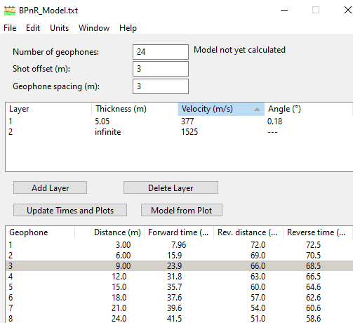
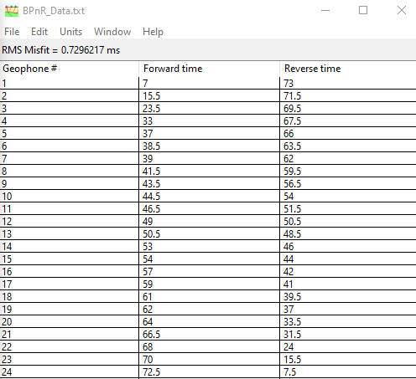
The best possible model has upper layer thickness/velocity of about 5.05 m &
377 m/s, lower layer velocity of 1525 m/s, and layer dip of 0.18°. (It was possible
to do slightly better than this using more significant digits in the parameters!)

Slide 20
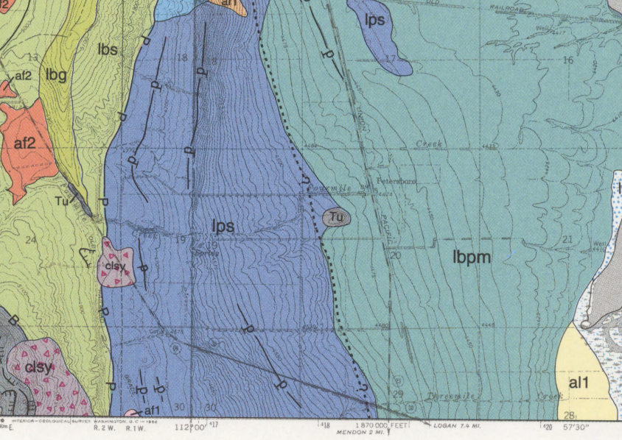
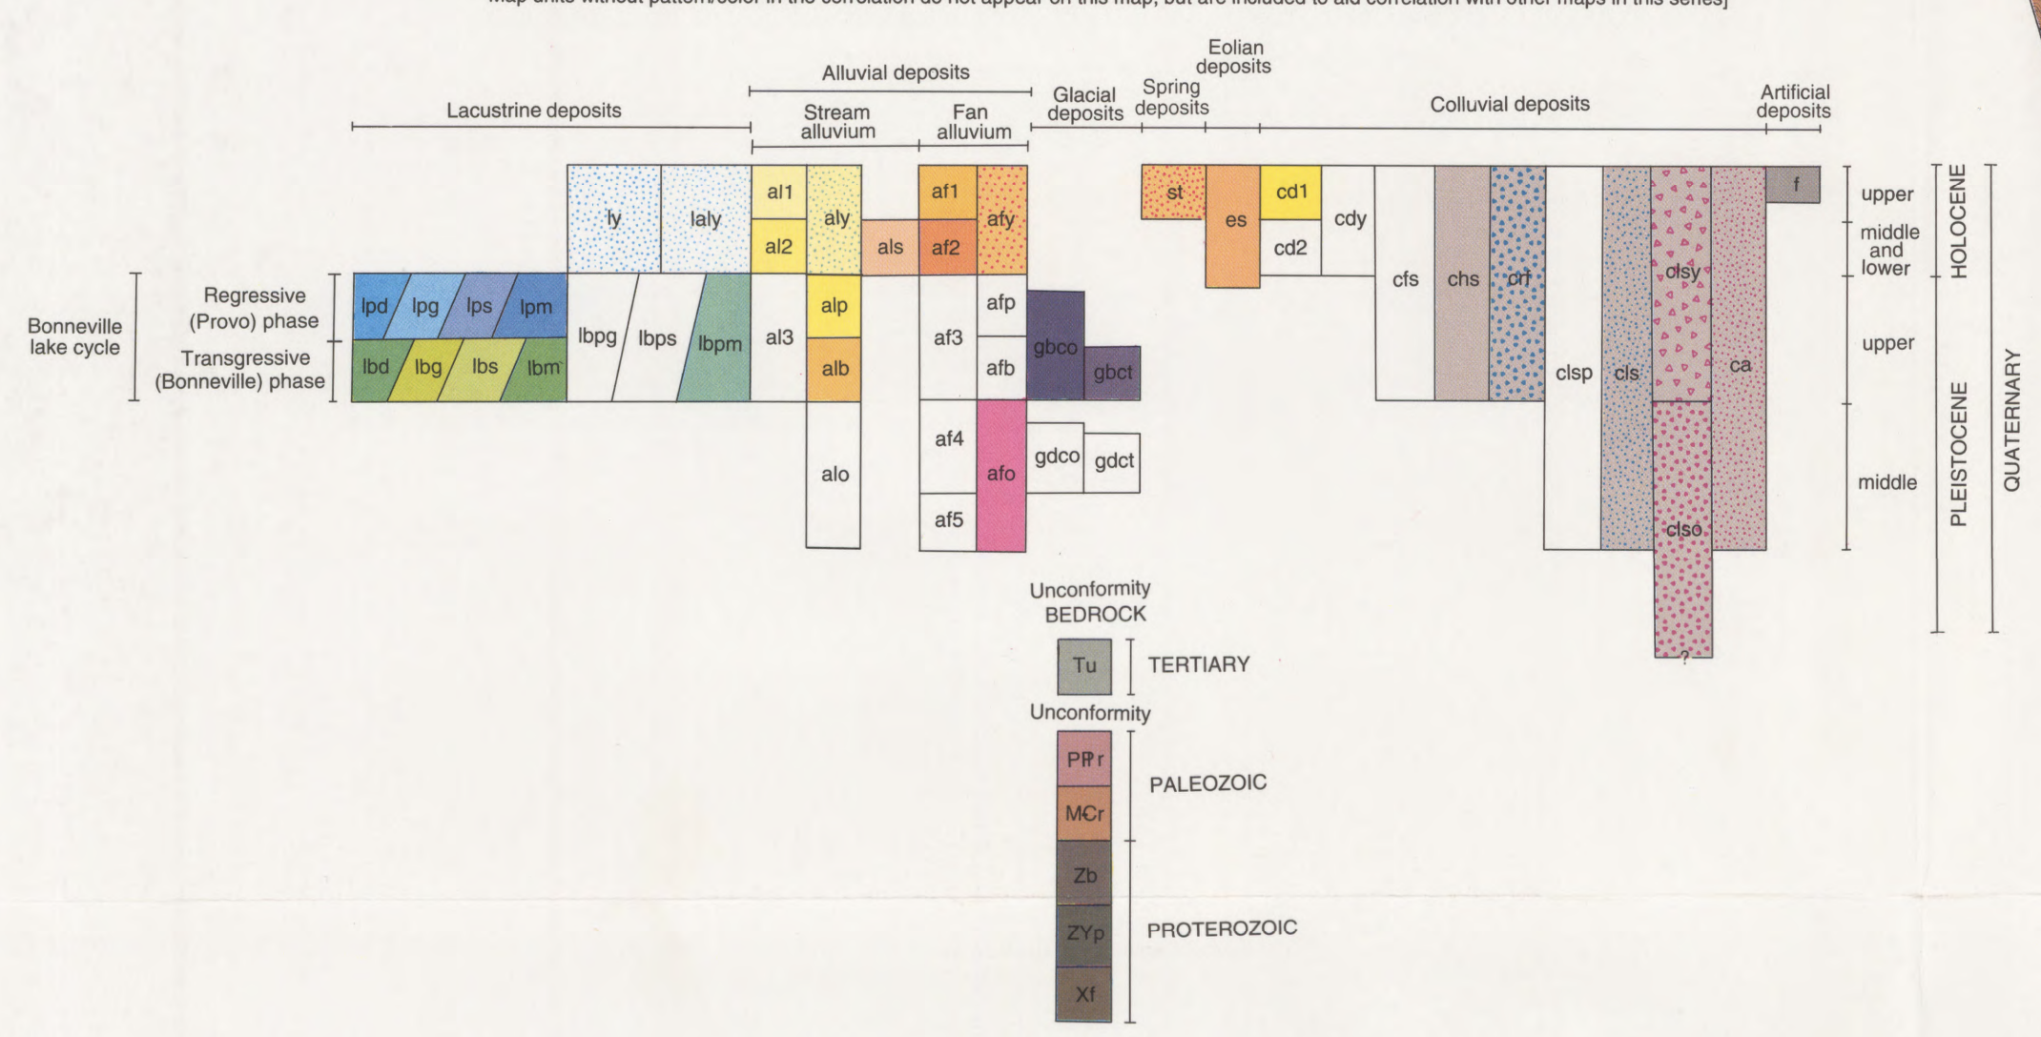
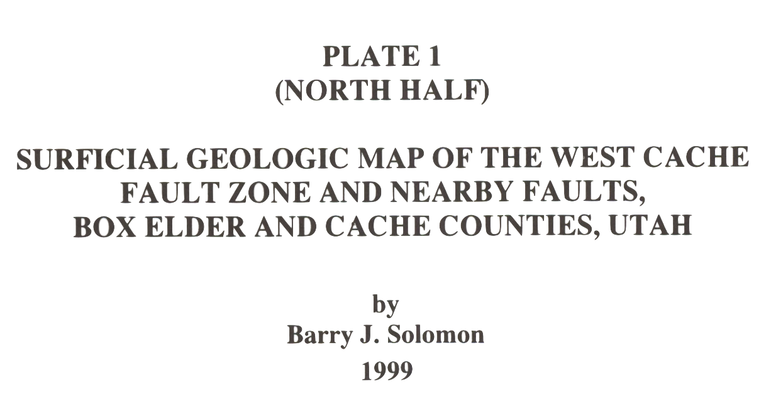
Background for the Benson Park-n-Ride site: Our motivation was to assess whether
we could find evidence for an inferred location of the West Cache Fault. Inspection at
the site showed the surface layer is a soil with fairly high clay content. Geologic
mapping near the location (circled above, from Solomon [1999]) suggests the surface
deposits are Provo lacustrine sand and silts (lps), and interprets the West Cache fault
(dashed w/ question marks, indicating the fault is not mapped based on observational
evidence there) as approximately following the contact with Provo/Bonneville lacustrine
silts and clays (lbpm). It is worth noting that only one recent offset of the WCF has been
dated after Lake Bonneville dropped to the Provo level. We placed our seismic
profile about 100 m west of the mapped fault “guess” (because further east was muddy
and still snow-covered!)

Slide 21
Lab 3 Continued
Your write-up should address the following:
(1.a) Is there unequivocal evidence for dip on the layer interface(s)
generating your arrivals?
(1.b) If the model has a “dipping” layer, is the dip consistent with
the thickness change you’d expect at this location if it were offset
by the WCF? (Note the forward shot was on the East side of the
profile!)
(1.c) Is there misfit in your best-fitting model of the picks that
can’t be reduced by changing the model parameters?
(1.d) If so, how might you interpret that misfit?

Slide 22
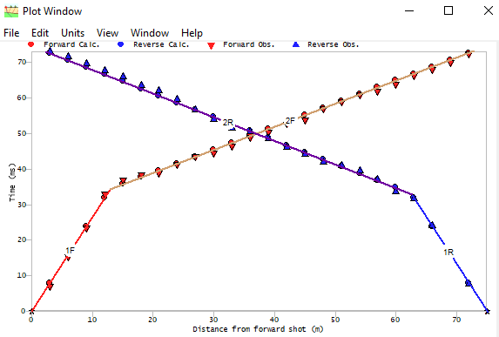
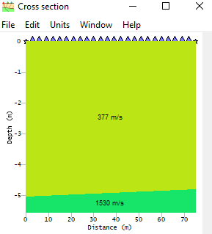
E
W
E
W
(1.a) Is there unequivocal
evidence for dip on the layer
interface(s) generating your
arrivals?
(1.a) The data are very well-fit (RMS 0.7296 ms) by a two-layer model with a very
slight dip (0.18°). The best model with similar parameter significant digits and no dip
gives an RMS misfit of 0.7582 ms. Using statistical tests, this difference is significant
at only about 22% confidence. So while the dip improves the fit, it is not “required” at
high confidence.

Slide 23
Aside: For those who may want to test statistical confidence in model
parameters for themselves, you can use the Likelihood Ratio Method for this.
We expect:
in which E is the RMS misfit for a set of parameters m; E_{min} is the smallest
possible misfit; M is the number of model parameters; N is the number of
measurements, (1 – α) is the confidence expressed as a fraction of 1; and F ^{–1} is
the inverse of the F-cumulative statistical distribution. The finv(•) function can be
found in Matlab, Excel, and other software!
For my calculations, E = 0.7582, E_{min} = 0.7296, M = 4, N = 48, and I varied
(1 – α) to match the ratio of E/E_{min} in order to find the confidence.

Slide 24
(1.b) If the model
has a “dipping” layer,
is the dip consistent
with the thickness
change you’d expect
at this location if it
were offset by the
WCF?
E
W
E
W
(1.b) I noted in the assignment that the forward source was on the East side of the
profile, so the sign of the thickness change is correct (i.e., Provo near-shore sediments
are thicker on the eastern, hanging-wall side of any hypothetical fault). But the very
slight dip (0.18°) translates to only 23 cm of thickness change of the upper layer across
the profile. So, if we crossed the West Cache normal fault (or a splay of the fault), it
apparently didn’t offset this (fairly deep!) layer boundary by much! If the velocity
change represents a change from shallow- to deep-water Bonneville sediments,
23 cm is much less than one might anticipate for a ~12 ka layer boundary!

Slide 25
(1.c) Is there misfit in your best-fitting model
of the picks that can’t be reduced by
changing the model parameters?
(1.d) If so, how might you interpret that
misfit?
All late!
All early!
(1.c) There is, but in these data it is very small! The largest are ~2 ms, with many of
the distal measurements exceeding 1 ms.
(1.d) Some of the differences appear systematic (e.g., consistently late arrivals in the
last eight geophones on the reverse shot), but the misfit can’t be reduced much with a
planar layer-over-halfspace model so we can’t attribute this to parameter error. One
possible explanation is picking error (because the onset of displacement is hard to see
in the presence of noise), but it could also result from a non-planar thickness variation
or nonuniform velocity of the upper layer.

Slide 26
Lab 3 Continued
(2) If we crossed the West Cache fault trace, our target would
have travel-times somewhere on a spectrum between a layer
over a vertical contact and an offset layer boundary:
There are no Xcel spreadsheet models of these among the Burger
codes, but I’ve created one (on the website; E-W_Seismic.xlsx).
m = 1/V₂
m = 1/V₂
m = 1/V₃
m = 1/V₂
m = 1/V₃
m = 1/V₂
m = 1/V₂
m = 1/V₂
m = 1/V₁
m = 1/V₁
m = 1/V₁
m = 1/V₁
V₁ = 500 m/s
B
V₁ = 500 m/s
A
z
V₂ = 2000 m/s
V₃ = 1000 m/s
V₂ = 2000 m/s

Slide 27
Lab 3 Continued
Use the spreadsheet to model both “fault-like” cases. Start out
using the parameters for V₁, thickness & V₂ from your Refract
model; then vary all five parameters as needed to improve the fit.
(2.a) Which of the three models is most successful (i.e., which has
the smallest RMS misfit)?
Be sure to include screenshots of your spreadsheet models (params,
data, RMS misfits, and plots!
m = 1/V₂
m = 1/V₂
m = 1/V₃
m = 1/V₂
m = 1/V₃
m = 1/V₂
m = 1/V₂
m = 1/V₂
m = 1/V₁
m = 1/V₁
m = 1/V₁
m = 1/V₁
V₁ = 500 m/s
B
V₁ = 500 m/s
A
z
V₂ = 2000 m/s
V₃ = 1000 m/s
V₂ = 2000 m/s

Slide 28
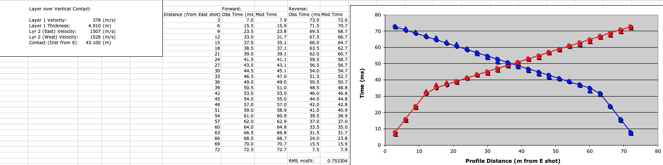
(2.a) The faulted model invoking a lateral velocity change in the second layer does not
improve significantly on the best-fitting model of a single horizontal layer boundary
and constant velocity within layers. The best-fitting Refract model with zero dip and
a misfit of 0.75817 ms (compared to 0.753304 ms above) had similar parameters
except for a constant 1514 m/s velocity in layer 2. The tiny improvement in misfit and
small difference (21 m/s) in layer 2 velocities suggests that we are fitting noise, and
does not justify adding two extra parameters to the model. (In fact, with a 0.72962 ms
RMS misfit, the dipping layer model did better than the fault model with changing
second-layer velocity while using one less parameter.)

Slide 29
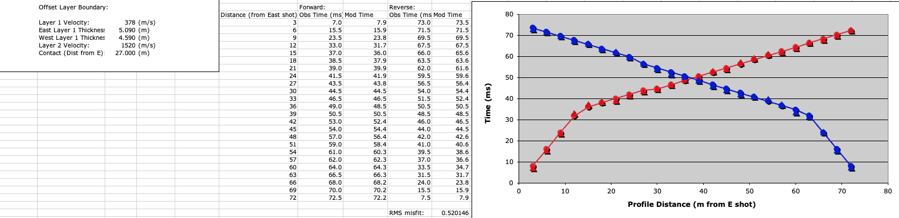
(2.a) The model with an offset layer boundary, on the other hand, does improve
very significantly over Refract ’s best-fitting model of a single horizontal layer
boundary and constant velocity within layers. The RMS misfit of 0.52015 ms is an
improvement over the dipping layer model (0.72962 ms) at 99% confidence (or 3σ),
which is equivalent to saying that such an improvement could happen by chance only
1 out of 100 times. The 0.5 meter offset indicated by the model is small for a surface-
breaking earthquake so could just be a near-surface splay, but given a lack of
geomorphic expression nearby it may be the main scarp of the Wellsville fault branch
of the West Cache fault zone! Trenching of the WCFZ further south suggests one to
three events since Bonneville highstand with the most recent occurring 3-5 ka.

