Slide 1
Geology 5660/6660
Applied Geophysics
5 Apr 2024
Last Time: Magnetics (Measurement, Modeling)
• Data collection: remove/avoid metal; be wary of solar activity.
• Reduction: subtract variations in main field (significant on
scales > a few hundred meters in latitude & height)
• World Magnetic Model calculator at:
https://www.ngdc.noaa.gov/geomag/calculators/magcalc.shtml#igrfwmm
• Induced magnetic field due to a dipole is given by:
For Mon 8 Apr: Burger 265-301 (§5.1-5.4)
© A.R. Lowry 2008-2024

Slide 2
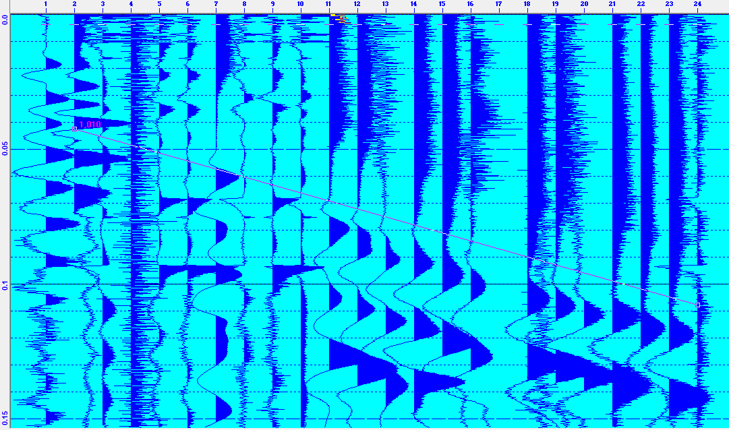
Seismic data from yesterday’s Hyrum excursion:
Not promising :-/

Slide 3
Magnetic Anomaly for an Arbitrary Body
Deriving the magnetic anomaly
from first principles is variously
described as “difficult” or
“complicated”… Given by
where is the unit direction vector
of the external field
dv
y
x
z
Can simplify conceptually as
the integral sum of a bunch of
dipoles distributed through the
volume of the body…
Analogous to gravity but with two
opposite-signed source terms!

Slide 4
Example:
Anomaly due to a sphere of radius R has vertical component
and horizontal component

Slide 5
Anomaly due to a semi-infinite
sheet has vertical component
for vertical Earth field… More
algebra if more general…
–x
+x
z
t
A
B

Slide 6
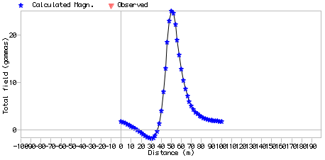
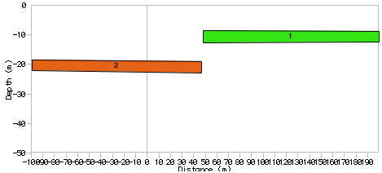
Note in GravMag, you must enter “Preferences” in order to
specify inclination/
declination of the
Earth’s main field
(then the program
allows you to input
azimuth of the
profile relative to
geographical north,
which you will need
to estimate or calculate
from GPS positions).
Also does remanent
magnetization, which
we neglect here.

Slide 7
DC Electrical Resistivity
Method:
Apply a direct current (or very low frequency alternating
current) to the Earth using a dipole current source/sink
Measure voltage across a second pair of electrode probes
The measured voltage is a difference in electrical potential…
Advantage: Instrumentation doesn’t require great sensitivity!
i
Source
V
Sink
+
–
Electrical
equipotential
Current (charge) flow

Slide 8
Relations for electromagnetic methods (including radar!)
are governed by Maxwell’s equations:
Note: The dot-product of a gradient operator with a vector gives the vector field’s “divergence”; the cross product gives its “curl”
is electric field; charge density; ε permittivity
is magnetic field
μ is magnetic susceptibility,
is current density
By Ohm’s Law,
(σ is conductivity,
ρ is resistivity)

Slide 9
Similar to gravity and magnetics, DC resistivity is a
potential field method:
Definition of electrical potential:
The electric field (where V is potential in volts)
If we assume no time dependence & no static charge:
Then:
This is Laplace’s equation!

Slide 10
DC Electrical Resistivity
d
i
Source
V
Sink
+
–
Electrical
equipotential
Current (charge) flow
Ohm’s Law:
So for a given current i and electrode
spacing d (defines ), V depends on ρ

Slide 11
Resistivity properties of rocks & soils:
clay
topsoil
gravel
weathered bedrock
shale
porous limestone
dense limestone
sandstone
graphitic schist
metamorphic rocks
gabbro
igneous rocks
1
10
100
1000
10⁴
10⁵
10⁶
Resistivity (Ω m)

Slide 12
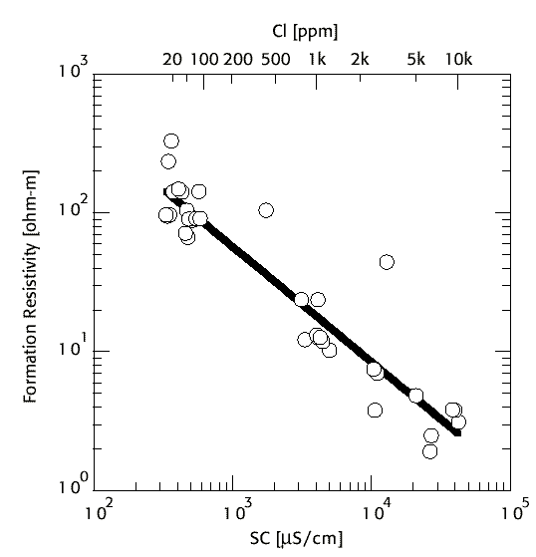
Sulfides
Temperature
Water Salinity in
Pore Fluids

