Slide 1
Geology 5660/6660
Applied Geophysics
6 Apr 2026
Last Time: Magnetic Measurements
• Instrumentation:
→ Fluxgate magnetometer : Measures field intensity
in the direction of orientation of wire coils & ferric cores
→ Proton precession magnetometer : Measures
intensity of the total field from frequency of AC voltage
• The Earth’s main core field (and long wavelengths of the
crustal field) is measured via satellite; shorter wavelengths
(1–500 km) are mostly mapped using aeromagnetics
• Even smaller-scale relies on handheld or vehicular
instruments
Read for Wed 8 Apr: Burger 450-493 (§7.4–7.7)
© A.R. Lowry 2008-2026

Slide 2
Last Time continued: Magnetic Measurements
• Data collection: remove/avoid metal; be wary of solar activity.
• Reduction: subtract variations in main field (significant on
scales > a few hundred meters in latitude & height)
• World Magnetic Model calculator at:
https://www.ngdc.noaa.gov/geomag/calculators/magcalc.shtml#igrfwmm

Slide 3
Modeling Magnetic Anomalies:
Poisson’s equation for magnetism (analogous to gravity) is:
where is magnetic field, a is magnetic potential,
μ is magnetic permeability,
is dipole moment per unit volume
If we assume a magnetic “monopole” (i.e., -m part of the
dipole is so far away we can ignore it) at the origin, then the
potential (A is cross-sectional area)
and

Slide 4
If we define the x direction as toward magnetic north, then
the total-field magnetic anomaly (difference from the
magnitude of the main field) is a scalar that can be
expressed as:
(where i is inclination)
A = 0.5 m²
k = 0.003
H_{E} = 55000 nT
i = 70°
H_{T}
H^{z}_{A}
H^{x}_{A}
H^{z}_{A}
i = 0°
H_{T}
H^{x}_{A}

Slide 5
For a dipole, the magnetic field is the sum of anomalies
generated by the positive and negative “monopoles”:
P
z_{n}
φ₁
r_{n}
φ₂
–m
z_{p}
r_{p}
L
+m
(Dipole inclination 120°;
depth to –m is 5 m;
length of dipole 15 m)
A = 0.5 m²
k = 0.003
H_{E} = 55000 nT
i = 70°
H_{T}
H^{z}_{A}
H^{x}_{A}

Slide 6
i = 90°
A = 0.5 m²
k = 0.003
H_{E} = 55000 nT
i = 60°
Here, ZA is the vertical component anomaly; HA is horizontal; and FAT is the total field anomaly (magnitude)
i = 30°
i = 0°

Slide 7
Magnetic Anomaly for an Arbitrary Body
Deriving the magnetic anomaly
from first principles is variously
described as “difficult” or
“complicated”… Given by
where is the unit direction vector
of the external field
dv
y
x
z
Can simplify conceptually as
the integral sum of a bunch of
dipoles distributed through the
volume of the body…
Analogous to gravity but with two
opposite-signed source terms!

Slide 8
Example:
Anomaly due to a sphere of radius R has vertical component
and horizontal component

Slide 9
Anomaly due to a semi-infinite
sheet has vertical component
for vertical Earth field… More
algebra if more general…
–x
+x
z
t
A
B

Slide 10
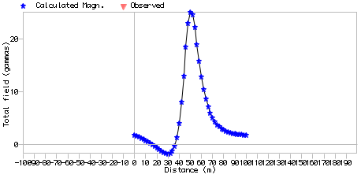
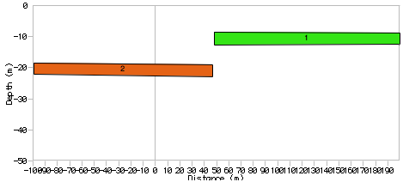
Note in GravMag, you must enter “Preferences” in order to
specify inclination/
declination of the
Earth’s main field
(then the program
allows you to input
azimuth of the
profile relative to
geographical north,
which you will need
to estimate or calculate
from GPS positions).
Also does remanent
magnetization, which
we neglect here.

Slide 11
DC Electrical Resistivity
Method:
Apply a direct current (or very low frequency alternating
current) to the Earth using a dipole current source/sink
Measure voltage across a second pair of electrode probes
The measured voltage is a difference in electrical potential…
Advantage: Instrumentation doesn’t require great sensitivity!
i
Source
V
Sink
+
–
Electrical
equipotential
Current (charge) flow

Slide 12
Relations for electromagnetic methods (including radar!)
are governed by Maxwell’s equations:
Note: The dot-product of a gradient operator with a vector gives the vector field’s “divergence”; the cross product gives its “curl”
is electric field; charge density; ε permittivity
is magnetic field
μ is magnetic susceptibility,
is current density
By Ohm’s Law,
(σ is conductivity,
ρ is resistivity)

Slide 13
Similar to gravity and magnetics, DC resistivity is a
potential field method:
Definition of electrical potential:
The electric field (where V is potential in volts)
If we assume no time dependence & no static charge:
Then:
This is Laplace’s equation!

