Slide 1
Geology 5660/6660
Applied Geophysics
6 Feb 2026
Last time: Refraction in Non-Ideal Media:
• Change in thickness ⇒ change in intercept time
• Single step change in thickness Δh:
→ In t-x plot, similar slopes before & after a shift in intercept
(with opposite sign forward vs reversed)
• Plus-Minus Method for arbitrarily changing h:
→ where m– is slope of a plot of t_{1i}–t_{2i} vs x_{i} for SP1, 2 and
geophones i
Here, t₀ is intercept of a line fit (earlier we used b for intercept!)
Read for Mon 9 Feb: Burger 167-199 (§4.2-4.3)
© A.R. Lowry 2008-2026

Slide 2
Last time continued: The Reflection Seismic Method:
• Seismic Reflection Travel-Times have eqns of a
hyperbola. For a single layer,
has intercept 2h₁/V₁ and
slope of the asymptote is 1/V₁!

Slide 3
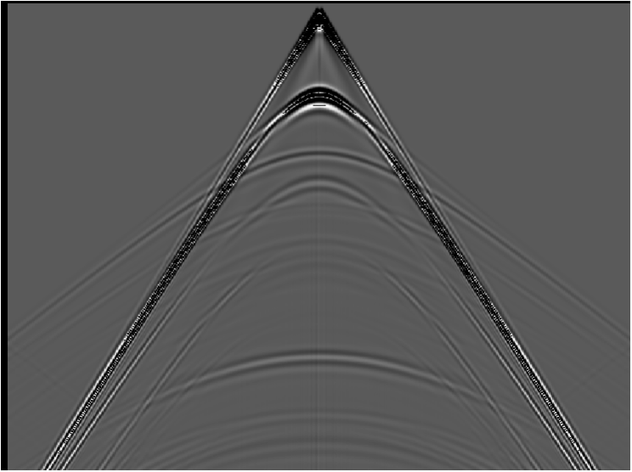
The Reflection Seismic Method:
Hyperbola:
The travel-time for a reflection
corresponds to the equation of a
hyperbola. If we re-write:
intercept = b;
asymptote m = b/a
water
shale
gas sand
shale
This implies an
intercept at 2h₁/V₁
and asymptotes
with slope ±1/V₁
±x/V₁

Slide 4
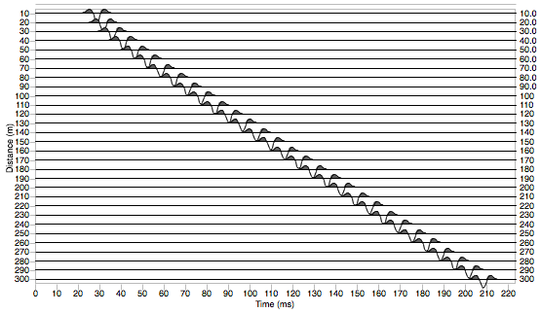
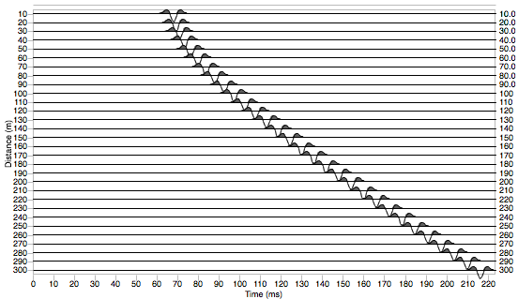
Some quick observations:
Changing only depth of the
layer boundary changes
intercept of the hyperbola
but not the slope or intercept
of the asymptotes, so a
reflection from a shallower
interface appears more
“pointy”
h₁ = 15 m
V₁ = 1500 m/s
h₁ = 45 m
V₁ = 1500 m/s

Slide 5
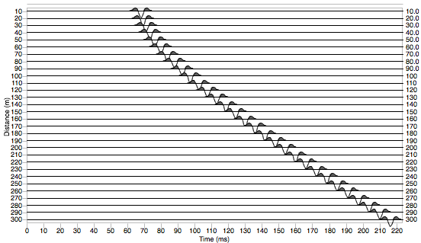
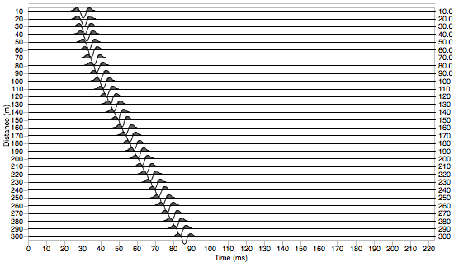
Changing velocity of the
layer changes intercept of
the hyperbola and the
slope of the asymptotes,
so a reflection from the
bottom of a layer with higher
velocity arrives sooner and
appears more “flat”
h₁ = 45 m
V₁ = 1500 m/s
h₁ = 45 m
V₁ = 4000 m/s

Slide 6
Normal Move-Out (NMO) is the difference in
reflection travel times at a distance x relative to the
travel time at the intercept (x = 0), i.e.,
NMO emphasizes changes in curvature of the hyperbola
(i.e., it is greater for shallower depth of reflection and for
lower velocity of the layer).
The reason we accord special status to NMO is that we
will want to correct for move-out in order to use
the reflection energy to image the subsurface as a
seismic section in two-way traveltime…
(“NMO”,
like “head wave”,
is a term that’s
leftover from
early industry
applications
of seismic
methods!)

Slide 7
Distance
water
shale
gas sand
shale
Two-Way Travel Time

Slide 8
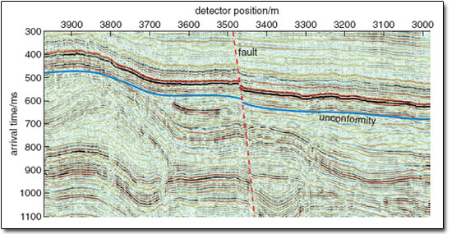
Shifting the seismic reflection amplitude to where it would be
(in two-way travel-time) for zero-offset produces an image…
Note that this approach is VERY different from the model of
velocity structure we generate from the refraction method!

Slide 9
Reflection from a second layer interface over half-space:
x/2
V₁
h₁
V₂
h₂
Can derive using Snell’s law, but easier to consider that:
For x = 0, ⇒ intercept of hyperbola
For x → ∞, asymptotic to the layer 2 refraction

Slide 10
Equation for the hyperbola then can be written as:
Note here that t₀ is the intercept time for the refraction arrival; i.e., the asymptotes to the hyperbola are shifted in time relative to the t = 0 axis!
After some algebra we have
And you might see where the algebra could start to get
complicated for 3, 4, … layers
This is part of why industry seismic reflection processing
historically did not go after full seismic velocity analysis
but instead sought shortcuts to image structures…

Slide 11
A Dipping Reflector:
V₁
h₁
α
α
Geometrically, this is equivalent to rotating the axis
of the reflector by the dip angle α. This rotates the
hyperbola on the travel-time curve by θ = tan⁻¹(–2h₁sinα)
and has equation

Slide 12
Example: V₁ = 1500, h = 45 m, α = 8°
Helpful Hint : Reflect does not model dipping layers, but
the Table 4-6 Excel spreadsheet does! The textbook
spreadsheets are also available in the zipfile on Canvas…

Slide 13
Getting velocity structure: The x² – t² method
If we have travel-times from a reflection, can plot t² vs x²
to get parameters of thickness & velocity from slope
and intercept of the resulting line fit!
Recall that the goal of geophysics is to invert for
parameters (in this case, velocity and thickness)
Given travel-times from a reflection, can plot t² vs x²
to get parameters of thickness & velocity from slope
and intercept of the resulting line fit.
For the single layer case:

Slide 14
So for slope m, intercept t₀² of a line fit:
t
t²
x
x²

Slide 15
Note x² – t² method is also useful for dipping layers!
θ
down-dip
limb
mean
slope
t
t²
up-dip
limb
x
x²

Slide 16
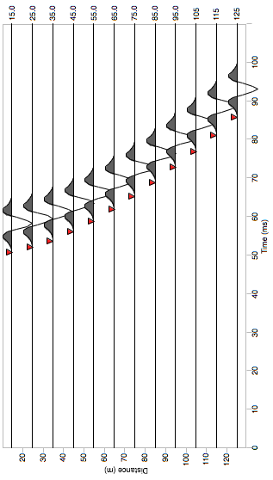
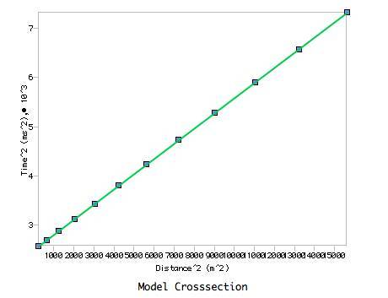
This single-layer approximation
is the approach taken to inverting
data in Reflect !

Slide 17
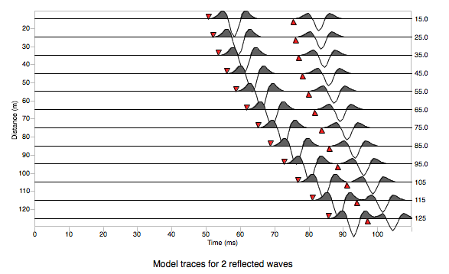
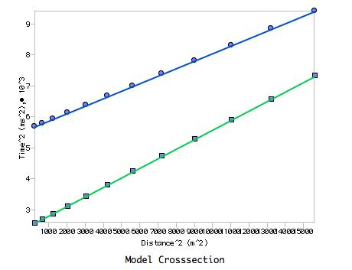
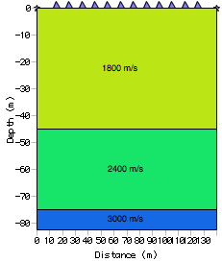
Also works for multiple layers–
However instead of explicitly
solving e.g.:
We use an approximation called
the Dix Equation

