Slide 1
Geology 5660/6660
Applied Geophysics
7 Feb 2024
Last time: Refraction With Dipping Layers
• Algebraic solution for parameters (thickness, dip, velocity)
of subsurface structure from observations (travel times)
is a simple example of data inversion
• Refract solves for multiple dipping layers using the
Adachi formulation…
• Limitations of the Refraction Method:
→ Do not get returns from low velocity layers
→ Can alias or miss entirely thin layers
Deeper layer thicknesses are overestimated for the
first case; underestimated for the second
Read for Wed 7 Feb: Burger 149-167 (§4-4.1)
© A.R. Lowry 2008-2024

Slide 2
Last time Continued: Refraction in Non-Ideal Media:
• Velocity changes within layers can be distinguished by
similar slopes (forward & reversed) over same locales
• Change in thickness ⇒ change in intercept time
• Single step change in thickness Δh:
→ In t-x plot, similar slopes before & after a shift in intercept
(with opposite sign forward vs reversed)
Here, t₀ is intercept of a line fit (earlier we used b for intercept!)

Slide 3
Refraction from an irregular surface: Delay-Time Method
y
E
G
h_{E}
V₁
A
B
V₂
Define delay time τ as the time the ray traveled in layer 1
along a “slant path”, less the time it would have taken to
travel the horizontal distance (AB) at velocity V₂. The
total delay time τ_{EG} traveling from E to G (or G to E) is
where t_{R} is total travel time. Delay time under E is
(For a horizontal layer, this is half of the “time intercept” on
our t–x plots!)

Slide 4
Using trigonometry and Snell’s law for the critical angle,
We can’t measure τ directly, but with reversed shots:
E
H
G
h_{E}
V₁
A
B
V₂
τ_{H} from E ≈ τ_{H} from G, and

Slide 5
Refraction from an irregular surface: Delay-Time Method
y
x
E
H
G
V₁
V₂
Problem however: to get h_{H} from τ_{H}, we need to know V₂!
But we can also expect:
(⇒ a line with slope 2/V₂!)

Slide 6
1
i
2
V₁
V₂
Sometimes also called the “plus-minus method”:
Plot t_{1i}–t_{2i} vs x_{i} for SP1, SP2 and all geophones i. Calculate
V₂ from slope m of the line fit (V₂ = 2/m).
At each geophone i, calculate thickness as

Slide 7
The Reflection Seismic Method:
Consider a single horizontal layer over a half-space, with
layer thickness h₁ and velocity V₁:
x/2
V₁
h₁
The travel-time for a reflected wave to a geophone at a
distance x from the shot is given by:

Slide 8
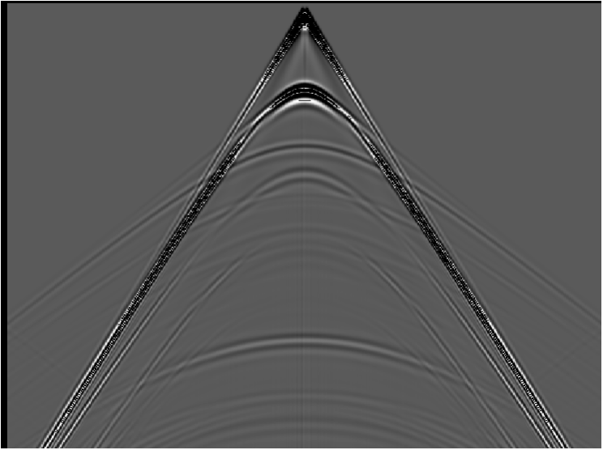
The Reflection Seismic Method:
Hyperbola:
The travel-time for a reflection
corresponds to the equation of a
hyperbola. If we re-write:
intercept = b;
asymptote m = b/a
water
shale
gas sand
shale
This implies an
intercept at 2h₁/V₁
and asymptotes
with slope ±1/V₁
±x/V₁

Slide 9
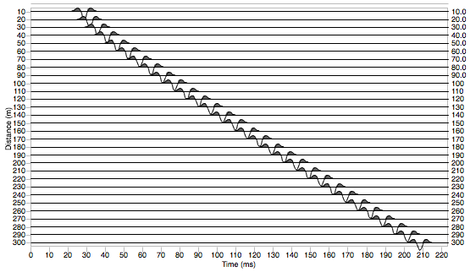
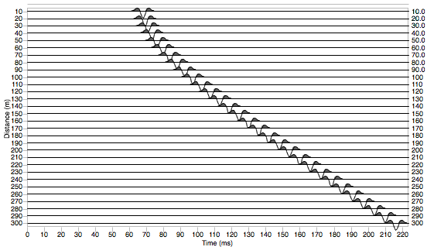
Some quick observations:
Changing only depth of the
layer changes intercept of
the hyperbola but not the
slope or intercept of the
asymptotes, so a reflection
from a shallower interface
appears more “pointy”
h₁ = 15 m
V₁ = 1500 m/s
h₁ = 45 m
V₁ = 1500 m/s

Slide 10
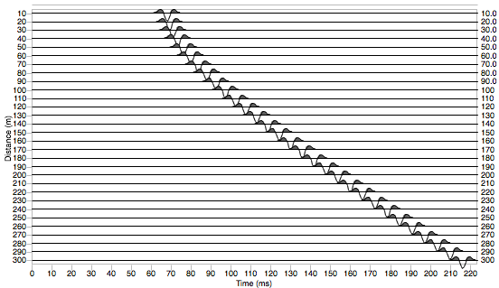
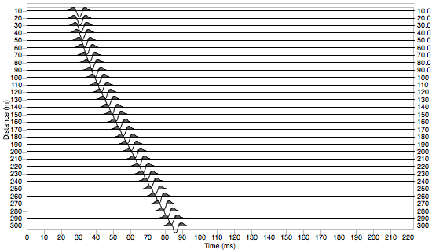
Changing velocity of the
layer changes intercept of
the hyperbola and the
slope of the asymptotes,
so a reflection in a layer
with higher velocity arrives
sooner and appears more
“flat”
h₁ = 45 m
V₁ = 1500 m/s
h₁ = 45 m
V₁ = 4000 m/s

Slide 11
Normal Move-Out (NMO) is the difference in
reflection travel times at distance x relative to the
travel time at the intercept (x = 0), i.e.,
NMO emphasizes changes in curvature of the hyperbola
(i.e., it is greater for shallower depth of reflection and for
lower velocity of the layer).
The reason we accord special status to NMO is that we
will want to correct for move-out in order to use
the reflection energy to image the subsurface as a
seismic section…
(“NMO”,
like “head wave”,
is a term that’s
leftover from
early industry
applications
of seismic
methods!)

Slide 12
Distance
water
shale
gas sand
shale
Two-Way Travel Time

Slide 13
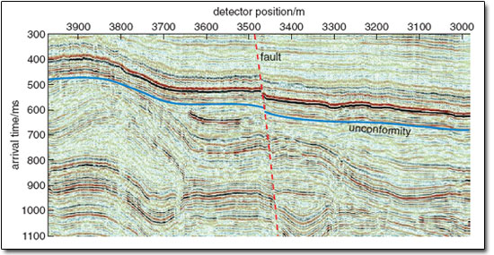
Shifting the seismic reflection amplitude to where it would be
(in two-way travel-time) for zero-offset produces an image…
Note that this approach is VERY different from the model of
velocity structure we generate from the refraction method!

