Slide 1
Geology 5660/6660
Applied Geophysics
7 Jan 2026
Last time: Overview of Applied Geophysics
• Important syllabus points: Labs, projects, exams, text, website
• Geophysics:
What is it? Who does it? (Career tracks) And why?
What this class will be about: Geophysical Imaging
Examples:
‹› Seismic reflection imaging of the subsurface under
Upheaval Dome (salt dome, or impact structure?)
‹› Magnetotelluric (electrical) imaging of a mining prospect
Reminder: Be thinking about possible ~nearby field sites!
(We will discuss in the next few weeks!)
Read for Fri 9 Jan: Burger 1-21
© A.R. Lowry 2008-2026

Slide 2
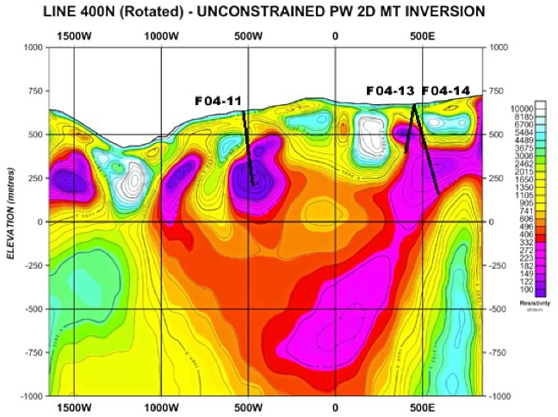
Magnetotelluric resistivity image of a mining claim
in Quebec, Canada

Slide 3
Seismic imaging: A brief thought exercise
!
‘Dja ever count seconds?

Slide 4
Seismic Concepts I: Velocity
!
Velocity of light in air ~ 3x10⁸ m/s
Velocity of sound in air ~ 340 m/s
Velocity is the distance traveled per unit time, V = Δx/Δt.
Rule of thumb is to count seconds and divide by 3 for
distance in km (or by 5 for distance in miles).

Slide 5
! Different types of materials have different seismic velocities…
Hence in geophysical imaging of the subsurface, we want
to measure changes in physical properties that tell us
something about the structure & materials down there:
Sound is a type of wave made up of compressions and rarefactions of atoms. It is also called a “dilatational strain wave”, or in seismology, a P-wave !
Energy
Source
Seismometers or “Receivers”
Soil:
V_{p} = 1 km/s
Limestone:
V_{p} = 3 km/s

Slide 6
Defn: The surface of furthest travel of a wave at a given time t is
called a wavefront.
Sound waves from an energy source radiate in all directions…
Velocity V = Δx/Δt, so in a uniform medium the wave
travels a distance Δx = VΔt in a time Δt.
Energy
Source
Seismometers or “Receivers”
Black line is
the “wavefront”,
or location of the
sound energy
furthest from the
source, at time t
Soil:
V_{p} = 1 km/s
Blue arrows are
“rays” in the
direction of wave
propagation
(perpendicular
to the wavefront)
Limestone:
V_{p} = 3 km/s

Slide 7
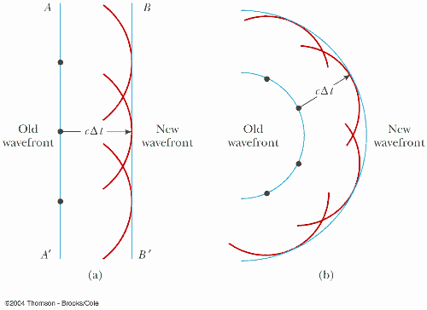
So, a valid (and important) question is, “How does info about
deep layers get back to the surface where we can measure it?”
Seismic Concepts II: Huygen’s Principle
Every point on a
wavefront can be
treated as a point
source for the next
generation of
wavelets. The
wavefront at time Δt
later is a surface
tangential to the
furthest point on
each of these
wavelets.
cΔt
Old
wavefront
cΔt
New
wavefront
Old
wavefront
New
wavefront

Slide 8
Thought exercise: Assume the source and seismometers
are all equally spaced at a distance Δx. Assume the soil
layer is 2Δx thick. Draw two diagrams showing what you
imagine the wavefront will look like at times 2Δt & 3Δt.
Energy
Source
Δx
Seismometers or “Receivers”
Soil:
V_{p} = 1 km/s
Limestone:
V_{p} = 3 km/s

Slide 9
Something important to think about…
Where is the wavefront at time 2.5Δt?
At 2.25Δt and 2.75Δt?
Given Huygen’s principle, what does that imply about the
wavefronts?
Energy
Source
Δx
Seismometers or “Receivers”
Black line is the
“wavefront”
at time t = Δt
Soil:
V_{p} = 1 km/s
Blue arrows are
“rays” in the
direction of wave
propagation
(perpendicular
to the wavefront)
Limestone:
V_{p} = 3 km/s

Slide 10
Now do a similar thought exercise assuming a planar
wavefront in a basalt layer that is 2Δx thick, over a slower
loess layer. Draw two diagrams showing what you
imagine the wavefront will look like at times 2Δt & 3Δt.
Energy
Source
Δx
Seismometers or “Receivers”
Basalt:
V_{p} = 3 km/s
Loess:
V_{p} = 1 km/s

