Slide 1
Geology 5660/6660
Applied Geophysics
8 Apr 2024
Last Time: Magnetic Modeling
• Induced magnetic field due to a dipole is given by:
• Magnetic field for an arbitrarily-shaped body is:
• Often we use analytical solutions derived for simple
body shapes, e.g., for a sphere of radius R:
• Semi-infinite sheet:
• GravMag uses Talwani solutions for 2D prisms…
For Wed 10 Apr: Burger 265-301 (§5.1-5.4)
© A.R. Lowry 2008-2024

Slide 2
Last Time continued: Intro to DC Electrical Resistivity
• DC Resistivity : inject electrical current across two (source
& sink) electrodes, measure voltage across two others.
• Governing equation derives from Maxwell’s equations
to get Ohm’s Law:
• Material property imaged is rock resistivity :
→ Low for clays, shales, graphite; intermediate for soils/
unconsolidated seds; high for consolidated seds and
crystalline rocks
→ Sensitive to sulfides, temperature, pore fluids

Slide 3
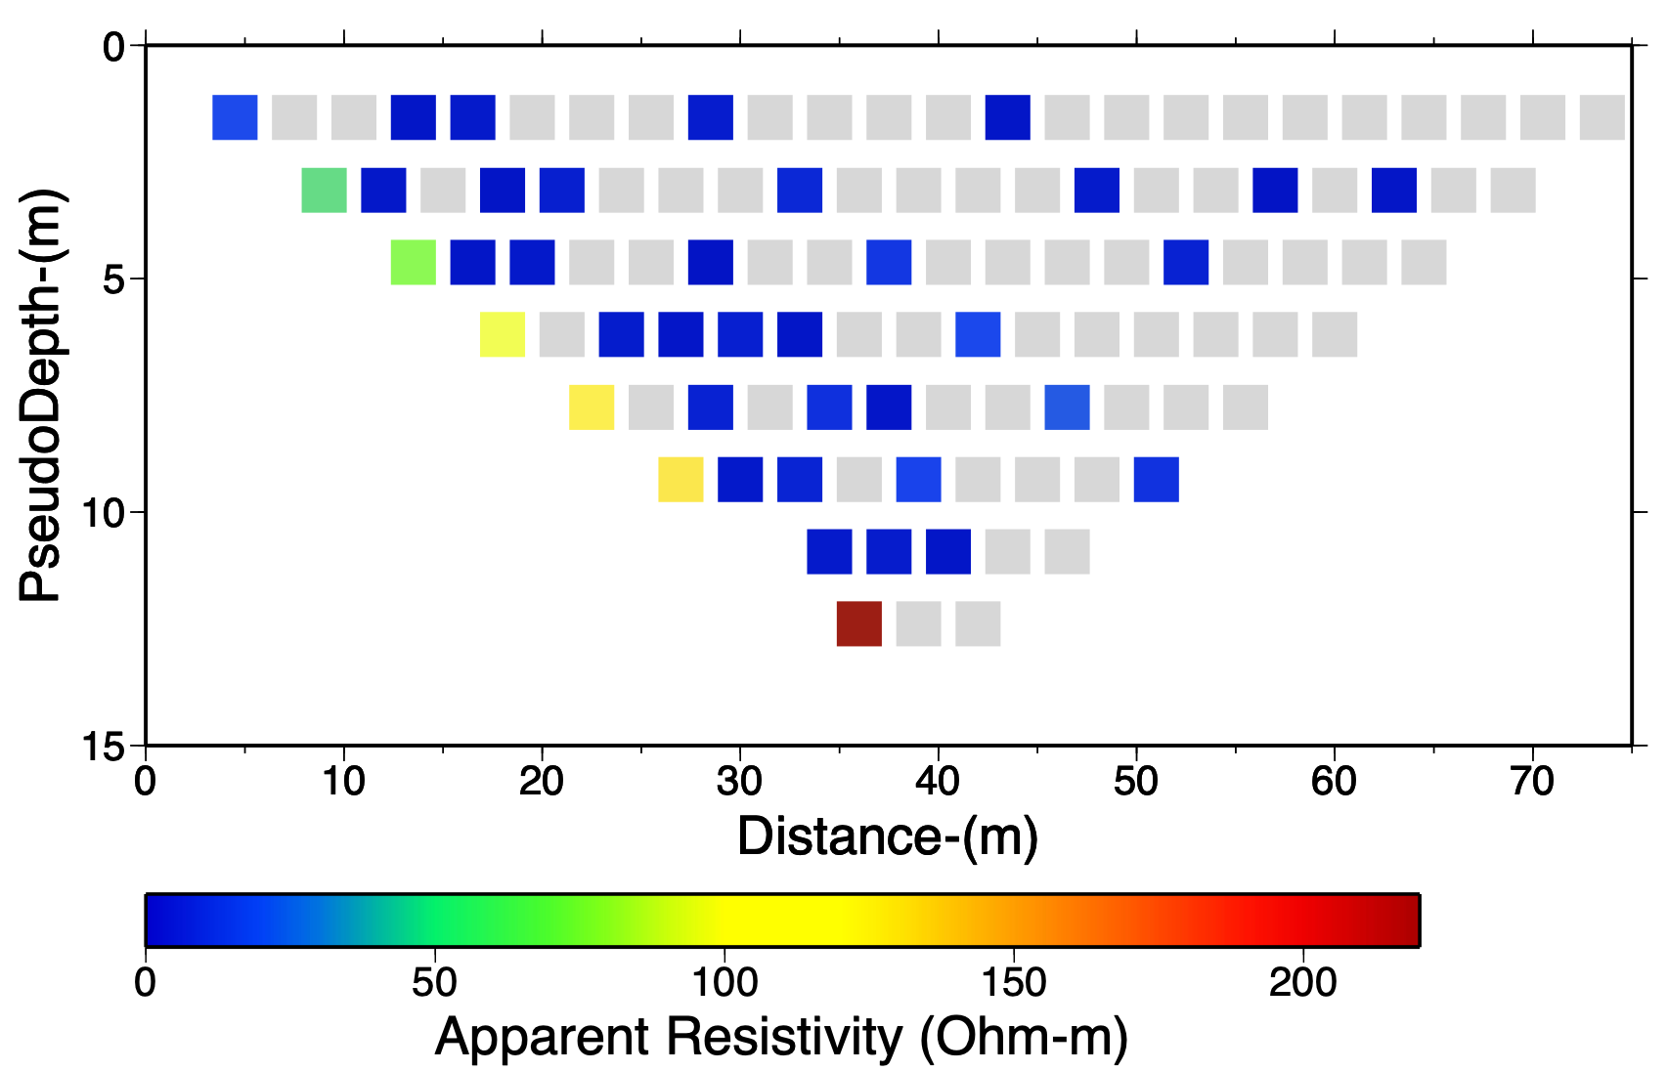
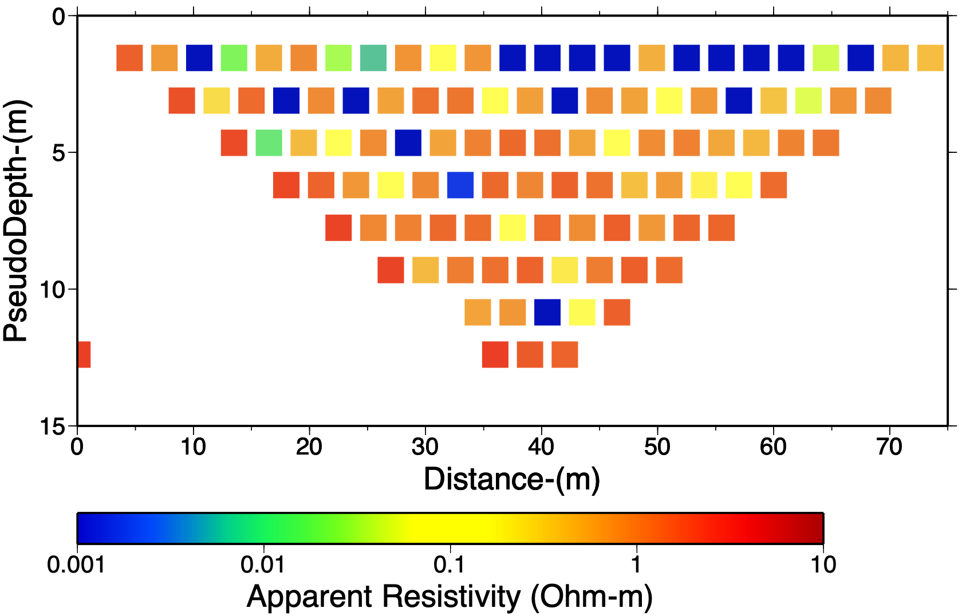
Hyrum (Blacksmith Fork) Data: Resistivity
• We’ll talk about “apparent resistivity”
today!
• Many of the apparent resistivities here
are negative (which is “nonphysical”
but really means resistivity is very low
and/or some of the current flow occurs
out-of-plane)
• In this case, the percent errors on
measurements were very large
(presumably because the soil is
clay rich and was water-saturated at
the time of measurement), leading low
resistivities to yield negative values.
Grey =
Negative
Rho-app

Slide 4
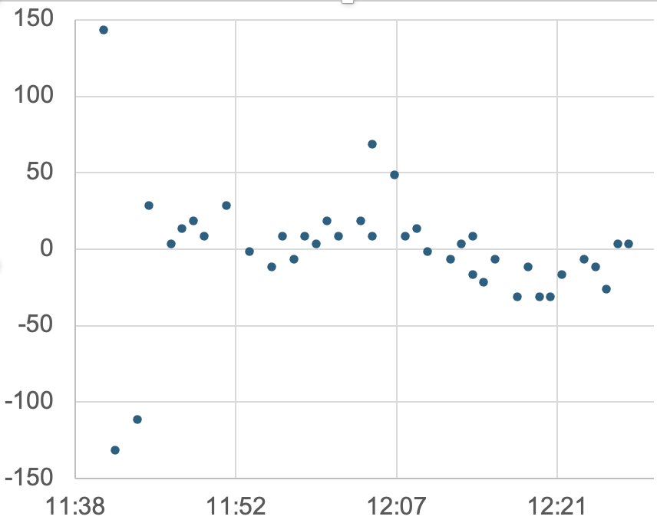
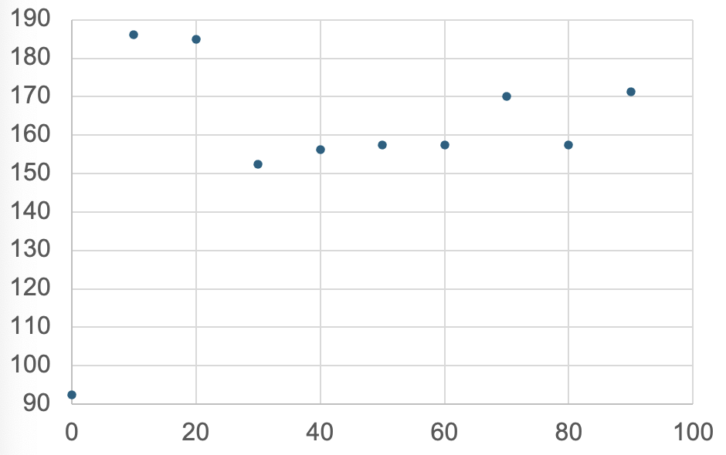
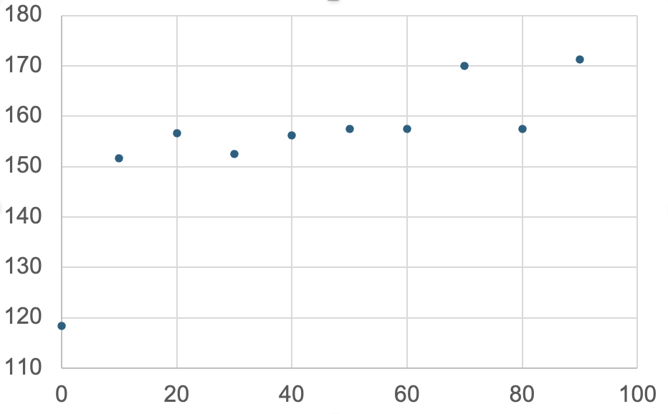
Hyrum (Blacksmith Fork) Data: Magnetics
With (Yukon-related?)
outliers
• Magnetic measurements
appear to be (mostly) as good
as one can get!
• Appears to show a trend in
the magnetic field (but no
local body?)
Without early outliers

Slide 5
Example: Current source I in an infinite homogeneous
medium with constant resistivity ρ
Expect V = 0 at r = ∞ and equipotential
surfaces are spherical around the source
(similar to gravity!)
+
(for some unknown constant A)
so
Integrating the relation above, then
or equivalently
So given a known I & a measured voltage at known r,
we can solve for a constant resistivity ρ.

Slide 6
More realistic representation of Earth is a halfspace:
+
Same current is forced into half the volume so
or equivalently
And for two current electrodes +I and –I, total potential
is given by the sum of potentials from the two
point sources:
V
+
–
r₁
r₂

Slide 7
2
b
a
1
In practice we measure voltage difference at two points,
ΔV = V_{a} – V_{b}

Slide 8
We are really interested however in imaging a subsurface
in which ρ varies. The potentials integrate ρ over the
volume so they provide information relevant for doing
exactly that!

