Slide 1
Geology 5660/6660
Applied Geophysics
8 Apr 2026
Last Time: Magnetic Modeling
• Induced magnetic field due to a dipole is given by:
• Magnetic field for an arbitrarily-shaped body is:
• Often we use analytical solutions derived for simple
body shapes, e.g., for a sphere of radius R:
• Semi-infinite sheet:
• GravMag uses Talwani solutions for 2D prisms…
For Fri 10 Apr: Burger 265-301 (§5.1-5.4)
© A.R. Lowry 2008-2026

Slide 2
Last Time continued: Intro to DC Electrical Resistivity
• DC Resistivity : inject electrical current across two (source
& sink) electrodes, measure voltage across two others.
• Governing equation derives from Maxwell’s equations…
to get Ohm’s Law :

Slide 3
DC Electrical Resistivity
d
i
Source
V
Sink
+
–
Electrical
equipotential
Current (charge) flow
Ohm’s Law:
So for a given current i and electrode
spacing d (defines ), V depends on ρ

Slide 4
Resistivity properties of rocks & soils:
clay
topsoil
gravel
weathered bedrock
shale
porous limestone
dense limestone
sandstone
graphitic schist
metamorphic rocks
gabbro
igneous rocks
1
10
100
1000
10⁴
10⁵
10⁶
Resistivity (Ω m)

Slide 5
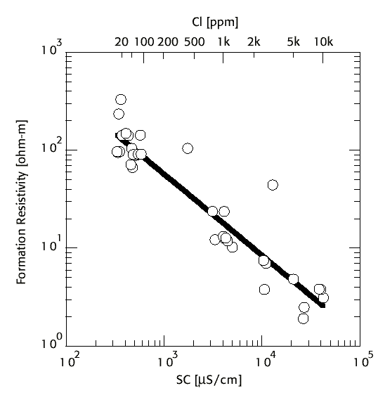
Sulfides
Temperature
Water Salinity in
Pore Fluids

Slide 6
Example: Current source I in an infinite homogeneous
medium with constant resistivity ρ
Expect V = 0 at r = ∞ and equipotential
surfaces are spherical around the source
(similar to gravity!)
+
(for some unknown constant A)
so
Integrating the relation above, then
or equivalently
So given a known I & a measured voltage at known r,
we can solve for a constant resistivity ρ.

Slide 7
More realistic representation of Earth is a halfspace:
+
Same current is forced into half the volume so
or equivalently
And for two current electrodes +I and –I, total potential
is given by the sum of potentials from the two
point sources:
V
+
–
r₁
r₂

Slide 8
2
b
a
1
In practice we measure voltage difference at two points,
ΔV = V_{a} – V_{b}

Slide 9
We are really interested however in imaging a subsurface
in which ρ varies. The potentials integrate ρ over the
volume so they provide information relevant for doing
exactly that!

Slide 10
Electrode Arrays: Spatial placement of the electrodes
Wenner Array: (common in older surveys)
I
a
V
a
a
Constant spacing (“a-spacing”):
r_{1a} = r_{2b} = a r_{1b} = r_{2a} = 2a

Slide 11
Wenner-Lee Array:
a
I
V₁
a
a
V₂
V₃
Additional voltage measurements to a center electrode
reduce sensitivity to near-surface resistivity variations
Schlumberger Array:
2s
I
V
a
Also less sensitive to near-surface resistivity variations,
& required half the effort to move electrodes for
sounding studies (of vertical changes in resistivity)

Slide 12
Dipole-Dipole Array:
I
V
Requires larger current source, but fairly common now
with the development of multichannel instruments
Pole-Dipole Array:
I
r₁
V
r₂
Most sensitive to resistivity in the shell between radii
r₁ & r₂ – commonly used for tunnel/karst detection

Slide 13
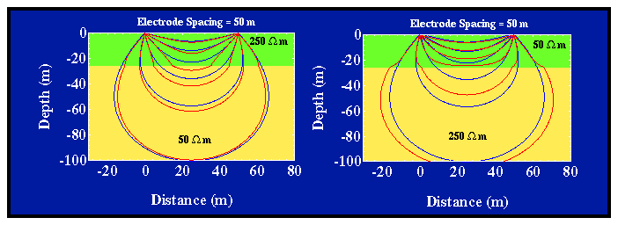
Modeling:
ρ₁
ρ₂
Current penetration for a layer over half-space:
Fraction of total current that penetrates below depth
of an interface, z, is (for a Wenner array):
a is electrode spacing,

Slide 14
ρ₁
ρ₂
k = –0.67; z = a/2
k = 0.67; z = a/2
z = a
z = 3a/2
z = 3a

Slide 15
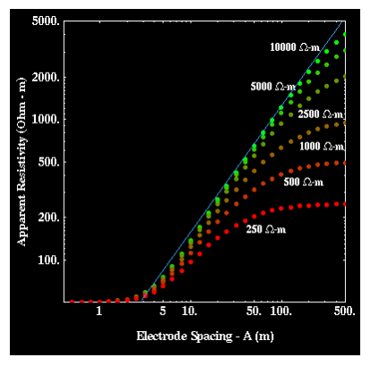
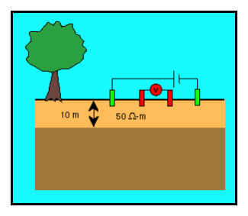
Apparent resistivity for a layer over halfspace: For Wenner
array, given by:
Sounding increases the a-spacing without changing the array center, to reflect larger volumes and hence deeper structure!

Slide 16
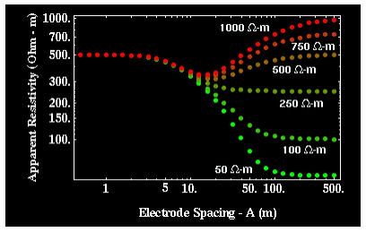
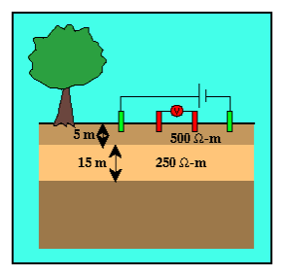
Apparent resistivity for the two-layer over half-space case:
for various half-space resistivity values.

Slide 17
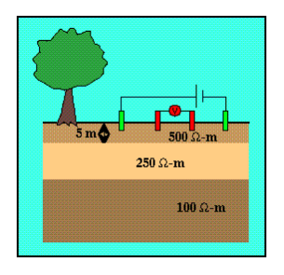
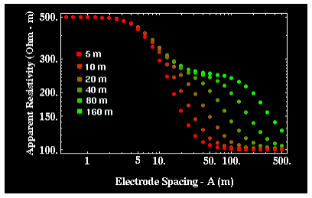
Apparent resistivity for the two-layer over halfspace case:
Dependence of apparent resistivity on thickness of middle layer

Slide 18
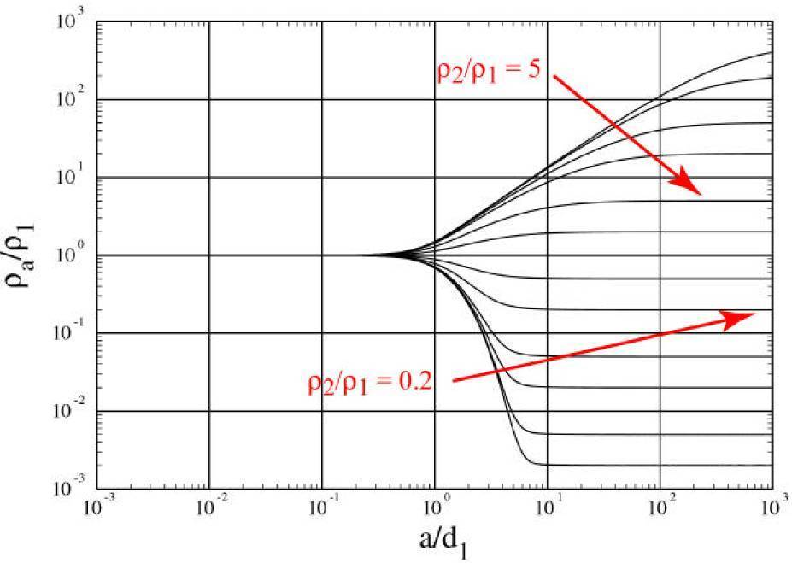
“Universal Curves"
Wenner array ρ_{app} depends only on ρ₂/ρ₁, a/d₁ for layer over a
halfspace

Slide 19
For 3+ layers:
Rule of thumb: if layer thickness < 0.1 the depth to top of
layer, it cannot be resolved
But also depends on resistivity contrast (thicker layers may
not be resolved if contrast is too small; transition of
apparent resistivity versus a-spacing is much sharper for
a resistive layer over a conductive layer than for the
opposite).
When layer thickness is small relative to depth-to-top,
solution from sounding can be highly non-unique

Slide 20
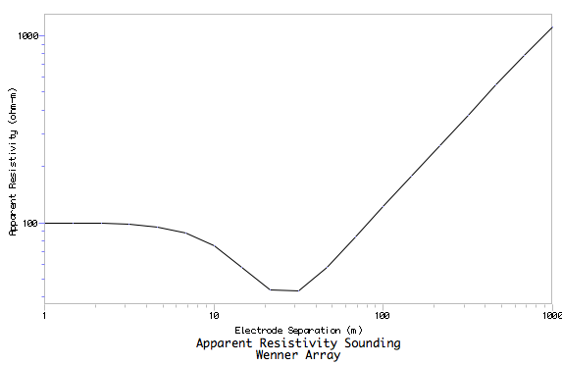

Resist does either Wenner or Schlumberger array for
vertical sounding only (horizontal layers); and is
somewhat less adaptable than the other Burger programs
ρ = 100 Ω m
10 m
(Particularly because of
forced logarithmic
variation of a-spacing)
(Worth noting though that the Burger Excel spreadsheets are much more flexible & adaptable!
ρ = 10 Ω m
10 m
ρ = 500 Ω m
10 m
ρ = 10000 Ω m

Slide 21
Profiling maintains constant a-spacing while moving the
array laterally. Wenner array ρ_{app} for a vertical contact:
I
V
ρ = 100 Ω m
ρ = 10 Ω m

Slide 22
Sounding maintains a constant center while increasing
the a-spacing. Wenner array ρ_{app} for a vertical contact:
I
V
x
ρ = 100 Ω m
ρ = 10 Ω m

Slide 23
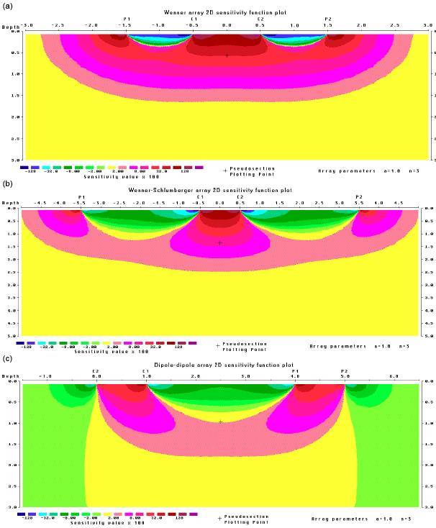
“Sensitivity kernels”
for apparent
resistivity (assumes
a homogeneous
Earth model). This is
a measure of how
much a perturbation
of resistivity at a given
point in the Earth can
be expected to change
the measurement of
apparent resistivity of
the array (reds positive,
blue-greens negative,
yellow ~ zero).

