Slide 1
Geology 5660/6660
Applied Geophysics
8 Apr 2026
Review lab 4...
© A.R. Lowry 2008-2026

Slide 2
(1) Seek a reflection in Benson Park-n-Ride data!
(a) First, use your best estimate of Layer 1 velocity and thickness from Lab 3
to model the expected arrival times of the first layer reflection in the modeling
code Reflect. (Include the plot and data windows in your writeup). Look at
the plot result with all the boxes checked, and with only the reflection box
checked. What challenges do you expect in picking real data?
(b) Load the Benson Park-n-Ride Forward shot data into the RAS24 software
and try to find that reflection. To help guide your eyes to a possible reflection,
I suggest the following steps:
i. Use the velocity line to approximate the expected asymptote for the
reflection (i.e., fix one end to the direct arrival at the first trace and set the
other end to match inverse slope of the 1st layer velocity).
ii. Use the “Select display filters” button/panel to emphasize high
frequencies (select “Low Cut”, “45” Hz, and “Preview” or “Apply”).
iii. Shift the pick lines to the approximate times you modeled in Reflect,
and include a screen-shot of the result in your write-up.
iv. Now, shift the pick lines to where you think the reflection actually is
based on looking at the data, and save/report those picks.

Slide 3
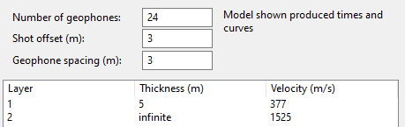


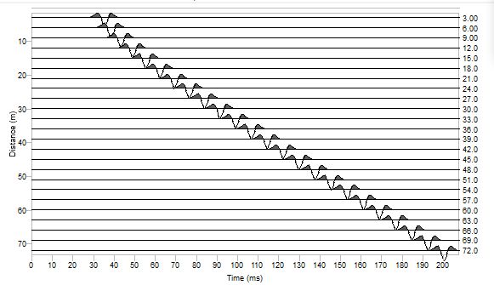
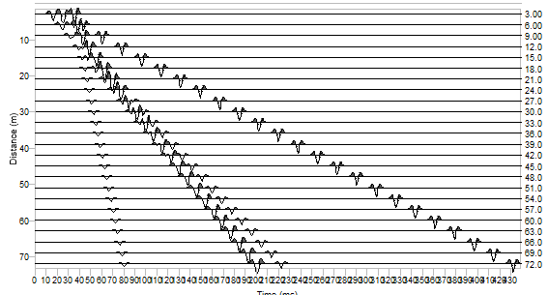
(1a). We had several possible models (with the faulted horizontal layer
performing best) so I used the ~ thickness and velocity from that:
The Reflect plot with all arrivals suggests that the reflection will be interfered
with by the Rayleigh wave on the first two traces, and the direct and air wave
arrivals on later traces. It also suggests one might easily mistake the air
wave for the reflection!

Slide 4
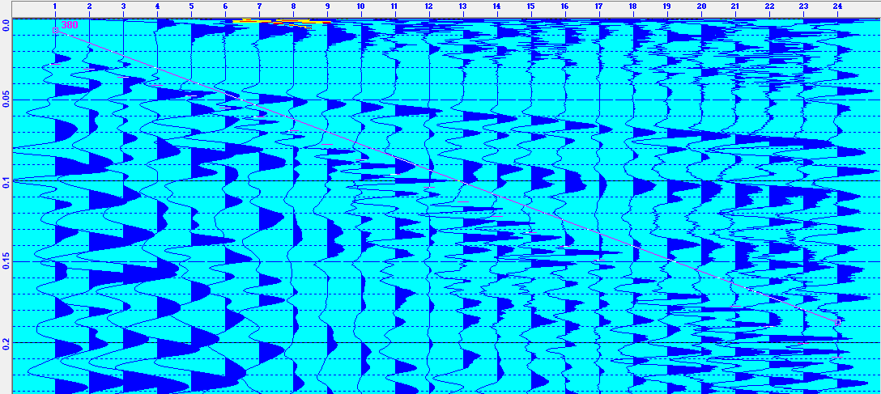
(1b). My picks (red) focused on the high-frequency arrival that comes in
about 5-20 ms later than the direct arrival, and 0-16 ms later than the
reflection arrival that I had modeled using Reflect (purple).
The “reflection” picks diverge ~linearly from both the direct arrival line
and the modeled reflection, which a reflection should not do (because
the direct arrival should be an asymptote for the reflection!). However
it is (arguably) still possible that this really is a reflection, given that
our best refraction model suggested an ~ 0.5 m thickness change.

Slide 5
(2) Now, enter your picks in the code Reflect, and use them to model a
best-fitting velocity and thickness for the layer. Include the model, section,
plot, fit and data windows in your writeup. (I recommend *not* using picks
that you are uncertain about in the data fitting portion of this exercise…
Note that the first ~5-6 traces are very difficult to pick!)
(a) How does the model you’ve generated from the reflection compare to
your understanding of the subsurface based on the three models you
created from refractions in Lab 3?
(b) Are you confident that the arrival you picked is really a reflection? If not,
what is it likely to be?

Slide 6
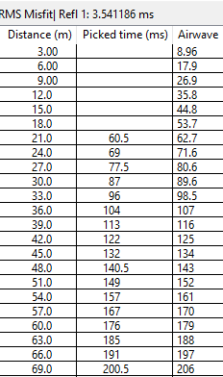
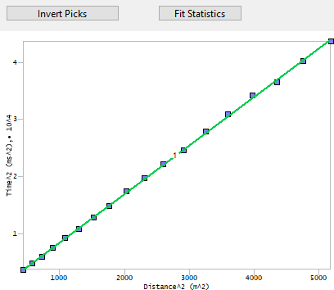
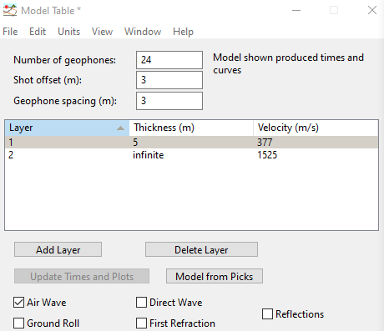
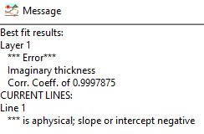
(2a). I was able to pick the high frequency arrivals only at geophones 7-24,
so I left 1-6 blank. When I attempted to “Invert Picks” from the x² – t² plot
window though, I get a nonphysical model (with a negative t₀²)!
This occurs despite the fact that the arrival times picked for the high
frequency arrival have a very high correlation coefficient, indicating that
the arrival is very well fit by a straight line in an x² – t² plot (and so it
probably is a real seismic arrival, just not a reflection, because the
intercept for the line is negative). Because it is not a reflection, there is
no viable model to compare to the model we found from refraction
modeling.

Slide 7
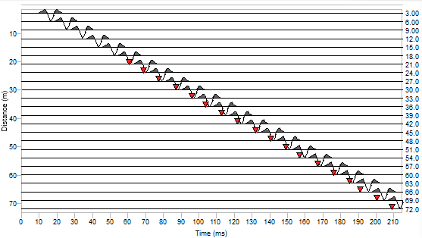
(2b). Since we’ve already established that it’s not a reflection, the real
question here is what is it? The most likely candidate for another
arrival slightly later than the direct wave is the air wave, since the Layer 1
velocity was only slightly faster than air.
The Refract model air wave comes in
slightly (2–6 ms) later than the picks, but
a 3% error is consistent with what we
might expect for errors in distance from a
tape measure (especially if the profile was
not a perfectly straight line)!

Slide 8
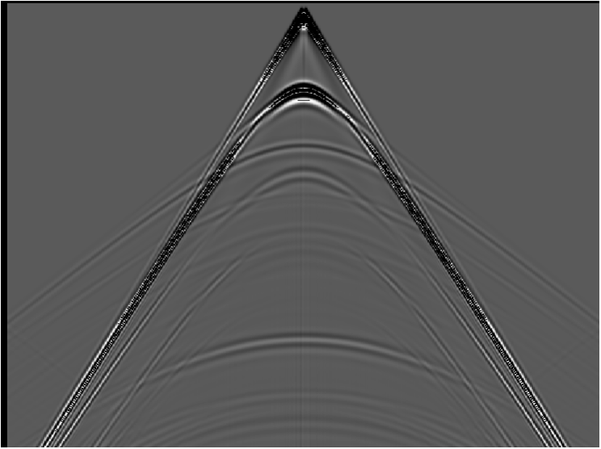
Lab 4: Seismic Reflections
0
2000
4000
6000
8000
10000
(m)
0
0.5
1.0
(sec)
1.5
2.0
2.5
3.0

Slide 9
(3) The previous slide shows synthetic (idealized) data generated
using a numerical (finite element) approach. There are four
primary reflections present in the data. Pick five travel-times
(i.e., at five different distances) from each of at least three of
those reflections. Using Excel (or some similar software that
allows you to regress a line fit– you can do this in Matlab, or
other software if you prefer), plot x² versus t² for each of your
reflections, and calculate the velocities and thicknesses these
would imply assuming each reflection is from a single-layer
interface over a half-space.
(4) Now do the same for one of the multiple reflections.

Slide 10
0
2000
4000
6000
8000
10000
(m)
0
(All four of the solid hyperbolas are reflections; the dashed hyperbola is the first multiple.)
0.5
1.0
(sec)
1.5
2.0
2.5
3.0

Slide 11
(Plots of time versus distance)

Slide 12
(3) Layer / Halfspace:
V₁ = 1540 m/s;
h₁ = 400 m
(Plots of x² vs t² with estimates of velocity and thickness from slope and intercept, assuming each is from a single layer over a halfspace.)
V₄ = 2470 m/s;
h₄ = 2810 m
V₃ = 2620 m/s;
h₃ = 1670 m
V₂ = 2660 m/s;
h₂ = 1280 m
“True” model:
V₁ = 1500; h₁ = 400
V₂ = 3048; h₂ = 600
V₃ = 2439; h₃ = 400
V₄ = 3048?; h₄ = 1160?
(4) Multiple: V_{m} = 1490 m/s; h_{m} = 790 m

Slide 13
(5) Again, without using Reflect, use the intercepts and
slopes of lines on your x² – t² plots with Dix equations
to calculate velocities and thicknesses of each layer.
(6) Do similar calculations for velocities and thicknesses
using Dix equations, but now instead of using
taken from the inverse slope of x² – t², use the first-
order T_{NMO} relation (i.e., use the inverse slope of a line
fit to a plot of T_{NMO} versus x²/2t₀). How does this change
the model? Which is likely to be more accurate and why?
(7) Now plug your travel-time picks into Reflect and
calculate a model of velocities and thicknesses. How
does this compare to your “hand-calculated” models?

Slide 14
(5) Dix equations
V₁ = 1500; h₁ = 400
V₁ = 1540 m/s;
h₁ = 400 m
V₂ = 3048; h₂ = 600
(x² vs t² with estimates of velocity and thickness from slope and intercept using Dix’s equations.)
V₃ = 2439; h₃ = 400
V₄ = 3048?; h₄ = 1160?
V₄ = 2280 m/s;
h₄ = 1130 m
V₃ = 2500 m/s;
h₃ = 390 m
V₂ = 3580 m/s;
h₂ = 770 m

Slide 15
(6) Using T_{NMO} 1st order binomial approximation
“True” model:
V₁ = 1500; h₁ = 400
V₁ = 2929 m/s;
h₁ = 2817 m
V₂ = 3048; h₂ = 600
(In this graph, TNMO is plotted vs x²/2t₀, and velocity and thickness are estimated from slope and intercept using Dix’s equations as before.)
V₃ = 2439; h₃ = 400
V₄ = 3048?; h₄ = 1160?
V₂ = 940 m/s;
h₂ = 197 m
V₃ = 4908 m/s;
h₃ = 712 m
V₄ = 2003 m/s;
h₄ = 1032 m
Dix equations:

Slide 16
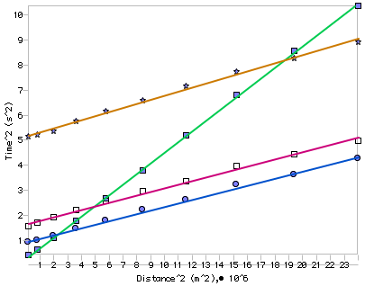
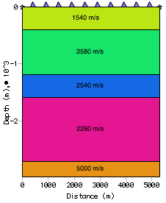
(7) Modeling in Reflect:
“True” model:
“Reflect” model:
V₁ = 1500; h₁ = 400
V₁ = 1540; h₁ = 400
V₂ = 3048; h₂ = 600
V₂ = 3580; h₂ = 770
V₃ = 2439; h₃ = 400
V₃ = 2500; h₃ = 390
V₄ = 3048?; h₄ = 1160?
V₄ = 2280; h₄ = 1130

