Slide 1
Geology 5660/6660
Applied Geophysics
8 Jan 2024
• Some important syllabus points
• Labs: Most weeks less than one hour (sometimes mental
exercises and demo; usually involves an application)
Some weeks may be longer (e.g., field data collection)
• 6660 differs from 5660 in requiring a course-related,
independent semester project which will be presented to
the class and submitted as a written report
• Text: Introduction to Applied Geophysics (Burger
et al.); can be accessed from Bookshelf tab in Canvas (BUT…)
• Math, physics, geology backgrounds?
http://aconcagua.geol.usu.edu/~arlowry/
Read for Wed 10 Jan: Burger 1-21
© A.R. Lowry 2008-2024

Slide 2
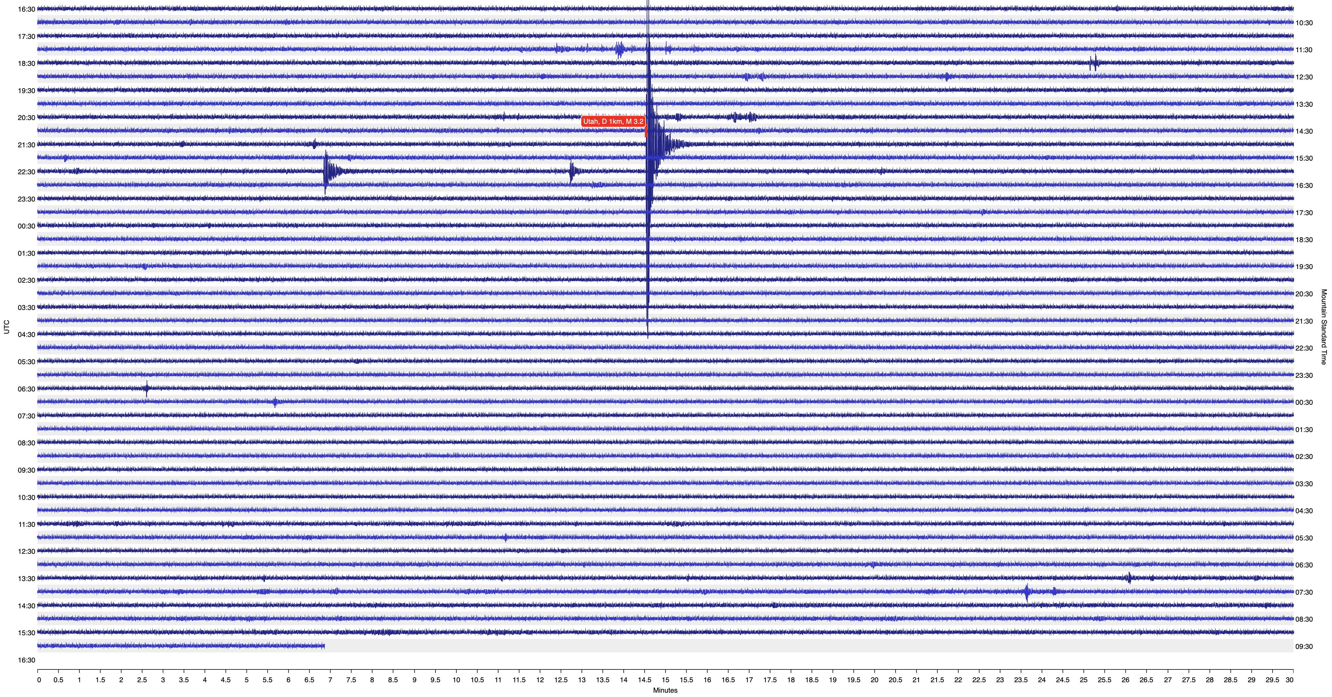
What is geophysics?

Slide 3
Brief Overview of Geophysics:
A VERY large discipline that includes:
Atmospheric Science (Meteorology, Climatology, & above...)
Hydrology, Glaciology
Oceanography
Planetary Science
• Solid Earth Science
Solid Earth geophysics includes:
Geodynamics
Geodesy
Earthquake Seismology
Mineral Physics
• Subsurface Imaging
This course will emphasize the lattermost subdiscipline

Slide 4
Two Career Tracks in Geophysics:
Academic/Research (PhD):
• Universities
(Teaching &/or Research)
• Federal Agencies
(USGS, NOAA, NIST, NASA,
DHS, DoD, EPA)
• Government Labs
(Lawrence Livermore NL,
Los Alamos NL, Pacific NL…)
• Industry
(Petroleum/Natural Gas,
Mining, Contractors to PNGM
& Defense, e.g. SAIC)
AGU ~130,000 members;
Industry: (MSc, PhD)
• Energy
(Petroleum, Natural Gas,
Coal, Geothermal)
• Mining
• Environmental &
Construction Contractors
• Et al…
(Problem-solving skills
from geophysical
training has benefited
many entrepreneurs…)
AAPG ~38,000 members
SEG ~14,000 members

Slide 5
We recognize most of you who are taking this course
have no intention to pursue a career in geophysics!
But…
If you work in the solid Earth sciences (e.g., geology)
you will spend a lot of time looking at the types of
data that we discuss in this class.

Slide 6
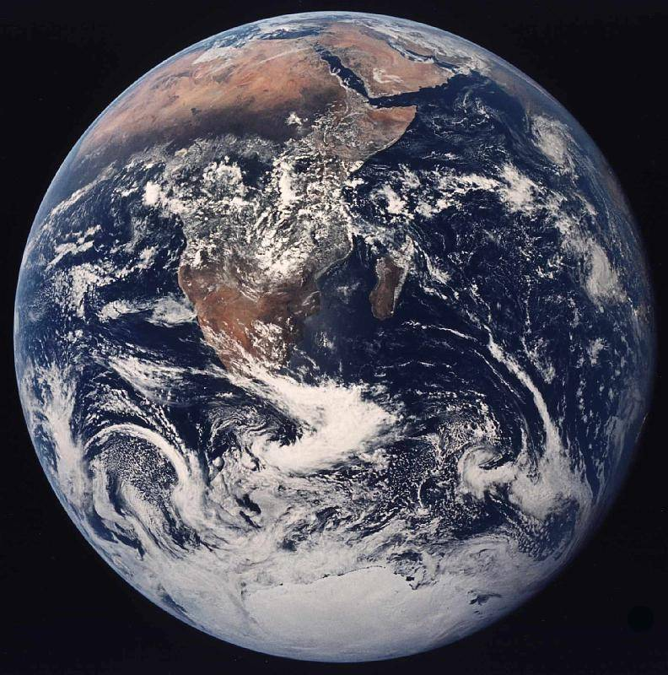
Geophysics = Geo + physics
• Highly
quantitative
• Applications-
oriented,
often with direct
societal impacts…
• Complex
problems
“Systems science”
⇒ often combines
elements of the
other physical
sciences including
physics, chemistry,
biology, …

Slide 7
Geophysics is a specialized set of mathematical &
physical tools for measuring and modeling Earth
(or planetary) processes…
Geophysical imaging provides two main types of
information:
Images of Structures
(e.g., dip of a surface)
Physical Properties
(e.g., impedance contrast ⇒ composition? fluids?)
Newer applications also use imaging to track changes in
subsurface properties through time (e.g. production
monitoring in oilfields).

Slide 8
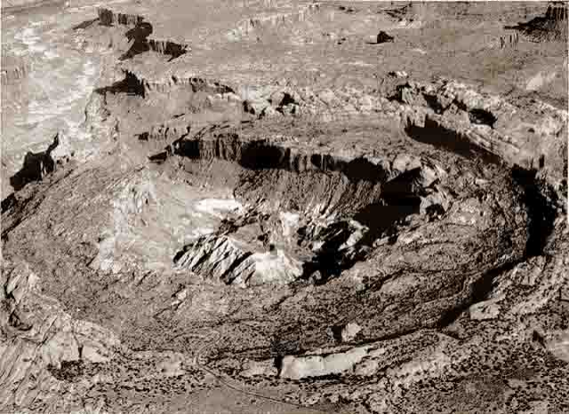
Seismic Reflections* from Upheaval Dome:
Salt Dome or Eroded Impact Structure?

Slide 9
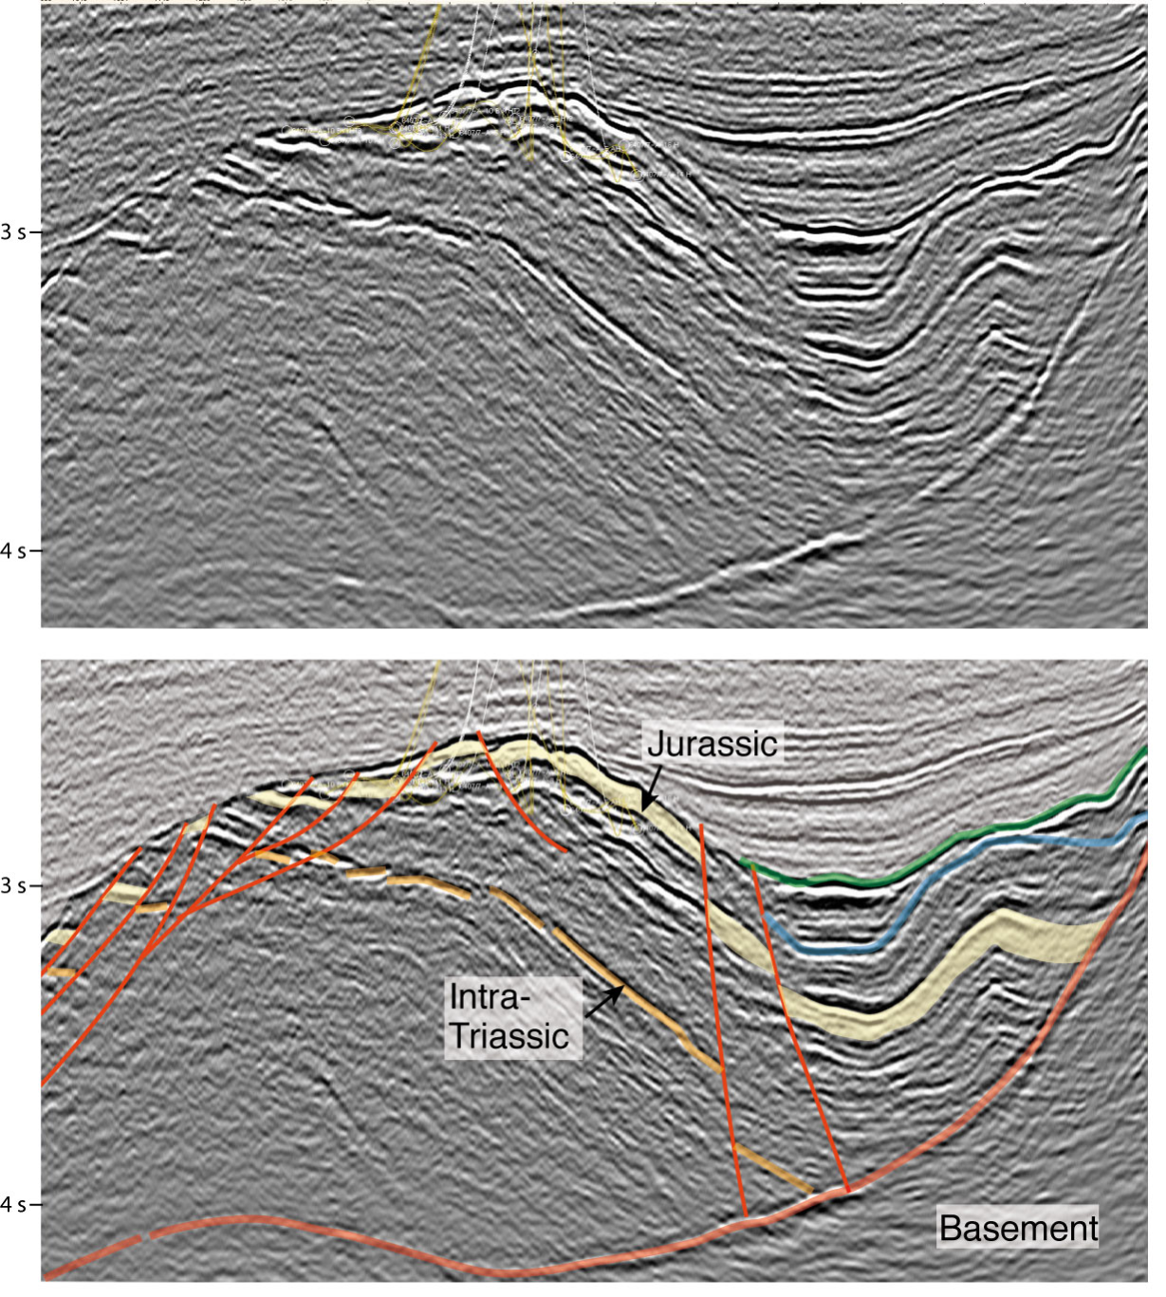
Seismic
Reflections*
*Sound waves reflect
from points in the
subsurface where rock
elastic properties change
(⇒ change in rock type,
porosity, fluid type, etc.).
Energy returns (or
“echos”) are migrated
to the approximate
spatial location of the
reflection source to form
an image of the
subsurface.

Slide 10
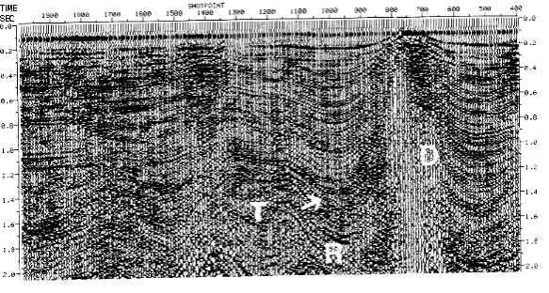
Seismic Reflections* from Upheaval Dome:
Salt Dome or Eroded Impact Structure?
Salt diapir imaged using 1960’s era seismic in the Gulf of Mexico

Slide 11
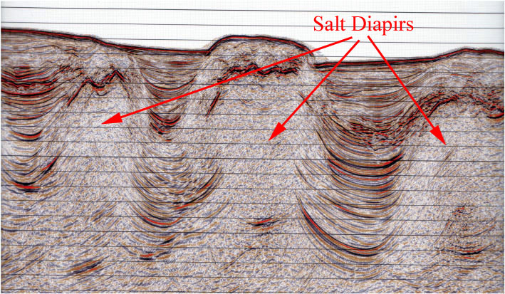
Seismic Reflections* from Upheaval Dome:
Salt Dome or Eroded Impact Structure?
Image courtesy Peter Clift, via AGU’s Georneys blog
Salt diapirs imaged with more modern seismic, offshore Brazil

Slide 12
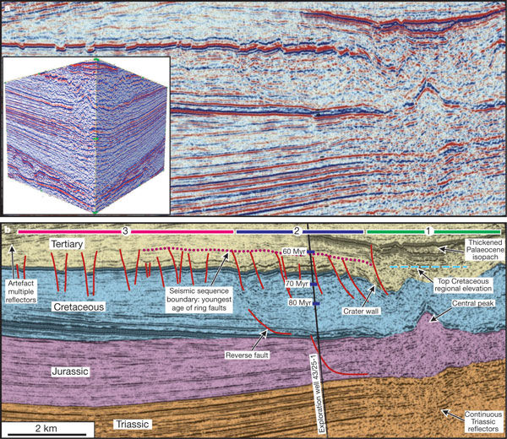
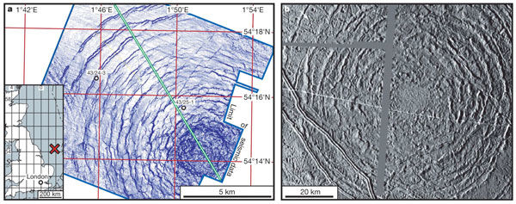
Imaging of Silverpit crater,
North Sea east of UK
(from Stewart & Allen,
Nature, 2002)

Slide 13
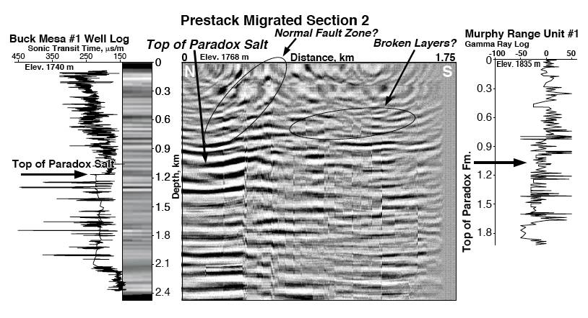
Seismic Reflections* from Upheaval Dome:
Salt Dome or Eroded Impact Structure?
From Kanbur et al., J. Geophys. Res. Planets, 2000

Slide 14
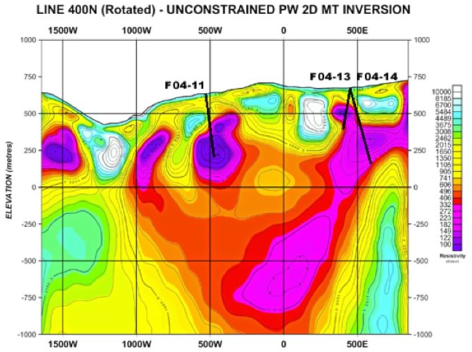
Magnetotelluric resistivity image of a mining claim
in Quebec, Canada

