Slide 1
Geology 5660/6660
Applied Geophysics
8 Mar 2024
Last Time: Ground Penetrating Radar
• Radar reflections image variations in Dielectric permittivity
(real part ε = permittivity)
→ 3-40 for most Earth materials;
→ higher when H₂O &/or clay present
• Radar attenuation similar to seismic: where:
→ higher for clay, silt, brines; limits imaging to upper few m
• Velocity is not estimated (rather depth is approx. from ~V)
→ (but can be estimated from
NMO or diffraction moveout!!!)
• Standard “processing” includes static corrections for
elevation, filtering, AGC
For Mon 18 Mar: Burger 349-378 (§6.1-6.4)
© A.R. Lowry 2008-2024

Slide 2
Introduction to Gravity
Gravity, Magnetic, & DC Electrical methods are all examples
of the Poisson’s equation of the form:
∇²u = f (sources),
where u is a potential,
is the gradient operator
Notation: Here, the arrow denotes a vector quantity;
the carat denotes a unit direction vector.
Hence, the gradient operator is just a directional form of slope…
Because Poisson’s eqn always incorporates a potential u,
we call these “Potential Field Methods”.
→
^

Slide 3
Gravity
We define the gravitational field as
And by Laplace’s equation,
(1)
given a single body of total mass M; here
G is the universal gravitational constant = 6.672x10⁻¹¹
Integrating equation (1), we have
(2)
Nm²
kg²
→

Slide 4
IF the body with mass M is spherical with constant density,
equation (2) has a solution given by:
Here r is distance from the center of mass;
is the (unit) direction vector pointing toward the center.
Newton’s Law of gravitation:
So expresses the acceleration of m due to M!
has units of acceleration ⇒ Gal in cgs (= 0.01 m/s²)
On the Earth’s surface,
m/s²

Slide 5
HOWEVER, ρ is not radially symmetric in the Earth…
so is not constant everywhere at the surface!
Gravity methods look for anomalies, or perturbations,
from a reference value of at the Earth’s surface:
g_{obs}
g_{ref}
ρ₁
ρ₀

Slide 6
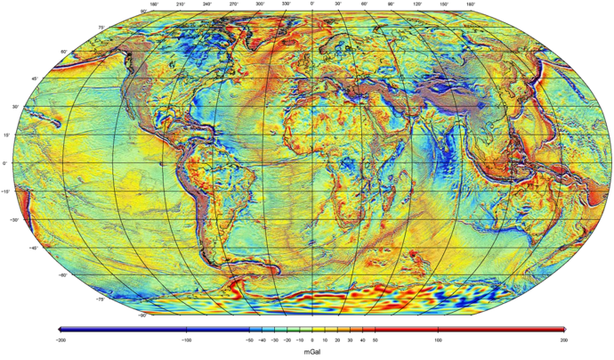
Example:
Global Free-Air Gravity Field from GRACE + GOCE + satellite altimetry + surface measurements…
WGM2012 model from Bureau Gravimetríque International

