Slide 1
Geology 5660/6660
Applied Geophysics
9 Feb 2024
Last time: Refraction in Non-Ideal Media:
• Plus-Minus Method for arbitrarily changing h:
→ where m– is slope of a plot of t_{1i}–t_{2i} vs x_{i} for SP1, 2 and
geophones i
The Reflection Seismic Method:
• Seismic Reflection Travel-Times have eqns of a
hyperbola. For a single layer,
has intercept 2h₁/V₁ and
slope of the asymptote is 1/V₁!
• Defined Normal Move-Out (NMO) as the reflection
travel-time at distance x minus the intercept (t at x = 0):
(NMO is used to shift reflection arrival times and make two-way travel time images!
Read for Wed 7 Feb: Burger 167-199 (§4.2-4.3)
© A.R. Lowry 2008-2024

Slide 2
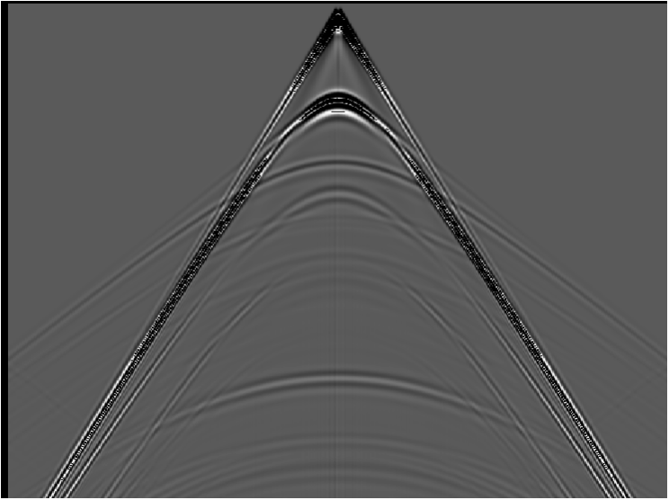
Distance
water
shale
gas sand
shale
Two-Way Travel Time

Slide 3
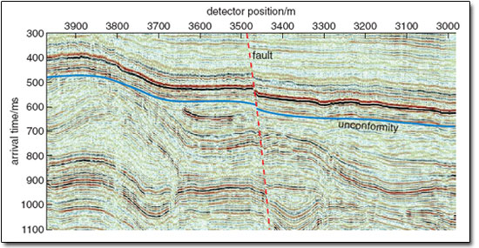
Shifting the seismic reflection amplitude to where it would be
(in two-way travel-time) for zero-offset produces an image…
Note that this approach is VERY different from the model of
velocity structure we generate from the refraction method!

Slide 4
Reflection from a second layer interface over half-space:
x/2
V₁
h₁
V₂
h₂
Can derive using Snell’s law, but easier to consider that:
For x = 0, ⇒ intercept of hyperbola
For x → ∞, asymptotic to the layer 2 refraction

Slide 5
Equation for the hyperbola then can be written as:
Note here that t₀ is the intercept time for the refraction arrival; i.e., the asymptotes to the hyperbola are shifted in time relative to the t = 0 axis!
After some algebra we have
And you might see where the algebra could start to get
complicated for 3, 4, … layers
This is part of why industry seismic reflection processing
historically did not go after full seismic velocity analysis
but instead sought shortcuts to image structures…

Slide 6
A Dipping Reflector:
V₁
h₁
α
α
Geometrically, this is equivalent to rotating the axis
of the reflector by the dip angle α. This rotates the
hyperbola on the travel-time curve by θ = tan⁻¹(–2h₁sinα)
and has equation

Slide 7
Example: V₁ = 1500, h = 45 m, α = 8°
Helpful Hint : Reflect does not model dipping layers, but
the Table 4-6 Excel spreadsheet does! The textbook
spreadsheets are also available in the zipfile on Canvas…

Slide 8
Getting velocity structure: The x² – t² method
If we have travel-times from a reflection, can plot t² vs x²
to get parameters of thickness & velocity from slope
and intercept of the resulting line fit!
Recall that the goal of geophysics is to invert for
parameters (in this case, velocity and thickness)
Given travel-times from a reflection, can plot t² vs x²
to get parameters of thickness & velocity from slope
and intercept of the resulting line fit.
For the single layer case:

Slide 9
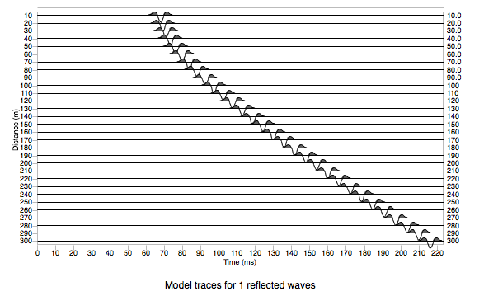
So for slope m, intercept t₀² of a line fit:
t
t²
x
x²

Slide 10
Note x² – t² method is also useful for dipping layers!
θ
down-dip
limb
mean
slope
t
t²
up-dip
limb
x
x²

Slide 11
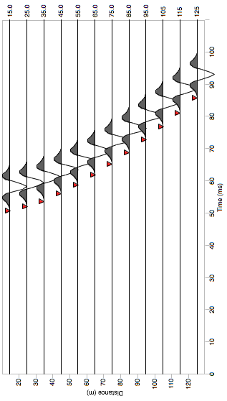
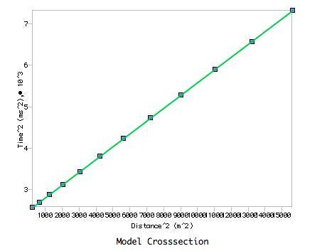
This single-layer approximation
is the approach taken to inverting
data in Reflect !

Slide 12
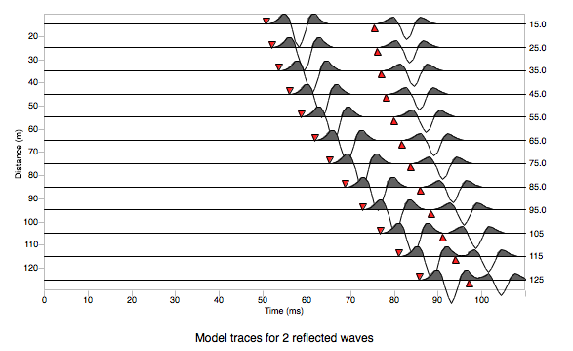
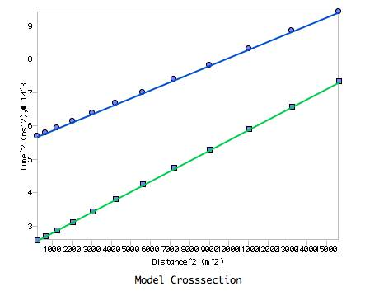
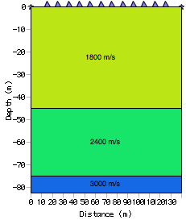
Also works for multiple layers–
However instead of explicitly
solving e.g.:
We use an approximation called
the Dix Equation

