Slide 1
Geology 5660/6660
Applied Geophysics
9 Feb 2026
(NMO is used to shift reflection arrival times and make two-way travel time images!
Last time: The Reflection Seismic Method:
• Seismic Reflection Travel-Times have eqns of a
hyperbola. For a single layer,
has intercept 2h₁/V₁ and
slope of the asymptote is 1/V₁!
• Defined Normal Move-Out (NMO) as the reflection
travel-time at distance x minus the intercept (t at x = 0):
• A second (or more) layer reflection involves messy
algebra to represent exactly using Snell’s law!
• For a single dipping layer,
Read for Wed 11 Feb: Burger 167-199 (§4.2-4.3)
© A.R. Lowry 2008-2026

Slide 2
Last time continued: Seismic Reflection Method:
• x² – t² Method : On a plot of t² vs x², for a single layer:
• For dipping layer: Mean slope is ; limb separation
⇔

Slide 3
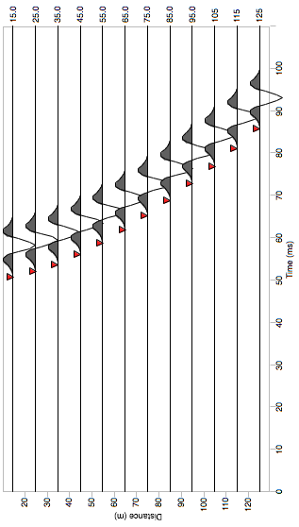
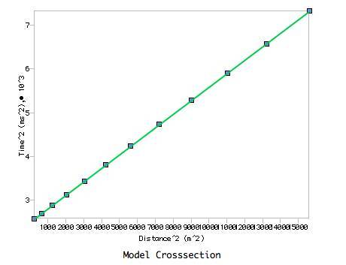
The x² – t² Method plus an assumption of
a single-layer approximation is the
approach taken to inverting data in Reflect!

Slide 4
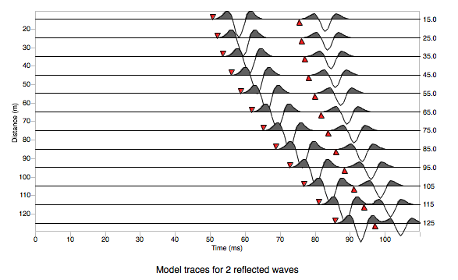
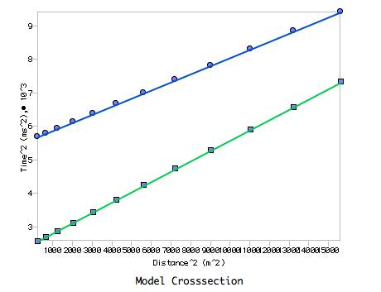
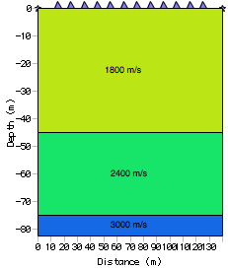
This also works for multiple layers–
However instead of explicitly
solving e.g.:
We use an approximation called
the Dix Equation

Slide 5
First, consider Green’s method: Recall the multiple layer case:
x/2
V₁
h₁
V₂
h₂
Solving for path length in each layer using Snell’s law
results in a complicated function of all velocities &
thicknesses…
Green’s method: Uses x² – t² and ignores bending of
the ray to get approximate thicknesses and velocities of
second, third etc layers using the single-layer equation…

Slide 6
First, consider Green’s method: Recall the multiple layer case:
x/2
V₁
h₁
V₂
h₂
Green’s method:
Inverse velocity, weighted by layer thickness
over total thickness
Distance

Slide 7
Dix’ Equation: x² – t² has slope 1/V ², so we can improve
slightly on Green’s method by defining a weighted
root mean square (RMS) velocity for n layers
as:
Here Δt_{i} is the one-way vertical
travel-time through layer i, i.e.,
Then on an x² – t² plot, we approximate with the linear equation:
for layer n
;
;

Slide 8
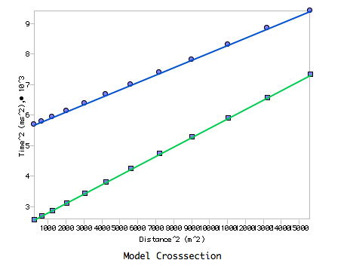
This means we can
solve for both the
velocity and thickness
in any layer for which
we have a reflection
above & a reflection
below, using observed
parameters of a
line-fit on an x² – t²
plot!
slope
intercept
slope
intercept

Slide 9
Caveat:
Recall that Dix’ equation is an approximation.
After refraction in overlying layers, reflections from the 2nd+
interface are no longer truly hyperbolic… e.g. (2-layer case)
contains a (t² – 2Ct + C ²) term.
Generally, approximation is good for small offsets, poorer
when source-receiver separation x is larger.
(We ignored this.)

Slide 10
Normal Move-Out and the dipping layer problem:
Recall our definition of NMO for a single horizontal layer:
We can write:
The binomial theorem tells us that:
So letting and , and assuming z << 1
(i.e. ) then
(An equal-sign with a dot over it denotes truncation of an infinite series!)
and

Slide 11
Note: If x is not << 2h, we could expand the series further…
(but that adds computation)
This from the text,
using a 1500 m/s
velocity in a 30 m
thick layer…
Why express the reflection travel-time this way if it is
inaccurate?
Because now we can write T_{NMO} in terms of the (observed) t₀
and (one) unknown velocity!

Slide 12
NMO correction can be applied to multiple layers using the
Dix equation approximation for V_{rms}:
But what about dipping layers?
V₁
h₁
α
Recall our dipping
layer problem: We can write
α

Slide 13
Using the same binomial thm approach we used for a horizontal layer,
can be expanded and truncated as
Recall the x² – t² plot for a
dipping layer: Could average
to get a line with
slope 1/V₁², and the difference
between the line and the limbs
related to the dip angle:
down-dip
limb
mean
slope
t²
up-dip
limb
x²

Slide 14
Binomial series approximation:
We can
similarly use
the (observed)
difference
between
up-dip &
down-dip NMO
to estimate dip
via:
mean
down-dip
limb
T_{NMO}
up-dip
limb
x

