Slide 1
Geology 5660/6660
Applied Geophysics
10 Apr 2024
Last Time: Electrical Resistivity
• DC Resistivity: inject electrical current across two (source
& sink) electrodes, measure voltage difference ΔV across two
others.
• Given known distances r between current electrodes (+ = 1, – = 2)
and voltage measurement electrodes (+ = a, – = b) and a known
injection current I, the apparent resistivity ρ_{app}:
is an expression of the measurement that assumes the
medium has constant resistivity ρ (but in reality it is a “weighted
average” of the subsurface resistivity).
For Wed 12 Apr: Burger 265-301 (§5.1-5.4)
© A.R. Lowry 2008-2024

Slide 2
Electrode Arrays: Spatial placement of the electrodes
Wenner Array: (common in older surveys; we used this
last Thursday…)
I
a
V
a
a
Constant spacing (“a-spacing”):
r_{1a} = r_{2b} = a r_{1b} = r_{2a} = 2a

Slide 3
Wenner-Lee Array:
a
I
V₁
a
a
V₂
V₃
Additional voltage measurements to a center electrode
reduce sensitivity to near-surface resistivity variations
Schlumberger Array:
2s
I
V
a
Also less sensitive to near-surface resistivity variations,
& required half the effort to move electrodes for
sounding studies (of vertical changes in resistivity)

Slide 4
Dipole-Dipole Array:
I
V
Requires larger current source, but fairly common now
with the development of multichannel instruments
Pole-Dipole Array:
I
r₁
V
r₂
Most sensitive to resistivity in the shell between radii
r₁ & r₂ – commonly used for tunnel/karst detection

Slide 5
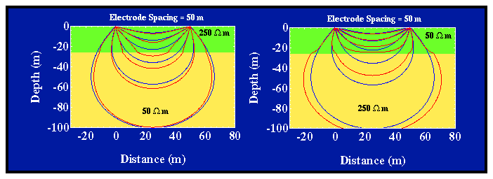
Modeling:
ρ₁
ρ₂
Current penetration for a layer over half-space:
Fraction of total current that penetrates below depth
of an interface, z, is (for a Wenner array):
a is electrode spacing,

Slide 6
ρ₁
ρ₂
k = –0.67; z = a/2
k = 0.67; z = a/2
z = a
z = 3a/2
z = 3a

Slide 7
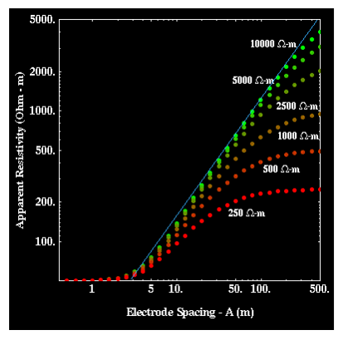
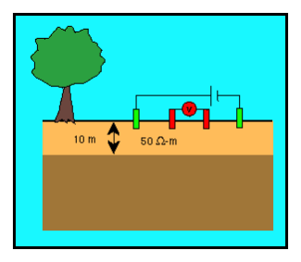
Apparent resistivity for a layer over halfspace: For Wenner
array, given by:
Sounding increases the a-spacing without changing the array center, to reflect larger volumes and hence deeper structure!

Slide 8
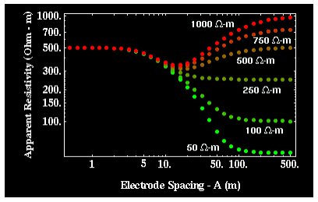
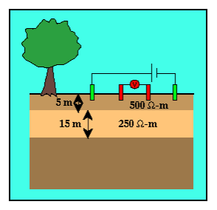
Apparent resistivity for the two-layer over half-space case:
for various half-space resistivity values.

Slide 9
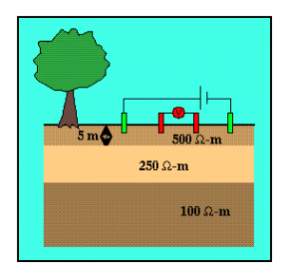
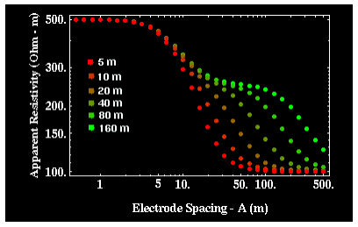
Apparent resistivity for the two-layer over halfspace case:
Dependence of apparent resistivity on thickness of middle layer

Slide 10
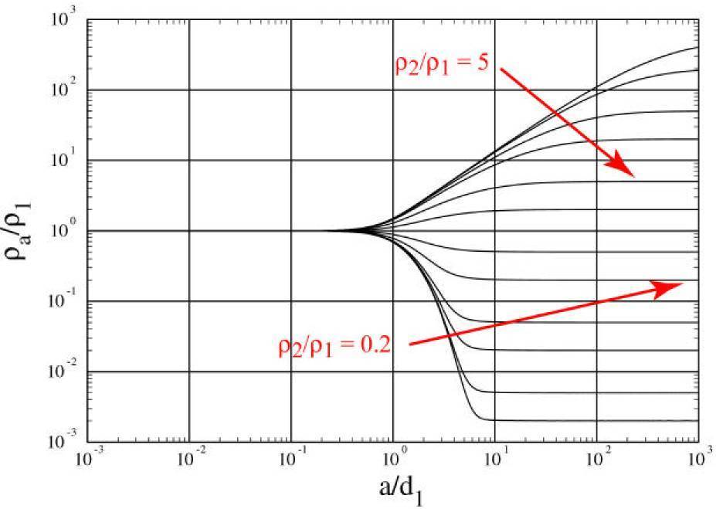
“Universal Curves"
Wenner array ρ_{app} depends only on ρ₂/ρ₁, a/d₁ for layer over a
halfspace

Slide 11
For 3+ layers:
Rule of thumb: if layer thickness < 0.1 the depth to top of
layer, it cannot be resolved
But also depends on resistivity contrast (thicker layers may
not be resolved if contrast is too small; transition of
apparent resistivity versus a-spacing is much sharper for
a resistive layer over a conductive layer than for the
opposite).
When layer thickness is small relative to depth-to-top,
solution from sounding can be highly non-unique

Slide 12
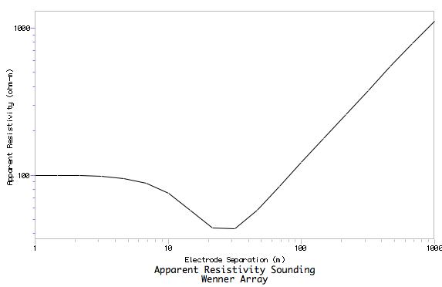
Resist does either Wenner or Schlumberger array for
vertical sounding only (horizontal layers); and is
somewhat less adaptable than the other Burger programs
ρ = 100 Ω m
10 m
(Particularly because of
forced logarithmic
variation of a-spacing)
(Worth noting though that the Burger Excel spreadsheets are much more flexible & adaptable!
ρ = 10 Ω m
10 m
ρ = 500 Ω m
10 m
ρ = 10000 Ω m

Slide 13
Profiling maintains constant a-spacing while moving the
array laterally. Wenner array ρ_{app} for a vertical contact:
I
V
ρ = 100 Ω m
ρ = 10 Ω m

Slide 14
Sounding maintains a constant center while increasing
the a-spacing. Wenner array ρ_{app} for a vertical contact:
I
V
x
ρ = 100 Ω m
ρ = 10 Ω m

Slide 15
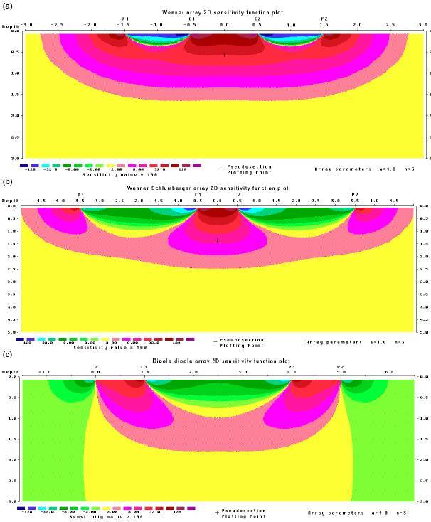
“Sensitivity kernels”
for apparent
resistivity (assumes
a homogeneous
Earth model). This is
a measure of how
much a perturbation
of resistivity at a given
point in the Earth can
be expected to change
the measurement of
apparent resistivity of
the array (reds positive,
blue-greens negative,
yellow ~ zero).

