Slide 1
Geology 5660/6660
Applied Geophysics
10 Apr 2026
Last Time: Intro to DC Electrical Resistivity
• DC Resistivity: inject electrical current across two (source & sink)
electrodes, measure voltage across two others.
• Material property imaged is rock resistivity:
→ Low for clays, shales, graphite; intermediate for soils/unconsolidated
sediments; high for consolidated sediments and crystalline rocks
→ Sensitive to sulfides, temperature, pore fluids
• Given known distances r between current electrodes
(+ = 1, – = 2) and voltage measurement electrodes
(+ = a, – = b) and a known injection current I, the
apparent resistivity ρ_{app}:
is an expression of the measurement that assumes the
medium has constant resistivity ρ (but in reality it is a “weighted
average” of the subsurface resistivity).
For Mon 13 Apr: Burger 302-340 (§5.5-5.11)
© A.R. Lowry 2008-2026

Slide 2
Last Time continued: DC Electrical Resistivity
• Electrode Arrays:
→ Wenner (constant spacing):
→ Wenner-Lee (local voltage measurements)
→ Schlumberger (move only current
electrodes):
→ Dipole-dipole
→ Pole-dipole (simple approach for tunnels/karst)
• In a layered medium, current penetration into a
second layer depends on depth of the layer interface
& resistivities as:
where

Slide 3
Last Time continued: DC Electrical Resistivity
• One-Dimensional Sounding:
→ Layer-over-halfspace: Wenner ρ_{app} ~ ρ₁ for a/z small;
~ ρ₂ for a/z large
→ Two layers over halfspace: May or may not pick up
sandwiched layer depending on thickness, contrast
→ Resist does multiple layers, 1D, log a-spacing steps
• Profiling: Vertical contact: ρ_{app} depends on where resistivity
contrasts occur relative to electrodes
• Sensitivity kernels: + resistivity anomalies increase ρ_{app}
unless they occur between a current and voltage electrode!

Slide 4
Field Exercises on Sunday:
• Meet at the loading dock at 10 am
• Dress for a ~ 6–8 hours in the field (layers, sunscreen,
chance of rain!)

Slide 5
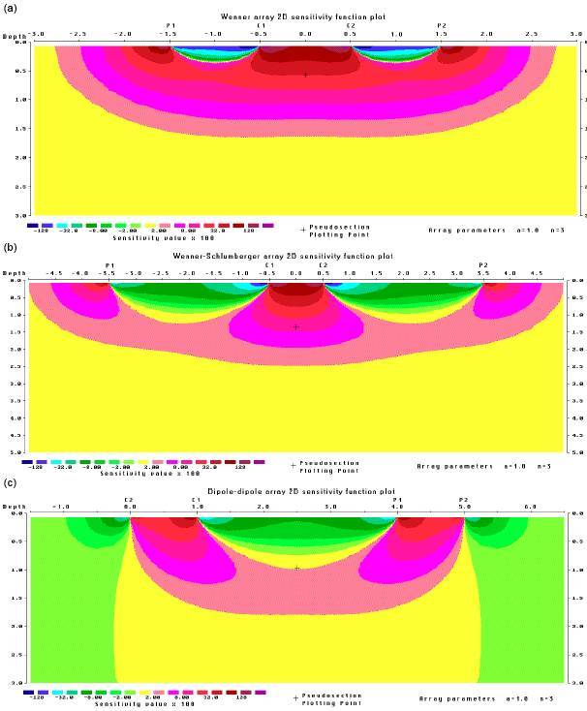
“Sensitivity kernels”
for apparent
resistivity (assumes
a homogeneous
Earth model). This is
a measure of how
much a perturbation
of resistivity at a given
point in the Earth can
be expected to change
the measurement of
apparent resistivity of
the array (reds positive,
blue-greens negative,
yellow ~ zero).

Slide 6
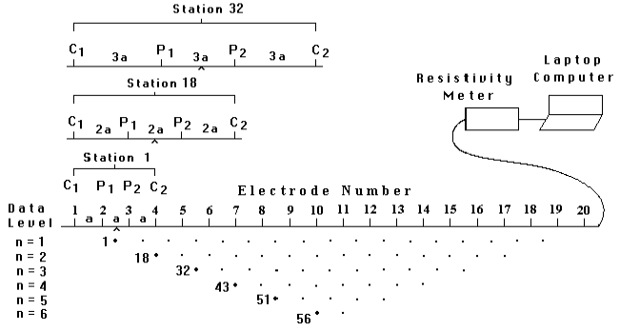
Resistivity “Pseudosection”:
Measurements are a combination of profiling (different x) &
sounding (different a-spacings)
Plot / contour ρ_{app} versus distance x and a-spacing increment
n, where n = a/a₀ and a₀ is smallest a-spacing

Slide 7
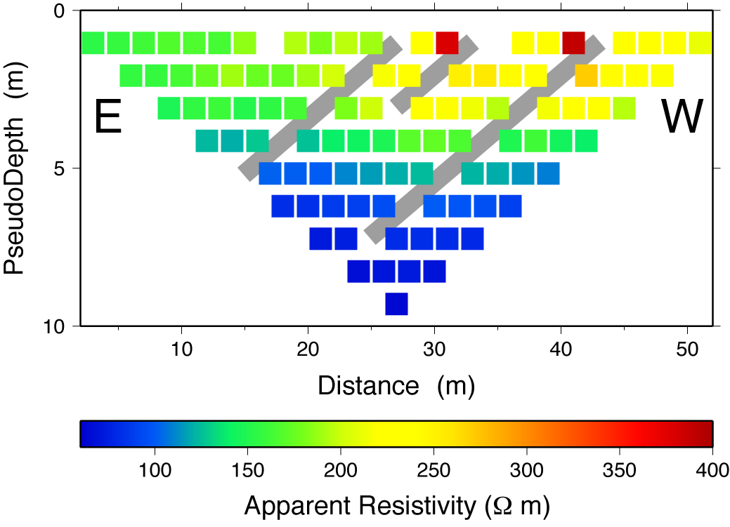

(This image from the West Cache fault, collected
in 2012, is an example of an apparent resistivity
pseudo-section):

Slide 8
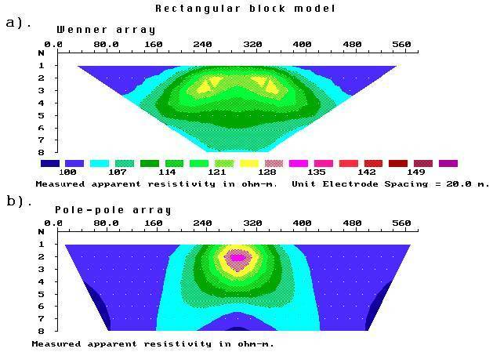
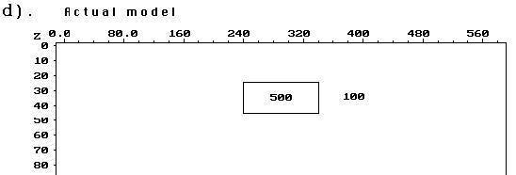
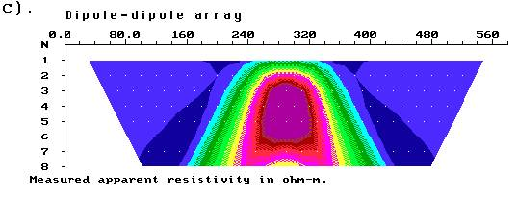
Clear from the
earlier modeling
of Wenner array
apparent resistivity
across a vertical
contact that this
approach can
give a VERY
approximate image
with potential for
a lot of “false”
anomalies…

Slide 9
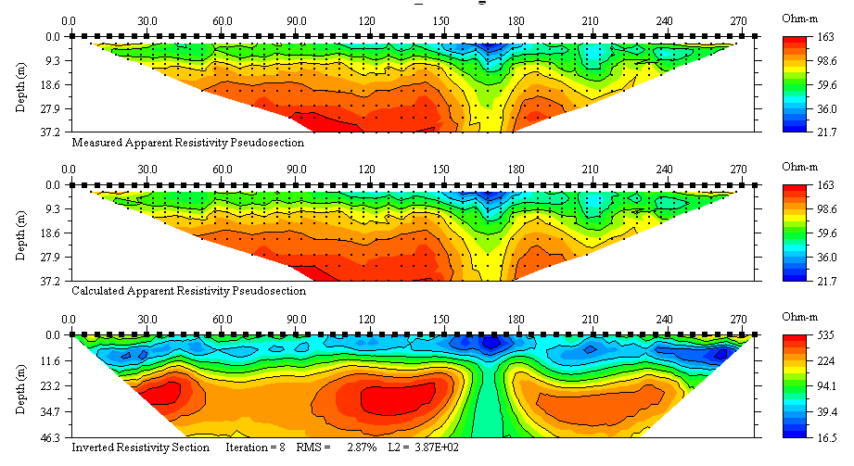
Note the change in scaling of the colorbars from pseudo-sections to inverted image!!!
(Calculated from the inverted model)
True inversion of the data will yield a much more accurate
image (for much the same reasons that depth migration
does in the seismic case!)

Slide 10
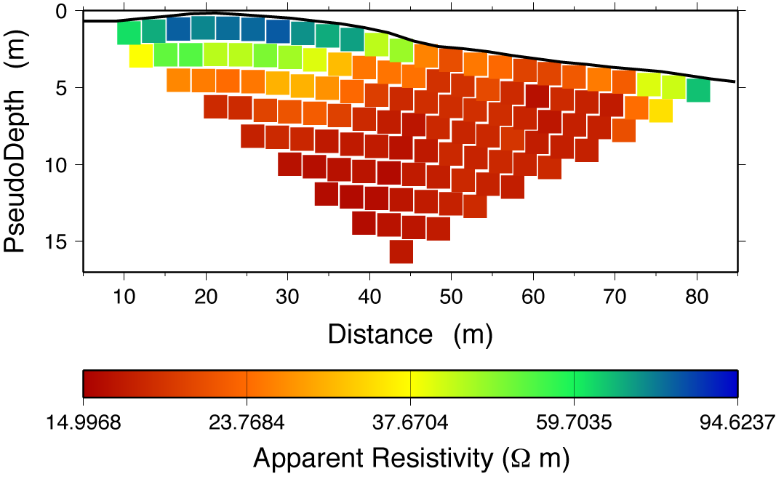
Resistivity pseudosection from the western trench location
for the East Cache Valley fault zone near Paradise…

Slide 11
Using resistivity sounding for a two layer model:
ρ₁ = 101 Ω m, h = 3.22 m
ρ₂ = 16.7 Ω m
RMS Misfit 1.897 Ω m
Vertical sounding at 25.7 m. Maroon line is measured; blue line
modeled using Excel spreadsheet based on Burger’s Table 5-4.

Slide 12
Can model equally well by using constant thickness and
varying the resistivities, or using constant resistivities &
varying the thickness…
Because these data did not go to a small enough a-spacing
to nail down ρ in the upper layer.
ρ₁ = 101 Ω m, h = 1.72 m
ρ₂ = 16.7 Ω m
RMS Misfit 0.847 Ω m

Slide 13
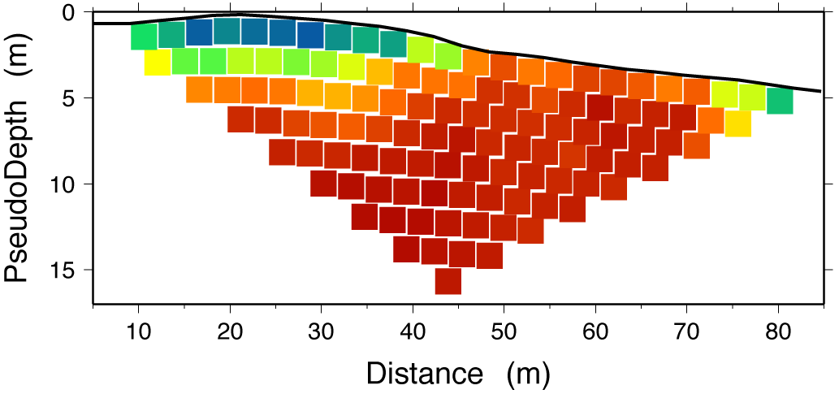
ρ₁ = 100
ρ₂ = 17
Layer-over-halfspace modeling suggested a variable-
thickness upper layer with ρ ~ 100 Ω−m (Bonneville deposits)
over ρ = 17 (Great Salt Lake fm). The data imply the trenched
geomorphology represents a beach burm deposit instead of
a fault scarp!

Slide 14
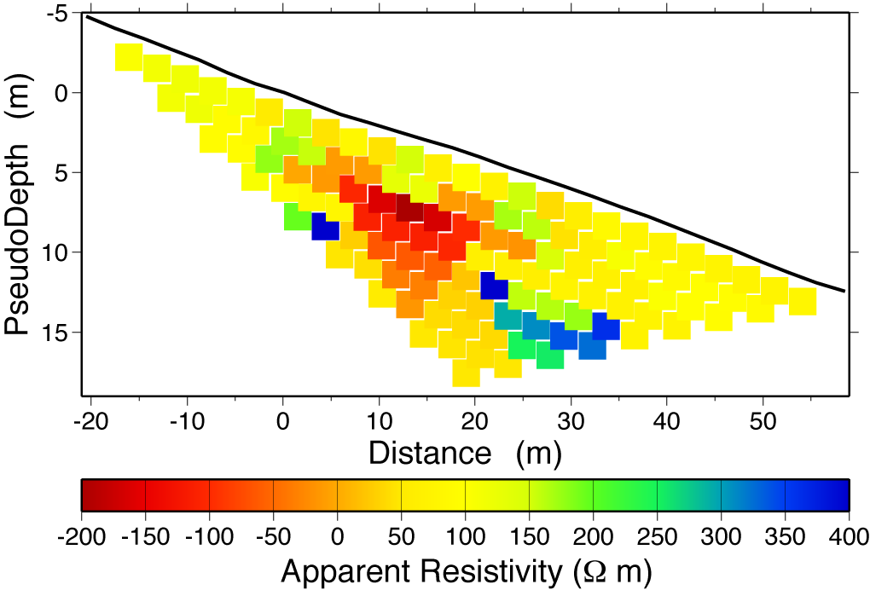
Little Mountain DC Resistivity Profile…

Slide 15
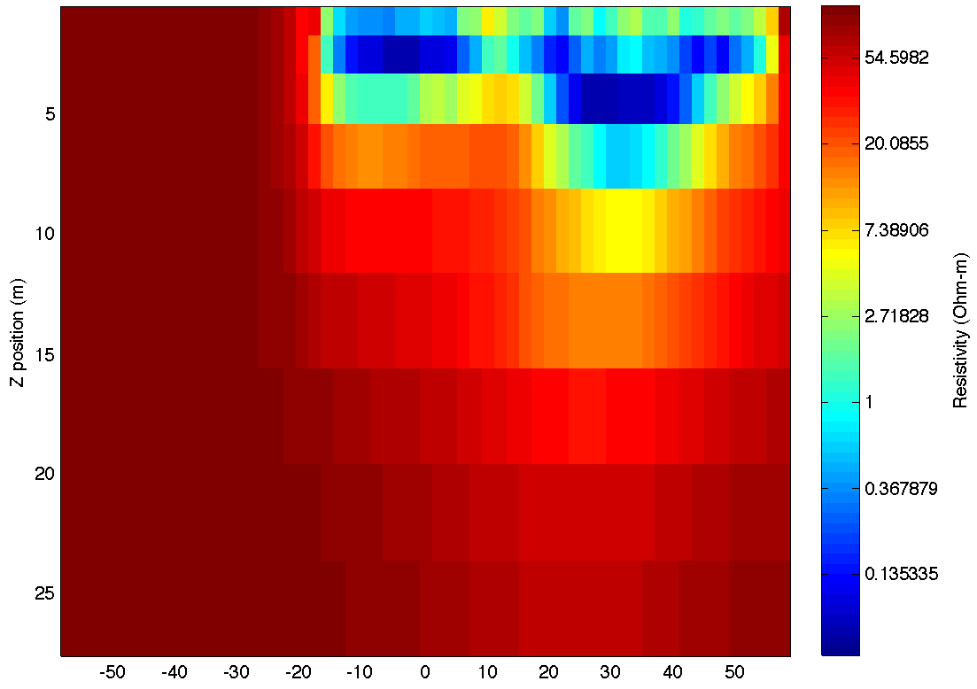
An inverted model of resistivity structure…

Slide 16
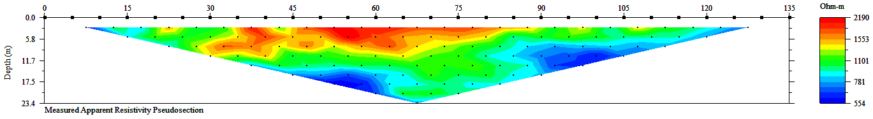
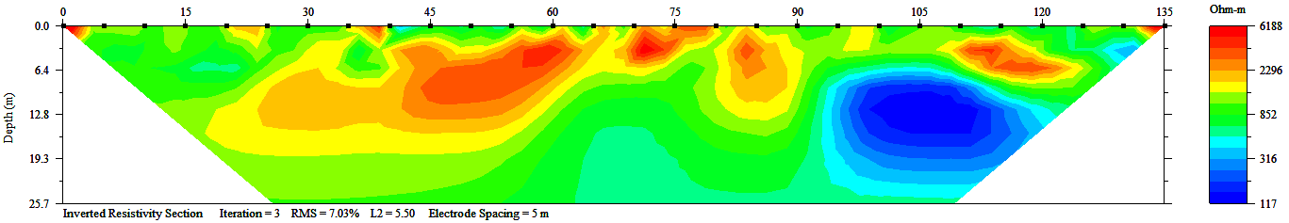
East Cache
fault in Green
Canyon
Pseudosection and inversion can be very
similar though…

Slide 17
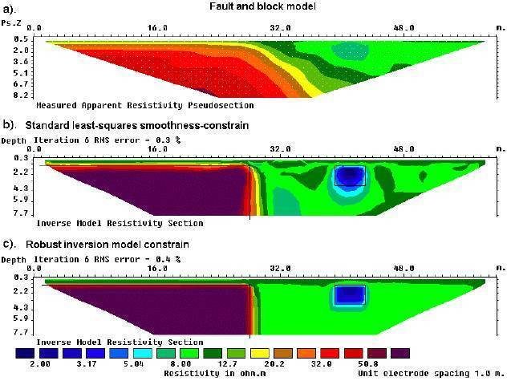

Slide 18
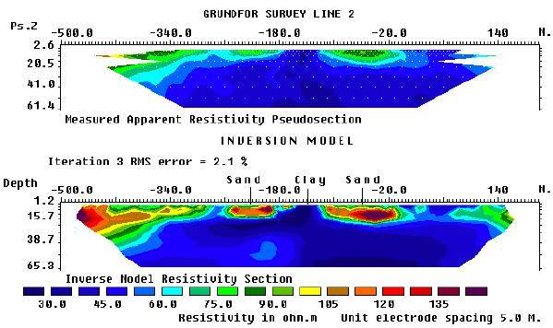
DC Resistivity: Applications
Lithology application: Sand vs. clay in a study of agricultural
groundwater contaminant plumes.

Slide 19
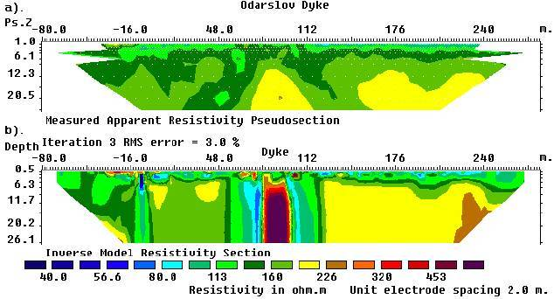
Mapping an intrusive dike feature…

Slide 20
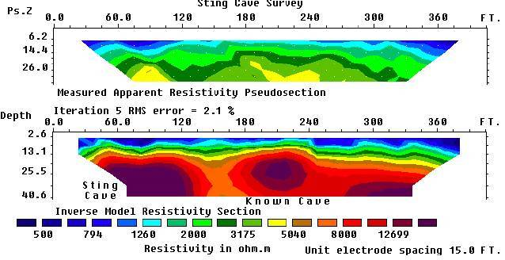
Mapping cave locations in karst terrain.

