Slide 1
Geology 5660/6660
Applied Geophysics
11 Feb 2026
Last Time: Seismic Reflection Methods
• Dix Equations for multiple layers:
approximates the true physics by neglecting a
t-to-the-first-power dependence in Snell’s law…
• But Dix’ equations enable us to use (observed) slopes and
intercepts in a t² vs x² plot to estimate velocities and
thicknesses of layers bounded by reflections
• Normal move-out can also be approximated from
(observed) t₀ and an estimated velocity as (e.g., 1st order):
Read for Fri 13 Feb: Burger 167-199 (§4.2-4.3)
© A.R. Lowry 2008-2026

Slide 2
Last Time Continued:
• Dipping Layer Problem:
→ Using Δt² on x²–t² plot: (works for 1-layer!)
→ Using T_{DMO} approximation on a T_{NMO} vs x plot:
(works for n-layers!)

Slide 3
Some practical considerations (a reminder!):
For x² – t² methods & Dix Equations:
Dix equation approximation of V_{rms} is most valid for
small-offset (near-vertical) rays; validity of approximations
decreases with distance (but increases with depth)
For reflection seismic in general:
NMO approximations in terms of t₀ require x << 2h (i.e.,
small-offset, near-vertical rays)
Reflections from shallow interfaces will be overwhelmed
by other arrivals at small-offsets

Slide 4
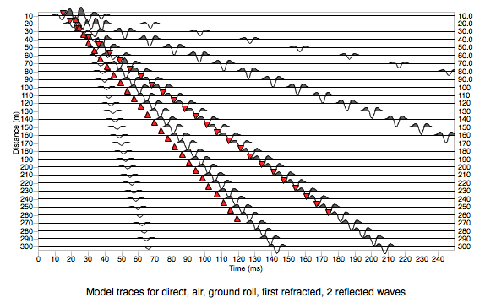
Burger refers to an “optimal window” at distances beyond
interference from low-V waves, but also must get beyond
direct & refracted wave interference to observe confidently
(Industry seismic)
Direct
Surface wave
Air wave
Refraction
“Optimal
window”

Slide 5
Practical considerations cont’d:
Multiples are waves that travel the two-way travel path
between two interfaces more than once:
Primary
Primary
Multiple
Multiple
Recognizable as having:
About twice the travel-time of the primary
The same apparent velocity but twice the thickness
from x² – t² analysis
Less move-out and lower amplitude than the primary

Slide 6
Practical considerations cont’d:
Multiples are waves that travel the two-way travel path
between two interfaces more than once:
Multiple
Primary
Multiple
The furthest reflection image point for a primary reflection
is ~half the distance to the furthest geophone…
But the furthest image point for a first multiple extends to
¾ the distance (and higher multiples further!). Thus,
multiples (if used!) can extend the profile imaging aperture.

Slide 7
Diffractions: Recall diffractions in the refraction method:
V₁
V₂
Observationally, impossible to distinguish diffracted arrival
associated with a step from a smooth thickness change over
one wavelength (10–20 m for 100 Hz)

Slide 8
Diffractions: In the reflection method, acts like a source!
x
x_{g}
V₁
h₁
r_{s}
h₂
The diffraction travel time is time t_{s} = r_{s}/V₁ from the source
to the step edge plus time t_{d} from step to geophone at a
distance x_{g} from the step

Slide 9
Worth noting: In migration of seismic data, we “migrate” travel-times
to what they would be for a zero-offset source by correcting for NMO,
but diffractions have a different moveout! After correcting for NMO,
twtt
(Smile!)
diffraction
(layer with offset)
(layer with no offset)

Slide 10
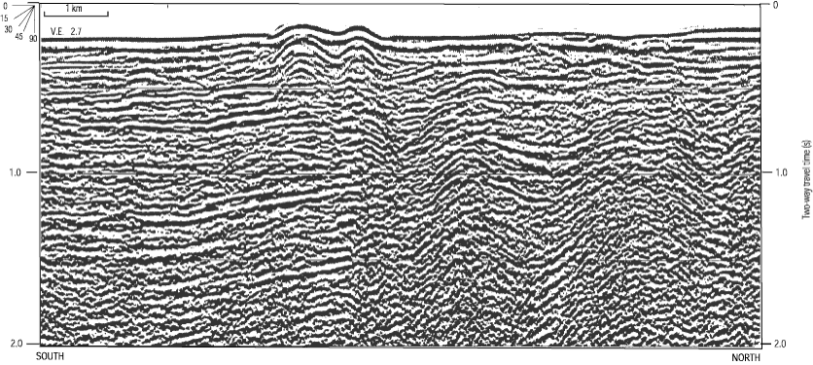
In typical seismic images we plot two-way travel-time
increasing downward (to simulate depth) so “smiles” are
flipped upside-down to form “frowns”
So (prior to diffraction migration processing!) these can
be a diagnostic tool to help recognize faults, salt diapirs
and other sharp lateral changes in velocity…

Slide 11
Some practical considerations continued:
Emphasize high frequencies to better differentiate from low-f
arrivals (e.g., surface waves) & to improve resolution
Vertical resolution: Recall V = fλ
(high frequency = short wavelength)
Theoretical limit of resolution for a thin bed is h = λ/4
(& in the practical limit h will be > λ/2)
λ = 10 m
h = 7.5 m
λ = 20 m

Slide 12
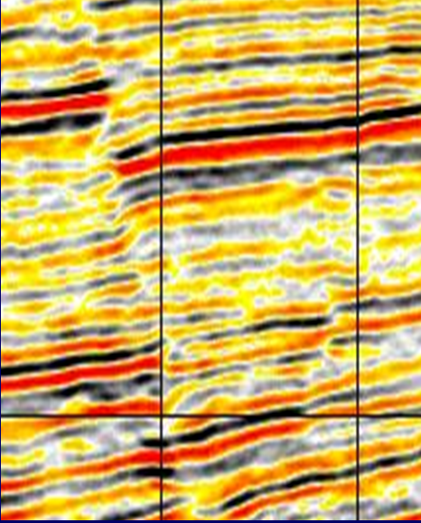
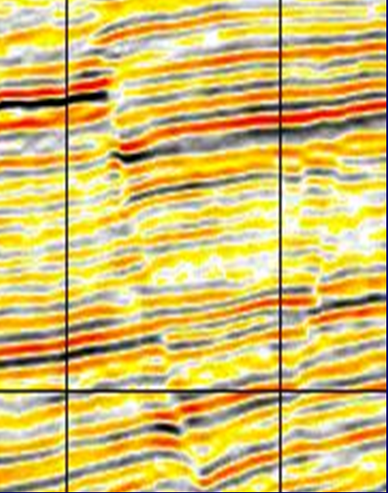
Well-Parameterized (Velocity)
Migration Enhances Resolution
These two images differ because of processing parameters, not source frequency… But note the difference in clarity for interpretation if the impedance contrast wavelets are “sharpened”
by emphasizing higher frequencies!
Standard Migration
High-end Migration
Courtesy of ExxonMobill

Slide 13
Frequency also determines horizontal resolution:
The first Fresnel zone (approximate area of the reflector
responsible for a signal) has radius
“Fresnel zone”
R
For V = 1500 m/s, f = 150 Hz, h = 20 m ⇒ R = 10 m

