Slide 1
Geology 5660/6660
Applied Geophysics
12 Jan 2024
Last time: Seismic Waves: A thought exercise
• The fundamental observable of seismic imaging is the
wave propagation velocity : V = Δx/Δt
• Different types of materials have different seismic velocities
that depend on both density & elastic properties …
(but predominantly the latter!)
A Wavefront is the surface of furthest wave disturbance
at a specific time t. A ray is the wave propagation direction
& is always normal to the wavefront!
Huygen’s principle: Every point on a wavefront can be
treated as a point source for the next generation of
wavelets
Read for Wed 17 Jan: Burger 1-21
© A.R. Lowry 2008-2024

Slide 2
How to use these powerpoints:
• Review them often: Before each class, while doing labs,
and prior to exams
• The most important points of each lecture (in my opinion)
are summarized on the first slide of the next lecture
• Note the notation!
→ Arial Black, italic means Important, pay
attention…
→ Arial Black, italic, red font means
Critically Important concept or terminology
that I expect you to understand intimately
for exams and labs
→ Times New Roman, italic, black font means this is an
equation or an algebraic variable
→ A Red Box with Grey Background means this is an
especially important concept or equation

Slide 3
Fundamental Concepts of Every
Geophysical Tool (each of which
we will cover in this course):
(1) Instrumentation
• How does it work?
• Sensitivity of instruments
• Types of information recorded
(e.g., seismometer: 3-component or vertical?
Broadband or narrow-band?
Acceleration, displacement, or strain?)

Slide 4
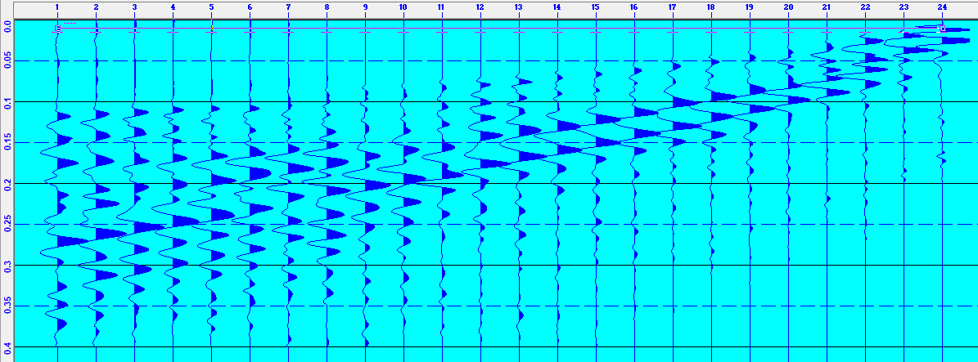
Our legacy hammer seismic…
And our newer hammer seismic…

Slide 5
Fundamental Concepts of Every
Geophysical Tool (each of which
we will cover in this course):
(1) Instrumentation
• How does it work?
• Sensitivity of instruments
• Types of information recorded
(e.g., seismometer: 3-component or vertical?
Broadband or narrow-band?
Acceleration, displacement, or strain?)
(2) Sampling
• In space and time (& what is aliasing ?)
(3) Theoretical development of methodology
• Assumptions?
• Approximations?
• “Skeletalization” of the data?

Slide 6
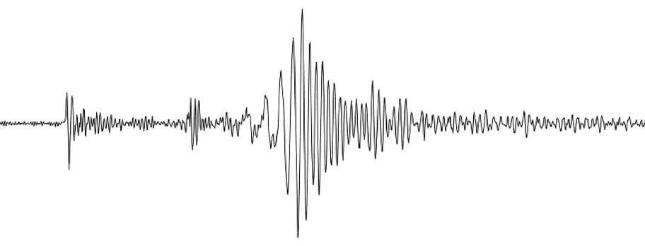
• “Skeletalization” of the data?
We might reduce the thousands of numbers in this record
to just one number…
But every number in this record contains information about
the structure of the Earth!

Slide 7
Fundamental Elements we will
cover in this course:
(4) Noise
• What are the sources of “unwanted” signal?
• How are these extraneous signals removed or
mitigated, and what else did we lose by doing that?
• Was it really unwanted in the first place?

Slide 8
Fundamental Elements we will
cover in this course:
(4) Noise
• What are the sources of “unwanted” signal?
• How are these extraneous signals removed or
mitigated, and what else did we lose by doing that?
• Was it really unwanted in the first place?
(5) INTERPRETATION
• Ambiguity and Artefacts
• What independent sources of geological and
geophysical information/knowledge/expectation
can be incorporated into the interpretation? (&
how can we avoid cognitive bias?)

