Slide 1
Geology 5660/6660
Applied Geophysics
12 Jan 2026
Last time: Course Overview
• Fundamental elements of each geophysical imaging tool:
➔Instrumentation (how it works; sensitivity; and what specific
types of observations it collects)
➔Sampling in both space and time
➔Theory (equations, assumptions, approximations, and
whether/how the data are skeletalized)
➔Noise (what is the noise source, how do we remove it, and
when is the noise… Not?)
➔Modeling & Interpretation (what is ambiguous in the data?
What features of an image could lead to misinterpretation?)
• Fundamental to theory are Partial Differential Equations...
Read for Wed 14 Jan: Burger 1-21
© A.R. Lowry 2008-2026

Slide 2
A Key Concept to Take Away From This Course:
Almost invariably, you will interpret properties
of the subsurface much, much more
accurately using data from two different types
of geophysical measurements than you will
from one…
And even better from three types than you will
from two.

Slide 3
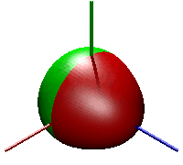
Seismology (A Brief Introduction)
Four useful types of Seismic Waves:
(1) P (primary) wave (Velocity V_{P} = 4 to 14 km/s)
(2) S (secondary) wave (V_{S} ≅ 2/5 to 3/5 V_{P}, or 0)
(3) Surface Waves (Love, Rayleigh) V slightly < V_{S}
(4) Normal Modes (Resonant “tones”, like a bell…)
→ continue for months after largest earthquakes
→ periods of minutes to an hour
→ “standing waves”
}
Body
Waves
Animation ₀S₃ from Lucien Saviot
http://www.u-bourgogne.fr/REACTIVITE/manapi/saviot/deform/
₀S₃: (25.7 minutes)

Slide 4
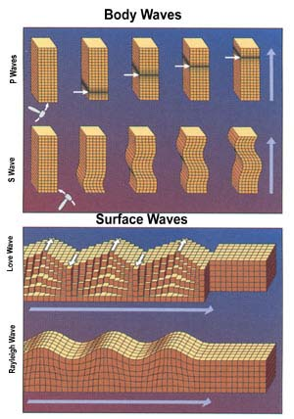
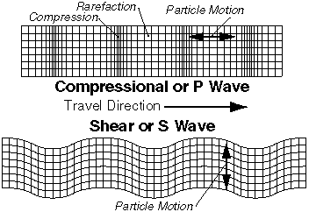
P
S
Surface (Love)
Surface (Rayleigh)

Slide 5

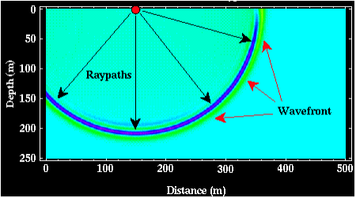
Seismic waves are strain disturbances
that propagate in a medium…
The text begins with an analogy to ripples in a pond. There is
similarity in that both are described by the wave equation;
both involve stress & displacements that propagate as
individual particles in the medium oscillate between potential
and kinetic energy states… But,
An important difference is rheology. Stress, displacement &
strain in a solid continuum are governed by Hooke’s Law.

Slide 6
Seismic waves are strain disturbances that propagate…
Elastic Rheology (Hooke’s Law):
Stress (= force per unit area) σ
and Strain (= change in shape) ε
are linearly related via
σ = cε
where c is an elastic coefficient (a material property).
Strain is a spatial derivative of displacement u
described by (in 1-D),

Slide 7
A quick “review” of various strains and their elastic constants:
Uniaxial compression:
Elongation
(change in
length l)
ε_{xx}
(strain)
ε_{yy}
Young’s modulus E:
σ = Eε_{xx}
applied σ
(elastic
constant)
Poisson’s ratio ν :
(elastic
constant)
(0 < ν < 0.5)
For dilatation θ (change in volume ΔV/V₀):
Bulk modulus K = ΔP/θ (where P is pressure)
(strain)
(elastic
constant)
applied σ_{s}
Shear rigidity modulus μ = σ_{s}/γ
ψ
γ = tanψ
(elastic
constant)
(strain)

Slide 8
Seismic waves are strain disturbances that propagate…
In seismology, it is most convenient to express elastic
properties in terms of Lame’s constants μ & λ.
These are not independent of the other elastic
parameters we’ve already seen: e.g.,
In fact, any of the five elastic constants can be
expressed in terms of any two of the remaining
elastic constants: I.e., there are only two independent
elastic moduli (for an isotropic solid ).

