Slide 1
Geology 5660/6660
Applied Geophysics
13 Feb 2026
Last Time: Seismic Reflection Methods
• Practicalities : Approximations valid for small offsets only; reflections
visible in optimal window; beware multiples! (which still can be
used to add information to imaging!)
• Diffractions: For a truncated layer boundary, travel-time
of the diffraction has different moveout than reflection energy
→ After migration, diffraction will remain as a “smile ” if twtt plotted
increasing upward (and in seismic section, shows up as a “frown ”)
• Resolution is frequency-dependent:
→ Vertical resolution is theoretically h ≥ λ/4 (but practical limit h > λ/2)
→ Horizontal resolution limit is a pixel with radius:
Read for Wed 18 Feb: Burger 200-253 (§4.4-4.7)
© A.R. Lowry 2008-2026

Slide 2
To emphasize high frequencies we use:
Geophones with high natural frequency ~ 100 Hz
Filters to remove low-frequency arrivals
High-rate sampling to avoid aliasing
High frequency source (e.g., dynamite, vibraseis)
To image with high resolution, we must also avoid
spatial aliasing (i.e., geophone sampling must be
relatively close!)
2000 Hz ⇒ 2000 samples per second

Slide 3
Reflection Seismic Data Processing:
Step I: Static Correction for elevation, variable
weathering &/or water table:
Generally we want to remove effects
of elevation & shallow layer thickness
in travel-time to image deeper reflections
V_{w}
V₁
V₂

Slide 4
Here w denotes weathered layer, s = source, g = geophone
First subtract a correction for low-velocity layer thickness:
Assumes vertical rays, known thickness (from refraction!)
& “corrects” travel time to what it would be if the top
layer had velocity V₁.
(Unsaturated soil V_{w} ~ 400 m/s;
saturated soil V₁ ~ 1500 m/s)
V_{w}
V₁
V₂

Slide 5
Then subtract a correction for elevation differences:
Typically choose elevation datum to be lowest point on the
survey. Static correction is a time shift applied to the
entire geophone trace!
Equivalently can use “refraction static”:
Shift head wave arrivals from layer 1
(on every trace) to give slope = 1/V₁.
e_{s}
e_{g}
elevation datum e_{d}
V_{w}
V₁
V₂

Slide 6
Static correction: Entire trace is shifted by a constant time
Dynamic correction: Different portions of the trace are
shifted by different amounts of time
Reflection Seismic Data Processing Step II:
Correction for Normal Move-out (NMO):
If we want an image of the subsurface in two-way travel-time
(or depth), called a seismic section, we correct for NMO to
move all reflections to where they would be at zero offset.
Could use Dix Eqns:
but for lots of reflections, lots of shots, this would involve lots
of travel-time picks and lots of person-time…
Instead we look for approaches that are easier to automate.

Slide 7
Approach A to Velocity Analysis:
Recall the second-order binomial series approximation to T_{NMO}:
We know x but not t₀, V_{s}. One approach is to use trial-&-error:
At every t₀, try lots of different “stacking velocities” V_{s} to find
which best “flattens” the reflection arrival:
V_{s} = ∞
V_{s} = 1800
V_{s} = 1400
V_{s} = 1000
(Simple, but not fully automatic, and will not help to bring out
weak reflections).

Slide 8
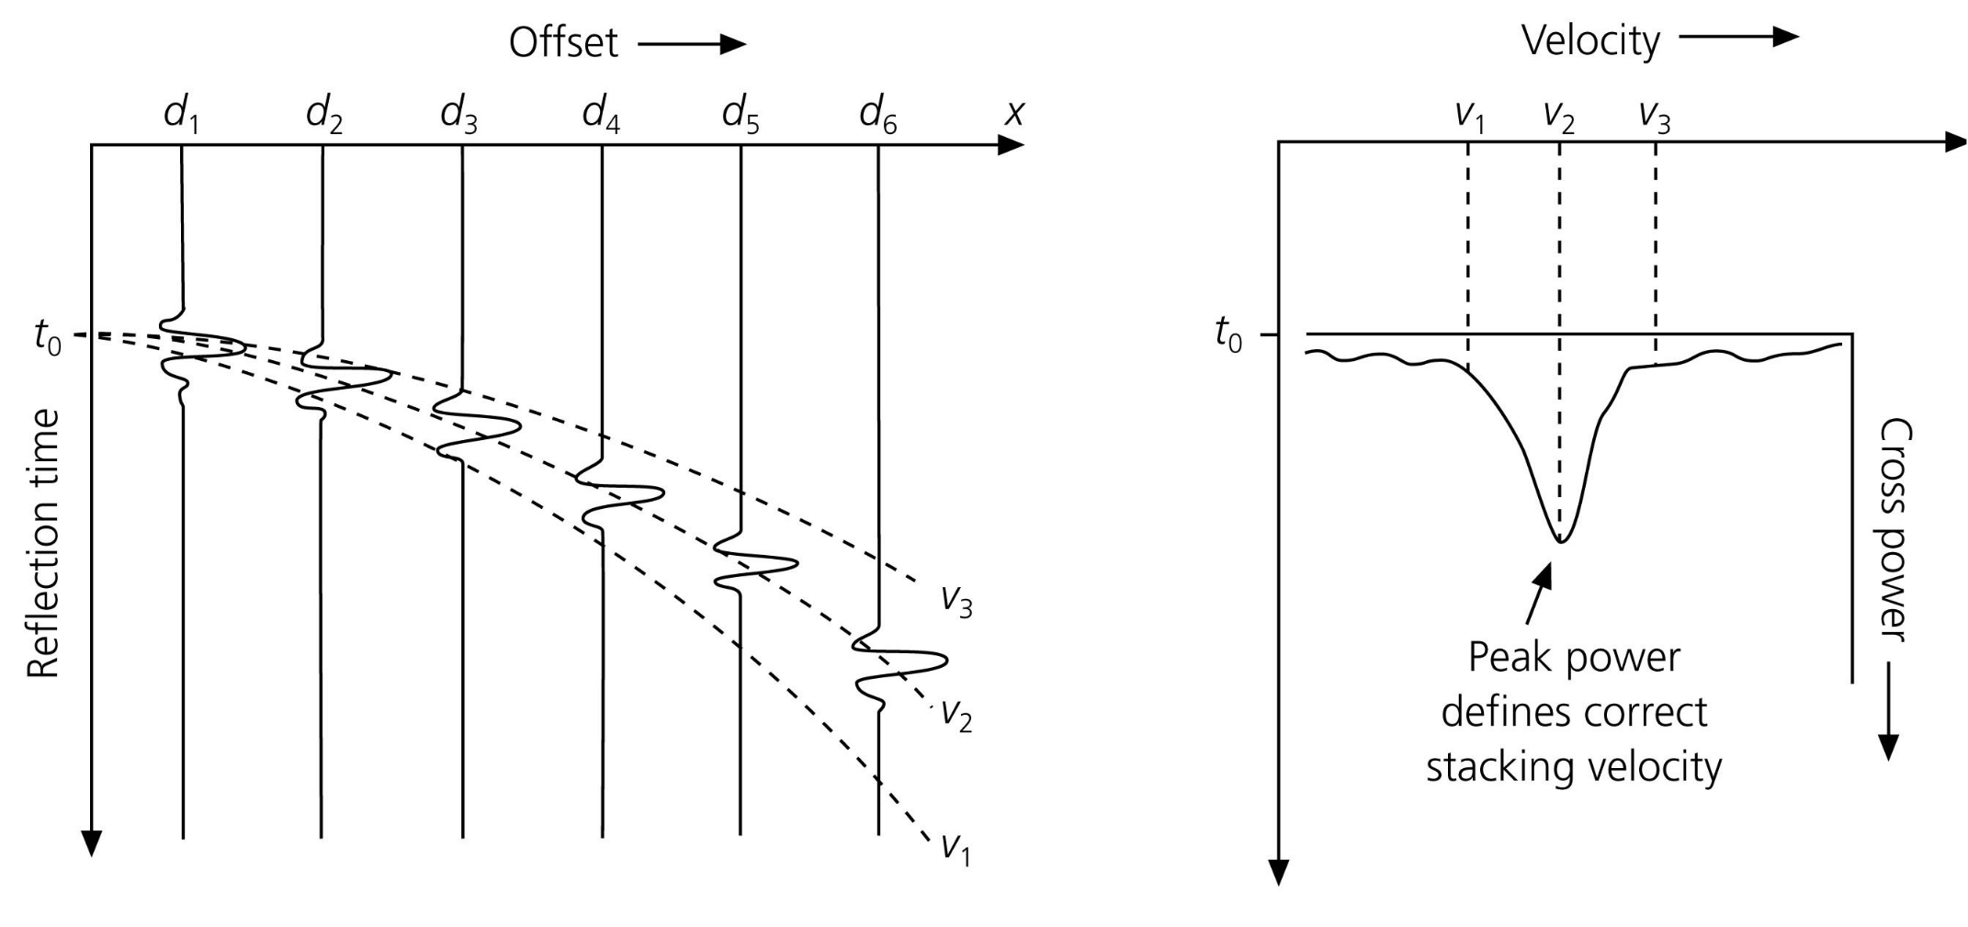
Approach B to Velocity Analysis:
Similar to Approach A, in that we try lots of t₀’s and stacking
velocities V_{s}… Difference is that for each trial we sum all
of the trace amplitudes and find which correction produces the
largest stacked amplitude at time t₀.
Stack amplitude
Peak stack amplitude
defines correct
stacking velocity

Slide 9
Approach C to Velocity Analysis:
Assume every t₀ is the onset of a reflection.
Window every geophone trace at
plus/minus a few ms and compare
(“cross-correlate”) all traces within
the window
S₁
S₂
S₃
S₄
S₅
S₆
S₇
S₈
S₉
The stacking velocity V_{s} that yields the most similar waveform
in all windows gives highest cross-corr & is used for that t₀.

Slide 10
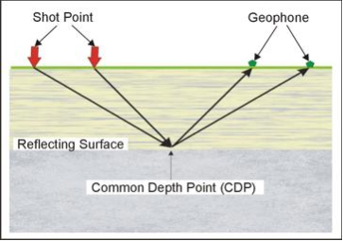
Step III: Stacking Common Mid Point Gathers:
For industry seismic, usually have lots of sources (shots) & lots
of receivers for every shot. Reflection signal is amplified and
noise is attenuated by stacking, i.e., summing traces from
different source-receiver pairs in an optimal way. Most
commonly begin with Common Mid Point (CMP) stacks:
First correct for
NMO (after
velocity analysis
to determine best
stack velocity V_{s}
for each t₀), then
sum all traces that
have the same
mid-point and place
the summed traces
at that point on the
image.
Shot Point
Geophone
Reflecting Surface
Common Mid Point (CMP)

Slide 11
After NMO correction and CMP stack, have a seismic section:
horizontal layers all image correctly in two-way travel-time.
If layers truly are ~ horizontal, processing can end here.
But what if layers dip?
V₁
h₁
α
The
reflecting point is
no longer directly below the source,
and NMO correction maps “true” to an apparent
reflecting point vertically beneath the stackpoint. For stacks
from a multiple source-receiver array, this maps dipping
reflectors to horizons that are shallower and may have
shallower dip than the true horizons.
α

Slide 12
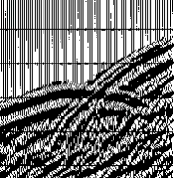
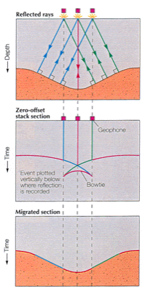
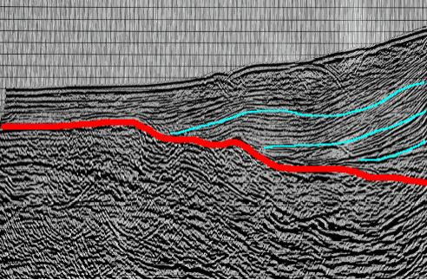
In cases where there are multiple
dipping reflectors, results in very
non-geological images of structure:
e.g., synclines
show up as
“bow ties”

Slide 13
Step IV: Migration seeks to distribute reflection energy
back to its correct position in two-way travel-time (& note
some types of migration can correct for diffraction “frowns”
as well as dip effects & “bow ties”).
Note that for a single dipping layer case with two-way travel
time to the reflection t₀, the true reflecting point in twtt must
lie somewhere on a circular arc of radius t₀:
So, if we have some sort of
independent information
relating to the medium
(e.g., dip angle) we can
map the reflections back
to their true location in
two-way travel-time.

Slide 14
Independent information comes from redundancy of
the source-receiver midpoints! If one unique surface is
responsible for a given set of reflection arrivals, that surface
must pass through all of the circular arcs. The “true”
reflecting surface is defined by a tangent passing through
each of the arcs.
x
In the relatively simple case
shown here of a uniformly
dipping, single layer
boundary, can calculate
dip of the reflector from any
pair of two-way travel-times
t_{0a}, t_{0b} :
t_{0a}
t_{0b}

Slide 15
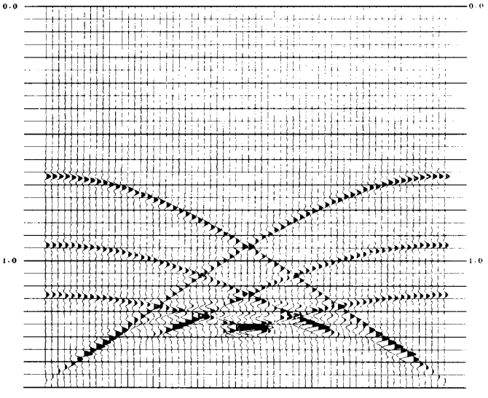
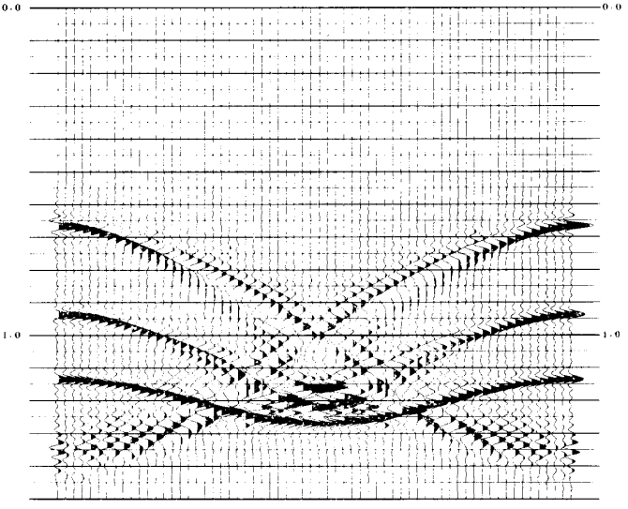
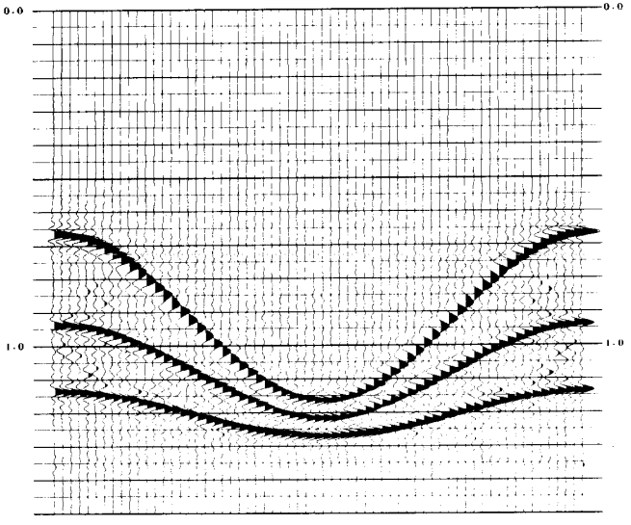
In practice, there are many different approaches to migration
(most pretty mathematically complicated, all requiring lots of
computer time)… But important to do if there is complicated
structure. Below, an example of Fourier-domain migration:
Common mid-point
stack of synthetic
data
15 degree
Claerbout (FD)
migration
f-k (frequency-
wavenumber)
migration
Fourier domain migration is similar to a 45-degree Claerbout
migration (but much more computationally efficient!)
(After Stolt, Geophysics, 1978)

