Slide 1
Geology 5660/6660
Applied Geophysics
14 Jan 2026
Last time: Brief Intro to Seismology &
stress & strain in an elastic medium:
Four types of seismic waves:
→ P (“Primary” = sound; a body wave)
→ S (“Secondary” = shear; also a body wave)
→ Surface waves (Love & Rayleigh: at free surface only)
→ Normal Modes (“Resonant tones” = standing waves)
An abbreviated introduction to stress and strain:
→ Stress σ, strain ε and displacement waves propagate
in a medium
→ Rheology is linear elastic: σ = cε (Hooke’s Law)
→ Defined several elastic constants (E, ν, K) & Lame’s
parameters μ & λ
Read for Fri 16 Jan: Burger 27-60 (Ch 2.2.2–2.6)
© A.R. Lowry 2008-2026

Slide 2
Seismic waves are strain disturbances that propagate…
For an isotropic solid, in two
dimensions stress and strain
are related as
σ_{yy}
σ_{yx}
Notation: here, the first index (subscript) denotes which face of the box the stress or strain is acting on; the second index denotes which direction it’s acting!
What’s the point of all of this?
Strain wave velocities
depend on elastic properties
because strain depends on
elastic properties!
σ_{xy}
σ_{xx}
where the dilatation θ = ε_{xx} + ε_{yy}. These look similar for 3D
but with the addition of shear and normal stresses/strains
in the z direction.
Note tensor notation! Stress and strain are tensors…

Slide 3
σ_{yy}
The forces acting at the edges of a
block of material within a medium
must balance the movement of the
block. If we consider force per unit
volume F/V and express acceleration
a in terms of displacement u,
must balance with (e.g., for a P-wave):
σ_{yx}
σ_{xy}
What’s the point of all of this?
Strain wave velocities
depend on mass density ρ
because F/V = ρ a!
σ_{xx}
These are the equations of motion!
(from Green’s
theorem)
(substitute stress in terms of strains
& substitute strains in terms of displacement
gradients, e.g.

Slide 4
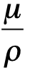
This gives the “dynamic wave equations”:
or equivalently
Here P-wave propagation velocity
and S-wave propagation velocity
(The P-wave equation!)
(The S-wave equation!)

Slide 5
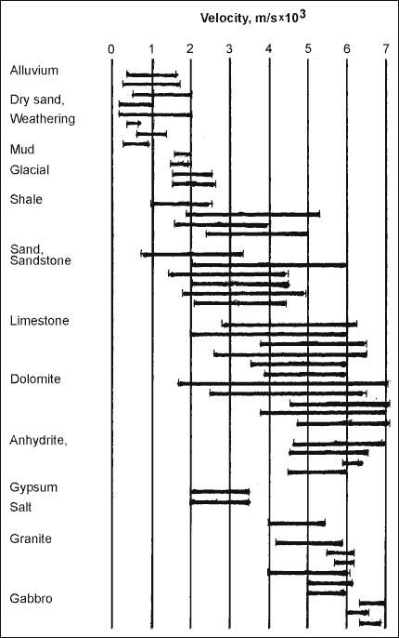
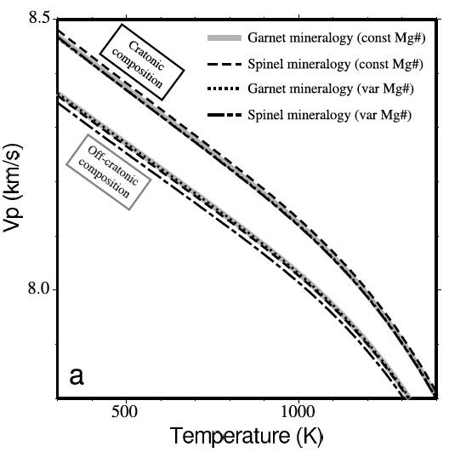
Rock properties that affect seismic
velocity include:
• Porosity
• Rock composition
• Pressure
• Temperature
• Fluid saturation
V_{p}, V_{s} are much more sensitive to
λ and μ than to ρ
Crustal Rocks
Perry et al., JGR 2006
Mantle
Rocks

