Slide 1
Geology 5660/6660
Applied Geophysics
(Lab)
14 Jan 2026
Today: Thinking Ahead for your Semester Project!
(Examples from Past Projects)
© A.R. Lowry 2008-2026

Slide 2
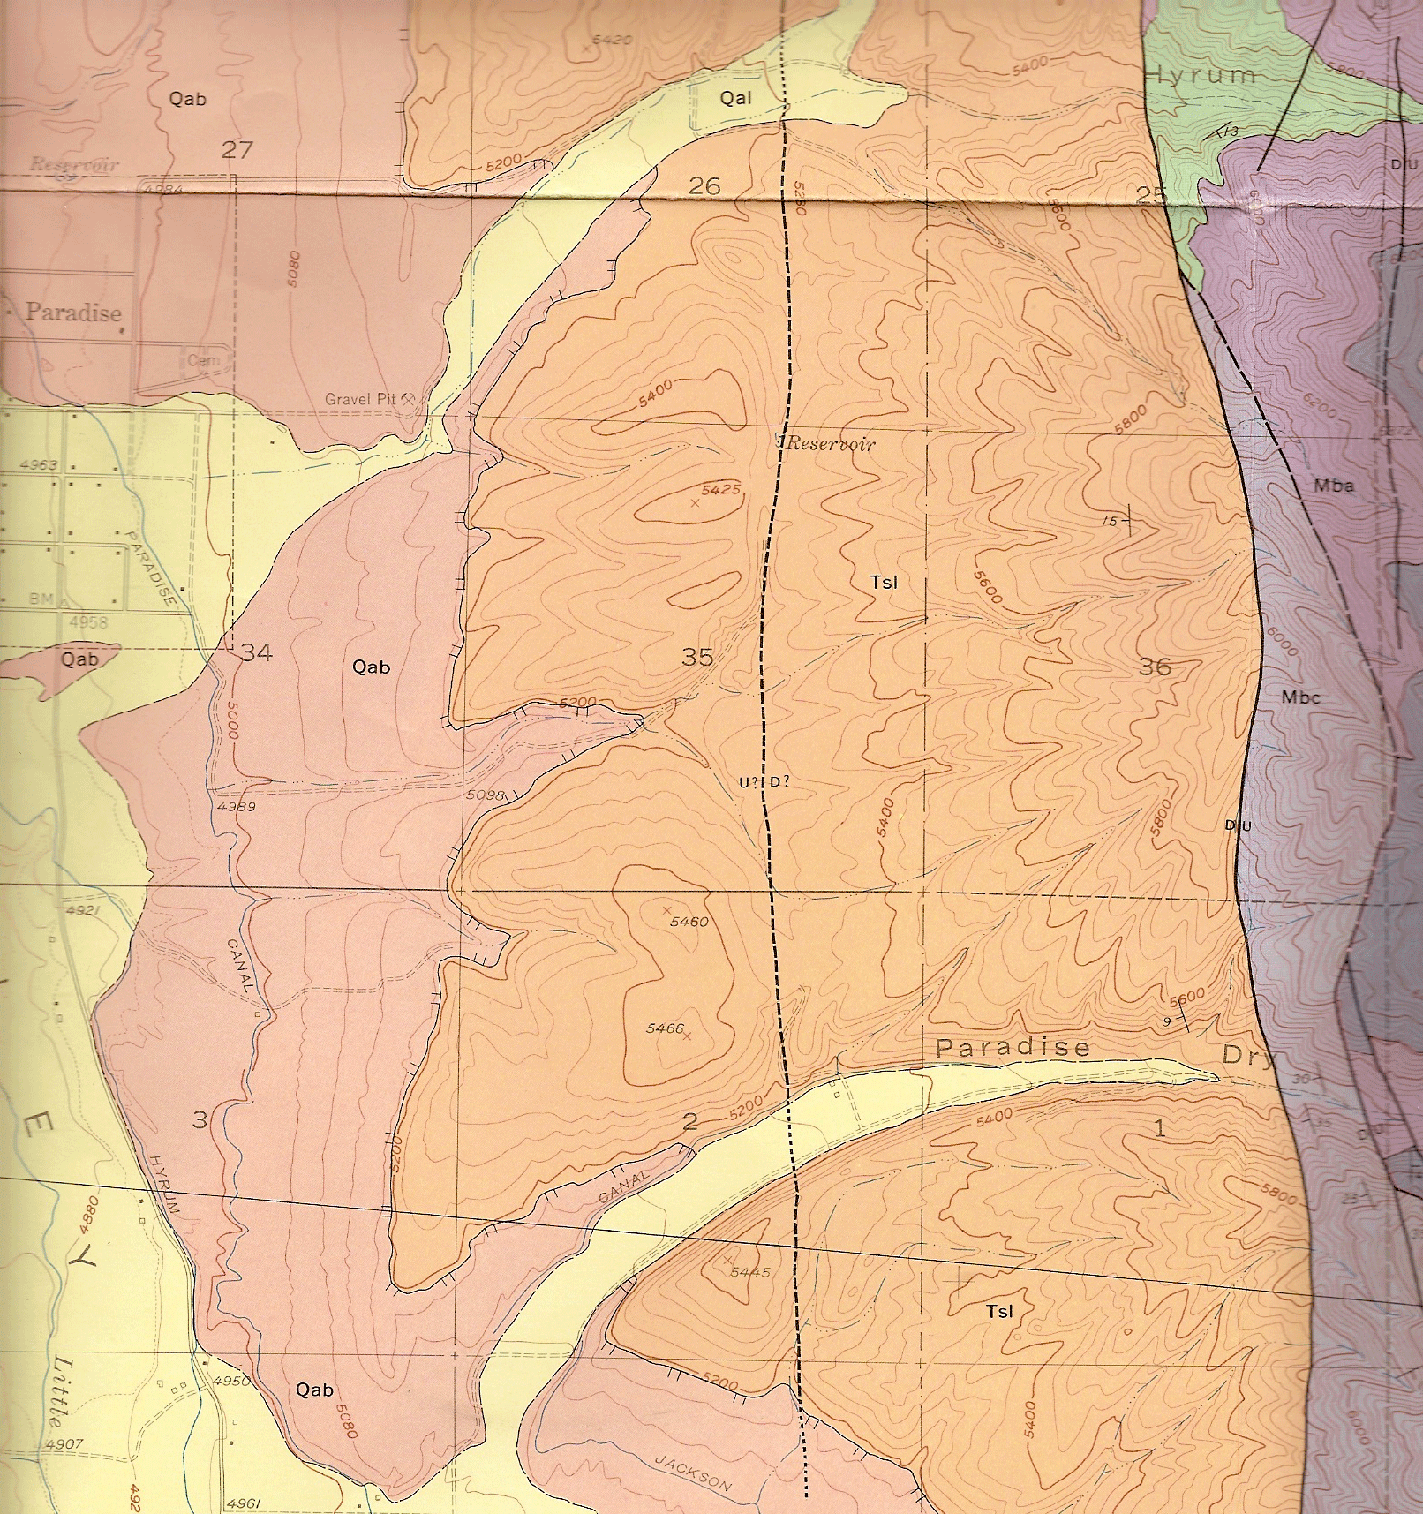
2008 Project: East Cache Fault Near Paradise
Fundamental question:
Is the western topographic
break a west-dipping fault
scarp or erosional/
depositional feature?
Used:
Ground penetrating radar
Seismic
Magnetic
Electrical resistivity
C
W
E
With thanks to Stephanie Davi & cohorts!

Slide 3
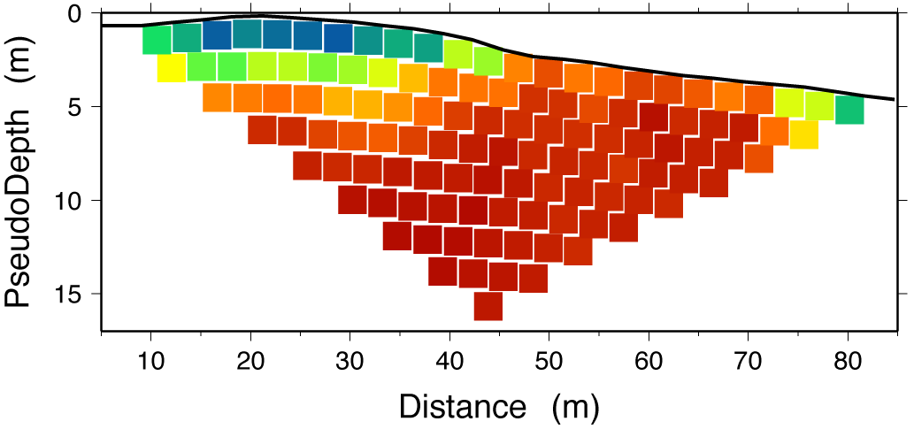
Interpretation of Electrical Resistivity Data:
ρ₁ = 100
“Topographic Break”
Note:
Layer 1 could
be thinner & have
higher resistivity!
Our data are ambiguous.
ρ₂ = 17
E
W
“Best” diagnostic tool: Electrical resistivity (here, an “apparent
resistivity” pseudosection overlain by an interpretive model)
coupled with surface geology indicated the topographic break
results from a silty/cobbly Bonneville shoreline “berm” beach
deposit constructed atop clay-rich T_{SL} Salt Lake Formation

Slide 4
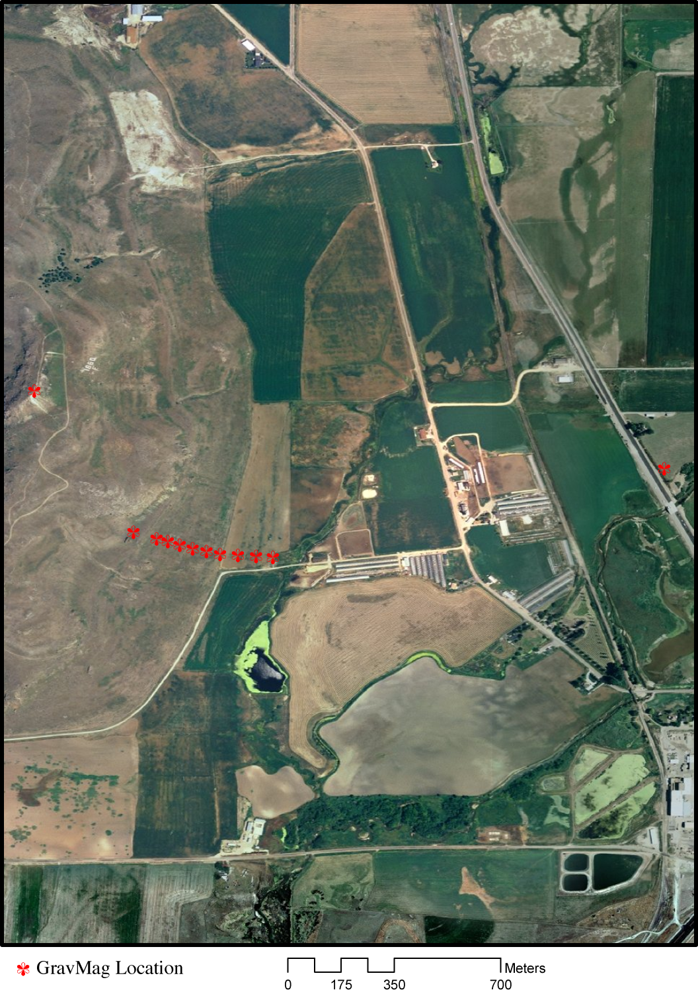
2010 Project: Little Mountain Near Franklin ID
Fundamental question:
Does the basement outcrop
represent a horst feature,
allochthonous thrust, or
paleotopography? (i.e., what’s
the dip of the basement/sed
contact?)
Used:
Seismic
Gravity
Magnetic
Electrical resistivity

Slide 5
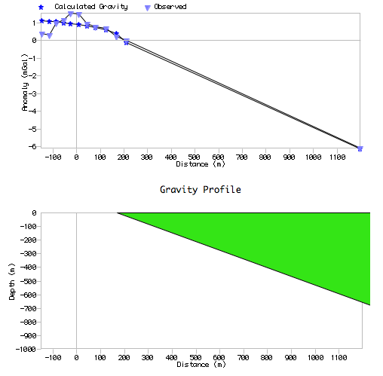
RMS = 0.4040 mGal
“Best” diagnostic tool:
Gravity data are best
fit by a contact
dipping shallowly
(< 35°) to the east,
which is most
consistent with a
simple horst model.
Δρ = –390 kg m⁻³

Slide 6
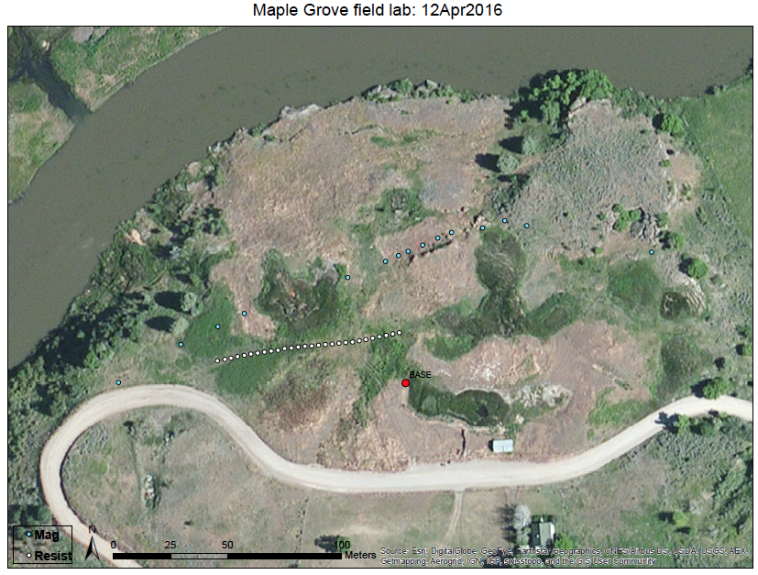

Maple Grove Travertines
“Lower
spring”
Fundamental question:
What’s down there?
Used:
• Seismic
• Magnetic
• Electrical resistivity
“Vertical contact”
position
“Upper
travertine
mound”

Slide 7
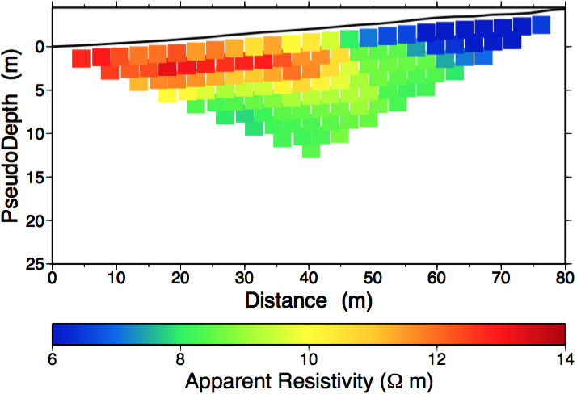
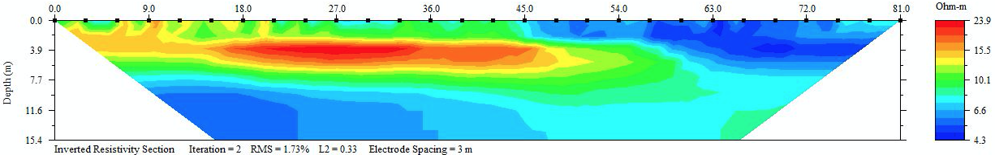
W
E
W
E
Best data: Resistivity suggests (higher resistivity) travertine
material shallow on west side; solute rich spring water and
possibly cavernous porosity on the east!

Slide 8
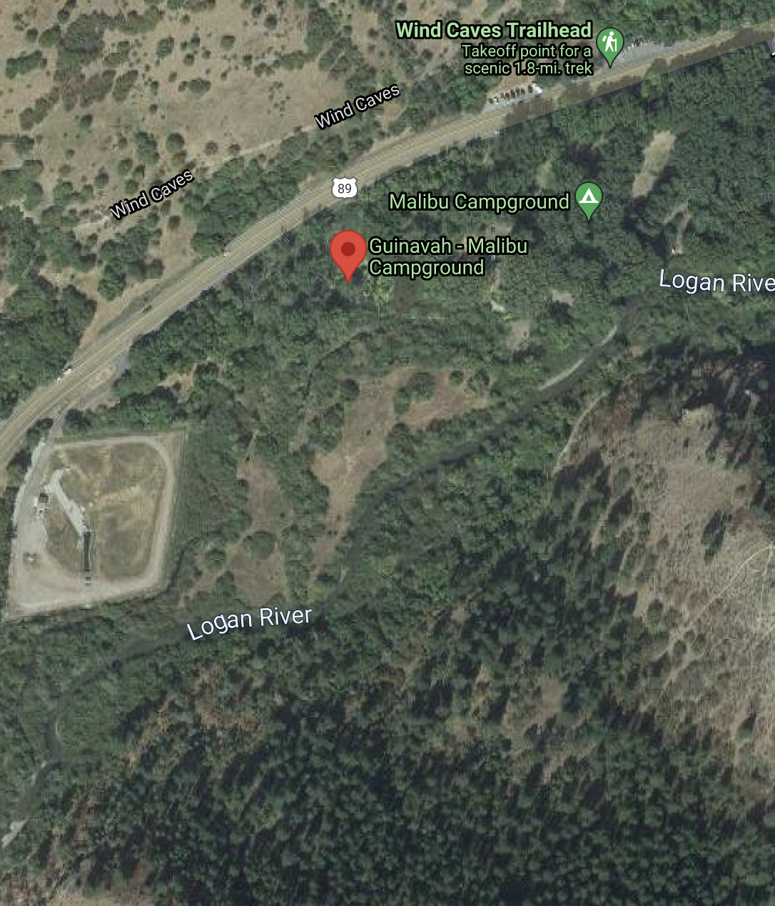
2018 Project: Guinevah Campground (Logan Canyon)
Fundamental question:
Do Lake Bonneville delta
deposits continue all the
way to Guinevah (higher
elevation than elsewhere?)
Used:
Seismic
Magnetic
Electrical resistivity

Slide 9
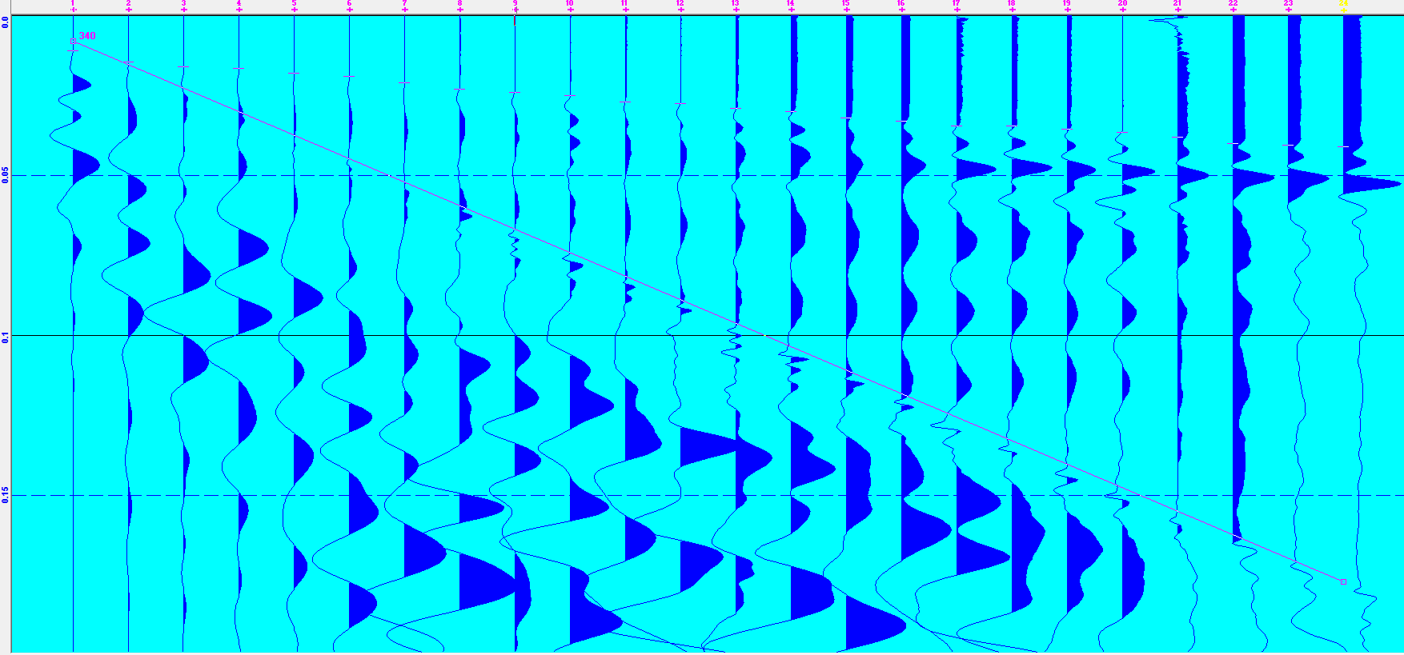
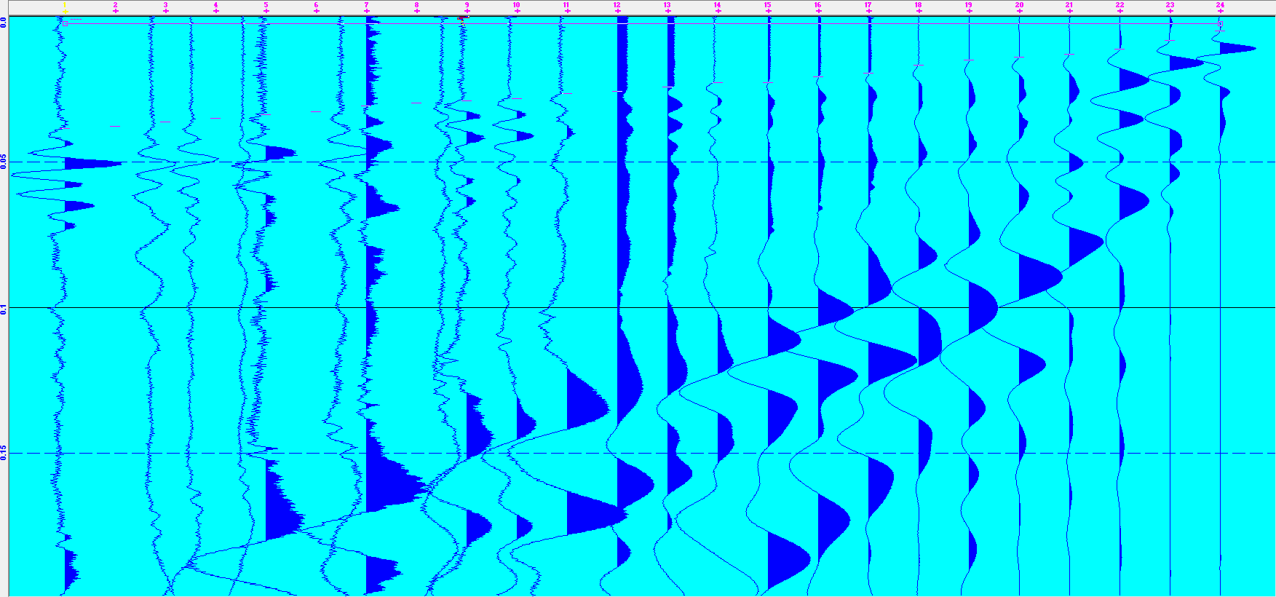
The seismic data
are actually fairly high
SNR (signal-to-noise
ratio) so picking the
data is straightforward.
The main challenges
are from static shifts
that displace the
amplitudes from zero,
and higher noise in the
reverse (likely because
distal geophones are
closer to the river, a
noise source, in the
latter). Note the clear
air-wave arrival (340
m/s line) evident in
both!
Air-wave

Slide 10
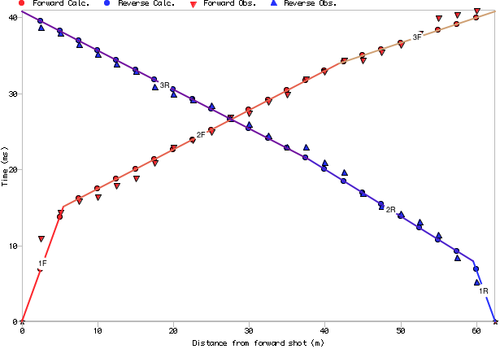
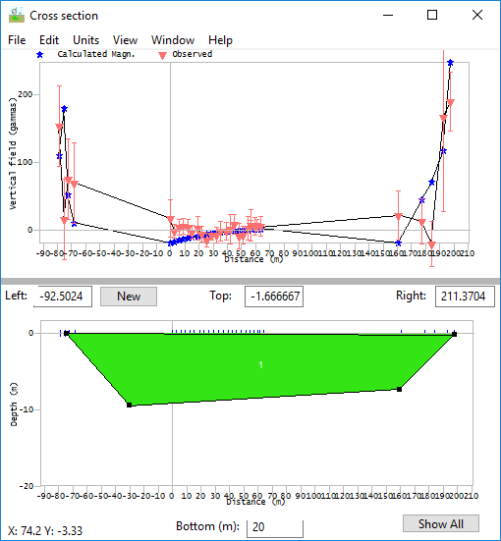
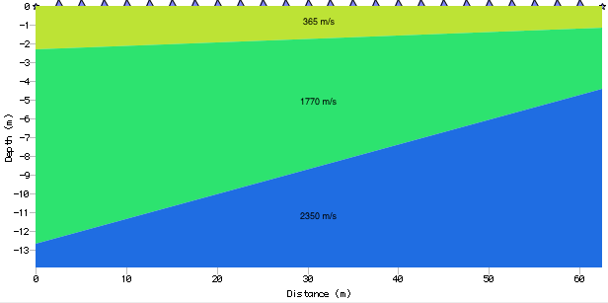
“Best” diagnostic tool(s): Seismic plus magnetic data indicate dry soil
over saturated soil with (probably) weathered dolomitic basement at
shallow depths of ~7–12 m (meaning ???)

Slide 11
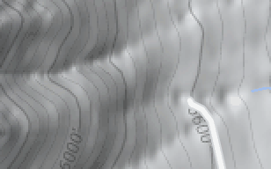
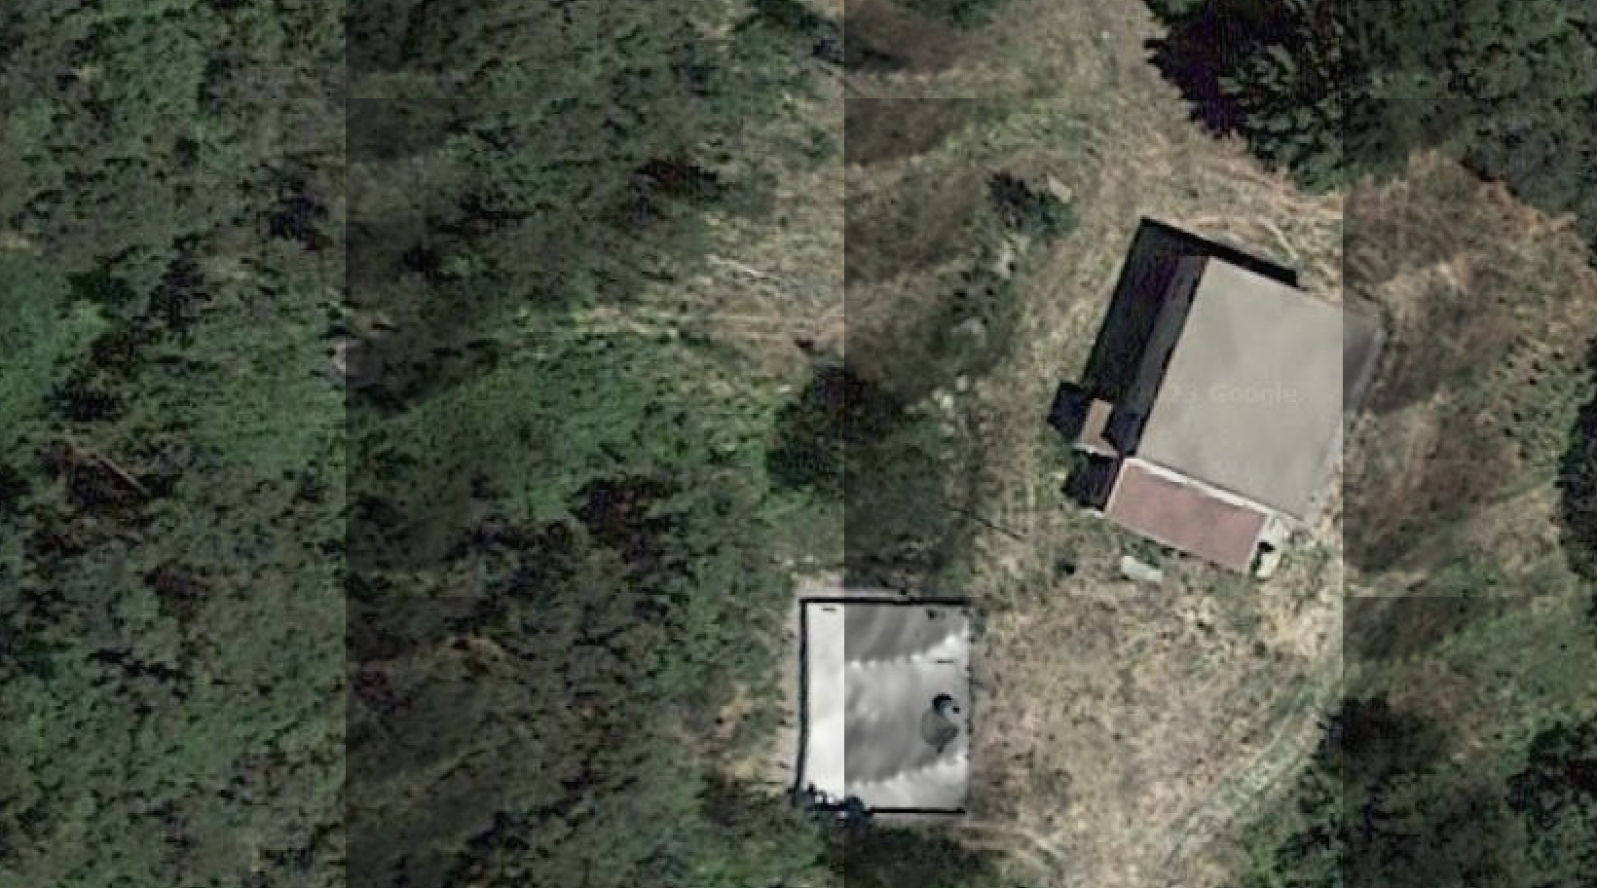
2022 Project: Dayton-Oxford Fault (near Clifton ID)
Fundamental question:
Where is the trace of
the Dayton-Oxford
fault (and where best to
drill a water well?)
Used:
Seismic
Magnetic
Electrical resistivity

Slide 12
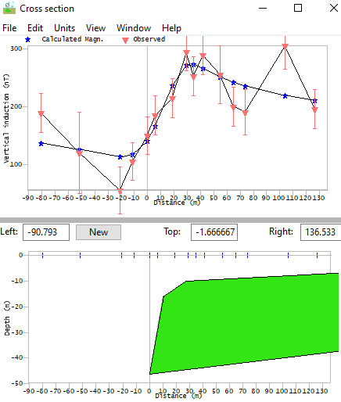
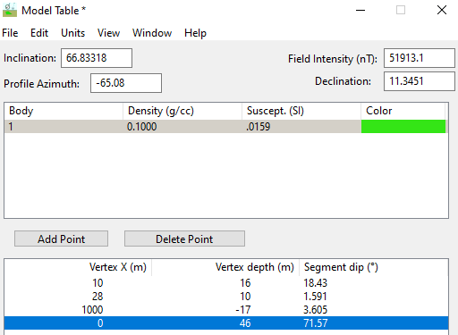
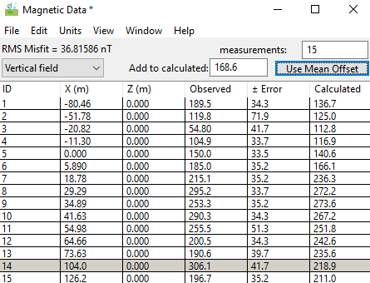
“Best” diagnostic tool(s): seismic & magnetic
Residuals in the refraction model indicated
locations along-profile where water saturated
the pore-spaces (near where surface water
was evident in the ravine!) Magnetic data
seemed to confirm that a layer of high magnetic
susceptibility was truncated by the Dayton-Oxford fault near the same profile
location!

Slide 13
So…. Be thinking about possible ideas!

