Slide 1
Geology 5660/6660
Applied Geophysics
15 Apr 2024
Last Time: DC Resistivity Modeling/Inversion/Interp
• Sensitivity kernels: + resistivity anomalies increase ρ_{app}
unless they occur between a current and voltage electrode!
• Apparent Resistivity Pseudosection is a “weighted
average” of resistivity structure (but with artefacts!)…
• Inversion of resistivity data (i.e., optimal parameterization of
a forward model) uses the physics of the voltage response to
give more structural detail and confidence.
• Applications including permeability mapping, lithologic
mapping, karst & tunnel detection
• Successfully used to inform past field studies for this class!
For Wed 17 Apr: Burger 302-340 (§5.5-5.11)
© A.R. Lowry 2008-2024

Slide 2
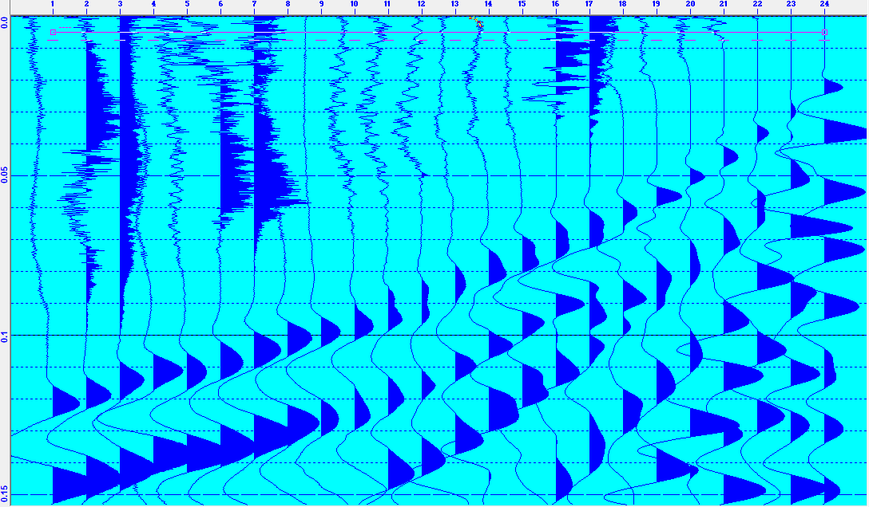
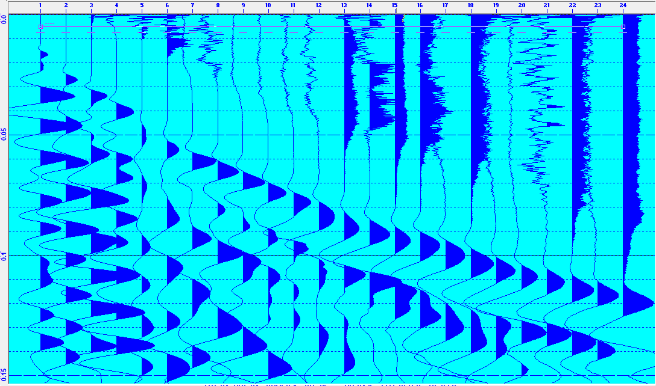
Saturday Field Exercises:
Got much better results; the dat
files are posted on the website!
Your first part of the assignment
will be to pick first arrivals using
the RAS-24 software.
Things to note: The direct arrivals
(nearest traces) are subtle; must
go to highest magnification to see.
The negative bump on the furthest
traces is also difficult to pick out;
you should vary the magnification
and consider neighboring traces.

Slide 3
Your semester project assignment
will be posted in a preliminary form on Wednesday,
and we’ll discuss the assignment a bit more then.
But if you want to get started early, there are several things
you can safely anticipate I will want you to do:
• Pick the seismic data using RAS-24 software
• Model the first arrivals using Refract
• Use the results of you Refract model geometry to
create a structure for modeling the magnetic data
in GravMag
There will be more, and the version of the assignment we will
discuss on Wednesday may not be the final version (but I
will inform everybody whenever I add something to the
assignment!)

Slide 4
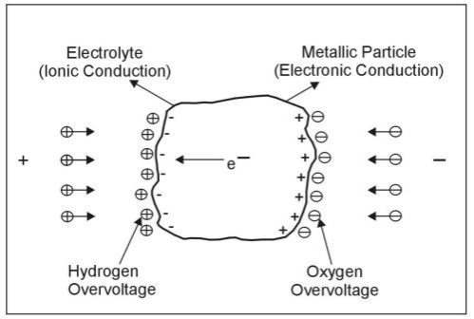
Induced Polarization (Induced Potential)
IP refers to the transient voltage measured after an electrical
current is turned off (or nonzero phase of a sinusoidal current).
Physical process is probably similar to charging a battery.
At contacts between the two, this results in a buildup of
charge (sometimes called an overvoltage).
One mechanism:
Current flow in many rocks
is dominated by ionic
conduction in pore fluid
electrolytes, but in some
minerals (e.g., sulfides,
graphite, magnetite, native
metals), flow occurs by
electronic conduction.

Slide 5
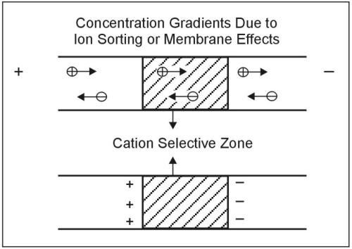
Another mechanism: In clays, can get electrodialysis
or “membrane polarization”: A membrane effect in which
one ion in the pore fluids is more mobile than the other
(cation mobility > anion in this example)

Slide 6
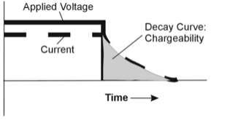
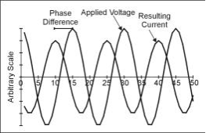
Two approaches to measurement:
• IP in the time domain:
Measured as
“chargeability”, area of
the voltage decay curve
normalized by voltage
measured before
current was turned off
(hence units of seconds).
• IP in the frequency
domain:
Apply an alternating
current instead of DC,
and measure amplitude
and phase as a function
of frequency of the AC.
Applied Current
Decay Curve
Chargeability
Measured Voltage
Phase
Applied Current
Resulting
Voltage
Difference

Slide 7

Chargeabilities of Various Rocks (ms)
20+% Sulfide
8-20% Sulfide
2-8% Sulfide
Volcanic Tuffs
Siltstones
Shale
Granite/Granodiorite
Limestone/Dolomite
Clean Sandstone
Gravels
Alluvium
1
10
100
1000
10000

Slide 8
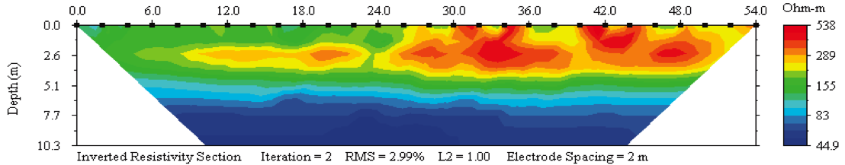
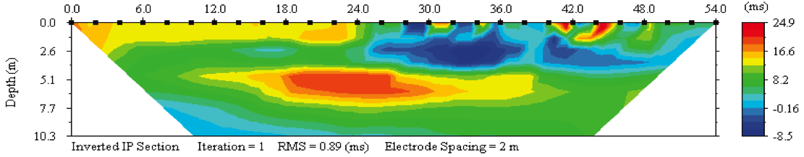
Measurements we make with the IP-resistivity meter are of the
time-domain variety…
west-side high resistivity = low soil moisture?
water table?
late spring wetting event?
E
W
Data collected
at the West
Cache fault
location...

Slide 9
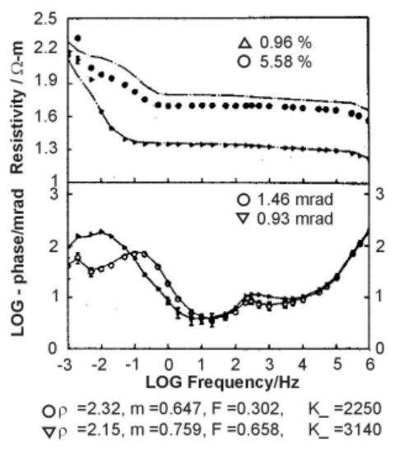
Example:
Two samples of
montmorillonite (clay)
soil at a waste
contamination site.
Apparent resistivity
decreases with
frequency because of
induced polarization;
the lower-ρ_{app} sample
is contaminated
(organic NAPL +
electrolytic APL)
Phase peaks are
different for different
fluids…

Slide 10
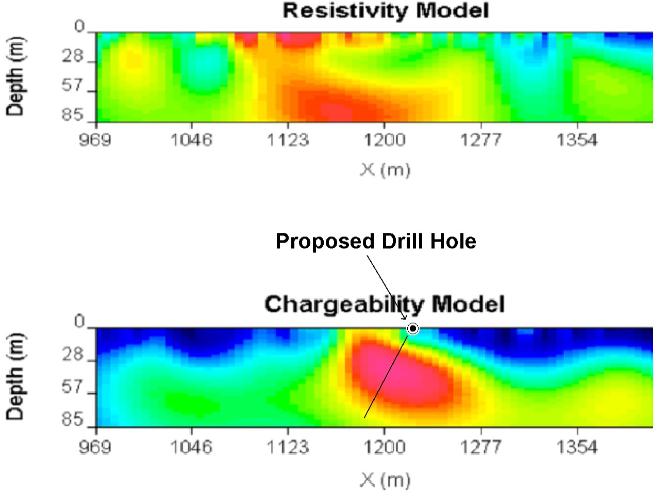
(From a gold
mining prospect
in Durango,
Mexico)
For a medium
comprised of
n different
materials,
apparent
chargeability η_{a}
is related to ρ_{a}
by … So incorporates information about how
apparent resistivity relates to true resistivity structure.

Slide 11
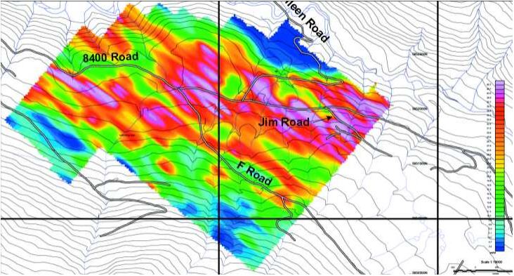
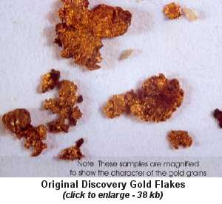
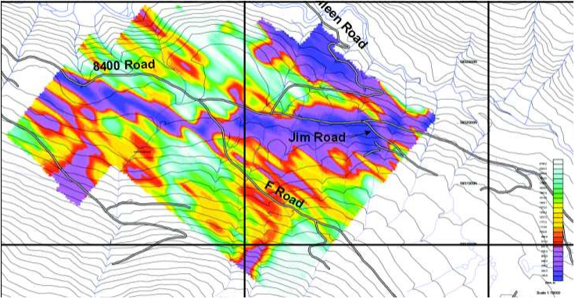
Apparent Chargeability
Another gold prospect:
mineralized boulder
field in east-central
British Columbia
Apparent Resistivity

Slide 12
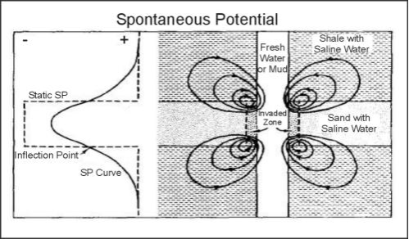
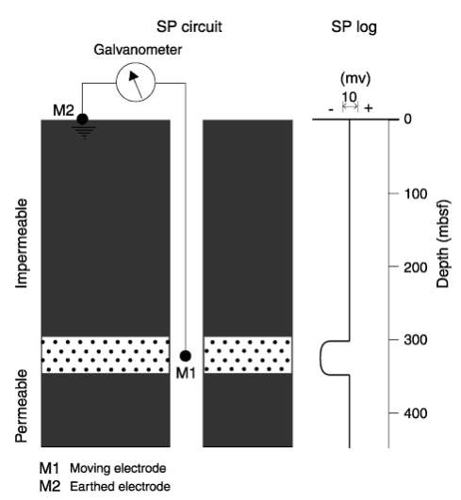
Spontaneous Potential (SP)
SP is an electrical potential that arises “without” an applied
current (i.e., electrical current flow arising from natural
processes or disturbances that are not initially electrical)
Three most common applications:
(i) Well-logging: Electrochemical potential arises from
differential diffusion of ions into drilling mudcake from
permeable formations ⇒ electrical current flow

Slide 13
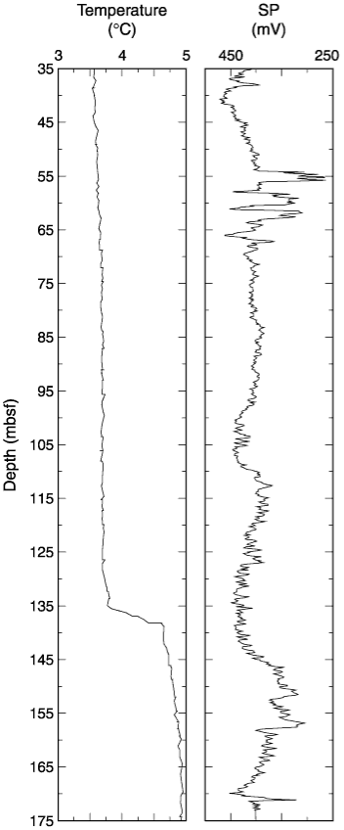
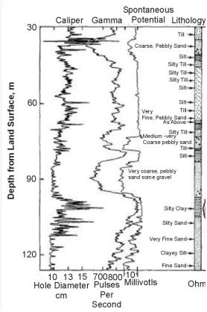
Note that
more
permeable
formations
express as
more
negative
spontaneous
potential… So
pay attention
to the sign
convention!

Slide 14
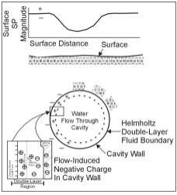
(ii) Mining: A second process occurs in ore bodies that are
partly above the water table (oxidizing conditions)
and partly below (reducing). Resulting differences
in charge concentration produce electrical current.
(iii) Karst investigation:
Water flowing through
a cavity can build up
a charge as well
(“streaming” or
electrokinetic
potential)

