Slide 1
Geology 5660/6660
Applied Geophysics
15 Apr 2026
Last Time: IP (Induced Polarization)
• Induced Polarization (IP) measures the chargeability
of transient voltage after DC current is shut off
(time-domain IP) or the phase of voltage relative to a
sinusoidal AC current (frequency-domain IP)
• Results from overvoltage (charge buildup)
→ ~ boundaries between ionic & electronic conduction
→ by electrodialysis (membrane effect) in clays
• Chargeability ~ anticorrelates with resistivity; highest for
sulfide ores
• IP in the frequency domain can provide more information!
• Heavily used in mining industry; sometimes in well logging
and environmental applications
© A.R. Lowry 2008-2026

Slide 2
Last Time continued: Self-Potential (SP)
• Spontaneous Potential (SP): “Natural” amperage (i.e.,
without injecting any current) can arise from:
→ Brine infiltration of drilling mudcake in permeable
formations (petroleum industry wireline application)
→ Oxidation/reduction reactions at the water table (mining)
→ Streaming potential in cavities (karst investigations)

Slide 3
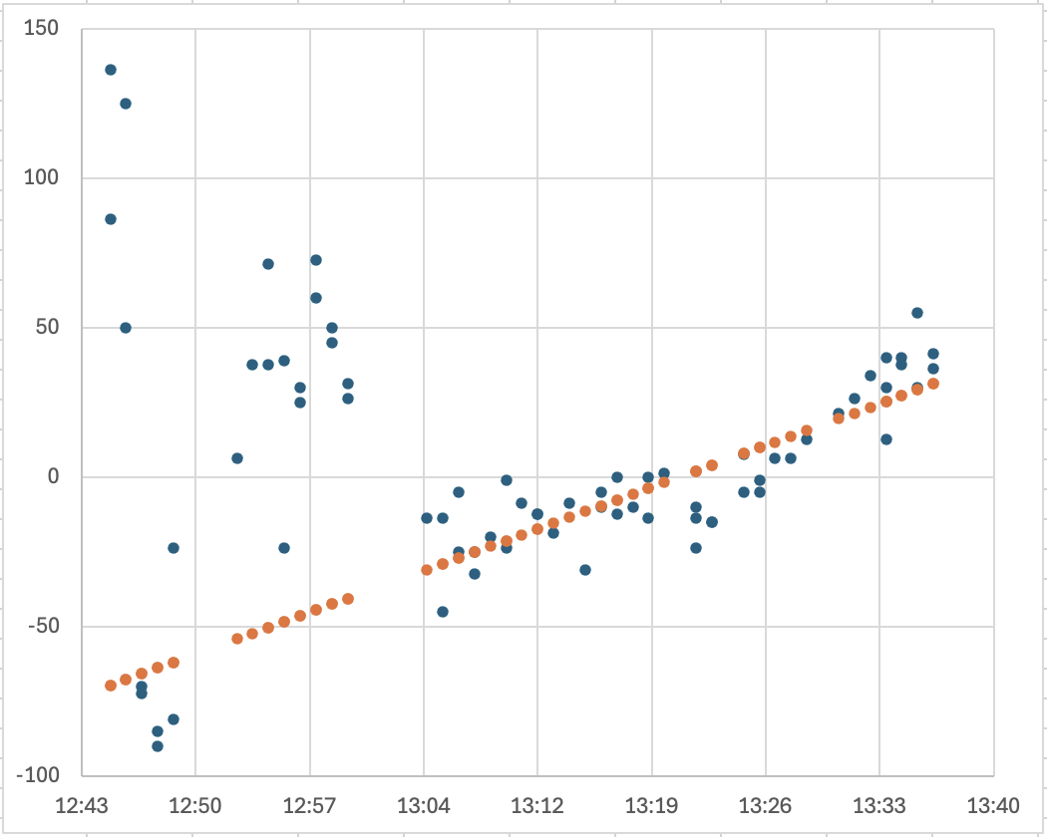
Smithfield Dry Canyon magnetic data:
• Here showing differences of measurements from the mean
value as a function of measurement time (blue dots)
• A simple linear drift model (orange dots) appears to be a
good approximation for most of the data!

Slide 4
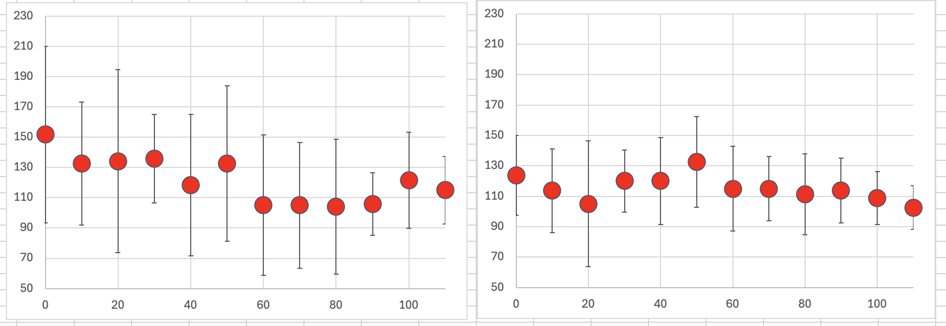
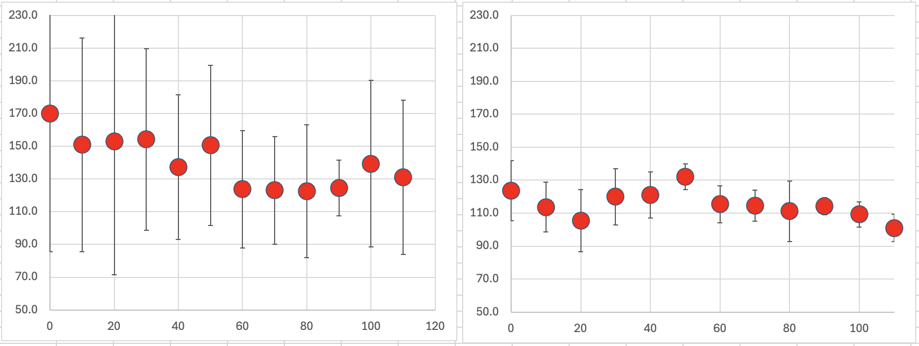
Smithfield Dry Canyon magnetic data:
Before drift correction, all data
Before drift correction, passes 3–6
Passes 3–6 appear to have more signal than noise after drift correction, so I will recommend using those data
I’ve highlighted the preferred data that you should use for modeling in a salmon color in the assignment
After drift correction, all data
After drift correction, passes 3–6

Slide 5
Your semester project assignment
is now posted in a preliminary form, and we’ll discuss the
assignment during our Lab session.
There may be changes later to the assignment but it’s very
similar now to what it will be in its final form. (I will inform
you if I change the assignment!)

Slide 6
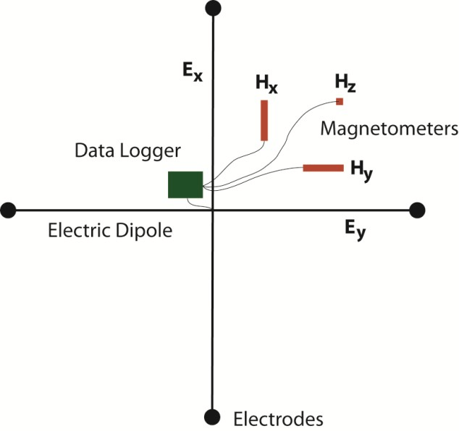
Magnetotelluric (MT) Method
Simultaneously record 3D magnetic field and horizontal
electric field… Passive measurement, so uses natural sources.
Instrumentation
consists of an
antenna (wires
placed across tens
of m) to measure
two horizontal
components of
the electric field,
and fluxgate
magnetometers
oriented to measure
3-component
magnetic field
in time series!
From Comeau (2015)
PhD dissertation

Slide 7
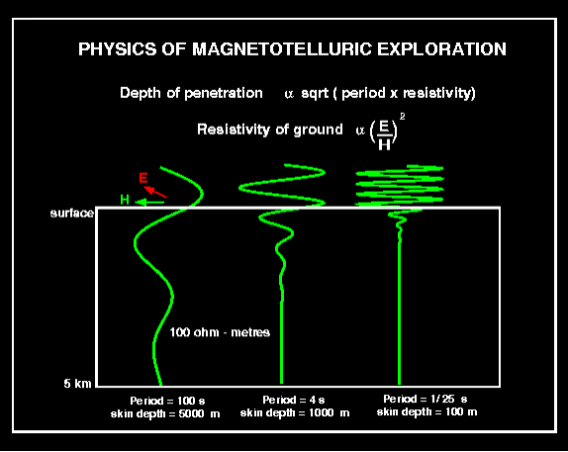
Magnetotelluric (MT) Method
Simultaneously record 3D magnetic field and horizontal
electric field… Passive measurement, so uses natural sources.
For a sine wave
sin(ωt),
where ρ_{sd} is
an averaged
resistivity over
the “skin depth”
(depth of
significant
penetration of
the electric field
E and magnetic
field H)

Slide 8
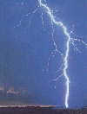
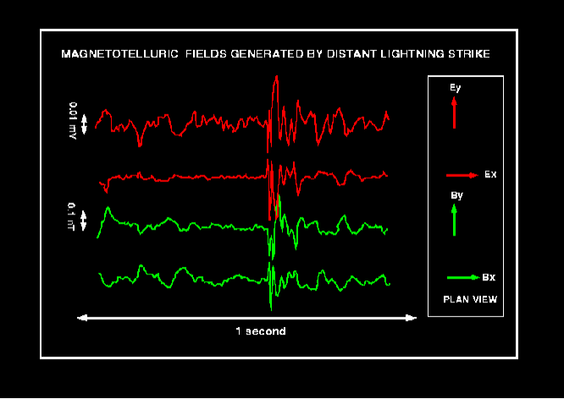
Magnetotelluric Method
Three highest-energy sources of electrical current in Earth:
(1) Global lightning strikes (predominates in the
10,000 Hz to ~1 Hz frequency range)
Averages ρ from 10s of m to a few km
Note here the images
denote magnetic
field as B instead
of H!

Slide 9
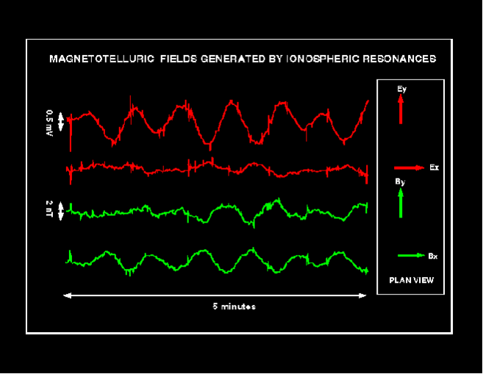
Magnetotelluric Method
Three highest-energy sources of electrical current in Earth:
(2) Ionospheric resonances (predominate periods of
seconds to minutes: here ~20 s period near sunset)
Gives ρ from ~2 to 10 km
The small,
high frequency
spikes correspond
to distant (global!)
lightning strikes.

Slide 10
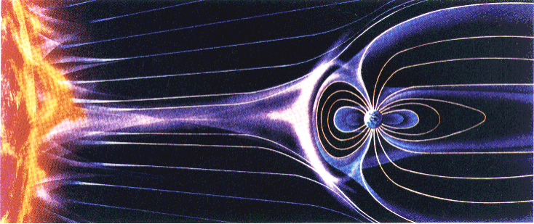
Magnetotelluric Method
Three highest-energy sources of electrical current in Earth:
(3) Ionospheric disturbances caused by interactions
with high energy particles and electrons emitted by the
sun in solar storms (predominates periods of days and
longer). Gives ρ from 10s to 100s of km (& to the core if
observed for long enough!!!)

Slide 11
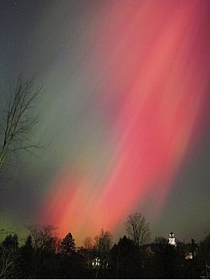
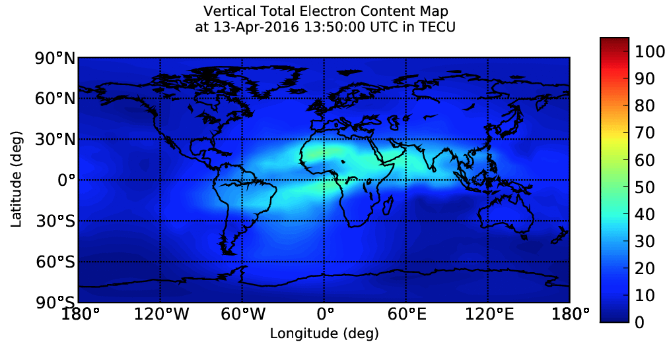

(Real-time ionospheric total electron content)
… Note this is the same interaction responsible for
aurora borealis
… Note also that ALL of these sources are extremely high
energy (much higher than we could reasonably generate!)

Slide 12
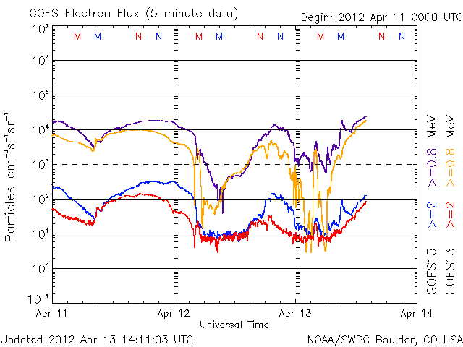
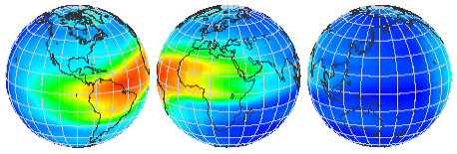
“Space weather”, or
flux of high-energy
charged particles &
electrons, is also of
practical interest
because of effects
on satellites (electron
flux greater than
some threshold can
induce charge on
electronic
componentry of
satellites; discharge
has fried a
communications
satellite or two…)
NOAA GOES Electron Flux
USU GAIM Total Electron Content

Slide 13
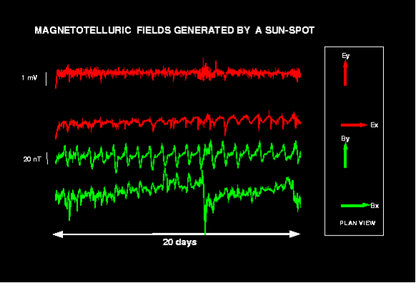
Example effect of a sunspot. The repeating signal (strongest
in E_{x} and H_{y}) is the diurnal variation as Earth rotates within
the solar wind. The large departure in H_{x} ~ day 12 is a sunspot.
This
example
gave
resistivity
constraint
to depths
of a few
100 km.

Slide 14
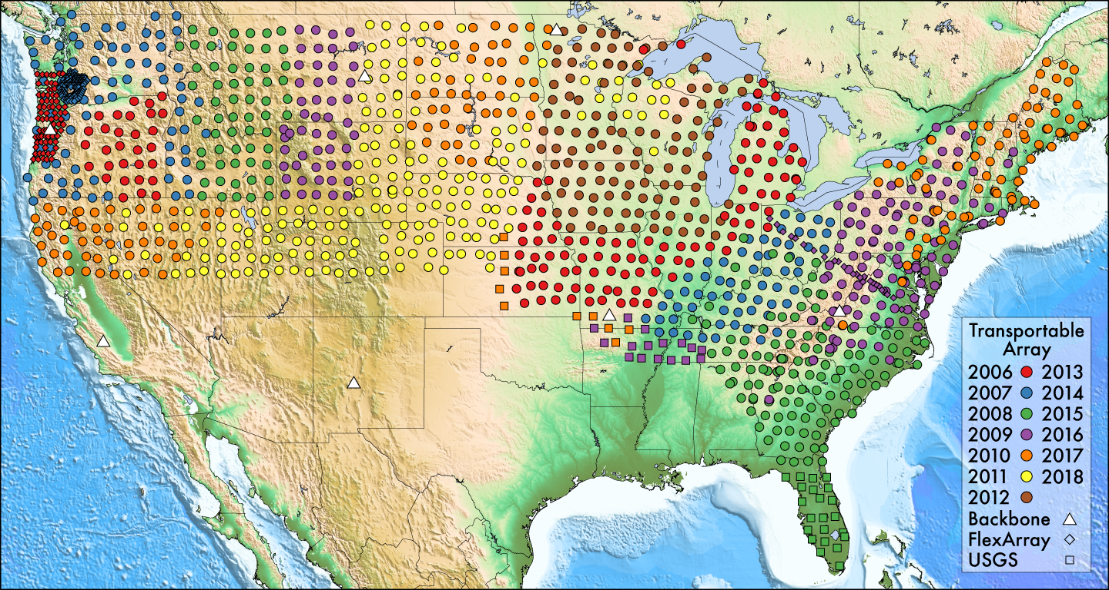
MT array deployments for EarthScope

Slide 15
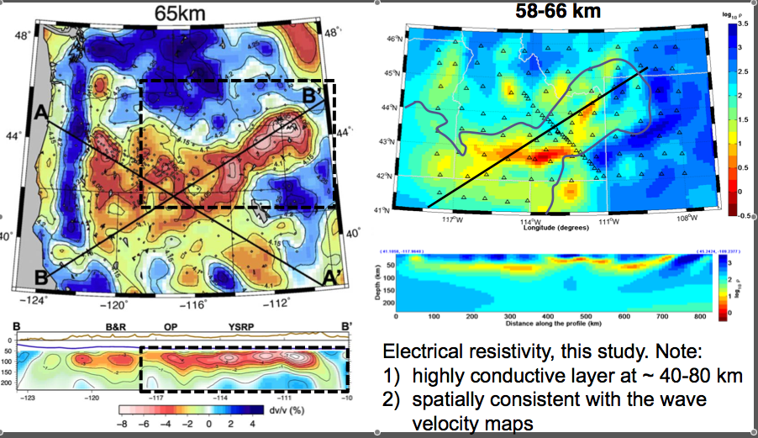
Yellowstone-Snake River Plain System:
Seismic V_{s} (Rayleigh wave tomo)
Electrical Resistivity ρ
Wagner et al., EPSL 2010
Kelbert et al., 2011 EarthScope Science
Meeting

Slide 16
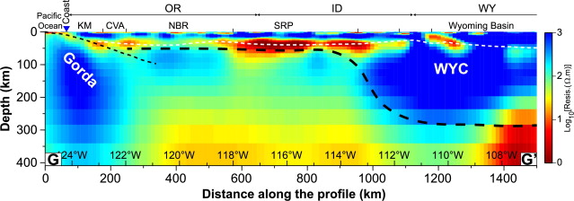
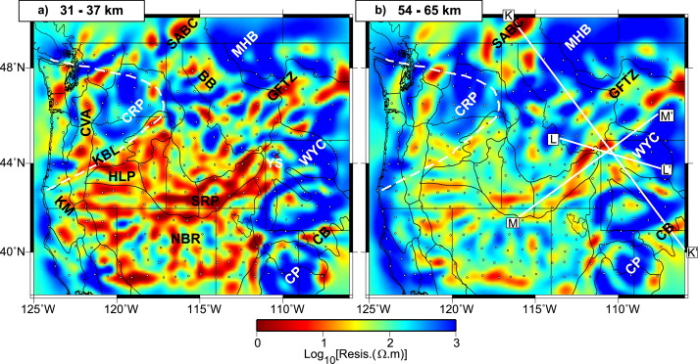
Meqbel et al., 2014 Earth Planet. Sci. Lett.

Slide 17
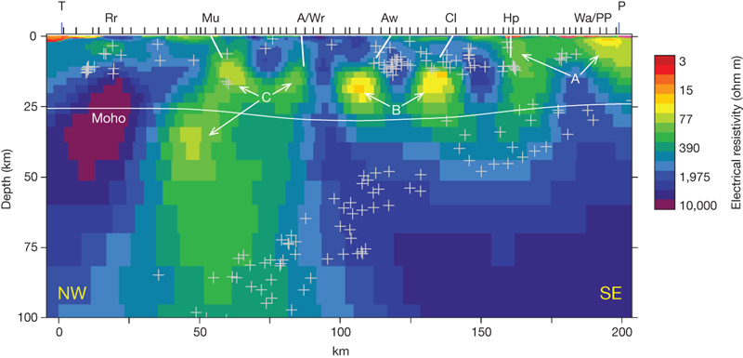
Resistivity structure beneath an advancing subduction zone…
(Marlborough region, northern South Island, New Zealand)
Wannamaker et al., Nature, 2009

Slide 18
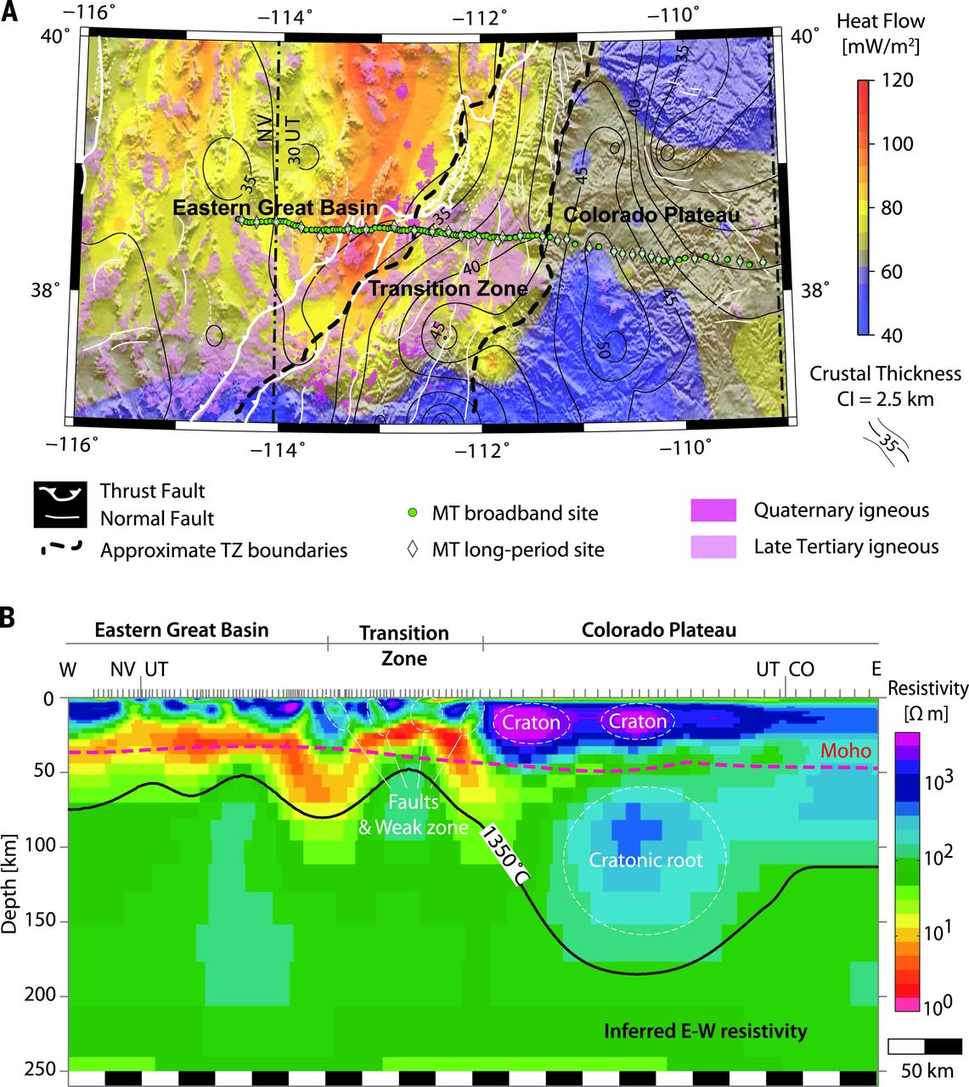
Resistivity structure
a bit south of here…
From older data
& newer inversion.
Newer techniques
are drawing interest
from industry…
And there is
research supporting
a strong relationship
between electrical
conductivity and
flow viscosity
Liu & Hasterok, Science, 2016

