Slide 1
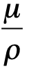
Geology 5660/6660
Applied Geophysics
16 Jan 2026
Last time: Lightning derivation of the Seismic Wave
Equation:
Stress, strain and displacement waves:
→ Rheology is linear elastic: σ = cε (Hooke’s Law)
→ We use Lamé’s elastic constants (λ, μ)
• The elastic wave equation:
→ Assumes an isotropic solid
→ Stress/strain relations assume infinitesimal strain
so that strain is the derivative of displacement: ε = ∂u/∂x
→ Results in the seismic wave equation(s) and
seismic velocities:
Read for Wed 21 Jan: Burger 27-60 (Ch 2.2.2–2.6)
© A.R. Lowry 2008-2026

Slide 2
Last time continued: Seismic velocity:
• Velocities are more sensitive to λ & μ than to ρ; depend on
porosity, lithology, cementation, pressure, temperature, fluids!

Slide 3
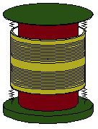
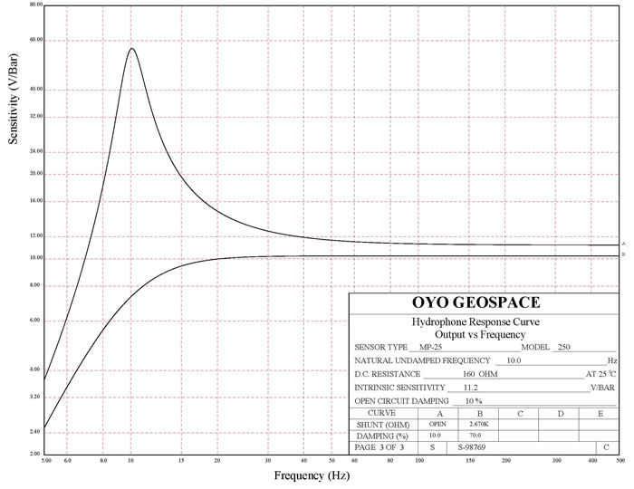
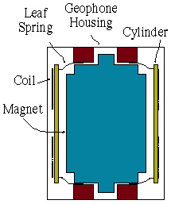
Geophone:
Commonly-used by industry, less
often for academic, seismic
reflection studies
Often vertical component only
Often low dynamic range
isometric view
Seismic
Instrumentation:
The most commonly-used instrumentation in (usually, oil & natural gas) industry is the geophone… Instrumentation used for earthquake studies and deep-Earth imaging is the seismometer!
10 Hz “natural frequency”
Undamped response
of mechanical system
Response after
electronic damping
10
20
100
200
500
A Seismometer differs in cost &
componentry… 3-c, > dynamic range
cross-sectional view

Slide 4
Understanding the Frequency Domain:
“Recall” that an idealized mass on a spring is a
harmonic oscillator : Position x of the
mass follows the form x = A cos (ωt + δ)
where A is amplitude, t is time, ω is the natural
frequency of the spring, and δ is a phase
constant (tells us where the mass was at
reference time t = 0).
x
T = 2π/ω
A
In the frequency domain this
is a spike or delta-function:
ω

Slide 5
Signal recorded by a seismometer is a convolution of the
wave source, the Earth response, and the seismometer
response.
Two “useful facts” to know about the frequency domain:
(1) A convolution in the time domain is a simple multiplication in frequency domain
(2) A delta-function (or “spike”) in one domain is a sinusoid in the other. A spike at zero is a constant!
Wave
Source
Earth
Response
Seismometer
Response
⊗
⊗
where ⊗ denotes convolution:
Example:
⊗
=
So, we want seismometer response
to look as much as possible like a
single delta-function in time:
⇔
t = 0
ω

Slide 6
Seismometer response is given by:
where i is current, ω₀ is “natural frequency” of the
spring-mass system oscillation, K is electromagnetic
resistance to movement of the coil, R is electrical
resistance to current flow in the coil, & x is movement
of the mass relative to the coil.
The damping factor h is given by:
where τ is the mechanical
damping coefficient.
Hence we choose K and R to give a time response that
looks as much as possible like a delta-function (= a flat
frequency response):

Slide 7
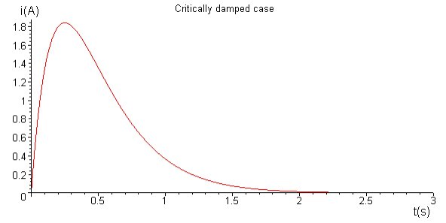
This corresponds to ω₀/h = 1: Critical damping
Underdamped
Critically Damped
Overdamped
Seismometers typically are designed to be slightly
overdamped (ω₀/h = 0.7).

Slide 8
Seismometer Damping
Source Function
An explosion at a depth of 1 km & t = 0
is recorded by a seismometer at the
surface with the damping response
shown. What will the seismogram look
like?
V = 5 km/s

Slide 9
The Key Takeaway:
→ A Seismogram (or geophone recording) is not an
exact record of ground displacement
→ Instead, it approximates motion (usually acceleration)
delayed by some amount
→ By knowing the seismometer response (and
“deconvolving” by dividing it out in the frequency
domain), we can correct to approximate true ground
motion in a limited frequency band

Slide 10
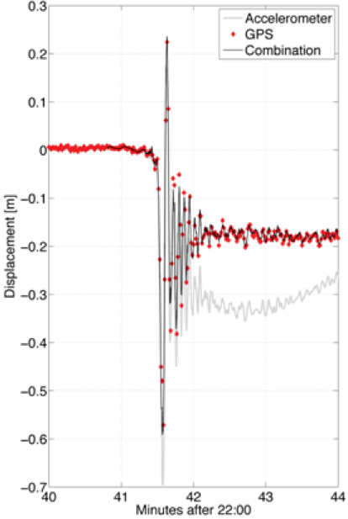
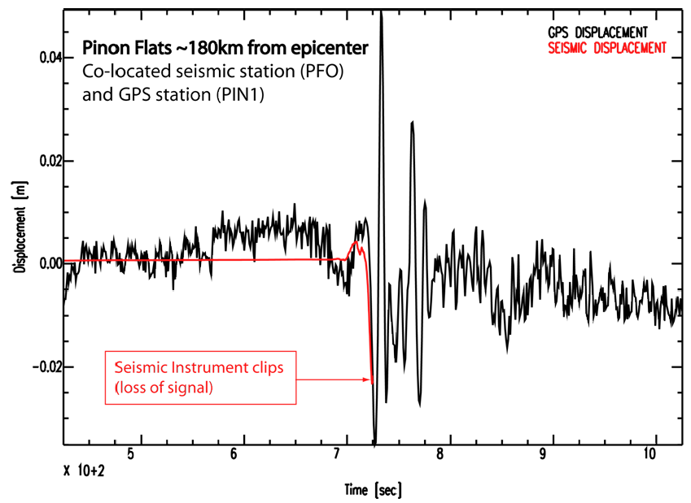
(Note: for really big signals, can get more robust operation
and lower frequencies from other types of instruments…
E.g. GPS!)
4 April 2010 M7.2 Baja California earthquake

