Slide 1
Geology 5660/6660
Applied Geophysics
18 Mar 2024
Last Time: Introduction to Gravity
• Governed by LaPlace’s equation:
with solution of the form:
• If we have a spherical body with mass M and constant (or
radially symmetric) density, this integral becomes:
• Method looks for anomalies in gravity Δg (relative to
the gravity expected for a uniform-density ellipsoid)
that result from lateral changes in mass density ρ
For Wed 20 Mar: Burger 349-378 (§6.1-6.4)
© A.R. Lowry 2008-2024

Slide 2
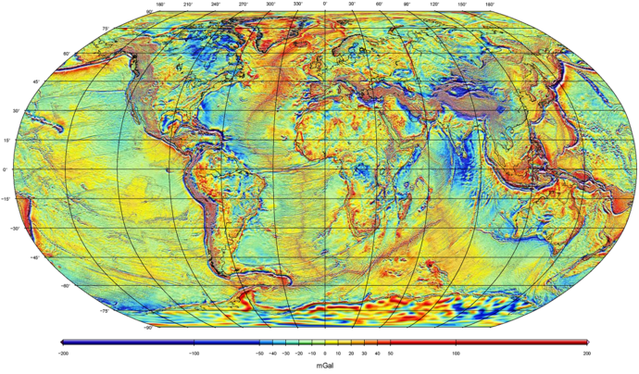
Example:
Global Free-Air Gravity Field from GRACE + GOCE + satellite altimetry + surface measurements…
WGM2012 model from Bureau Gravimetríque International

Slide 3
Gravity Measurements:
I. Absolute Gravity :
Measure the total field ⇒ time of a falling body
vacuum
Must measure time to ~10⁻¹¹ s;
distance to ~10⁻⁹ m
for 1 μgal accuracy!
Nevertheless this is the most
accurate ground-based
technique (to ~3 μgal)
Disadvantages: unwieldy; requires
significant power and a long time
(a day) to measure that accurately
prism
laser
~2m

Slide 4
Gravity Measurements:
II. Relative Gravity :
Measures difference in at two locations.
• Pendulum : difference in period T:
Errors in timing of period T ⇒ ~0.1 mgal
• Mass on a spring : MΔg = kΔl
or Δg = kΔl/M
Worden and Lacoste-Romberg
are of this type
(“zero-length” spring of L-R yields
errors around 6 μgal)
l
spring
constant
k
length l
mass M

Slide 5
Gravity Measurements:
III. Satellite Gravity :
Measure (from space) the height of an
equipotential surface (called the geoid, N)
relative to a
reference
ellipsoid.

Slide 6
Gravity Measurements:
III. Satellite Gravity:
Measure (from space) the height of an equipotential
surface (called the geoid, N) relative to a reference
ellipsoid
Ocean Altimetry: Measure height of the ocean
surface using radar or laser (e.g., SEASAT, JASON)
Satellite Ranging: Satellite orbits follow the geoid
Measure orbits by ranging from the ground to the
satellite or ranging between two satellites
(e.g., GRACE)
N

Slide 7
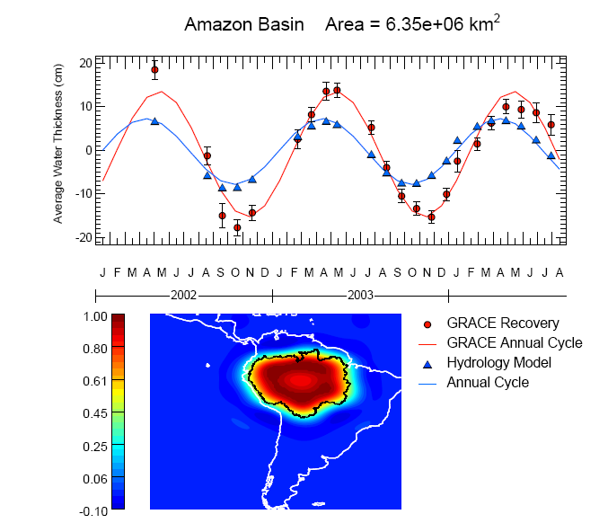
GRACE designed for time-variable gravity, mostly hydrosphere

Slide 8
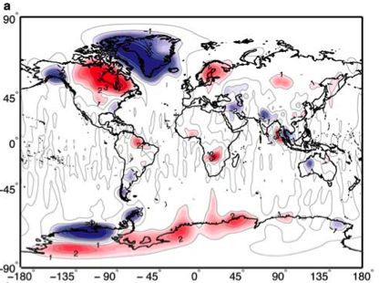
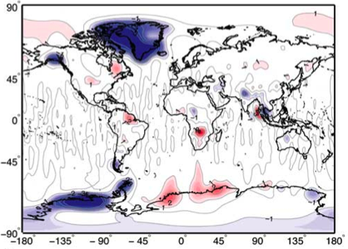

GRACE Mass Trend 2003-2010: (Jacob et al., Nature, 2012)
Total mass trend
Corrected for solid Earth
(i.e., the residual relates to
hydrology + cryosphere)

Slide 9
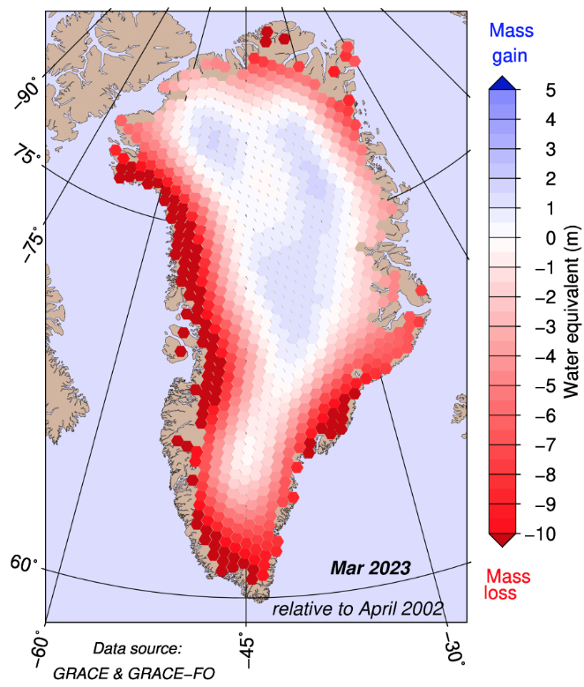
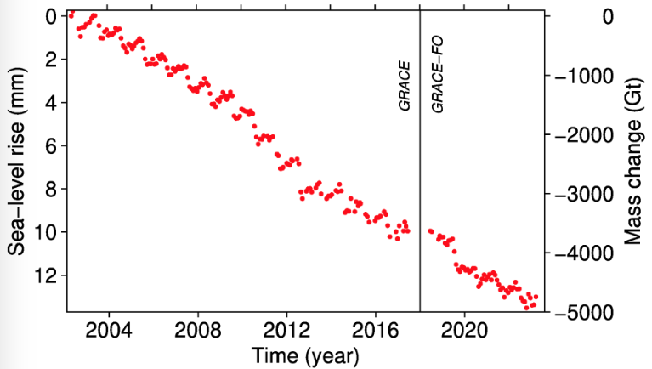
GRACE-derived mass trend over Greenland shows
melting and accumulation; net loss is 222±9 km³/yr!
Contributions
to global sea
level change:
Greenland:
0.61±0.02 mm/yr
Antarctica:
0.45±0.20 mm/yr
Continental:
0.41±0.08 mm/yr
Total Anthropogenic:
1.48±0.22 mm/yr
Altimetry: 3.3 mm/yr
Images from polarportal.dk

Slide 10
Example:
Global Free-Air Gravity Field from GRACE + GOCE + satellite altimetry + surface measurements…
WGM2012 model from Bureau Gravimetríque International

