Slide 1
Geology 5660/6660
Applied Geophysics
18 Mar 2026
(Lab 5)
Lab 5 assignment (GPR)
Due one (1!) week from Friday,
27 March at 2:30 pm
© A.R. Lowry 2008-2026

Slide 2
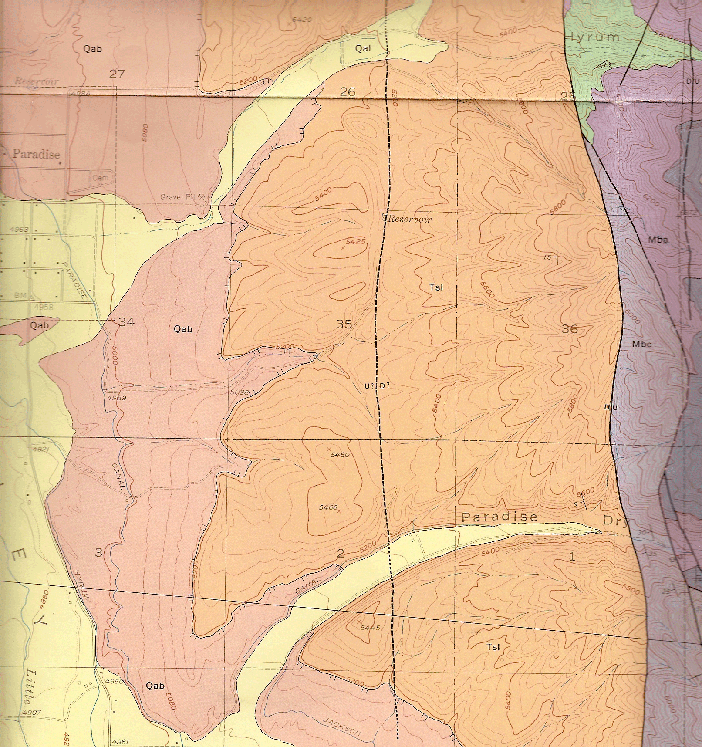
Lab 5: Ground Penetrating Radar
Introducing the field locale:
Southern segment of the
East Cache Fault (near
Paradise)
Three radar lines;
two trenches
Three (?) fault strands
East = west-dipping
listric normal fault
Central = antithetic
West = Bonneville
high-stand and/or (?)
west-dipping normal
fault
C
W
E
With thanks to Stephanie Davi & cohorts!

Slide 3
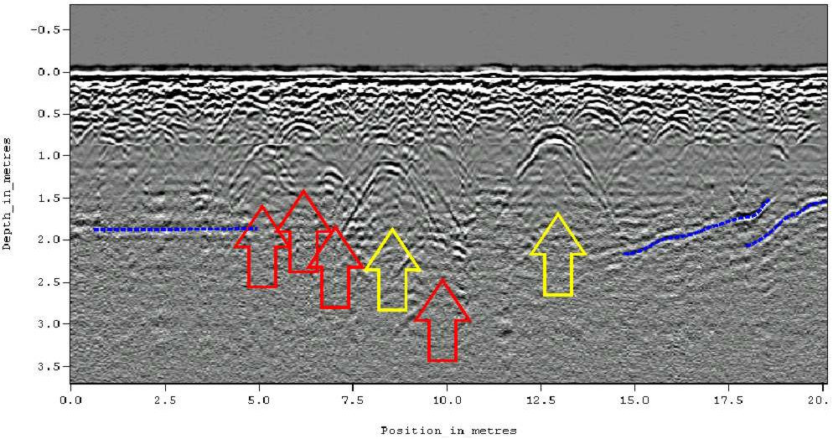
Useful Things to Remember (Part 1):
Diffractions appear in GPR much like they do in seismic sections
(From a Historical Cemetery in Alabama)

Slide 4
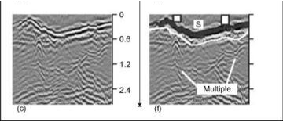
Useful Things to Remember (Part 2):
Multiples look different than we’ve seen previously:
Because we usually have common-offset or zero-offset source
and receivers, look for reflections that consistently arrive at
twice (or more) the two-way travel-time of “earlier” reflections.
Can also get “ringing” of the ground surface…

Slide 5
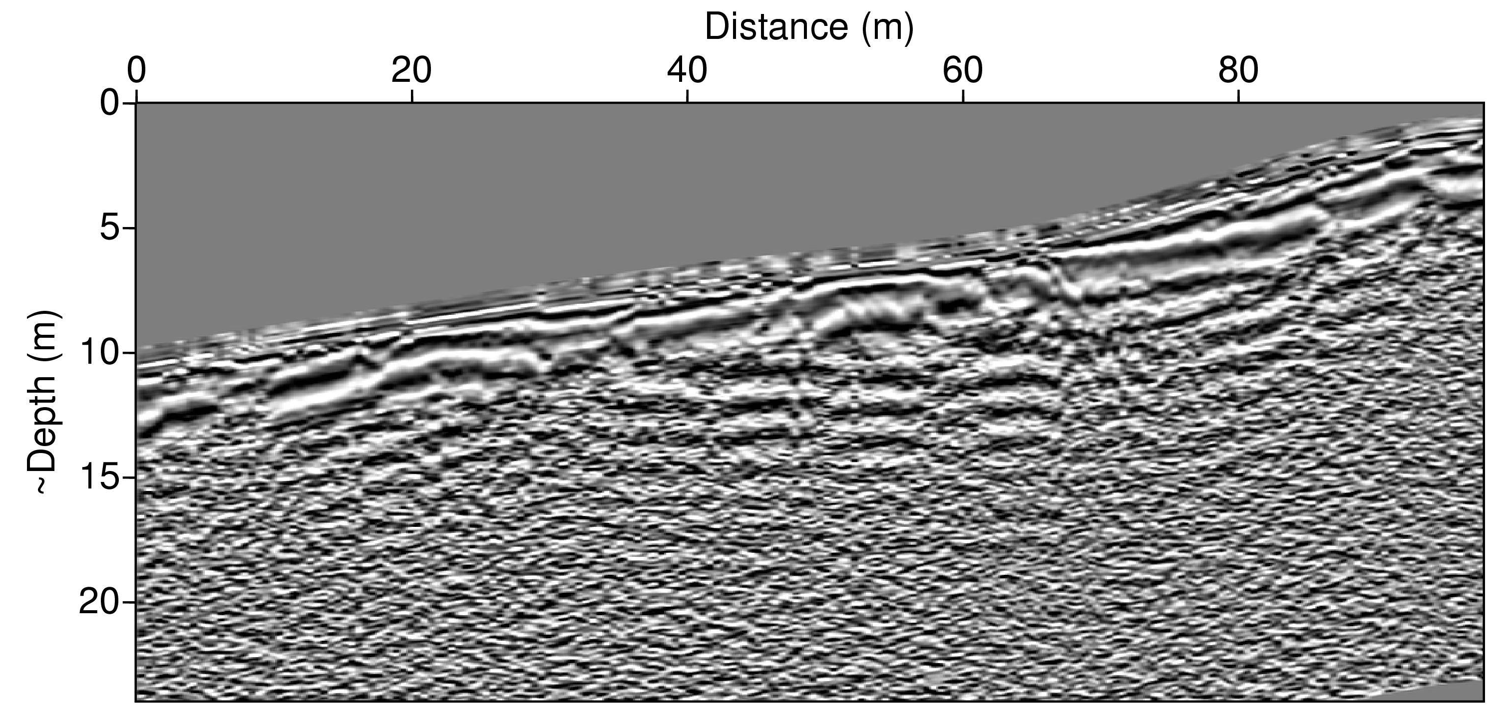
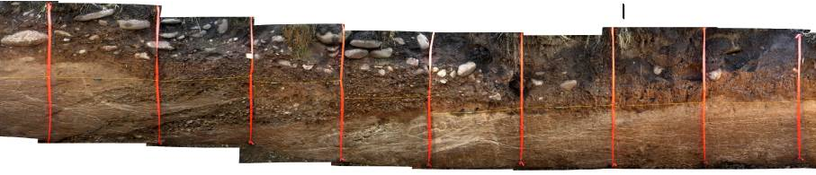
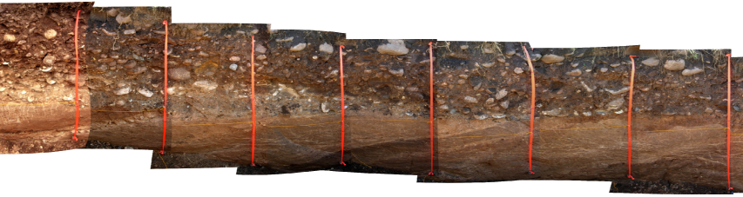
Western Fault Strand (“W”)
Ribbons are spaced 1 m apart for scale; no vertical exaggeration!
Antennae for
Paradise surveys
= 100 MHz!
East dipping layers of the Tertiary Salt Lake Formation (T_{SL})

Slide 6
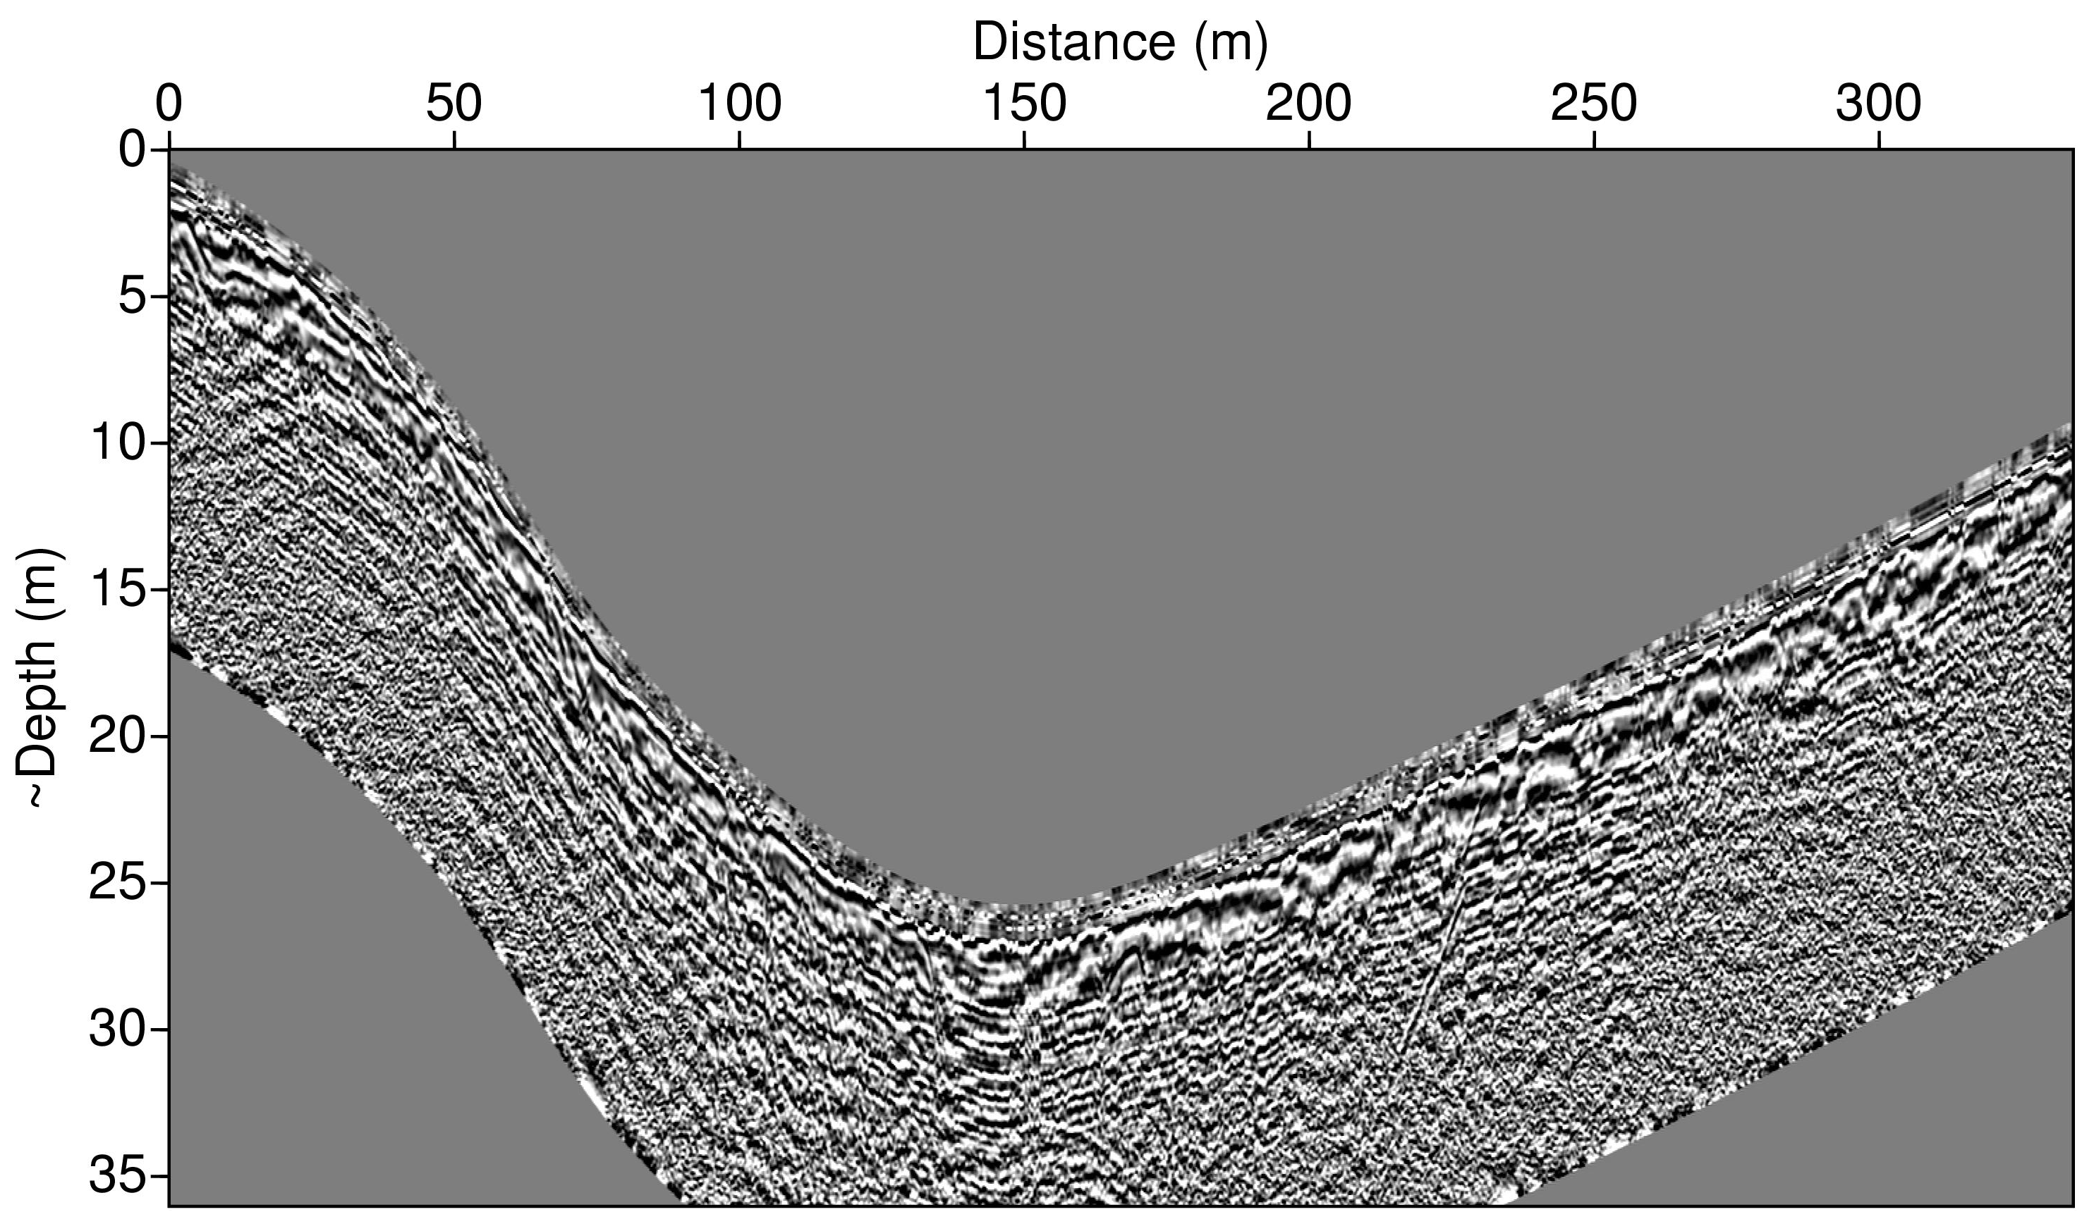
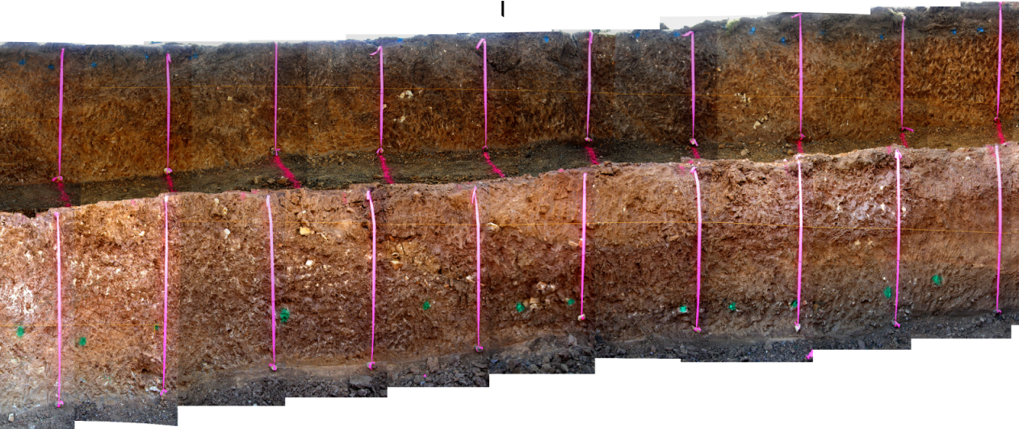
Central Fault Strand (“C”)
Note relatively poor data quality (ringing, poor trace correlation)

Slide 7
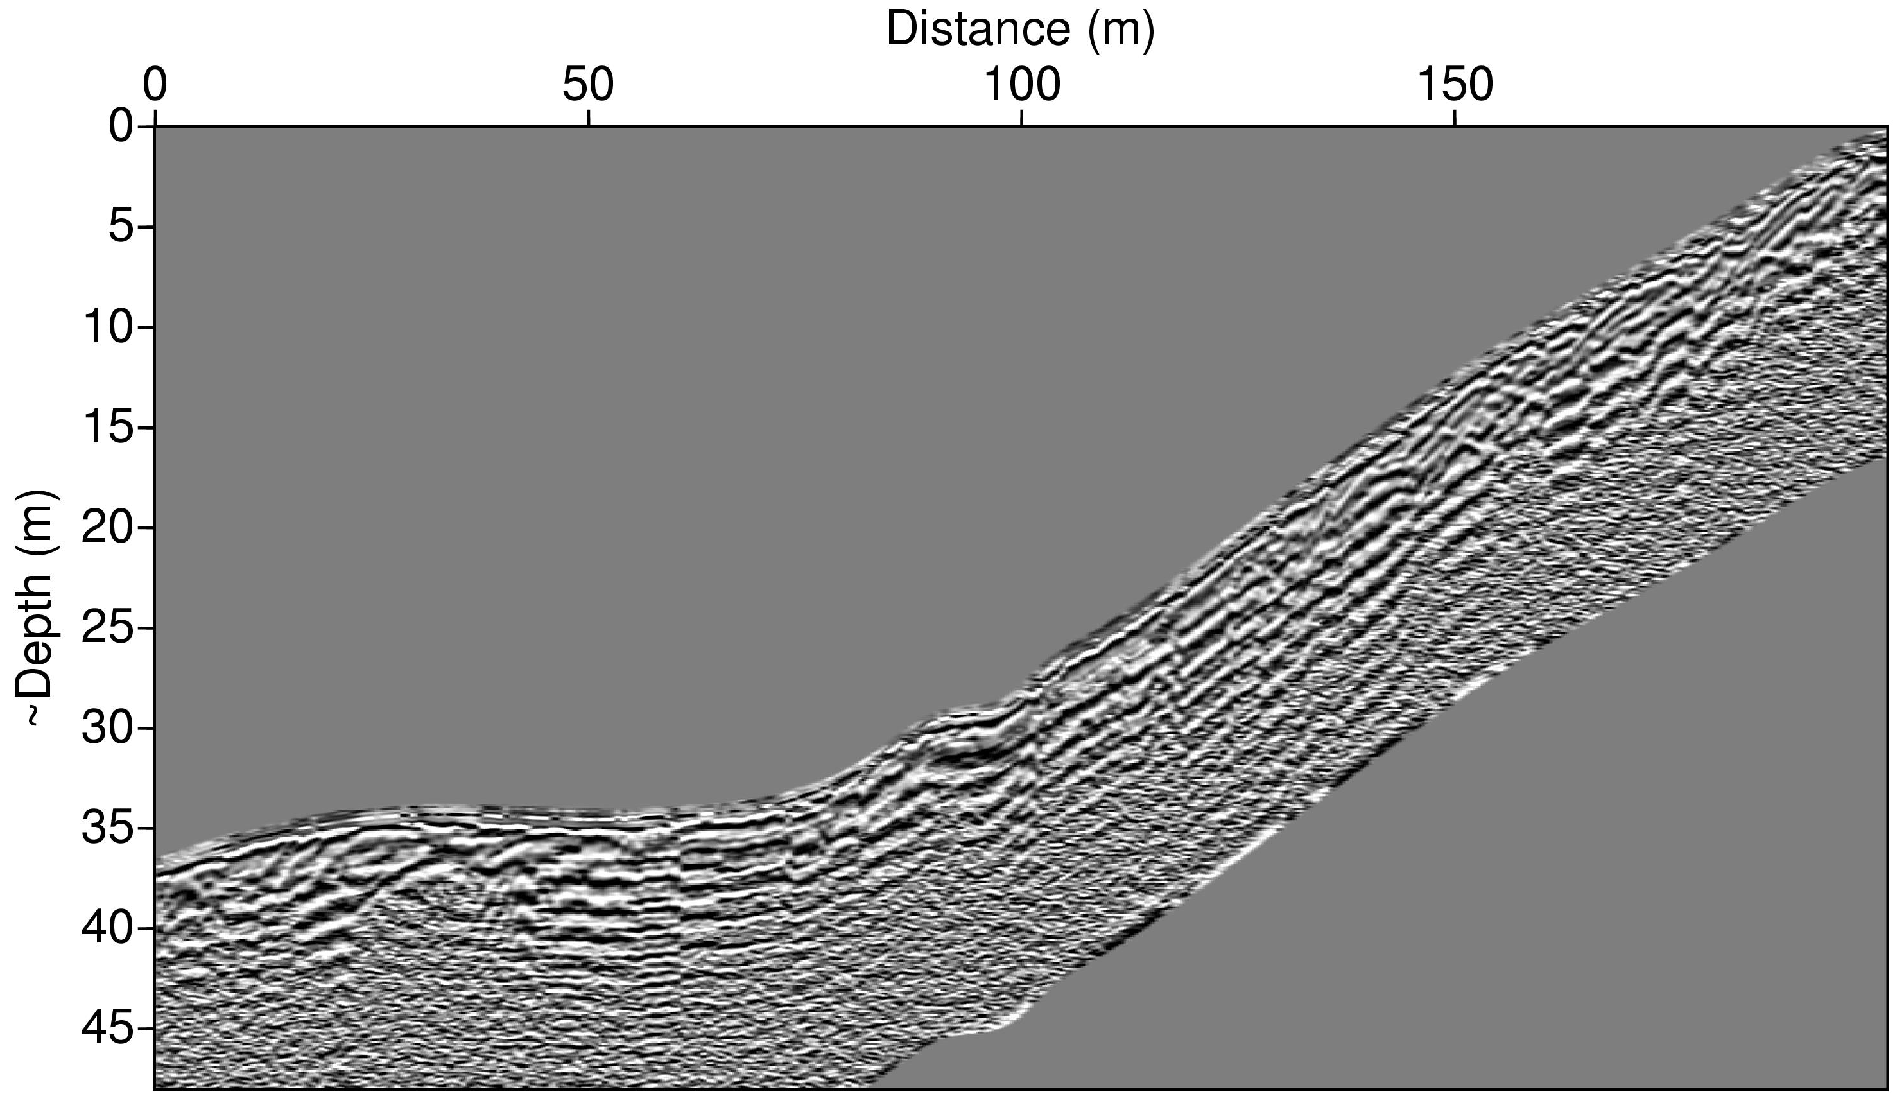
Eastern Fault Strand (“E”)
road
(No trench dug on this section)

Slide 8
Lab 5:
Carefully compare the information contained in trench
sections with information in each radar profile. What
correlative features can you identify? Are there major
features in any of the radar profiles that seem to be
missing in the trench? Why do you think they chose
to trench where they did, based on the radar images?
(2) Using the information you’ve gleaned from the trench
data and whatever else you may have available, draw
an interpretive line drawing from each radar profile
and label the features. Be sure to note any features
(such as offset horizontal beds and/or diffraction
arrivals) that might indicate a fault trace, and discuss
whether and/or why (and where) you would (or would
not) recommend any additional trenching based on
these profiles.

Slide 9
(3) Recall that radar velocity is given by
a. Try to find a horizon on each of the W, C radar profiles
that you can calibrate to true depth by comparison to the
trench photos. Assuming that μ = 1, ε_{true} is the true (real part
of) dielectric permittivity of the medium and ε_{assumed} is the
permittivity that was assumed in order to convert time to
depth in the images, what is the approximate
ratio of ε_{true}/ε_{assumed} for each profile?

Slide 10
b. Find at least one diffraction in each of the profiles.
First derive a “depth” equation for the diffraction
hyperbola given some assumed velocity V_{a}. Then
use the observed moveout in your diffraction
hyperbolas to estimate V/V_{a}. Do you think they used
a value typical of soil or of sediment?
Be sure to include a clear description of all calculations and
assumptions that went into getting these numbers. Also in
your write-ups, please include the number/letter scheme
used here (i.e., (1), (2), (3)a and (3)b) and separately
address every question under each part.

