Slide 1
Geology 5660/6660
Applied Geophysics
19 Apr 2024
Last Time: Magnetotelluric (MT)
• Magnetotelluric (MT) measures 3D magnetic field H, horizontal
electrical field E in time series to get electrical resistivity structure:
where ρ_{sd} is averaged resistivity over an
ω-dependent skin depth.
• Passive method ⇒ sources include lightning strikes (10,000–1 Hz;
ionospheric resonances (1–.001 Hz); ionospheric disturbances
(.001–very low Hz)
• Some (minor but growing) applications in oil & mining; commonly used
in large scale studies of tectonics, melts and volatile/fluid transport
• EarthScope data show evidence of (primarily E-W trending) small-scale
melt bodies under W-C Snake River Plain and widespread melt in
lower crust of the Basin-Range province!
• Likely to grow in usage in the future
Read for Mon 22 Apr: We’re done with text!
© A.R. Lowry 2008-2024

Slide 2
Wireline Logging
describes a suite of geophysical tools that are lowered
into a well (often oil & gas; sometimes water, mining, or
environmental monitoring) to record physical properties of
the down-hole environment.
Much cheaper than coring (~$15–60 per m, plus transport);
provides in situ information on medium that can’t be gained
from core & enables “ground-truthing” of physical properties
imaged by surface geophysics.
Main types include:
• Electrical (resistivity, spontaneous potential)
• Nuclear (active and passive gamma, neutron)
• Seismic (sonic ⇒ acoustic (i.e. P-wave), velocity log)
• “Other” (caliper, temperature, camera, magnetic
susceptibility, …)

Slide 3
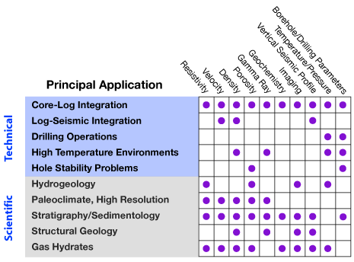

Applications matrix (from the
IODP-USIO website at Lamont-
Doherty)

Slide 4
Typically a single wireline
tool will include several
different sources and
sensors to maximize
efficiency…

Slide 5
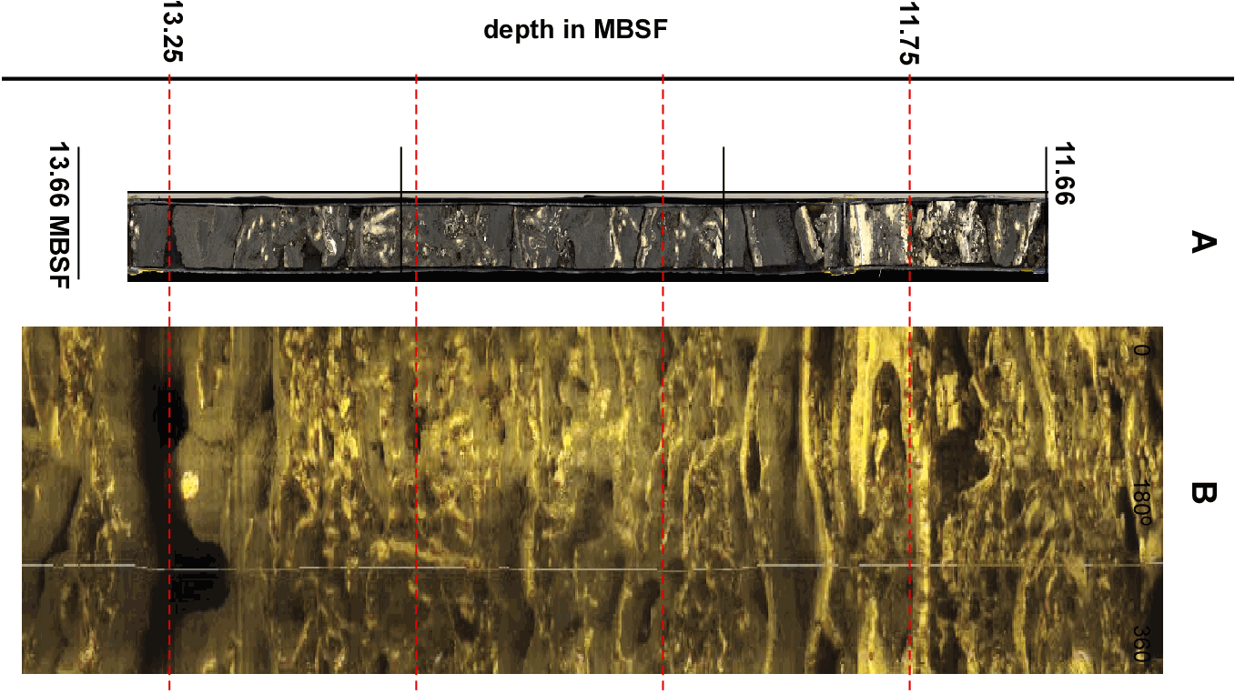
Borehole television or televiewer (acoustic reflection) is useful
to get fracture orientations, breakouts & drilling-induced tension
fractures (⇒ stress orientation; caliper also gives this). When
compared to unrolled images of core, image correlation enables
correction to true depth & orientation of the core.

Slide 6
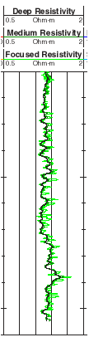
Electrical Logging
is perhaps most similar to stuff we’ve already seen.
Resistivity logging uses four or more electrodes (two+
current, two+ voltage) to measure apparent resistivity of the
well environment. Often use different spacings to image
“shallow” and “deep”; may also measure ρ of borehole fluid.
Recall resistivity dependence:
Low ρ_{a}
High ρ_{a}
Lithology
shale, clay
sandstone, limestone
Pore Fluid
brine
freshwater, hydrocarbon
Porosity
high
low
So resistivity is used in combination with other
logs to infer lithology, porosity, pore fluids. FMS
(formation microscanner; here “focused”) also yields
dip, structure, foliation & correlation to core...

Slide 7
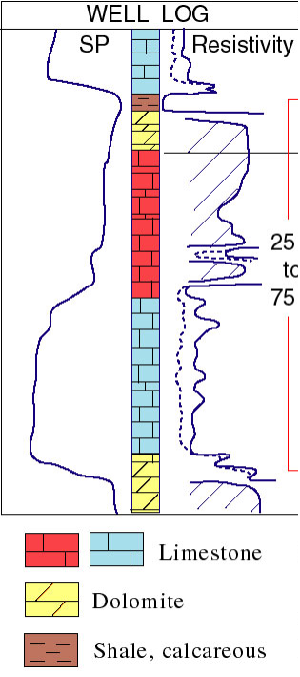
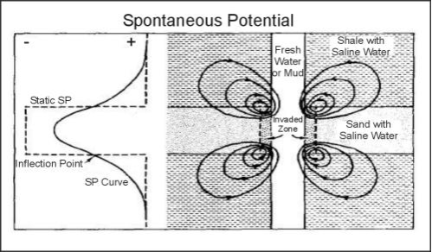
Spontaneous Potential Logging we’ve
already seen… Low SP indicates interaction
of brine fluids with drilling mud disturbance.
Low SP
High SP
Low ρ_{a}
brine in porous
limestone, sandstone
shale
High ρ_{a}
fresh water or hydrocarbon
in porous limestone/sandstone;
tight limestone
or sandstone
So SP is used in
combination with other
logs (especially resistivity)
to infer lithology, pore fluid
type, permeability

Slide 8
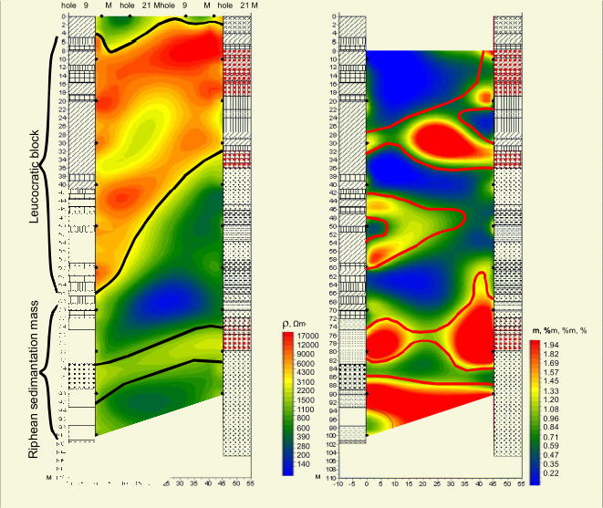
Induced Potential also gets used in a borehole context, but
as in the case of surface surveys, it is used primarily for
mining and environmental monitoring applications.
Here, cross-
borehole
imaging shows
high resistivity
associated with
a metasomatic
granite; high
chargeability
with sulfides
accompanying
trace deposits
of gold.
Resistivity
Chargeability

Slide 9
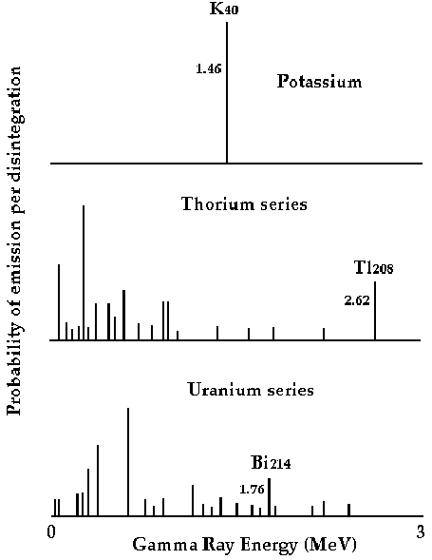
Nuclear Borehole Logging
uses either passive or active recording of radioactive
(nuclear fission) emissions.
Natural Radioactivity
logging records spectral
content of passively-sensed
gamma rays produced by
fission. Spectra are different
for different radioactive
elements so measure
concentrations of K, U, Th in
the formation.
Radioactivity in sediments
generally means weathered
by-products of feldspar, so
(courtesy Kansas
Geological Survey)
mostly used to infer lithology (although it also has
implications for cementation, permeability, strat correlation).

Slide 10
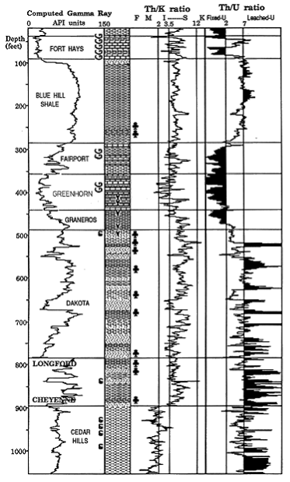
Generally
speaking,
low gamma
means clean
sandstone or
limestone;
high gamma
indicates
presence of
shale.
Proc Oc Drill Prog v198, 2001
(courtesy Kansas Geological Survey)

Slide 11
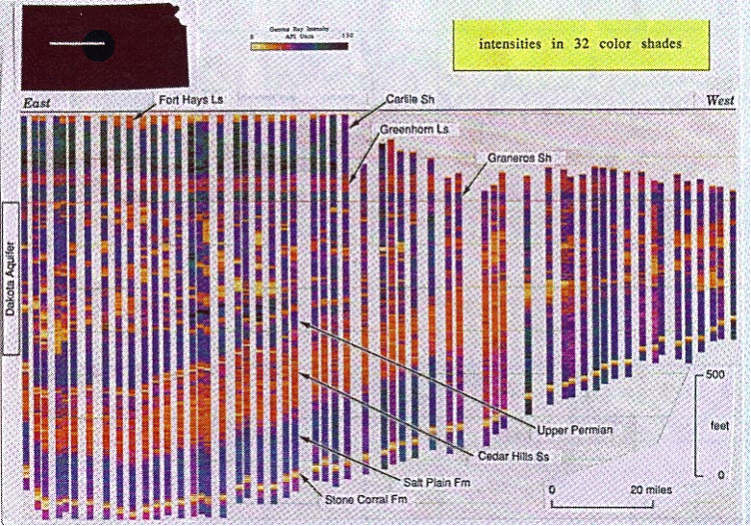
Profile of Permian to Upper Cretaceous γ-logs for a basin
in western Kansas

Slide 12
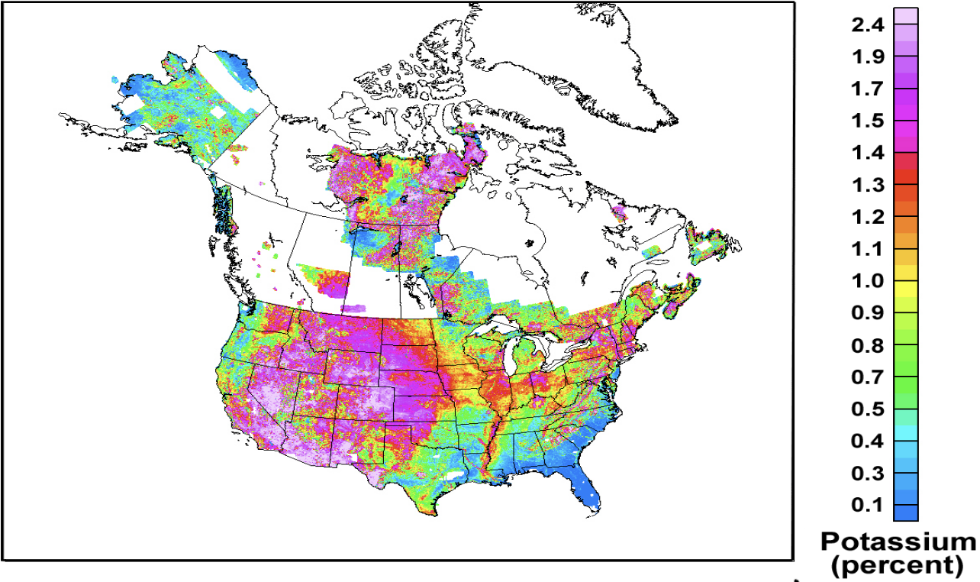
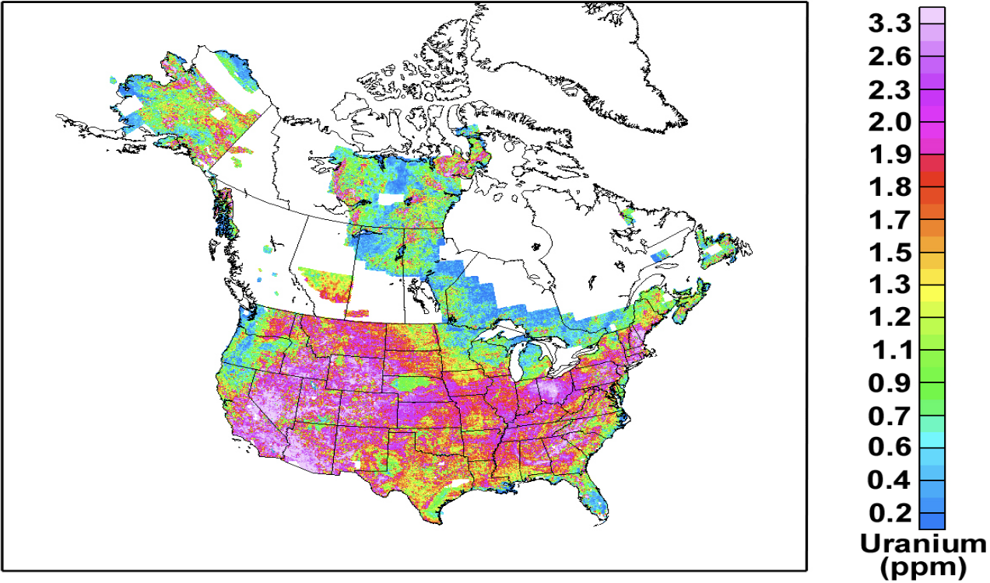
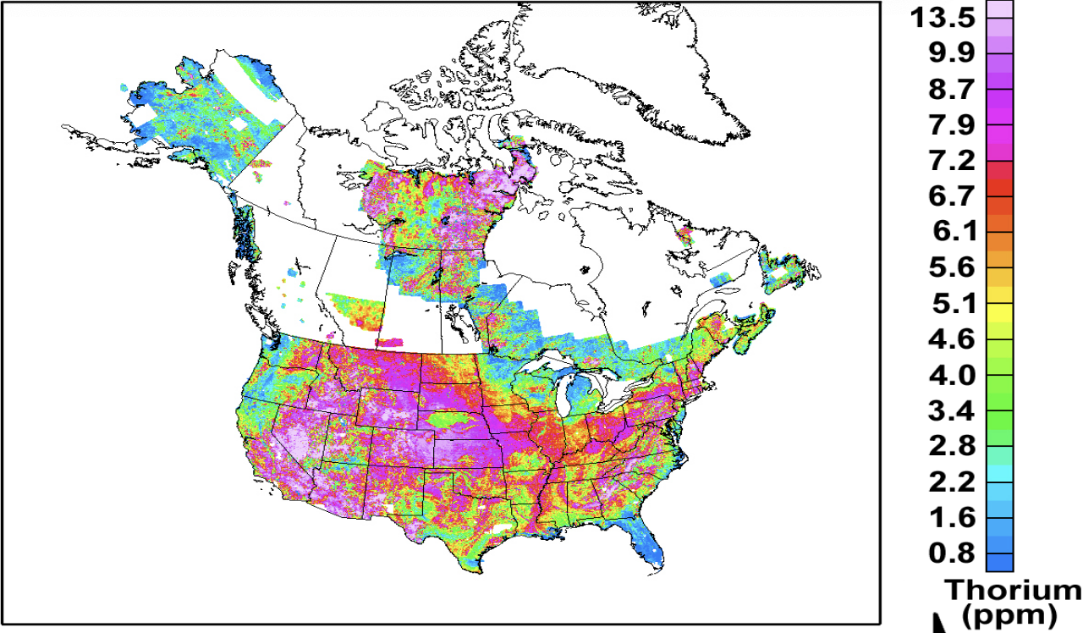
K
Aside:
Aero-spectral
gamma also has
applications in mining
industry and other
exploration problems
Duval et al., USGS Open File Rep 2005-1413
U
Th

Slide 13
Nuclear Logging:
Anhydrite and Gypsum
Gabbro and Basalt
Coal
Some Lignites
Limestone and Dolomite
Sandstone - Orthoquartzite
Arkose
Caliche
Shale
Red
Bentonite
Organic
Schist and Gneiss
Granite and Rhyolite
Potash and Phosphate Beds
Increasing Total Gamma
Total “γ” natural radioactivity of various rocks

Slide 14
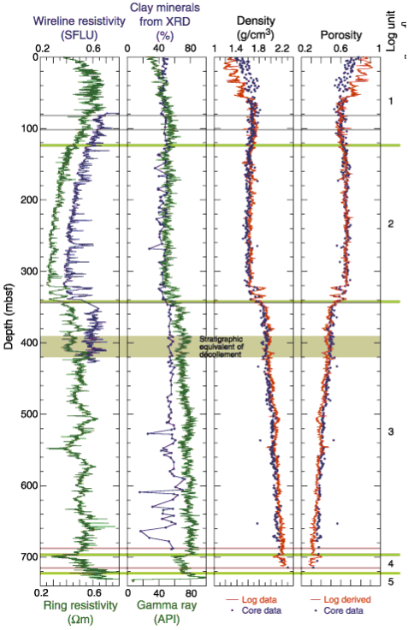
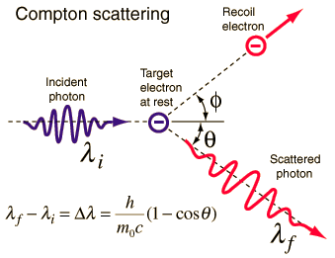
“Formation Density” (γ-γ) logs
estimate density of electrons in the
total formation (rock matrix plus
pore fluids) by measuring Compton
scattering of gamma rays
(generated by a radioactive Cesium
source on the wireline tool). Gamma
rays detected relate directly to
electron density in the medium.
Porosity can be determined IF the
rock lithology and pore fluid type are
independently known!

Slide 15
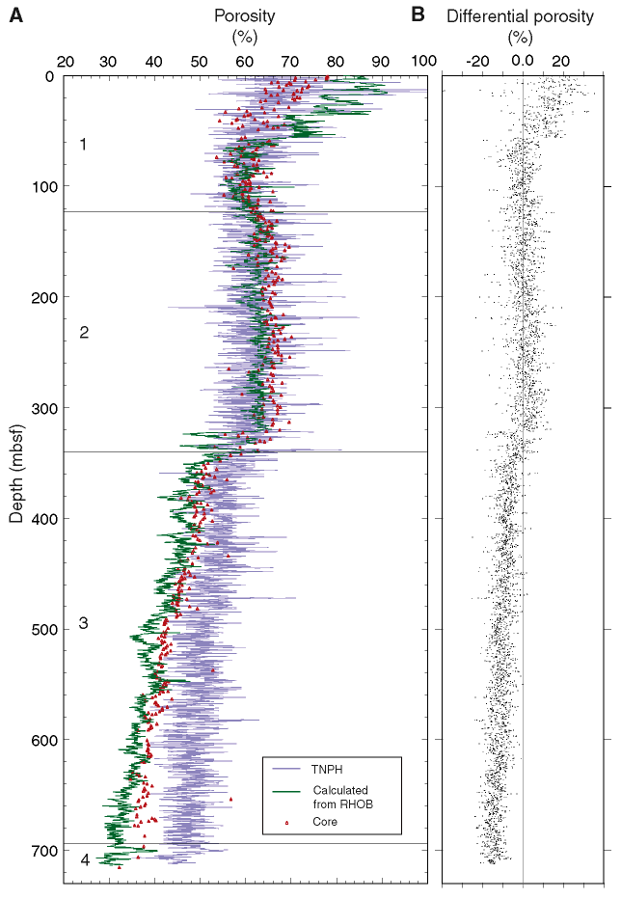
Neutron Log: Radioactive
source (Am-Be or Pu-Be)
emits fast neutrons; these
interact with/lose energy to
hydrogen atoms until they
slow to energies where they
scatter or are absorbed,
releasing a γ-ray.
Hence provides a measure
of concentration of H
atoms… After correcting for
borehole muds, P-T-salinity,
formation lithology, & pore
fluid type (using other logs),
can use to estimate porosity.
TNPH = neutron
RHOB = γ–γ
Proc Oc Drill Prog v196, 2001

