Slide 1
Geology 5660/6660
Applied Geophysics
17 Apr 2026
Last Time: Borehole logging
• Wireline Logging is the practice of lowering a geophysical
tool down a well to measure physical properties in situ
• Single logs are (often) ambiguous; combine logs to get
lithology, porosity, pore fluid type
• Important for:
→ Relating core to the in-situ borehole environment
→ Relating surface seismic to the in-situ borehole environment
→ Determining formation lithologies, porosity, fluid chemistry
→ Temperature for thermal/hydrocarbon maturation studies
→ Guiding drilling operations
• Borehole televiewer (from P reflections) gives fracture properties,
“dipmeter”, log/core correlation
© A.R. Lowry 2008-2026

Slide 2
Last Time Continued: Wireline Logging
• Resistivity logs work on similar principles to surface DC
resistivity method; low ρ implies shale, clay or briny fluid
• Low Spontaneous Potential (SP) indicates presence of
high-porosity/permeability, brine-filled formations
• Natural Radioactivity (“Gamma”) Log measures high
energy EM (γ -freq) radiation; multi-spectral → concentrations
of K, Th, U elements. Useful for shale content, cementation,
some detrital minerals, strat correlation, paleosols...

Slide 3
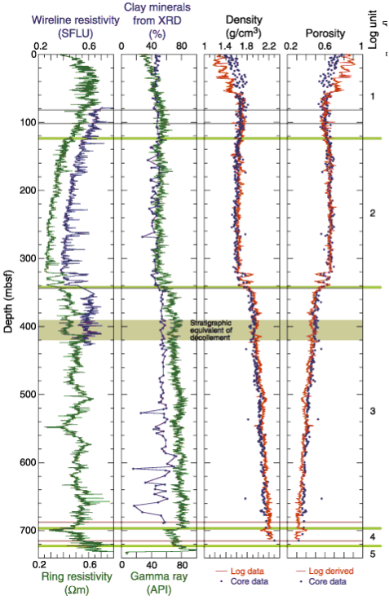
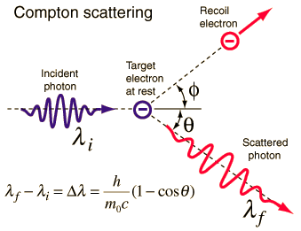
“Formation Density” (γ-γ) logs
estimate density of electrons in the
total formation (rock matrix plus
pore fluids) by measuring Compton
scattering of gamma rays
(generated by a radioactive Cesium
source on the wireline tool). Gamma
rays detected relate directly to
electron density in the medium.
Porosity can be determined IF the
rock lithology and pore fluid type are
independently known!

Slide 4
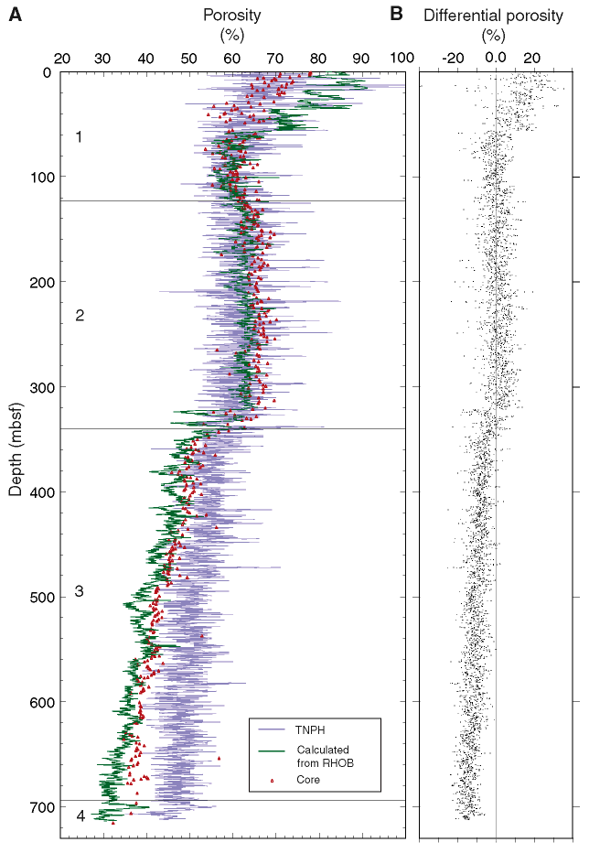
Neutron Log: Radioactive
source (Am-Be or Pu-Be)
emits fast neutrons; these
interact with/lose energy to
hydrogen atoms until they
slow to energies where they
scatter or are absorbed,
releasing a γ-ray.
Hence provides a measure
of concentration of H
atoms… After correcting for
borehole muds, P-T-salinity,
formation lithology, & pore
fluid type (using other logs),
can use to estimate porosity.
TNPH = neutron
RHOB = γ–γ
Proc Oc Drill Prog v196, 2001

Slide 5
“Formation Density” (γ-γ) logs
estimate density of electrons in the
total formation (rock matrix plus
pore fluids) by measuring Compton
scattering of gamma rays:
(generated by a radioactive Cesium
source on the wireline tool). Gamma
rays detected relate directly to
electron density in the medium.
Porosity can be determined IF the
rock lithology and pore fluid type are
independently known!

Slide 6
Neutron Log: Radioactive
source (Am-Be or Pu-Be)
emits fast neutrons; these
interact with/lose energy to
hydrogen atoms until they
slow to energies where they
scatter or are absorbed,
releasing a γ-ray.
Hence provides a measure
of concentration of H
atoms… After correcting for
borehole muds, P-T-salinity,
formation lithology, & pore
fluid type (using other logs),
can use to estimate porosity.
TNPH = neutron
RHOB = γ–γ
Proc Oc Drill Prog v196, 2001

Slide 7
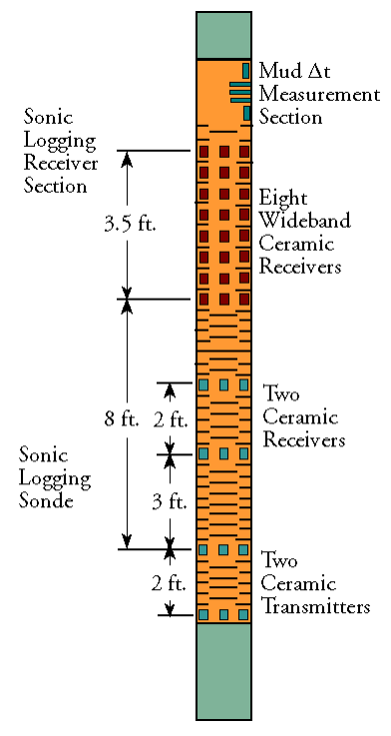
Sonic Log:
Measures acoustic (P-wave) travel
times at very high frequencies
Array sonde like the one shown
here can measure mud velocity,
formation P-wave and Stoneley
wave (like a surface Rayleigh wave:
interference pattern of P & S near a
free surface). In combination can
give both v_{P} and v_{S} velocities.
Used to measure velocities for well-
correlation with seismic (“synthetic
seismograms”) and for porosity φ:
Empirically,
(Here, rock matrix Δt_{m}
is derived from lab
measurement)
Example: Array Sonic Sonde

Slide 8
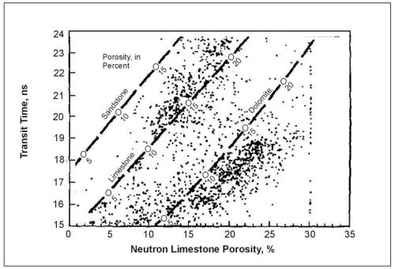
Typical applications of well-logging involve a combination of
simple physics and empirical observations (e.g., “crossplots”)
to sort out contributions from lithology, porosity, & pore fluids
in the formation… Now done with automated software.
Sonic log
Neutron log

Slide 9
Worth noting that much of the characterization of wireline log
response was done decades ago, using a limited range of
formation environments… Today’s drilling targets are sometimes
more challenging, and may require a new look at petrophysics!

Slide 10

Vertical Seismic Profiling uses geophones
(or sources!) in the borehole and sources (or geophones!)
arranged along the ground surface to better characterize
seismic properties in the near-well environment
“Seismic while drilling”
uses noise generated by
the drill bit as a source
for geophones at the
surface…

Slide 11
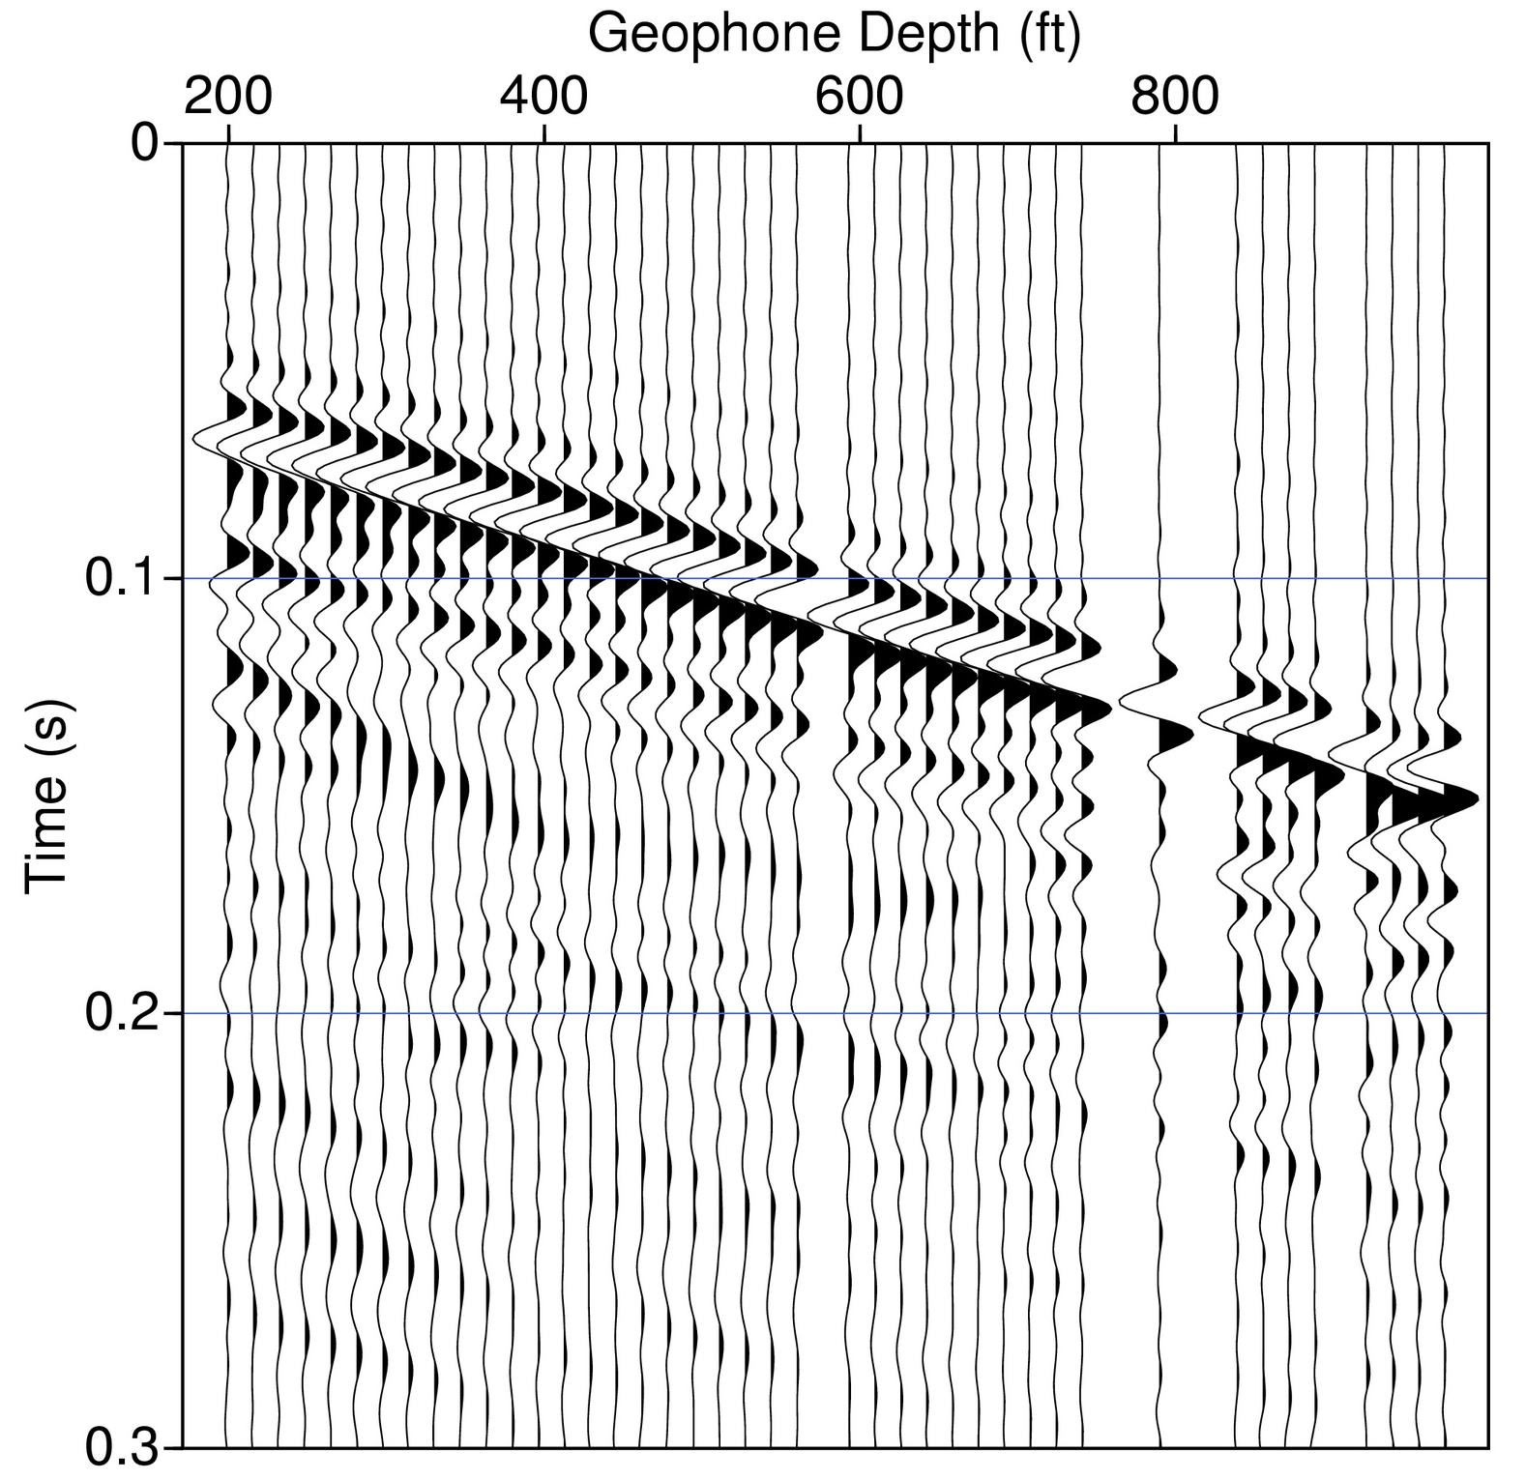
One primary
advantage of
VSP over e.g.
sonic log is that
frequency
content (& thus
3D spatial
averaging,
amplitude
response) is
more similar to
that of surface
seismic (so
provides better
depth migration
constraint, AVO
constraint)

Slide 12
Can isolate the
down-going
wave-field for
averaging of
interval
velocities for
migration
constraint; & the
up-going
(reflected)
wave-field for
correlation with
surface seismic &
AVO analysis…
Stoneleigh wave
Multiples
Reflected Stoneleigh wave

Slide 13
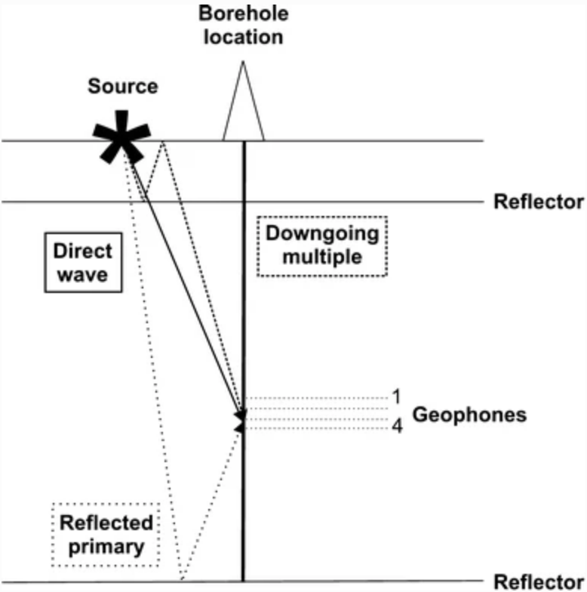
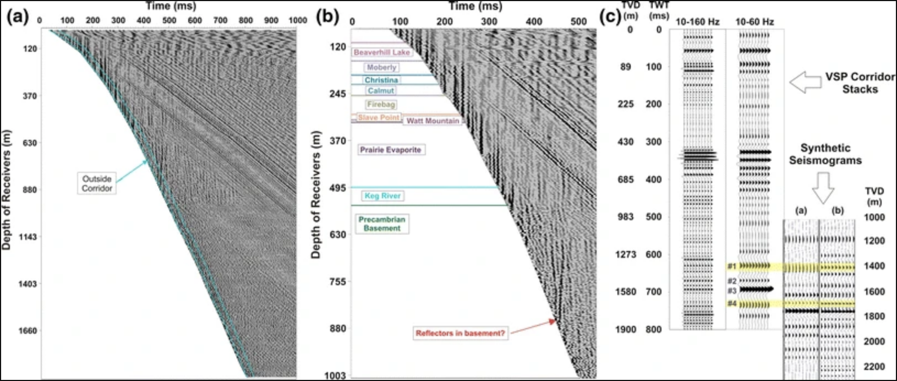
Various (upgoing & downgoing)
wavefields are separated using
filtering, allowing separation of
direct, multiples, upgoing
reflections and tube (Stoneleigh)
waves… Stacked reflections
can then give a more realistic
relationship to surface seismic
than (modeled) synthetic sections
Chan & Schmitt (2015) Int. J. Earth Sci.

Slide 14
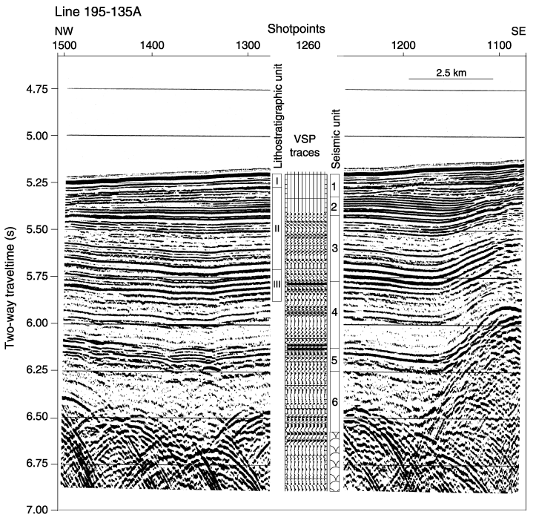
Here used
stacking of the
up-going
wavefield from a
zero-offset
source to
generate VSP
traces for well-
seismic
stratigraphic
correlation.
Volpi et al., Proc ODP Leg 178

