Slide 1
Geology 5660/6660
Applied Geophysics
20 Feb 2026
Last Time: Seismic Reflection Methods
• For resolution, we strive to get high frequencies:
→ Geophones with natural frequency 100 Hz; filter out low-f
→ High sample rate to avoid aliasing
→ High frequency source
• Because of attenuation, resolution is generally better
for shallow imaging; gets poorer with increasing depth
Read for Mon 23 Feb: Burger 200-253 (§4.4-4.7)
© A.R. Lowry 2008-2026

Slide 2
Last Time: Seismic Reflection Data Processing
• Processing Step I : Static Correction for elevation,
weathered (or soil) layer velocity & thickness:
OR shift all traces to enforce a head wave slope 1/V₁
• Step II : Dynamic Correction for Normal Move-out
using velocity analysis to optimize stacking velocities
V_{S}(t₀) at every possible t₀ for each source
→ automate by maximizing stack amplitude or
cross-correlation

Slide 3
Last Time continued: Reflection Data Processing
• Step III : Stacking (Common Midpoint Gathers)
Sum all NMO-corrected traces that have a common midpoint
for the source-receiver pair, and position that trace at
the midpoint location on the image…
However, dipping layers will be out of place.
Results e.g. in “bow-ties”
• Step IV: Time Migration rotates reflection energy to its
“true” location on a two-way travel-time image. Use multiple
source-receiver midpoints to determine where in 2wtt energy
must derive to get a continuous surface! For a dipping layer
and neighboring traces with different
intercepts t_{0a} and t_{0b} separated by x:

Slide 4
Other processing steps may include:
Amplitude adjustments : Small changes in impedance
contrast can change amplitudes significantly, making
reflections visually hard to follow. Some software will
normalize a reflection on one trace to that on the next.
Frequency adjustments : Filter to remove unwanted
low-frequency info (e.g. ground roll) digitally after the
fact instead of a priori (so information is preserved if
needed!)
Transmission adjustments : “Inverse filtering” to
upweight desired higher frequency (higher resolution)
info that is attenuated more by the Earth medium; also
filtering to remove effects of multiples
Conversion of time section to depth section, and
depth migration

Slide 5
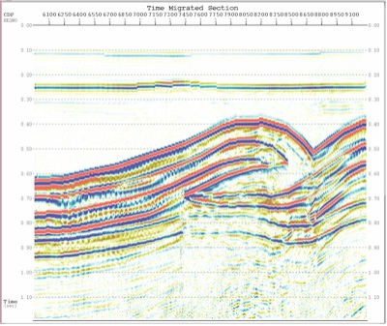
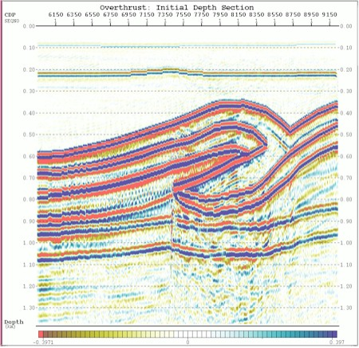
Time Migrated seismic image
Depth Migrated seismic image

Slide 6
Note also that, once dip is known from initial
migration and time is converted to depth
by depth migration, a clearer image will result
if the processor goes back a few steps to create
new shot gathers from groupings that create
reflections from the same point in space (instead
of simply using common midpoints)…
These are called Common Depth Point
(CDP) gathers, making reflection processing an
iterative process that repeats many of the steps
(and in some cases, several times)!

Slide 7
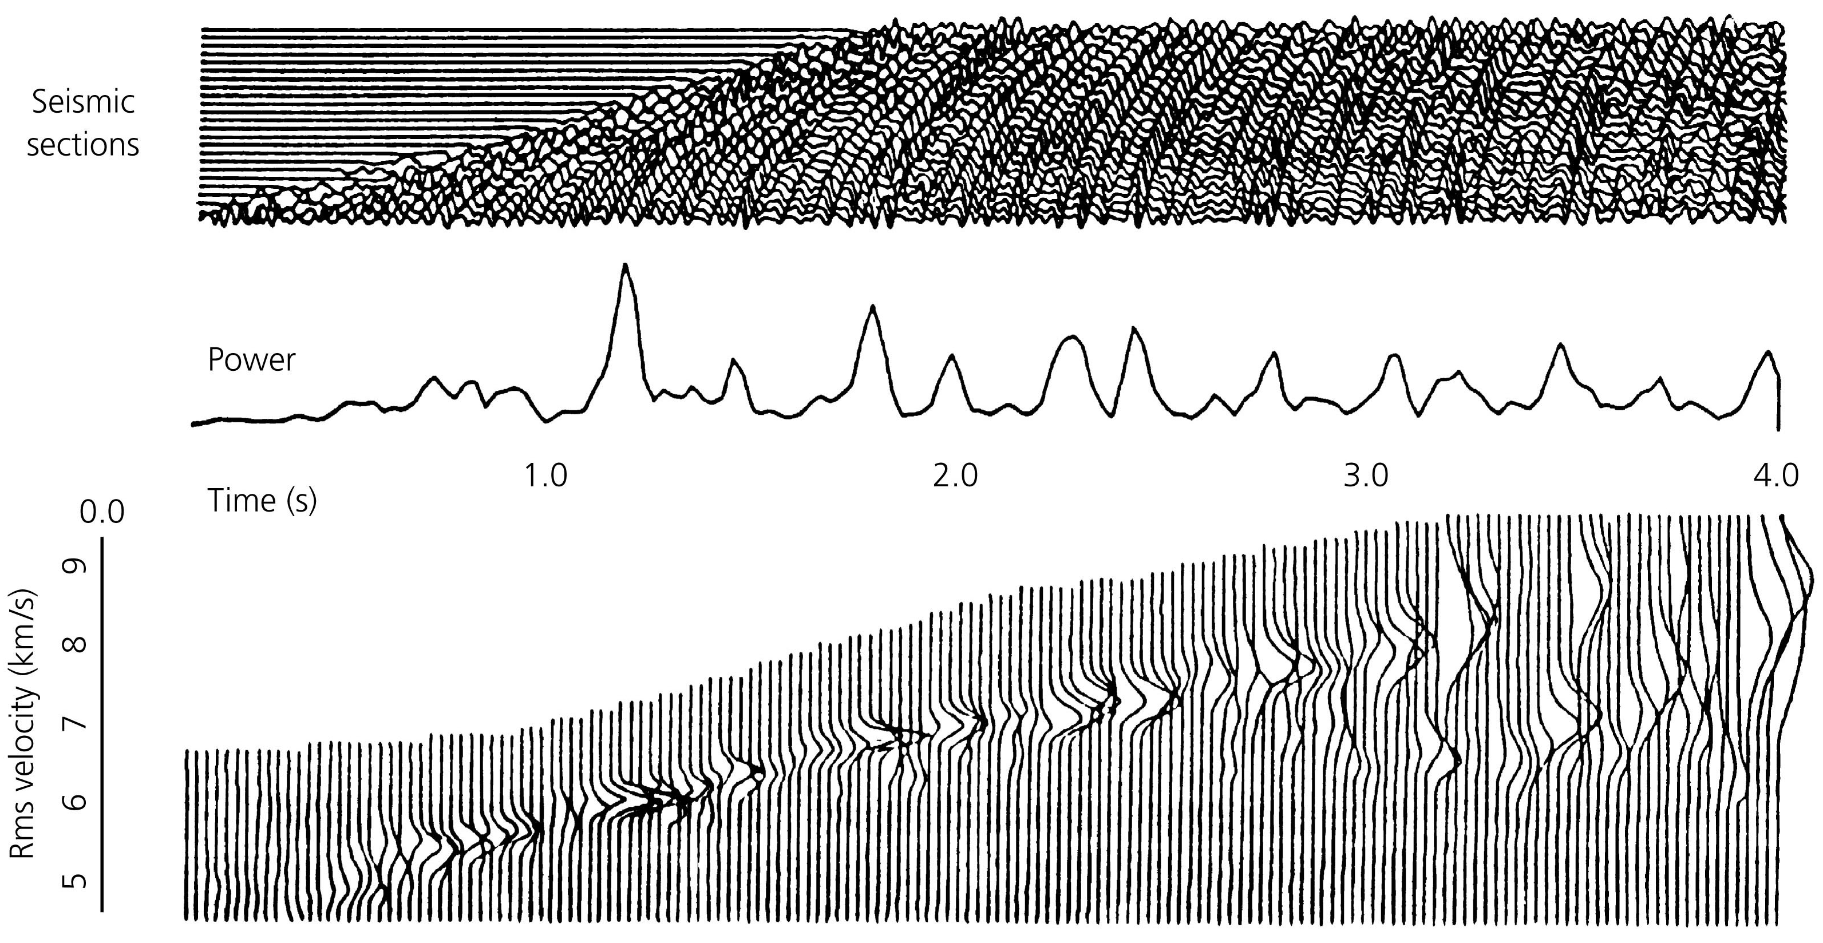
To convert 2WTT to depth, we need to know velocity… Recall
we had to estimate V_{RMS} for NMO correction!
As you might expect, values for V_{RMS} will tend to increase with
increasing two-way travel-time…

Slide 8
Using the velocity analysis from NMO correction, it becomes
only a matter of book-keeping to calculate depth. Important
to recognize however that V_{RMS} can vary laterally as well
as vertically, so need independent estimates for different
locations (e.g. different gathers used for NMO correction).
Without depth conversion, reflection energy under structures
is diffused or disturbed; can get “false structures” such as
velocity pull-ups & pull-downs
reef

Slide 9
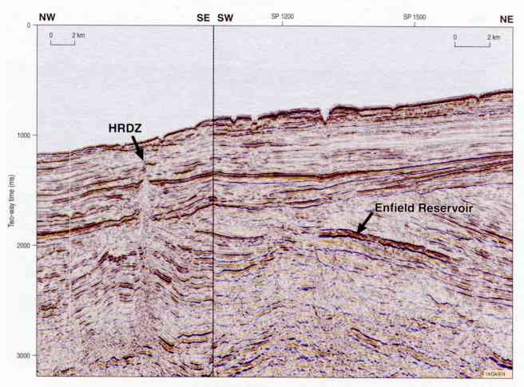
HRDZ: “Hydrocarbon-related diagenetic zone”…

Slide 10
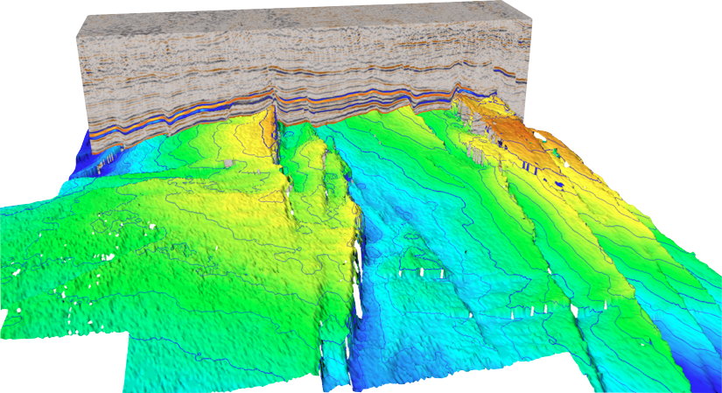

Haakon Fossen 2010
Seismic
Interpretation

Slide 11
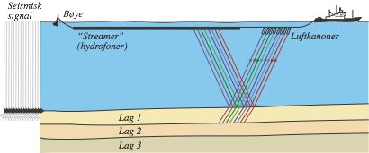
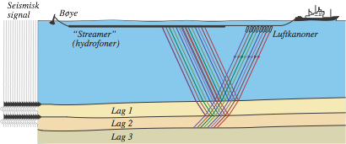
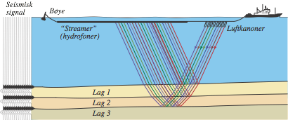
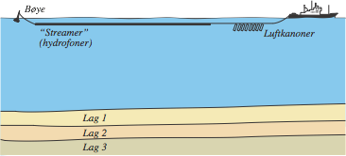
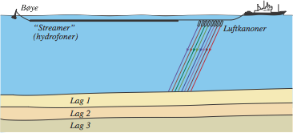
Haakon Fossen 2010
Seismic Data
• Usually active source (explosions, as distinct from natural sources)
• Industry seismic images the upper 0-8 km of the crust
• Deep seismic images the entire crust and the uppermost part of the mantle
Buoy
Airgun source
array
Hydrophone array

Slide 12
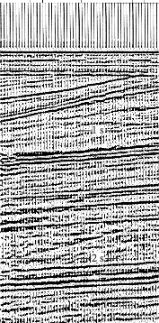
Haakon Fossen 2010
Seismic Data

Slide 13
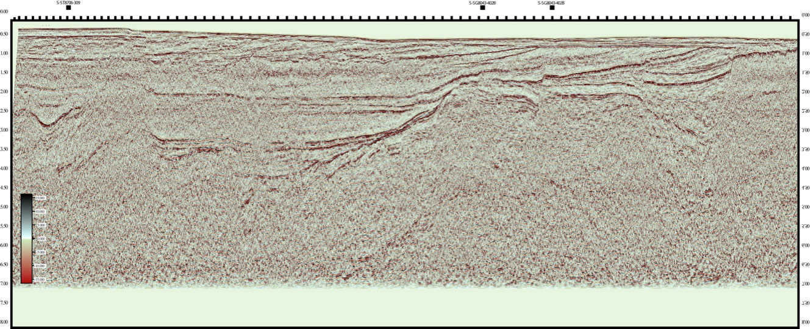
Haakon Fossen 2010
2D Seismic Data
• 2D lines are long profiles that are processed independently
• Generally collected now for regional reconnaissance studies
• Covers large areas and gives an overall picture of the geology

Slide 14
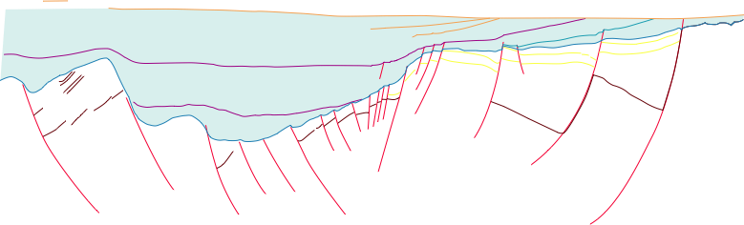
Haakon Fossen 2010
2D Seismic Data
• Interpretation may rely on regional outcrops or an exploration
well to infer major formation boundaries/units

Slide 15
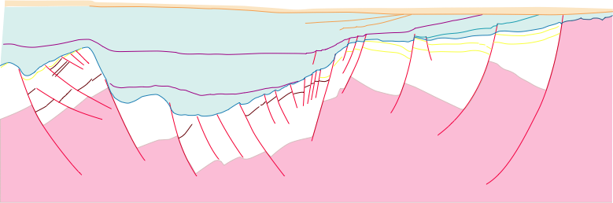
Haakon Fossen 2010
2D Seismic Data
• Interpretation may rely on regional outcrops or an exploration
well to infer major formation boundaries/units
• But, 3D structure will also be present as “artefacts”!

Slide 16
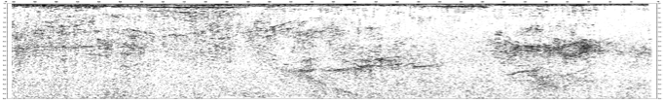
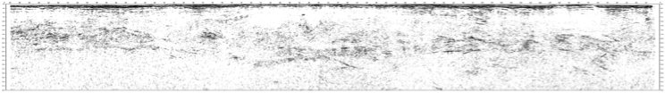
Haakon Fossen 2010
Deep seismic profiling
• Imaging depth ranges from 0-50 km
Strongest & most continuous impedance contrasts below
sedimentary cover are lithologic changes ~mid-crust
and at the Moho

