Slide 1
Geology 5660/6660
Applied Geophysics
20 Feb 2026
Review Lab 2
© A.R. Lowry 2008-2026

Slide 2
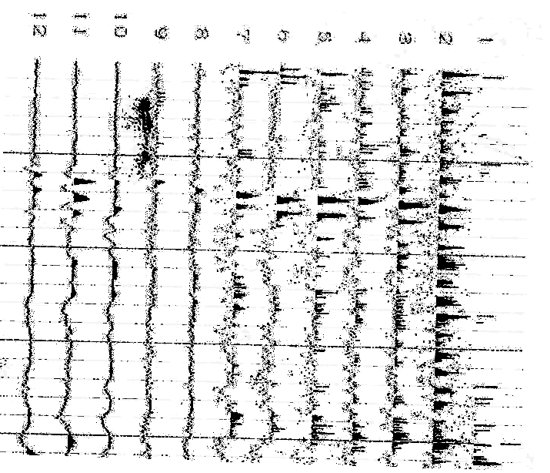
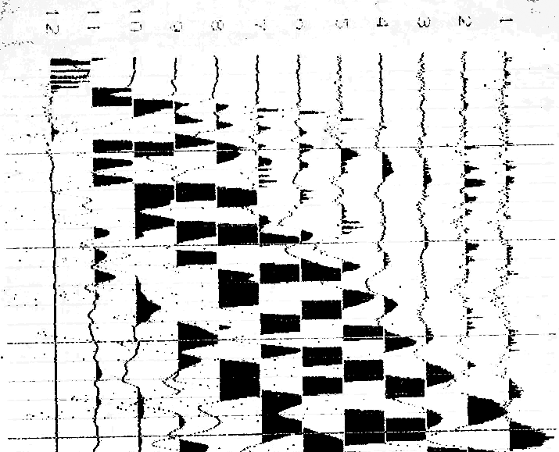
0.01 s
0.02 s
0.03 s
0.04 s
0.05 s
The seismic data above were collected on a farm near Gosport, IN. The
faint lines demark 0.01 s intervals; darker lines are at 0.05 s. The
geophones were placed at distances of (0,4,8,12,16,20,26,32,38,44,50
56,62,68,74,80,86,92,96,100,104,108,112,116) m from the source.

Slide 3
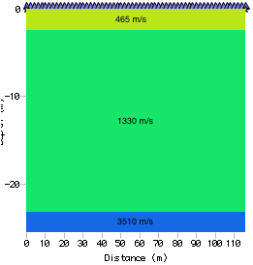
Lab 2: Attenuation, Gosport Indiana
0.01 s
0.02 s
0.03 s
0.04 s
0.05 s
The seismic data were used to create the
1D velocity model at right (with layer 1
thickness h = 2.3 m, layer 2 h = 20.6 m).
(1)a. Calculate the crossover distances
between the direct arrival and layer 1,
and between layer 2 and layer 3. (1)b.
Estimate the frequency, f, for a first arrival
from each of the three layers.

Slide 4
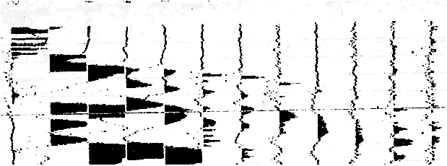
Hints: For f, helps to blow up to large scale; more accurate if you create
and use a ruler…
Subtleties: The direct arrival (geophones 11L-12L) is difficult to see on
this plot, and geophone 10L is probably an interference pattern between
the direct and first refraction arrivals. However I did not penalize anyone
for using that to estimate frequency, and generally I allowed a broad
range of frequency estimates for the direct.

Slide 5
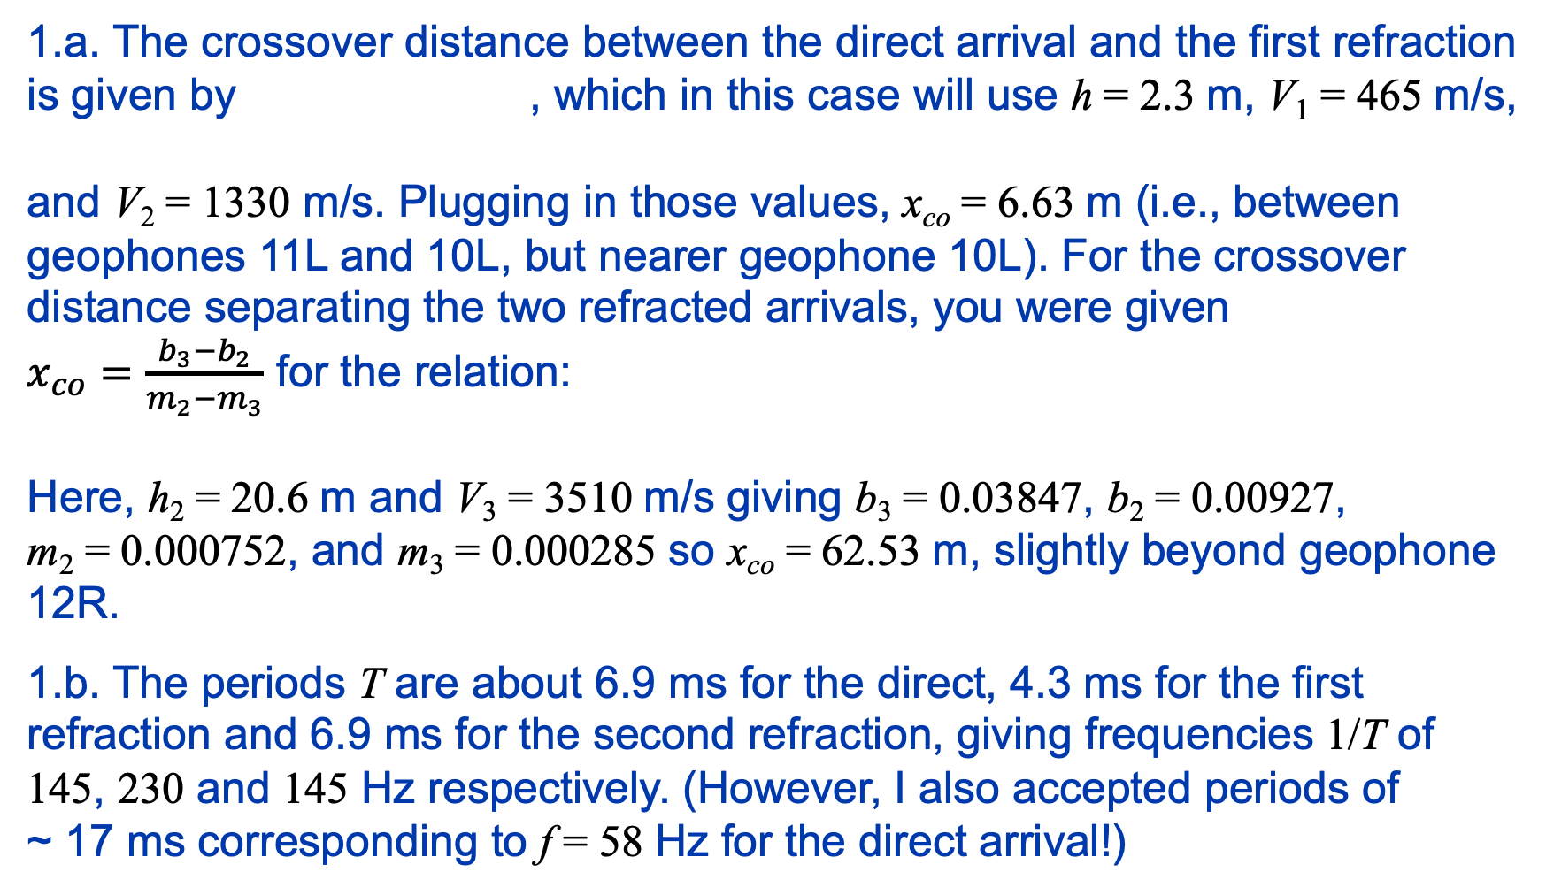
1.a. The crossover distance between the direct arrival and the first refraction
is given by , which in this case will use h = 2.3 m, V₁ = 465 m/s,
and V₂ = 1330 m/s. Plugging in those values, x_{co} = 6.63 m (i.e., between
geophones 11L and 10L, but nearer geophone 10L). For the crossover
distance separating the two refracted arrivals, you were given
$x_{co}=\frac{b_{3}−b_{2}}{m_{2}−m_{3}}$ for the relation:
Here, h₂ = 20.6 m and V₃ = 3510 m/s giving b₃ = 0.03847, b₂ = 0.00927,
m₂ = 0.000752, and m₃ = 0.000285 so x_{co} = 62.53 m, slightly beyond geophone
12R.
1.b. The periods T are about 6.9 ms for the direct, 4.3 ms for the first
refraction and 6.9 ms for the second refraction, giving frequencies 1/T of
145, 230 and 145 Hz respectively. (However, I also accepted periods of
~ 17 ms corresponding to f = 58 Hz for the direct arrival!)
1

Slide 6
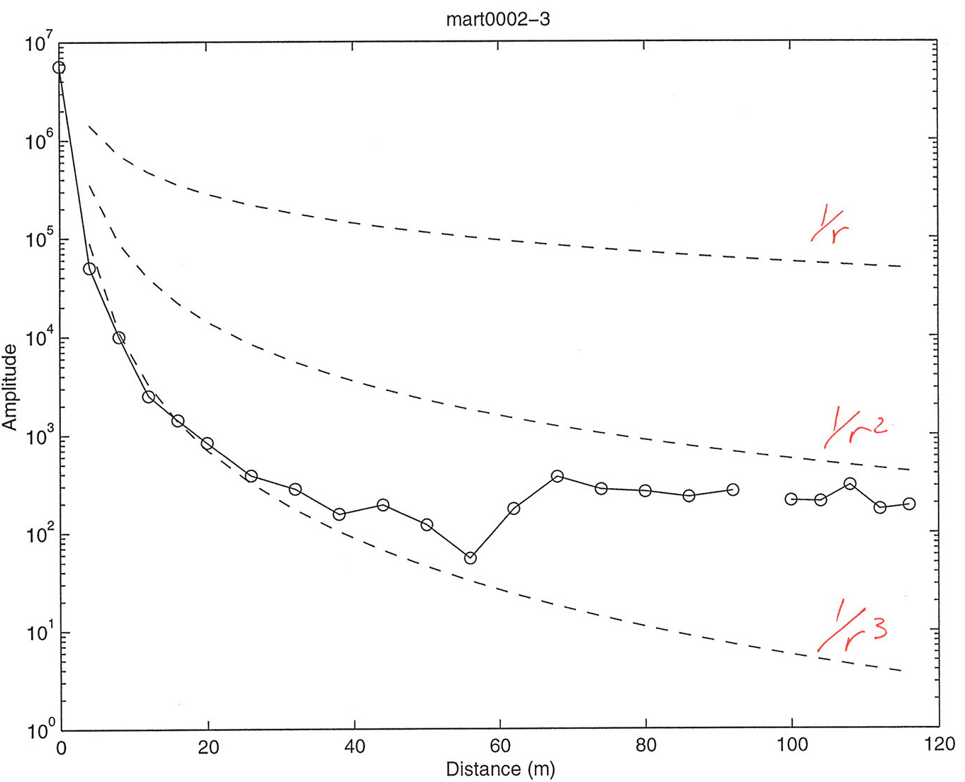
Lab 2: Amplitudes from observations
The amplitudes of each first arrival were measured and are shown below.
(2)a. Are these amplitudes consistent with what you might expect given
the crossover distances? Why or why not?
The amplitudes are given to you
in an Xcel spreadsheet on the
course website. (2)b. In column
D of the spreadsheet, calculate
the geometrical spreading for
each arrival, assuming A₀ is the
amplitude required to get the
observed amplitude at the
distance r of the first (nearest to
the source) geophone that
measures a first arrival from a
given layer.

Slide 7
The amplitudes of each first arrival were measured and are shown below.
(2)a. Are these amplitudes consistent with what you might expect given
the crossover distances? Why or why not?
Amplitudes of multipath arrivals near crossover distances!
2.a. The amplitude patterns do show
a strong pattern of variations
consistent with the interpretation that
amplitudes between crossovers reflect
different arrivals with different travel
paths. Neglecting amplitudes nearest
the crossover distances, which are
clearly “outliers” reflecting multipath
effects, amplitude change is < 1/r³ for
the direct arrival, > 1/r³ for the first
refraction, and > 1/r² for the second
refraction!
X
X

Slide 8
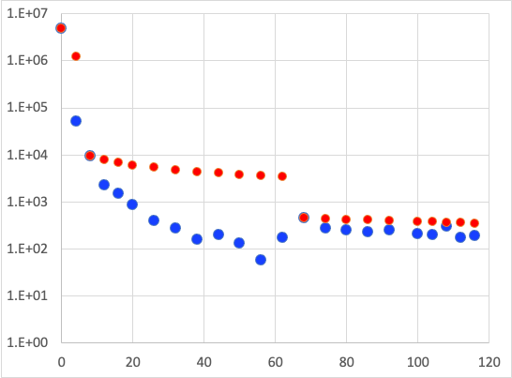
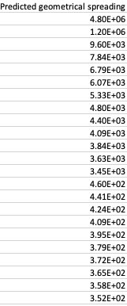
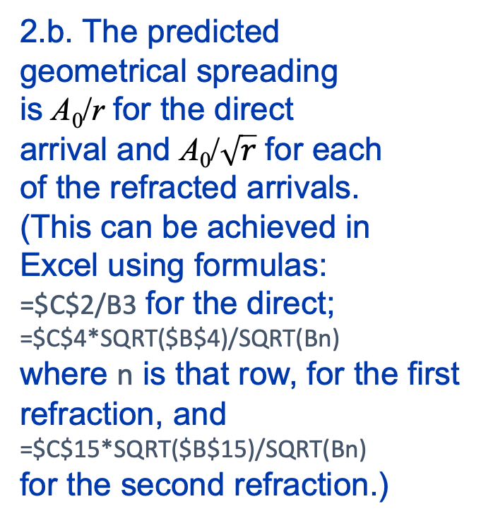
Lab 2: Amplitudes from observations
2.b. The predicted
geometrical spreading
is A₀/r for the direct
arrival and A₀/$\sqrt{r}$ for each
of the refracted arrivals.
(This can be achieved in
Excel using formulas:
=$C$2/B3 for the direct;
=$C$4*SQRT($B$4)/SQRT(Bn)
where n is that row, for the first
refraction, and
=$C$15*SQRT($B$15)/SQRT(Bn)
for the second refraction.)
The plot above appears to show that the amplitude decrease expected from geometrical
spreading is much less than what we observe. It also hints that the quality factor for the
first and second layers is less than that of the third layer!

Slide 9
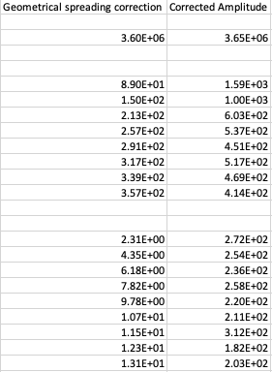
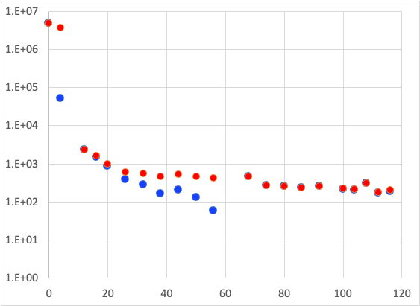
(2)c. In column E, calculate a correction for the amplitudes for the effects of
geometrical spreading. For the direct arrival (layer 1) correction, use
to calculate the correction; for layers n (= 2, 3) use
(2)d. In column f, add the
geometrical spreading
correction to the original
amplitude to get an approximate
“plane wave” amplitude.
After correcting for geometrical
spreading, the amplitude changes
are much smaller for all but the
layer 3 arrivals, and it is much less
obvious that the attenuation
effects are significantly different
for different layers.

Slide 10
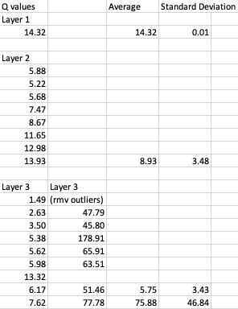
Formulae used e.g. =-3.141569*145*(B3-$B$2)/(465*LN(F3/$C$2)) for
Layer 1; =-3.141569*230*(B6-$B$5)/(1330*LN(F6/$C$5)) for Layer 2; and
=-3.141569*145*(B16-$B$15)/(3510*LN(F16/$C$15)) for Layer 3. I also
calculated Layer 3 values without using the geophones at
68 and 108 m, as these arguably might be
outlier amplitudes…
Outliers?
Then, recognizing that
→
Use linear regression of the
corrected amplitudes to estimate
the P-wave attenuation Q for
each layer!
And average!

Slide 11
You should include plots of your model and your data, and don’t
forget to discuss the RMS misfit! Plotting can be done in Xcel,
Matlab, or whatever else you feel comfortable with, but
remember that the plot image must be ported into a single-
document write-up of the lab.
(d) Assuming that both the velocity structure and your
attenuation estimates are correct, look through your text (and
whatever other literature you may be able to find, but be sure
to include references!) for examples of soils/sediments/rocks
that match your estimates of V_{P} and Q_{P}. Does the combination
of these two properties reduce the ambiguities in possible
interpretations? What interpretation of the data would make
the most geological sense given the location (farm country
near the terminus of Laurentide glaciation)?

Slide 12
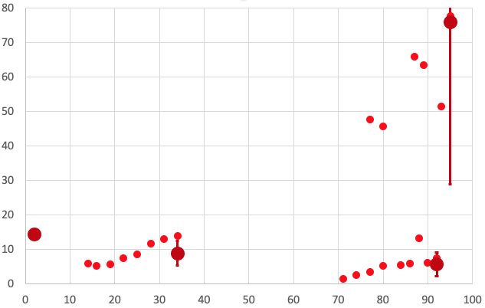
The best estimates of P-wave quality factor Q for each layer, after averaging, are
14.3 for Layer 1, 8.9 ± 3.5 for Layer 2, and 5.8 ± 3.4 for Layer 3 (or alternatively,
76 ± 47 for Layer 3 if we believe that the solution with outliers removed is better!)
Q
Mean distance (m)

Slide 13
2.d. The “optimal” seismic model has an upper layer with velocity 465 m/s and
Q_{P} = 14.3; second layer V_{P} = 1330 m/s and Q_{P} = 8.9, and third layer with V_{P} = 3510 m/s
and Q_{P} ambiguous (5.8 if we use all amplitudes, 76 if we suspect the highest
amplitudes involve multipath).
1
2
3
465
145
14.3
V = 1330 m/s
f = 230 Hz
Q = 8.9 ± 3.5
V = 3510 m/s
f = 145 Hz
Q = 5.8 ± 3.4
(Q = 76 ± 47)
X
X
(X)
(X)

Slide 14
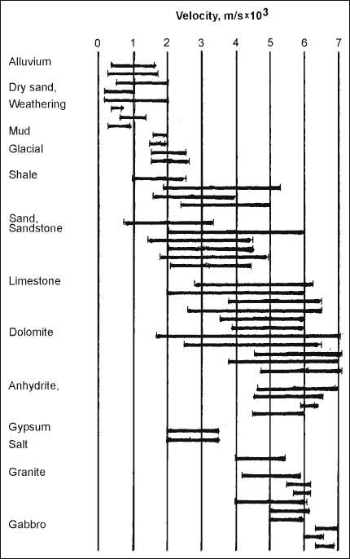
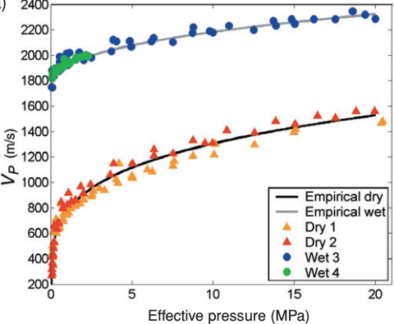
The velocities are consistent with a wide
range of possibilities but Layer 1 is likely
dry soil, alluvium or dry sand; Layer 2 could
be the same material as Layer 1 (but below
the water table) or a change to a different
type of alluvium or shale; and Layer 3 may
be shale, sandstone, limestone or dolomite.
A change in velocity from V_{P} = 400–800 to
V_{P} = 1200–2200 is very typical of the water
table!
Crustal Rocks
1
2
3
Prasad et al. (Near Surface Geophysics, 2005)

Slide 15
Measurements of Q are much harder to find,
but generally Q_{P} of saturated unconsolidated
materials are less than for dry materials (and
soil Q_{P} = 2–20 is consistent with our
measurements within errors), so interpretation
of the layer 1–2 boundary (Q_{P} = 14/9) as the
water table within silty soil is also supported
by the attenuation properties. An even lower
attenuation coefficient (Q_{P} = 6) in layer 3
is puzzling (if we expect consolidated rocks to
attenuate less) but could reflect unconsolidated
glacial-derived clay; however the higher
estimate of Q_{P} = 76 might indicate basement
rock. Unfortunately, what this exercise shows
most clearly is that true-amplitude analyses
are themselves ambiguous, and therefore that
attenuation is a difficult measurement to make
without more information on multipath effects!
Crustal Rocks
1
2
3

Slide 16
Lab 4: Seismic Reflections
Due 2:30 pm Mar 6

Slide 17
(1) Seek a reflection in Benson Park-n-Ride data!
(a) First, use your best estimate of Layer 1 velocity and thickness from Lab 3
to model the expected arrival times of the first layer reflection in the modeling
code Reflect. (Include the plot and data windows in your writeup). Look at
the plot result with all the boxes checked, and with only the reflection box
checked. What challenges do you expect in picking real data?
(b) Load the Benson Park-n-Ride Forward shot data into the RAS24 software
and try to find that reflection. To help guide your eyes to a possible reflection,
I suggest the following steps:
i. Use the velocity line to approximate the expected asymptote for the
reflection (i.e., fix one end to the direct arrival at the first trace and set the
other end to match inverse slope of the 1st layer velocity).
ii. Use the “Select display filters” button/panel to emphasize high
frequencies (select “Low Cut”, “45” Hz, and “Preview” or “Apply”).
iii. Shift the pick lines to the approximate times you modeled in Reflect,
and include a screen-shot of the result in your write-up.
iv. Now, shift the pick lines to where you think the reflection actually is
based on looking at the data, and save/report those picks.

Slide 18
(2) Now, enter your picks in the code Reflect, and use them to model a
best-fitting velocity and thickness for the layer. Include the model, section,
plot, fit and data windows in your writeup. (I recommend *not* using picks
that you are uncertain about in the data fitting portion of this exercise…
Note that the first ~5-6 traces are very difficult to pick!)
(a) How does the model you’ve generated from the reflection compare to
your understanding of the subsurface based on the three models you
created from refractions in Lab 3?
(b) Are you confident that the arrival you picked is really a reflection? If not,
what is it likely to be?

Slide 19
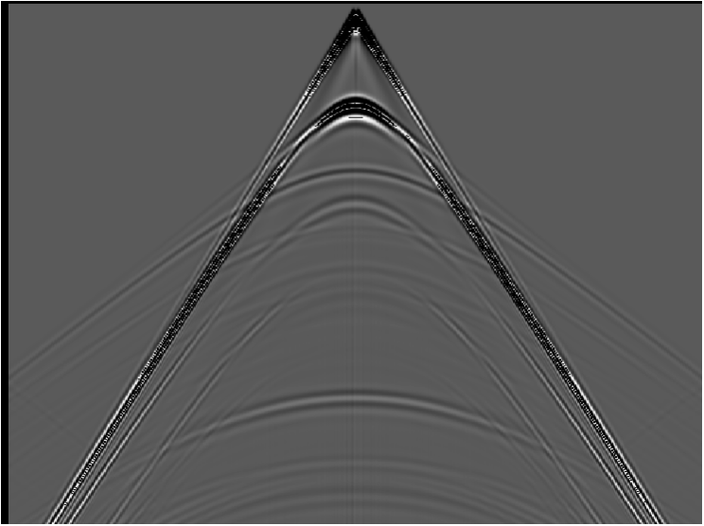
Lab 4: Seismic Reflections (Part II)
0
2000
4000
6000
8000
10000
(m)
0
0.5
1.0
(sec)
1.5
2.0
2.5
3.0

Slide 20
(3) The previous slide shows synthetic (idealized) data generated
using a numerical (finite element) approach. There are four
primary reflections present in the data. Pick five travel-times
(i.e., at five different distances) from each of at least three of
those reflections. Using Excel (or some similar software that
allows you to regress a line fit– you can do this in Matlab, or
other software if you prefer), plot x² versus t² for each of your
reflections, and calculate the velocities and thicknesses these
would imply assuming each reflection is from a single-layer
interface over a half-space.
(4) Now do the same for one of the multiple reflections.

Slide 21
A brief note on regression of a line fit: The most common
approach (in the absence of measurement uncertainties)
is the method of least-squared misfit of the measurements
to the line. Given y = mx +b with slope m and intercept b,
the least-squares line fit is given by:
where N is the number of measurements.
Obviously this is well-suited to automation! (And there is a
function in Xcel that will do this without having to code it!)

Slide 22
(5) Again, without using Reflect, use the intercepts and
slopes of lines on your x² – t² plots with Dix equations
to calculate velocities and thicknesses of each layer.
(6) Do similar calculations for velocities and thicknesses
using Dix equations, but now instead of using
taken from the inverse slope of x² – t², use the first-
order T_{NMO} relation (i.e., use the inverse slope of a line
fit to a plot of T_{NMO} versus x²/2t₀). How does this change
the model? Which is likely to be more accurate and why?
(7) Now plug your travel-time picks into Reflect and
calculate a model of velocities and thicknesses. How
does this compare to your “hand-calculated” models?

