Slide 1
Geology 5660/6660
Applied Geophysics
20 Mar 2024
Last Time: Gravity Measurements
• Measurements may be surface-based (i.e., taken with
instruments placed on the ground surface) or
space-based; absolute or relative
• Surface measurements are accurate to ~3-6 μGals (for absolute
gravimeters or relative measurements by Lacoste-Romberg):
i.e., nearly one part in 10⁹ of the total acceleration!
• Satellite measurements (especially GRACE, GOCE) can be
extremely accurate (<0.1 μGal!), but only as an average
over very large spatial scales (> 500 km)
• Time-variable gravity can be useful for understanding
dynamical processes (fluid envelopes & solid Earth)
• Surface-based time-variable g also used for environmental/
hydrologic applications
For Fri 22 Mar: Burger 349-378 (§6.1-6.4)
© A.R. Lowry 2008-2024

Slide 2
Example: Free Air Gravity from Satellite Ocean Altimetry

Slide 3
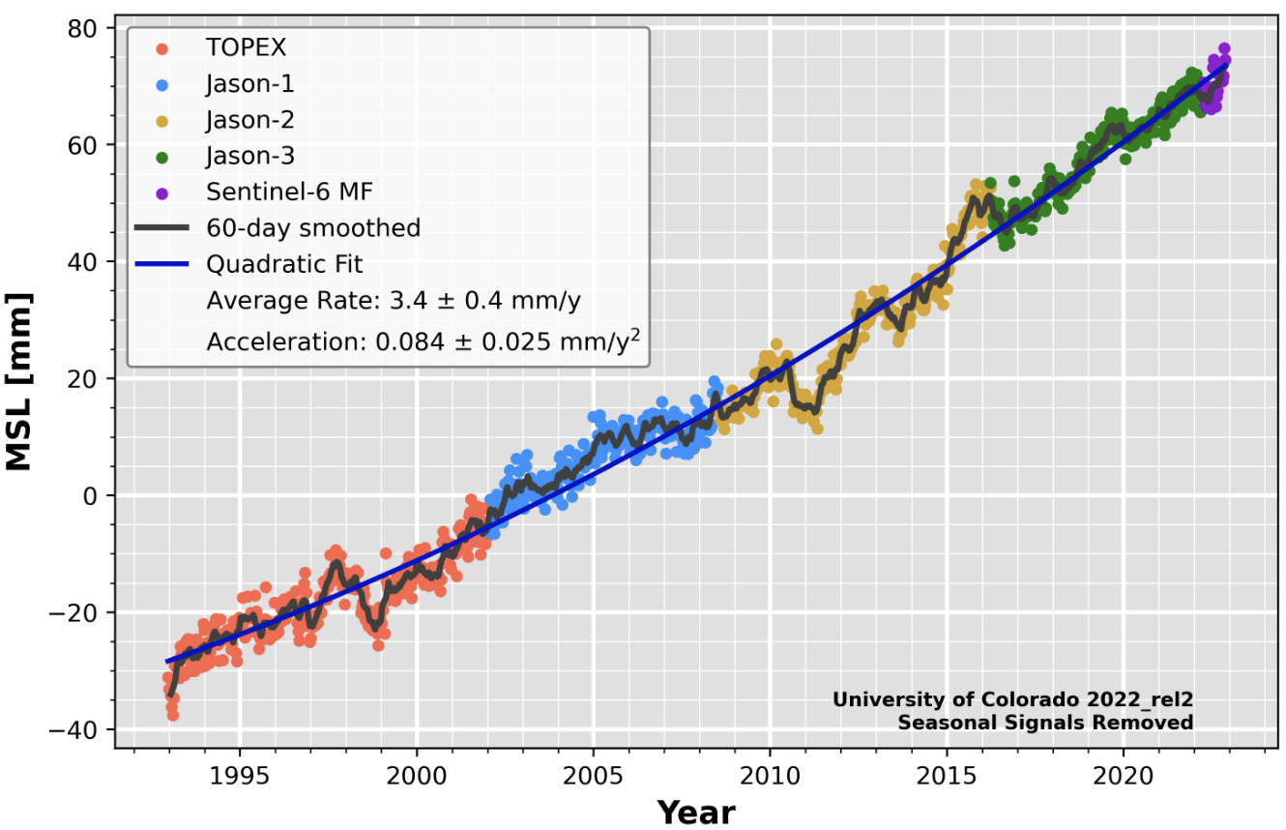
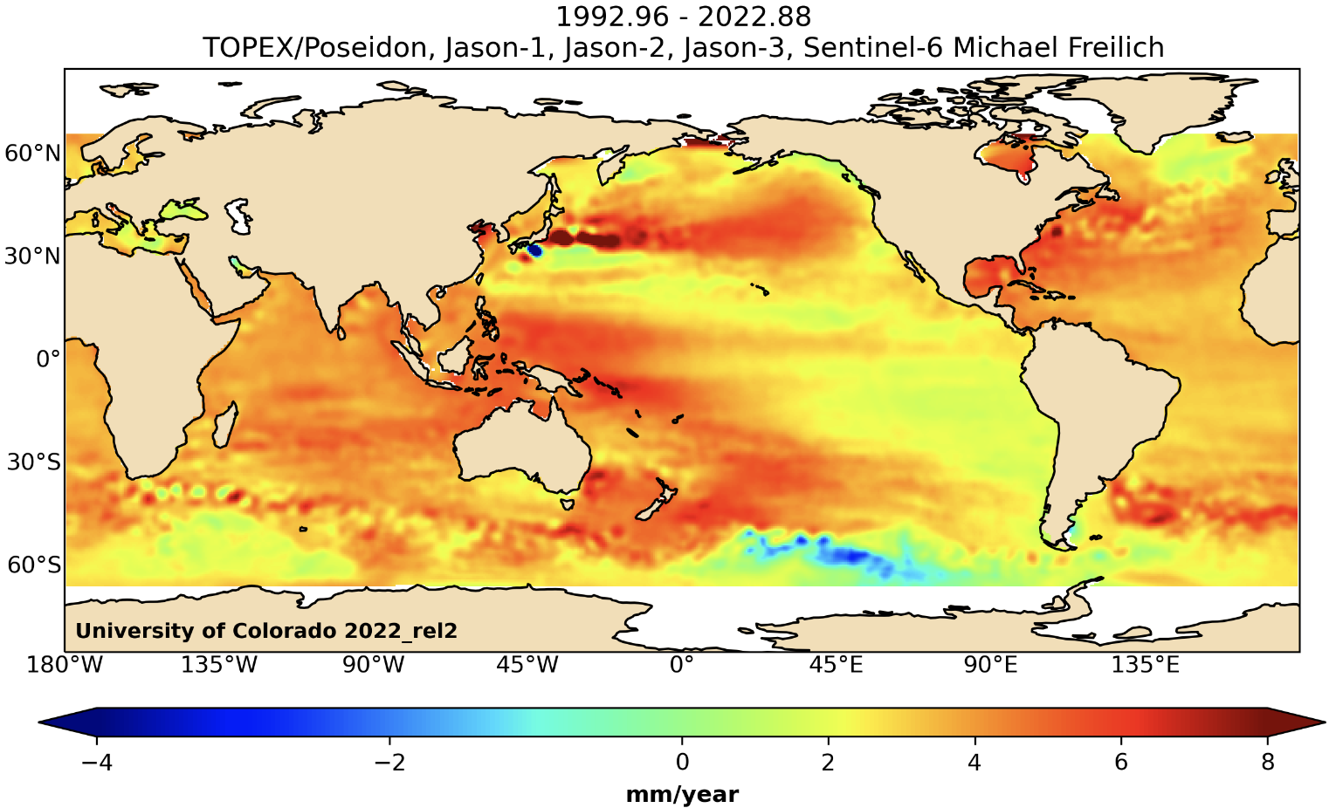

(Note altimeters were
actually intended to find
out more about sea level
change! The gravity field
was an afterthought)

Slide 4
Detail: Indian Ocean (East of Madagascar)

Slide 5
Detail: Western Pacific

Slide 6
Most structural studies use terrestrial (or
surface-based) measurements: These require
corrections:
Recall: for spherical or
point mass M
Terrestrial measurement means setting a gravimeter down
on the Earth’s surface… So measurements will include
effects from changes in distance to Earth’s center of mass,
mass attraction of (known) topography, and mass
attractions of (unknown) interior density… We are only
interested in the last so try to subtract out the other stuff.

Slide 7
Recall: for spherical or
point mass M
It’s also useful to recall that our expression for gravity due
to a spherical mass came from an integral:
And integrals can be approximated as sums!

Slide 8
Corrections include:
• Tidal attractions from nearby
celestial bodies (dominated by
distance to moon, sun, Jupiter)
• Associated solid Earth tidal deformation
• Mass of atmosphere above (a function of atmospheric
pressure)
For these corrections, record time/location of
measurement and the atmospheric pressure.

Slide 9
Corrections include:
• Earth’s ellipticity and spin
Distance r from Earth’s
center of mass is a function
of latitude, so we subtract
gravity at a specified
ellipsoidal surface from
the total gravity.
Earth’s rotation induces
an outward (centrifugal)
acceleration as a function of
radial distance from axis of
rotation (i.e., latitude), so we
correct for this also.
6356 km
φ
6378 km
Latitude correction:
(1 μGal accuracy ⇒
1.25 m latitude accuracy!)
(See text eqn 6.12 for g₀, A & B)

Slide 10
Corrections include:
• Altitude (“free air correction” )
Following topography also results in differences in radial
distance to the center of mass. Correction for that change
in distance due to topography is called “free air”:
More accurately, including the ellipsoid:
(latter terms are small ⇒ ~ –0.3086 mGal/m)
(1 μGal accuracy ⇒ 3 mm height accuracy!)

Slide 11
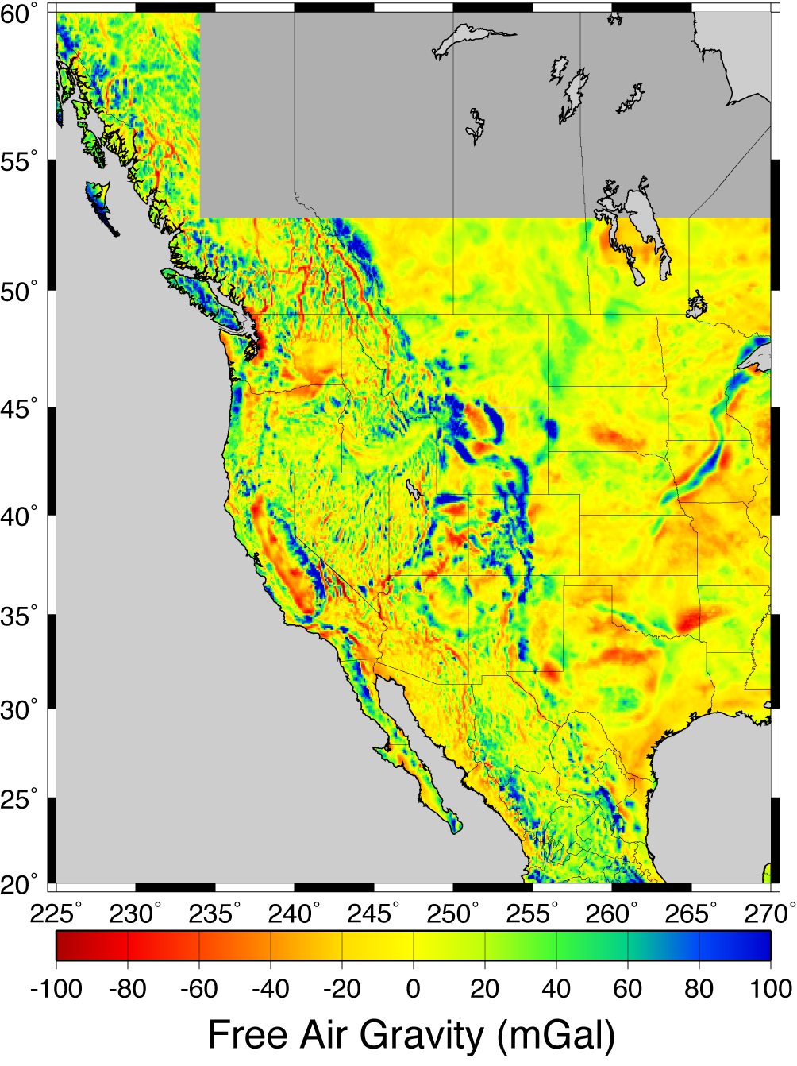
After observed gravity
measurement is corrected
for free air and other
effects talked about so far,
we call it the
free air anomaly
At right, millions of
terrestrial free air relative
measurements have been
referenced to a small
network of absolute
gravity stations and
adjusted to a common
reference.

Slide 12
Corrections include:
• Topographic mass (“Bouguer correction” )
z
Simple Bouguer : Approximate topography as a slab with
thickness h:
For standard ρ = 2670 kg/m³, simple Bouguer correction is
0.11195 mGal/m.
Complete Bouguer : Further correct for upward attraction
of mass above; “negative attraction” of missing mass
below…

Slide 13
