Slide 1
Geology 5660/6660
Applied Geophysics
20 Mar 2024
(Lab 5)
(1) Review lab 4...
(2) Lab 5 assignment (GPR)
Due one (1!) week from today,
27 March at 2:30 pm
© A.R. Lowry 2008-2024

Slide 2
(1) Seek a reflection in Benson Park-n-Ride data!
(a) First, use your best estimate of Layer 1 velocity and thickness from Lab 3
to model the expected arrival times of the first layer reflection in the modeling
code Reflect. (Include the plot and data windows in your writeup). Look at
the plot result with all the boxes checked, and with only the reflection box
checked. What challenges do you expect in picking real data?
(b) Load the Benson Park-n-Ride Forward shot data into the RAS24 software
and try to find that reflection. To help guide your eyes to a possible reflection,
I suggest the following steps:
i. Use the velocity line to approximate the expected asymptote for the
reflection (i.e., fix one end to the direct arrival at the first trace and set the
other end to match inverse slope of the 1st layer velocity).
ii. Use the “Select display filters” button/panel to emphasize high
frequencies (select “Low Cut”, “45” Hz, and “Preview” or “Apply”).
iii. Shift the pick lines to the approximate times you modeled in Reflect,
and include a screen-shot of the result in your write-up.
iv. Now, shift the pick lines to where you think the reflection actually is
based on looking at the data, and save/report those picks.

Slide 3
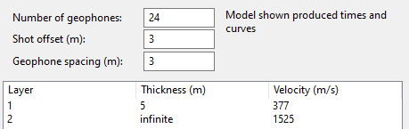


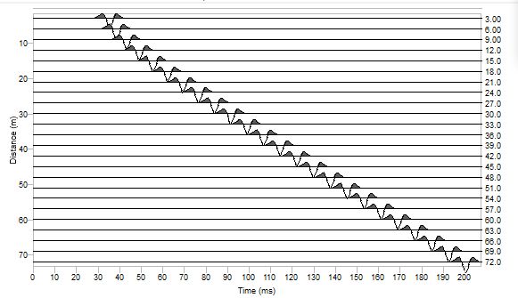
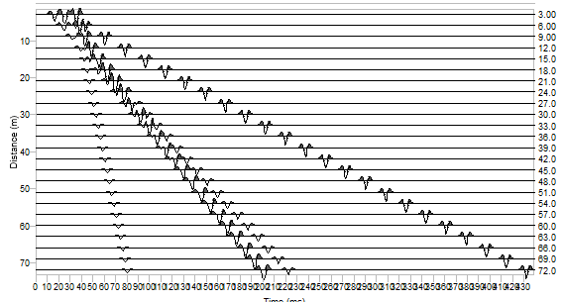
(1a). We had several possible models (with the faulted horizontal layer
performing best) so I used the ~ thickness and velocity from that:
The Reflect plot with all arrivals suggests that the reflection will be interfered
with by the Rayleigh wave on the first two traces, and the direct and air wave
arrivals on later traces. It also suggests one might easily mistake the air
wave for the reflection!

Slide 4
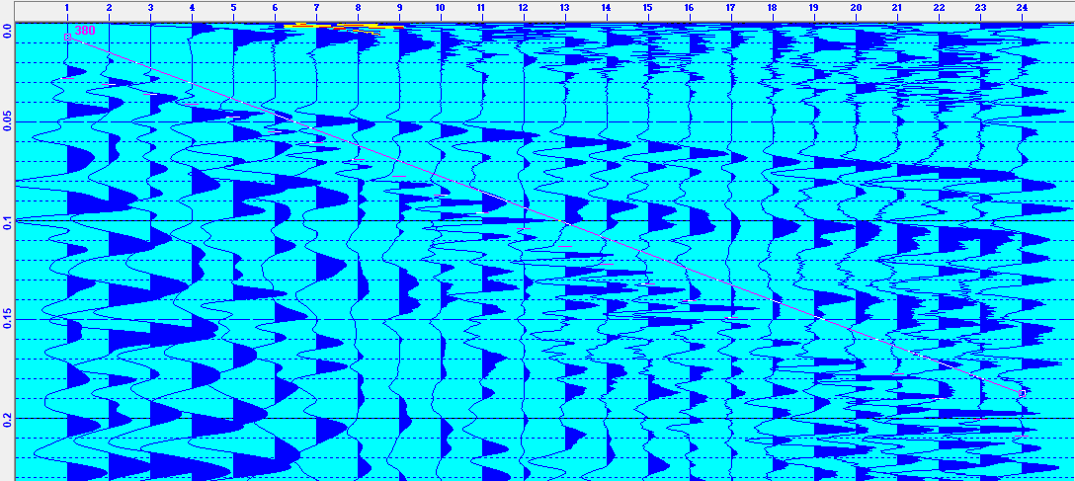
(1b). My picks (red) focused on the high-frequency arrival that comes in
about 5-20 ms later than the direct arrival, and 0-16 ms later than the
reflection arrival that I had modeled using Reflect (purple).
The “reflection” picks diverge ~linearly from both the direct arrival line
and the modeled reflection, which a reflection should not do (because
the direct arrival should be an asymptote for the reflection!). However
it is (arguably) still possible that this really is a reflection, given that
our best refraction model suggested an ~ 0.5 m thickness change.

Slide 5
(2) Now, enter your picks in the code Reflect, and use them to model a
best-fitting velocity and thickness for the layer. Include the model, section,
plot, fit and data windows in your writeup. (I recommend *not* using picks
that you are uncertain about in the data fitting portion of this exercise…
Note that the first ~5-6 traces are very difficult to pick!)
(a) How does the model you’ve generated from the reflection compare to
your understanding of the subsurface based on the three models you
created from refractions in Lab 3?
(b) Are you confident that the arrival you picked is really a reflection? If not,
what is it likely to be?

Slide 6
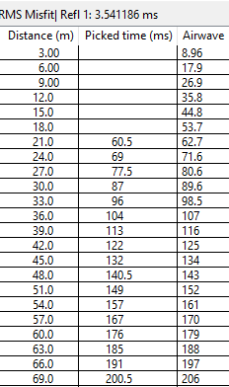
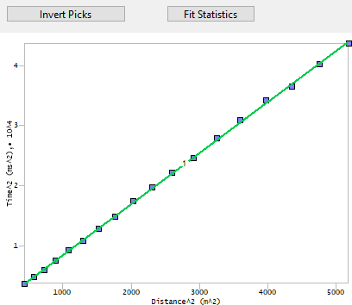
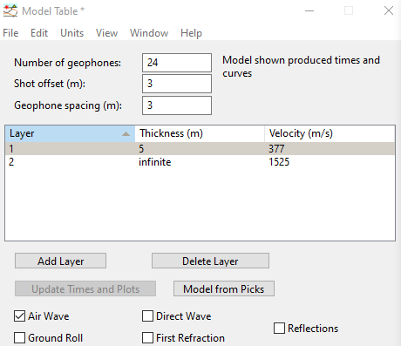
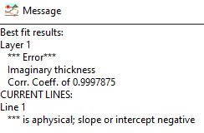
(2a). I was able to pick the high frequency arrivals only at geophones 7-24,
so I left 1-6 blank. When I attempted to “Invert Picks” from the x² – t² plot
window though, I get a nonphysical model (with a negative t₀²)!
This occurs despite the fact that the arrival times picked for the high
frequency arrival have a very high correlation coefficient, indicating that
the arrival is very well fit by a straight line in an x² – t² plot (and so it
probably is a real seismic arrival, just not a reflection, because the
intercept for the line is negative). Because it is not a reflection, there is
no viable model model to compare to the model we found from refraction
modeling.

Slide 7
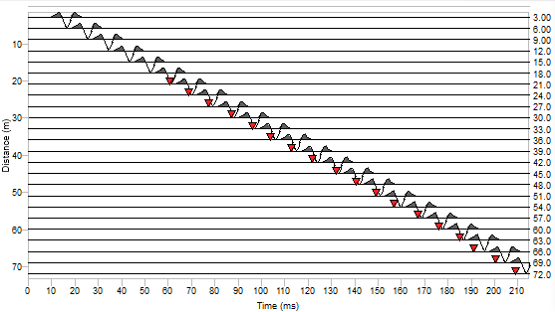
(2b). Since we’ve already established that it’s not a reflection, the real
question here is what is it? The most likely candidate for another
arrival slightly later than the direct wave is the air wave, since the Layer 1
velocity was only slightly faster than air.
The Refract model air wave comes in
slightly (2–6 ms) later than the picks, but
a 3% error is consistent with what we
might expect for errors in distance from a
tape measure (especially if the profile was
not a perfectly straight line)!

Slide 8
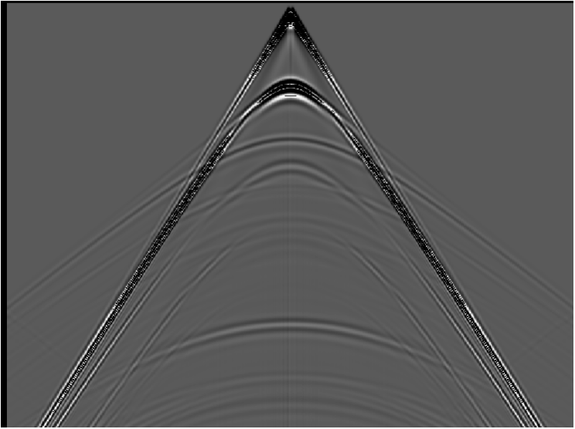
Lab 4: Seismic Reflections
0
2000
4000
6000
8000
10000
(m)
0
0.5
1.0
(sec)
1.5
2.0
2.5
3.0

Slide 9
(3) The previous slide shows synthetic (idealized) data generated
using a numerical (finite element) approach. There are four
primary reflections present in the data. Pick five travel-times
(i.e., at five different distances) from each of at least three of
those reflections. Using Excel (or some similar software that
allows you to regress a line fit– you can do this in Matlab, or
other software if you prefer), plot x² versus t² for each of your
reflections, and calculate the velocities and thicknesses these
would imply assuming each reflection is from a single-layer
interface over a half-space.
(4) Now do the same for one of the multiple reflections.

Slide 10
0
2000
4000
6000
8000
10000
(m)
0
(All four of the solid hyperbolas are reflections; the dashed hyperbola is the first multiple.)
0.5
1.0
(sec)
1.5
2.0
2.5
3.0

Slide 11
(Plots of time versus distance)

Slide 12
(3) Layer / Halfspace:
V₁ = 1540 m/s;
h₁ = 400 m
(Plots of x² vs t² with estimates of velocity and thickness from slope and intercept, assuming each is from a single layer over a halfspace.)
V₄ = 2470 m/s;
h₄ = 2810 m
V₃ = 2620 m/s;
h₃ = 1670 m
V₂ = 2660 m/s;
h₂ = 1280 m
“True” model:
V₁ = 1500; h₁ = 400
V₂ = 3048; h₂ = 600
V₃ = 2439; h₃ = 400
V₄ = 3048?; h₄ = 1160?
(4) Multiple: V_{m} = 1490 m/s; h_{m} = 790 m

Slide 13
(5) Again, without using Reflect, use the intercepts and
slopes of lines on your x² – t² plots with Dix equations
to calculate velocities and thicknesses of each layer.
(6) Do similar calculations for velocities and thicknesses
using Dix equations, but now instead of using
taken from the inverse slope of x² – t², use the first-
order T_{NMO} relation (i.e., use the inverse slope of a line
fit to a plot of T_{NMO} versus x²/2t₀). How does this change
the model? Which is likely to be more accurate and why?
(7) Now plug your travel-time picks into Reflect and
calculate a model of velocities and thicknesses. How
does this compare to your “hand-calculated” models?

Slide 14
(5) Dix equations
V₁ = 1500; h₁ = 400
V₁ = 1540 m/s;
h₁ = 400 m
V₂ = 3048; h₂ = 600
(x² vs t² with estimates of velocity and thickness from slope and intercept using Dix’s equations.)
V₃ = 2439; h₃ = 400
V₄ = 3048?; h₄ = 1160?
V₄ = 2280 m/s;
h₄ = 1130 m
V₃ = 2500 m/s;
h₃ = 390 m
V₂ = 3580 m/s;
h₂ = 770 m

Slide 15
(6) Using T_{NMO} 1st order binomial approximation
“True” model:
V₁ = 1500; h₁ = 400
V₁ = 2929 m/s;
h₁ = 2817 m
V₂ = 3048; h₂ = 600
(In this graph, TNMO is plotted vs x²/2t₀, and velocity and thickness are estimated from slope and intercept using Dix’s equations as before.)
V₃ = 2439; h₃ = 400
V₄ = 3048?; h₄ = 1160?
V₂ = 940 m/s;
h₂ = 197 m
V₃ = 4908 m/s;
h₃ = 712 m
V₄ = 2003 m/s;
h₄ = 1032 m
Dix equations:

Slide 16
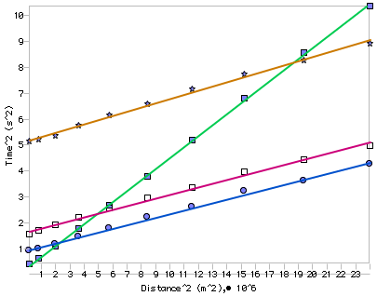
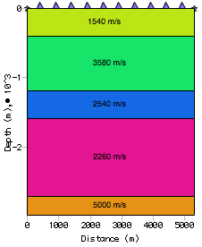
(7) Modeling in Reflect:
“True” model:
“Reflect” model:
V₁ = 1500; h₁ = 400
V₁ = 1540; h₁ = 400
V₂ = 3048; h₂ = 600
V₂ = 3580; h₂ = 770
V₃ = 2439; h₃ = 400
V₃ = 2500; h₃ = 390
V₄ = 3048?; h₄ = 1160?
V₄ = 2280; h₄ = 1130

Slide 17
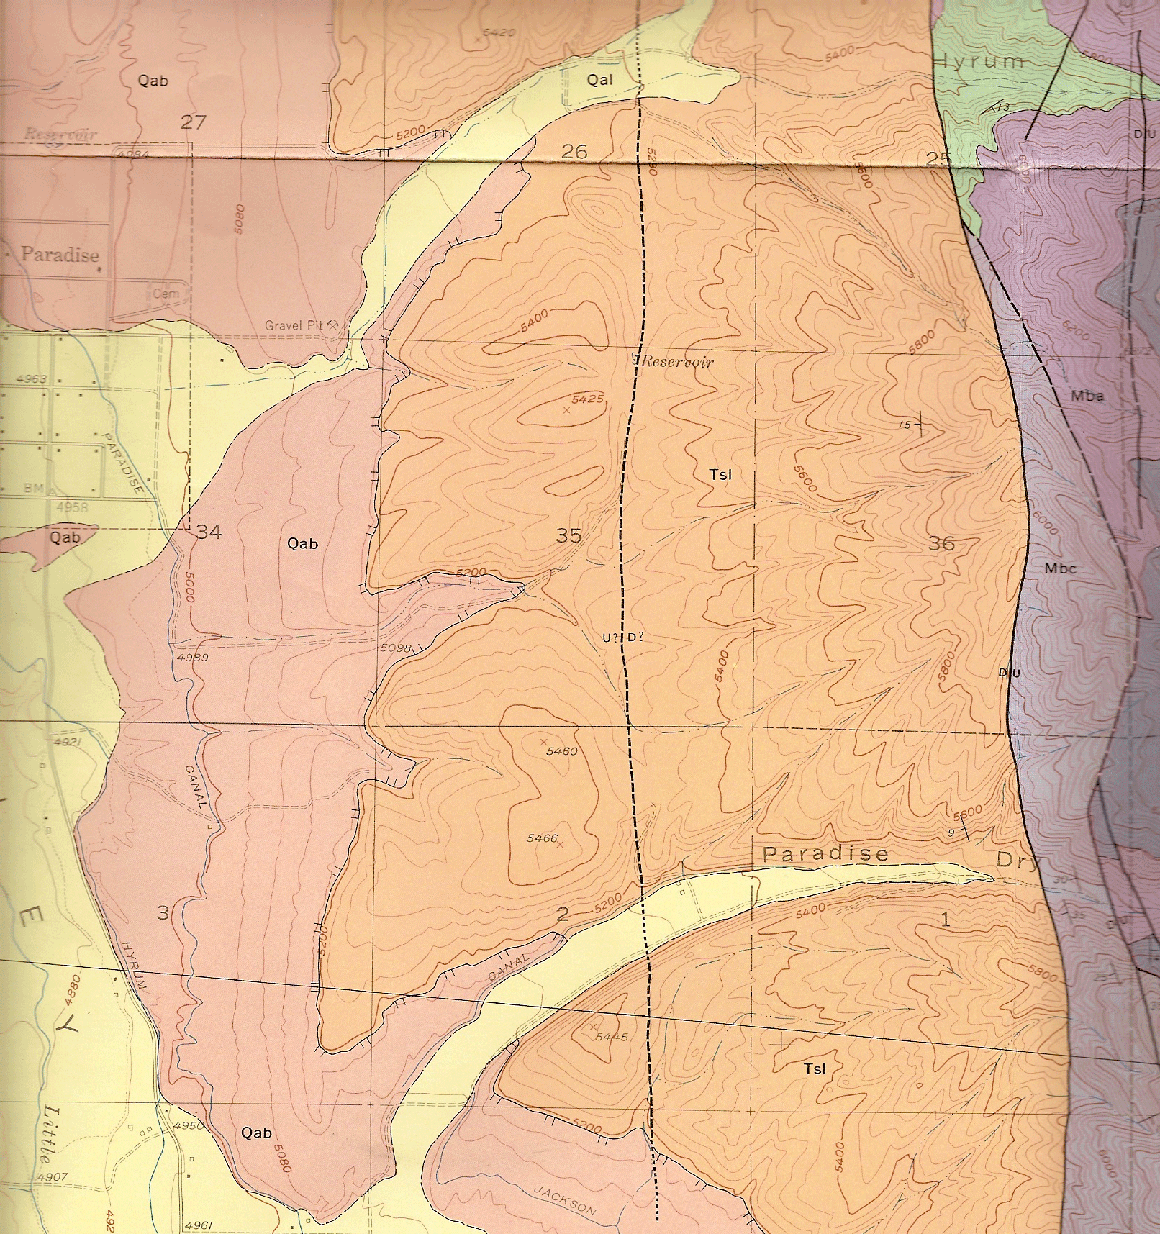
Lab 4: Ground Penetrating Radar
Introducing the field locale:
Southern segment of the
East Cache Fault (near
Paradise)
Three radar lines;
two trenches
Three (?) fault strands
East = west-dipping
listric normal fault
Central = antithetic
West = Bonneville
high-stand and/or (?)
west-dipping normal
fault
C
W
E
With thanks to Stephanie Davi & cohorts!

Slide 18
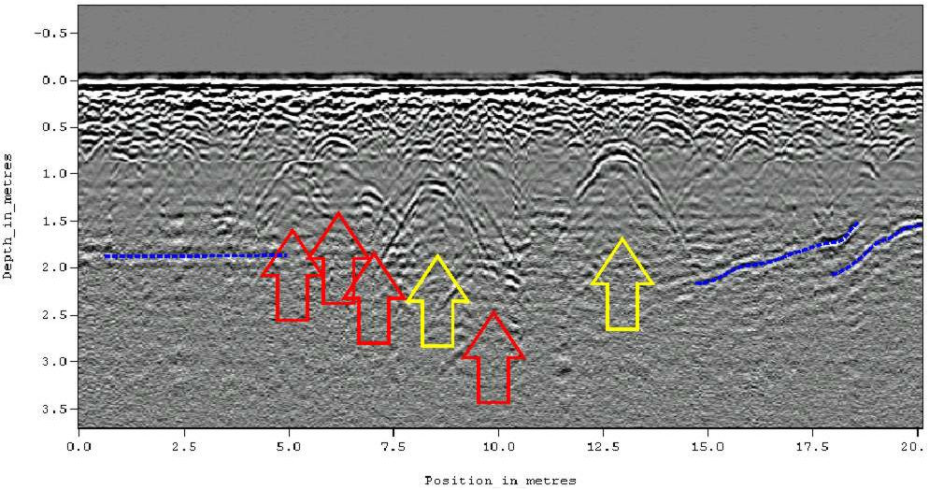
Useful Things to Remember Part 1:
Diffractions appear in GPR much like they do in seismic sections
(From a Historical Cemetery in Alabama)

Slide 19
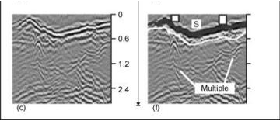
Useful Things to Remember Part 2:
Multiples look different than we’ve seen previously:
Because we usually have common-offset or zero-offset source
and receivers, look for reflections that consistently arrive at
twice (or more) the two-way travel-time of “earlier” reflections.
Can also get “ringing” of the ground surface…

Slide 20
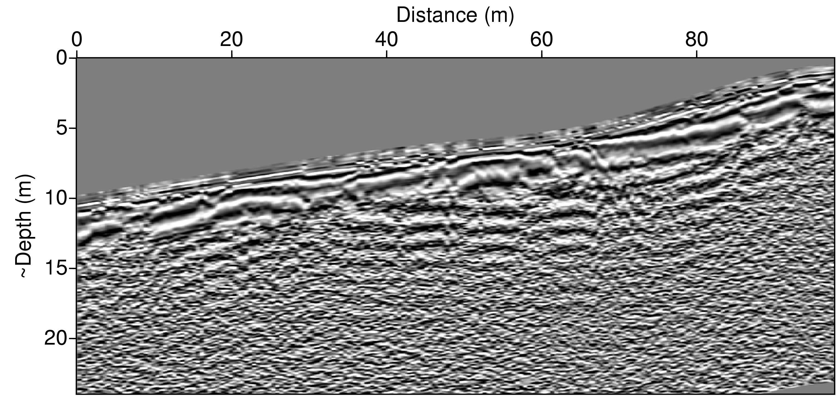
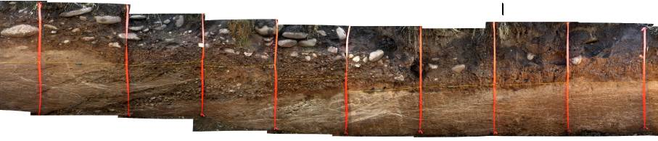
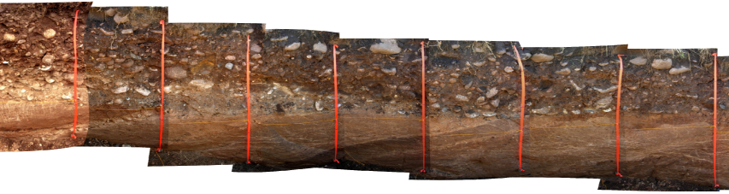
Western Fault Strand (“W”)
Ribbons are spaced 1 m apart for scale; no vertical exaggeration!
Antennae for
Paradise surveys
= 100 MHz!
East dipping layers of the Tertiary Salt Lake Formation (T_{SL})

Slide 21
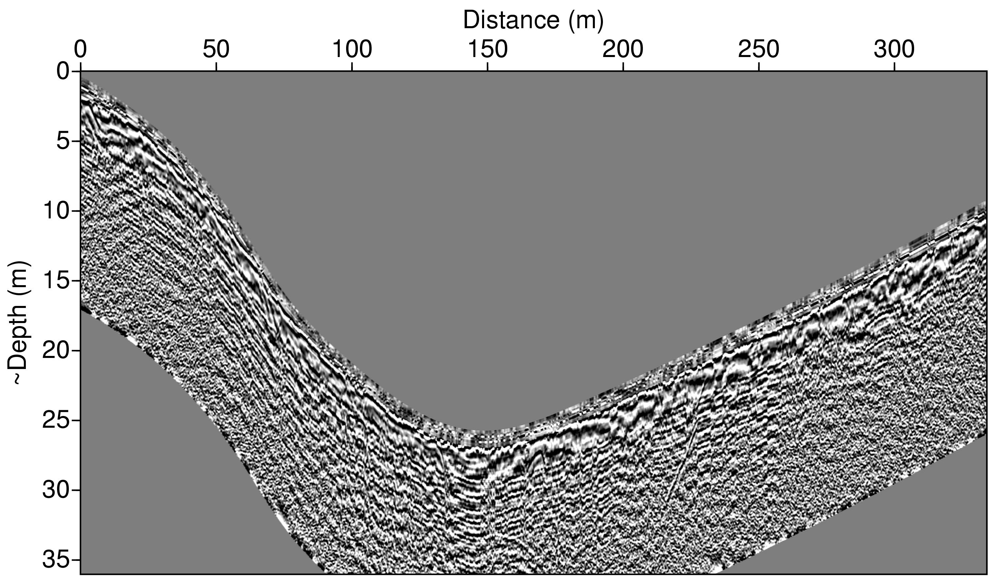
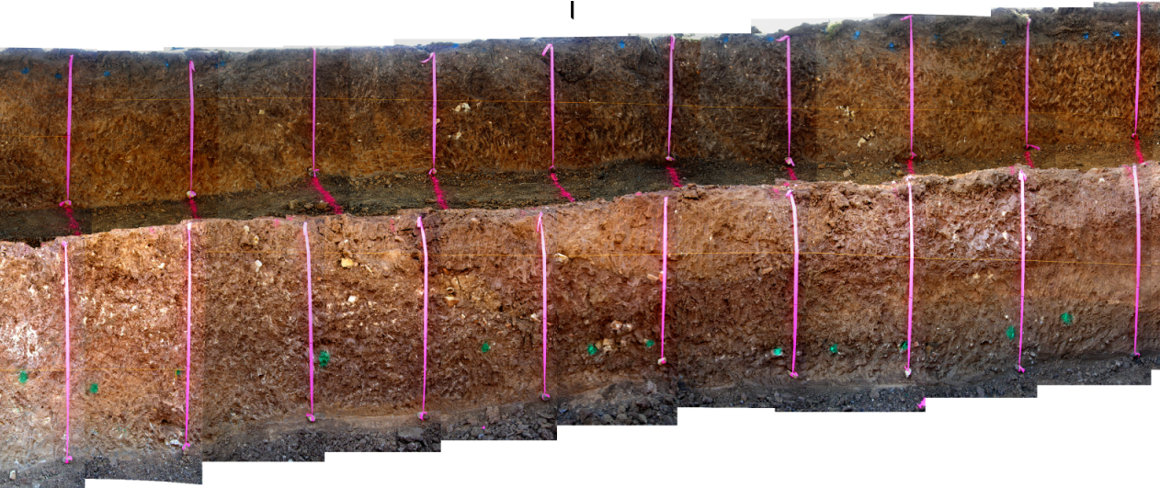
Central Fault Strand (“C”)
Note relatively poor data quality (ringing, poor trace correlation)

Slide 22
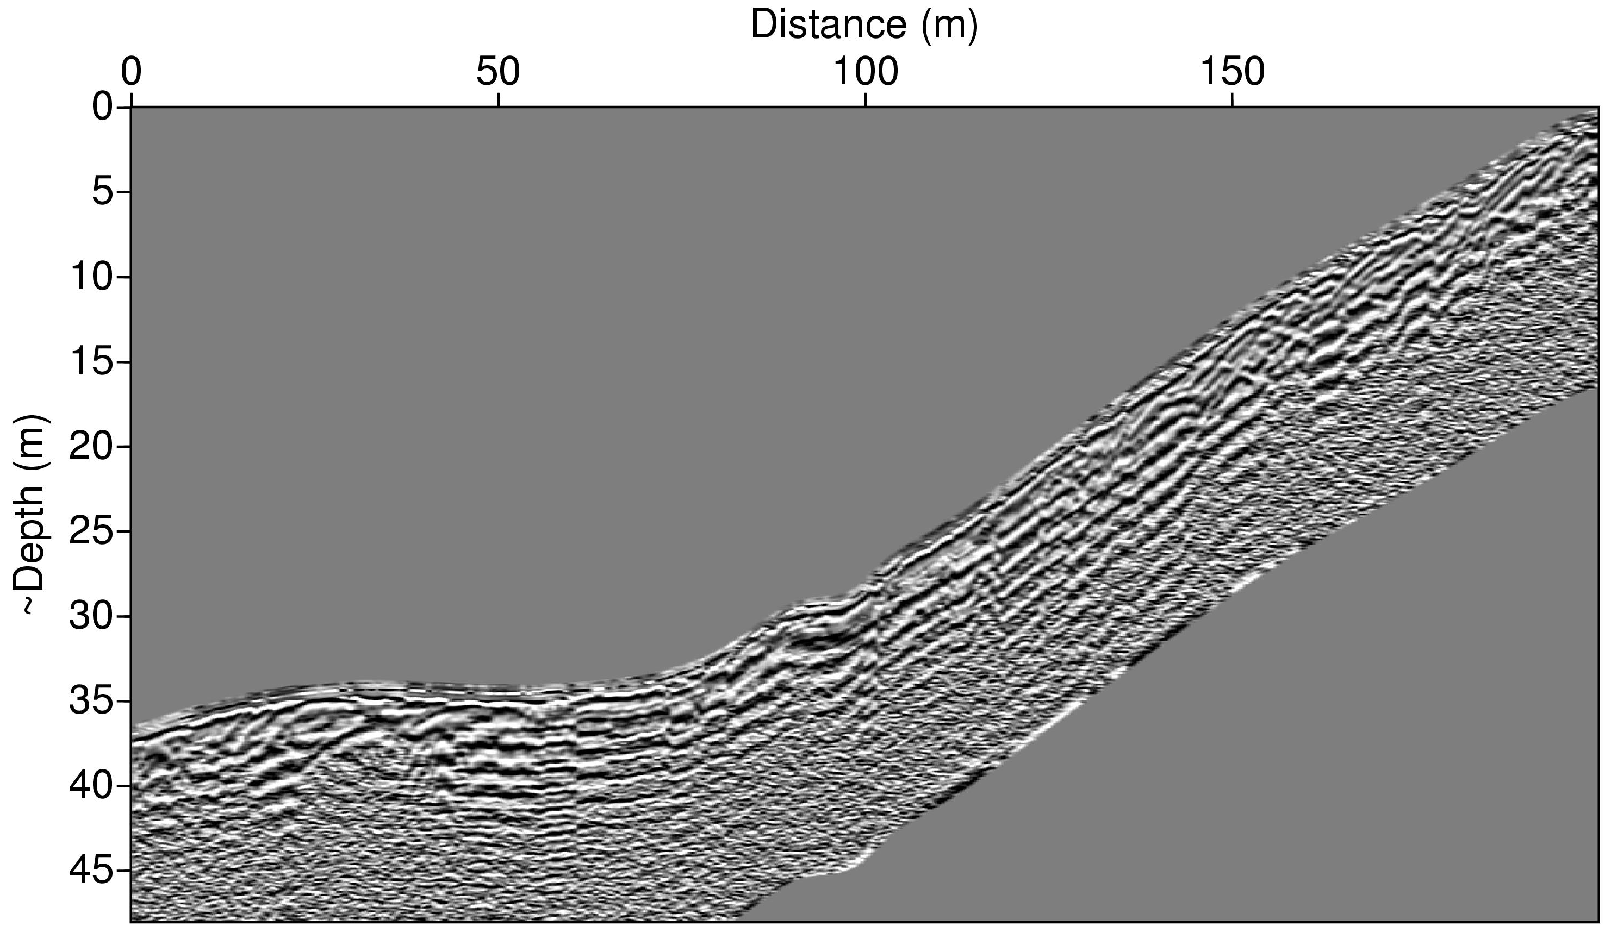
Eastern Fault Strand (“E”)
road
(No trench dug on this section)

Slide 23
Lab 4:
Carefully compare the information contained in trench
sections with information in each radar profile. What
correlative features can you identify? Are there major
features in any of the radar profiles that seem to be
missing in the trench? Why do you think they chose
to trench where they did, based on the radar images?
(2) Using the information you’ve gleaned from the trench
data and whatever else you may have available, draw
an interpretive line drawing from each radar profile
and label the features. Be sure to note any features
(such as offset horizontal beds and/or diffraction
arrivals) that might indicate a fault trace, and discuss
whether and/or why (and where) you would (or would
not) recommend any additional trenching based on
these profiles.

Slide 24
(3) Recall that radar velocity is given by
a. Try to find a horizon on each of the W, C radar profiles
that you can calibrate to true depth by comparison to the
trench photos. Assuming that μ = 1, ε_{true} is the true (real part
of) dielectric permittivity of the medium and ε_{assumed} is the
permittivity that was assumed in order to convert time to
depth in the images, what is the approximate
ratio of ε_{true}/ε_{assumed} for each profile?

Slide 25
b. Find at least one diffraction in each of the profiles.
First derive a “depth” equation for the diffraction
hyperbola given some assumed velocity V_{a}. Then
use the observed moveout in your diffraction
hyperbolas to estimate V/V_{a}. Do you think they used
a value typical of soil or of sediment?
Be sure to include a clear description of all calculations and
assumptions that went into getting these numbers. Also in
your write-ups, please include the number/letter scheme
used here (i.e., (1), (2), (3)a and (3)b) and separately
address every question under each part.

