Slide 1
Geology 5660/6660
Applied Geophysics
20 Mar 2026
Last Time: Gravity Measurements
• Measurements may be surface-based (i.e., taken with
instruments placed on the ground surface) or
space-based; absolute or relative
• Surface measurements are accurate to ~3-6 μGals (for absolute
gravimeters or relative measurements by Lacoste-Romberg):
i.e., nearly one part in 10⁹ of the total acceleration!
• Satellite measurements (especially GRACE, GOCE) can be
extremely accurate (<0.1 μGal!), but only as an average
over very large spatial scales (> 500 km)
• Time-variable gravity can be useful for understanding
dynamical processes (fluid envelopes & solid Earth)
• Surface-based time-variable g also used for environmental/
hydrologic applications
Read for Mon 23 Mar: Burger 349-378 (§6.1-6.4)
© A.R. Lowry 2008-2026

Slide 2
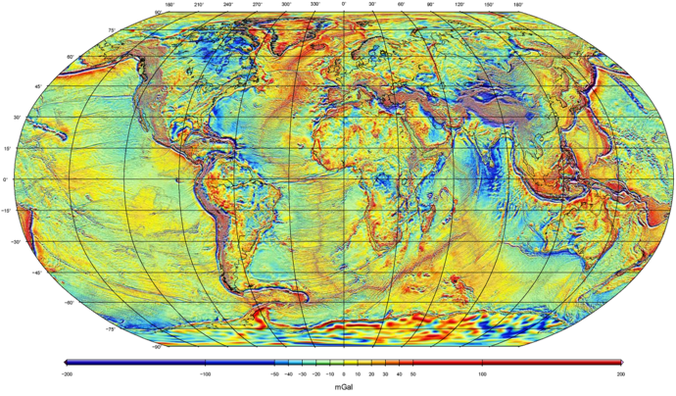
Example:
Global Free-Air Gravity Field from GRACE + GOCE + satellite altimetry + surface measurements…
WGM2012 model from Bureau Gravimetríque International

Slide 3
Example: Free Air Gravity from Satellite Ocean Altimetry

Slide 4
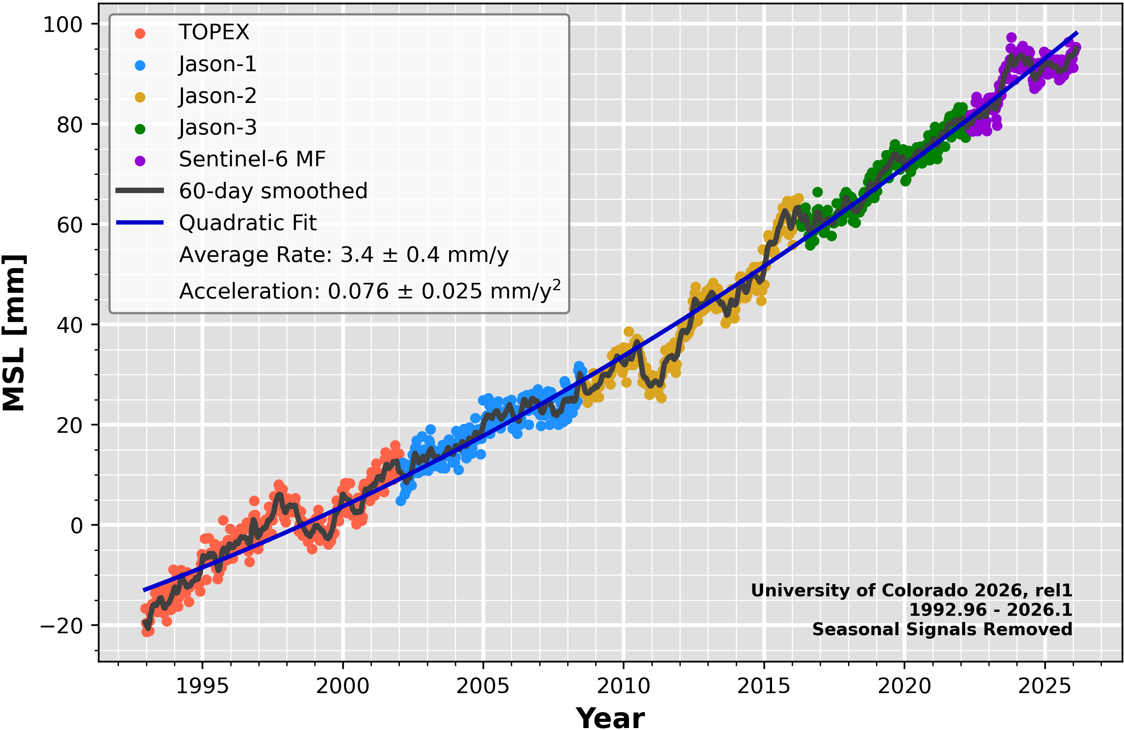
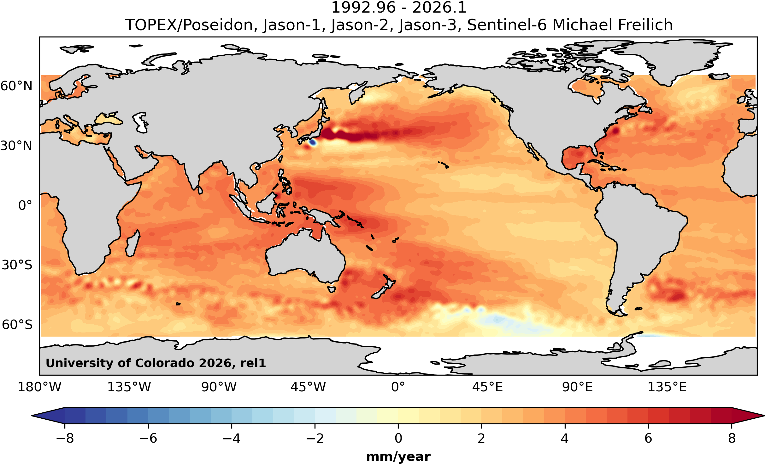

(Note altimeters were
actually intended to find
out more about sea level
change! The gravity field
was an afterthought)
Contributions
to global sea
level change:
Greenland:
0.61±0.02 mm/yr
Antarctica:
0.45±0.20 mm/yr
Continental:
0.41±0.08 mm/yr
Total Anthropogenic:
1.48±0.22 mm/yr
Altimetry: 3.4 mm/yr

Slide 5
Detail: Indian Ocean (East of Madagascar)

Slide 6
Detail: Western Pacific

Slide 7
Most structural studies use terrestrial (surface-
collected) measurements. All measurements
require corrections:
Recall: for spherical or
point mass M
Terrestrial measurement means setting a gravimeter down
on the Earth’s surface… So measurements will include
effects from changes in distance to Earth’s center of mass,
mass attraction of (known) topography, and mass
attractions of (unknown) interior density… We are only
interested in the last so try to subtract out the other stuff.

Slide 8
Recall: for spherical or
point mass M
It’s also useful to recall that our expression for gravity due
to a spherical mass came from an integral:
And integrals can be approximated as sums!

Slide 9
Corrections include:
• Tidal attractions from nearby
celestial bodies (dominated by
distance & direction to Moon, Sun, Jupiter)
• Associated solid Earth tidal deformation
• Mass of atmosphere above (approximately
given by atmospheric pressure)
For these corrections, record time/location of
measurement and the atmospheric pressure.

