Slide 1
Geology 5660/6660
Applied Geophysics
21 Feb 2024
Lab 4
Seismic Reflections
Due 2:30 pm Mar 6
© A.R. Lowry 2008-2024

Slide 2
(1) Seek a reflection in Benson Park-n-Ride data!
(a) First, use your best estimate of Layer 1 velocity and thickness from Lab 3
to model the expected arrival times of the first layer reflection in the modeling
code Reflect. (Include the plot and data windows in your writeup). Look at
the plot result with all the boxes checked, and with only the reflection box
checked. What challenges do you expect in picking real data?
(b) Load the Benson Park-n-Ride Forward shot data into the RAS24 software
and try to find that reflection. To help guide your eyes to a possible reflection,
I suggest the following steps:
i. Use the velocity line to approximate the expected asymptote for the
reflection (i.e., fix one end to the direct arrival at the first trace and set the
other end to match inverse slope of the 1st layer velocity).
ii. Use the “Select display filters” button/panel to emphasize high
frequencies (select “Low Cut”, “45” Hz, and “Preview” or “Apply”).
iii. Shift the pick lines to the approximate times you modeled in Reflect,
and include a screen-shot of the result in your write-up.
iv. Now, shift the pick lines to where you think the reflection actually is
based on looking at the data, and save/report those picks.

Slide 3
(2) Now, enter your picks in the code Reflect, and use them to model a
best-fitting velocity and thickness for the layer. Include the model, section,
plot, fit and data windows in your writeup. (I recommend *not* using picks
that you are uncertain about in the data fitting portion of this exercise…
Note that the first ~5-6 traces are very difficult to pick!)
(a) How does the model you’ve generated from the reflection compare to
your understanding of the subsurface based on the three models you
created from refractions in Lab 3?
(b) Are you confident that the arrival you picked is really a reflection? If not,
what is it likely to be?

Slide 4
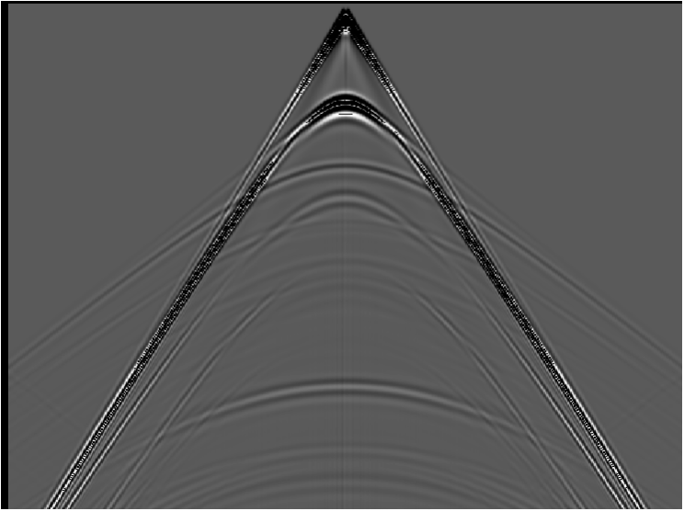
Lab 4: Seismic Reflections
0
2000
4000
6000
8000
10000
(m)
0
0.5
1.0
(sec)
1.5
2.0
2.5
3.0

Slide 5
(3) The previous slide shows synthetic (idealized) data generated
using a numerical (finite element) approach. There are four
primary reflections present in the data. Pick five travel-times
(i.e., at five different distances) from each of at least three of
those reflections. Using Excel (or some similar software that
allows you to regress a line fit– you can do this in Matlab, or
other software if you prefer), plot x² versus t² for each of your
reflections, and calculate the velocities and thicknesses these
would imply assuming each reflection is from a single-layer
interface over a half-space.
(4) Now do the same for one of the multiple reflections.

Slide 6
A brief note on regression of a line fit: The most common
approach (in the absence of measurement uncertainties)
is the method of least-squared misfit of the measurements
to the line. Given y = mx +b with slope m and intercept b,
the least-squares line fit is given by:
where N is the number of measurements.
Obviously this is well-suited to automation!

Slide 7
(5) Again, without using Reflect, use the intercepts and
slopes of lines on your x² – t² plots with Dix equations
to calculate velocities and thicknesses of each layer.
(6) Do similar calculations for velocities and thicknesses
using Dix equations, but now instead of using
taken from the inverse slope of x² – t², use the first-
order T_{NMO} relation (i.e., use the inverse slope of a line
fit to a plot of T_{NMO} versus x²/2t₀). How does this change
the model? Which is likely to be more accurate and why?
(7) Now plug your travel-time picks into Reflect and
calculate a model of velocities and thicknesses. How
does this compare to your “hand-calculated” models?

