Slide 1
Geology 5660/6660
Applied Geophysics
21 Jan 2026
Last time: Instrumentation:
• A seismometer (or geophone) is an inertial mass that moves
relative to a frame, coupled to the ground
• Mass = magnet (or coil) moves wrt coil (or magnet); Voltages are
amplified and recorded as signal.
• Motions are damped to levelize signal & minimize “ringing”
Useful Concepts: Time & Frequency Domains
• Time (t)-dependent signals (time domain) can be expressed
as amplitudes of sums of sin(ωt) & cos(ωt) for all frequencies ω
(frequency domain).
• A Seismogram is t-domain convolution (ω-domain
multiplication) of source, Earth response, & instrument response
Read for Fri 23 Jan: Burger 65-81 (Ch 3-3.2)
© A.R. Lowry 2008-2026

Slide 2
Last time continued: Instrumentation
The damped harmonic oscillator/electronic design of
geophones/seismometers means that:
→ A Seismogram (or geophone recording) is not an
exact record of ground displacement
→ Instead, it approximates motion (usually acceleration)
delayed by some amount and convolved with seismometer
response function
→ Knowing the seismometer response we can correct to
approximate true ground motion in a limited
frequency band

Slide 3
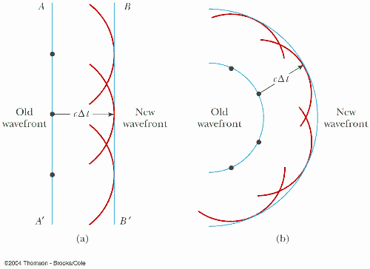
Huygen’s Principle:
Every point on a wavefront can be treated as a point source
for the next generation of wavelets. The wavefront at a time
Δt later is a
surface tangent
to the furthest
point on each
of these
wavelets.
cΔt
Old
wavefront
cΔt
New
wavefront
Old
wavefront
New
wavefront
We’ve seen
this before…
This is useful
because the
extremal points
have the greatest constructive interference, and later
arrivals may destructively interfere (!)

Slide 4
Fermat’s Principle (or the principle of least time):
The propagation path (or raypath) between any two points
is that for which the travel-time is the least of all possible
paths.
Recall that a ray is normal to a wavefront at any given time:
A key principle because most of our applications will involve
a localized source and a first-arriving wave observed at a point.

Slide 5
Fermat’s principle leads to
Snell’s Law:
Travel-time is minimized
when the ratio of sines of the
angle of incidence θ (angle
between the raypath and the
normal to a velocity boundary)
is equal to the ratio of the
velocities, i.e.,
V₁ = fast
V₂ = slow
•
least time in slow
θ
least time
straight line
•
least time in fast

Slide 6
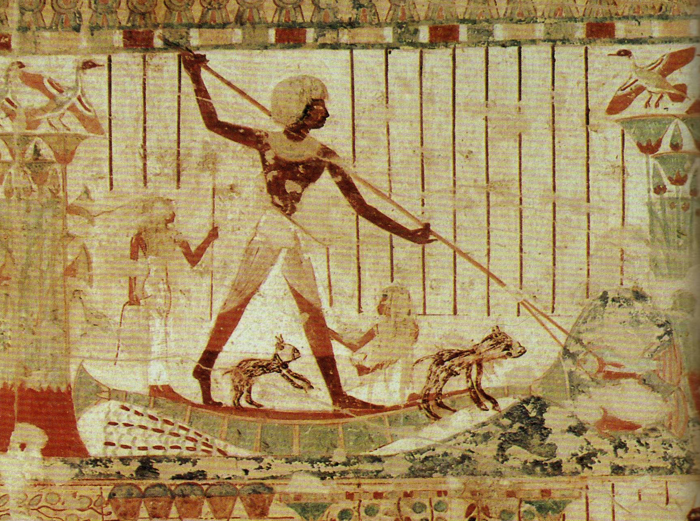
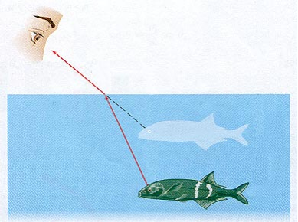
NOTE that much of the wave theory that applies to
seismology also applies to optics (a wave phenomenon also)…
Spear-fishers understand Snell’s law intuitively, after learning
to always aim below the visual location of the fish!

Slide 7
Given these rays… Which block is faster
and which is slower?

Slide 8
Reflections & Refractions:
Consider that when a seismic wave meets a layer boundary
between media with different velocities V = fλ = λ/T,
Energy E must be conserved
Stress σ must be continuous (i.e. the same on both sides)
Displacement u must be continuous
This is achieved by “partitioning” the energy between
reflections & refractions, and in many cases by converting
part of the energy from one type of wave to the other!
(ω = 2πf
= 2π/T!)
reflected P
refracted P
reflected S
refracted S
incoming P

Slide 9
Reflections & Refractions:
All of the reflected and refracted waves must obey
Snell’s Law. Consequently,
A reflected wave (traveling at the same velocity) will have the
same angle of incidence as the incoming wave.
A reflected or refracted wave traveling at faster velocity will
be bent toward the layer boundary
A reflected or refracted wave traveling at slower velocity will
be bent away from the boundary.
reflected P
refracted P
reflected S
refracted S
incoming P

Slide 10
Consider the “idealized” scenario of a source at the surface
producing seismic waves that traverse a horizontal boundary
between two layers (slower upper & faster lower):
θ_{c}
There will always be some angle of incidence for which the
the angle of the refracted ray is parallel to the layer boundary.
Rays arriving at angles > this critical angle will not transmit
refracted energy into the lower layer (all energy is reflected or
converted). The critical angle, θ_{c}, is given by:
or

Slide 11
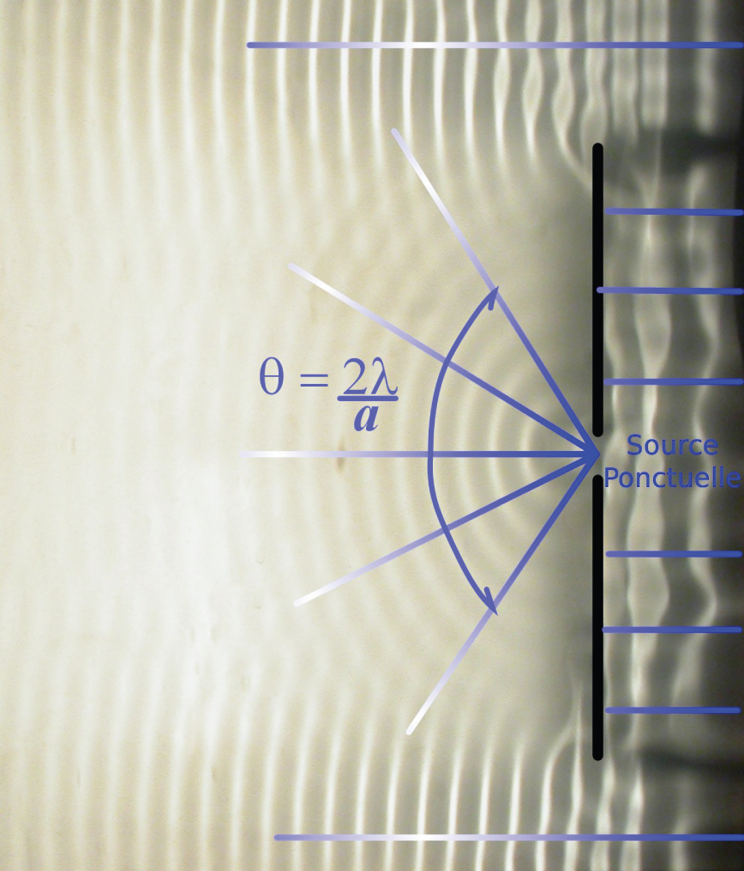
From Huygen’s Principle we also predict diffractions,
waves that don’t fit the ray-theory approximation:
These waves are always
there but not generally
observed unless for
some reason part of
the destructively
interfering wavefield
is removed…
Diffractions commonly
result when a structure is
“non-ideal”, e.g. when it
is discontinuous or
compact.

