Slide 1
Geology 5660/6660
Applied Geophysics
21 Jan 2026
(Lab 1)
This Week’s Lab:
• How to pick a seismic phase arrival time
Due 28 Jan at 2:30 pm
© A.R. Lowry 2008-2026

Slide 2
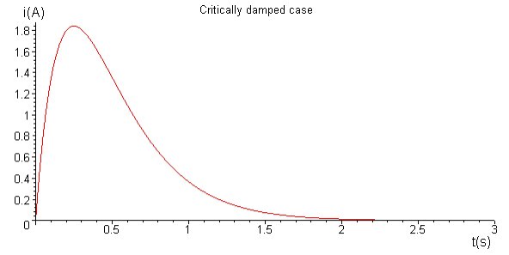

How to pick a seismic phase arrival time
Damped Seismometer Response
Seismic Arrival
Recalling what a seismometer records…
At what point in time did the seismic wave arrive?
Acceleration
Time

Slide 3
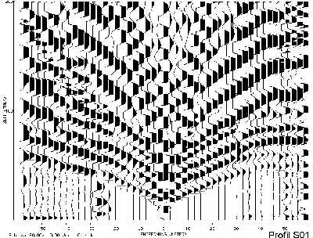
Seismic Section
Time (s)
Distance (m)
In seismic refraction studies, we pick the time of
first arrival of seismic energy!

Slide 4
Some useful info about seismic sections:
• Seismic traces ⇒ ground acceleration
at the observing seismometer/geophone
• Noise will be present (we reduce by
stacking or using a large/strong source)
• Amplitudes (i.e., deflections) are often
made more easily visible by amplification
⇒ “gain”
• Positive-valued deflections on the trace
are often “filled” to help visually correlate
arrivals at neighboring traces
• For a vertical geophone, if polarity is
correct, positive = up
• Wave first motion indicates the direction of
first motion at the source! (Upward = away)
Time (s)
First
arrival
“pick”
Distance (m)
In seismic refraction studies, we pick the time of
first arrival of seismic energy!

Slide 5
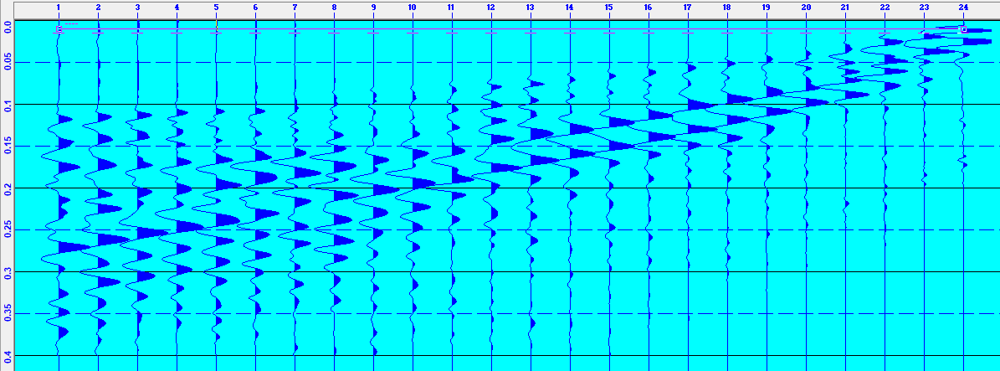
So when is the first arrival occurring on each of these traces?

Slide 6
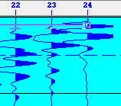
By convention, polarity is defined so that upward first
motions are plotted as positive (i.e., filled) on the seismic
section.
In this plot, the first motions are negative!
Does that make sense?

Slide 7
By convention, polarity is defined so that upward first
motions are plotted as positive (i.e., filled) on the seismic
section.
In this plot, the first motions are negative! This can result
from mis-wiring of electronics, attaching geophone leads
to the cable backwards, a plotting error, or a source that
produces inward first motion... For this reason, it’s important
to look carefully!

Slide 8
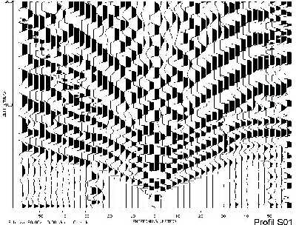
Time (s)
Distance (m)
In seismic refraction studies, we pick the first arrival
of seismic energy!

Slide 9
Time (s)
Distance (m)
Time (s)
Distance (m)
As a first approximation, the refraction method approximates
the travel-time picks as straight lines and models the velocity
structure assuming multiple layers with planar boundaries
(because, as we’ll see, the math is easy).

Slide 10
Recall this from week 1?
energy
source
3 m
Seismometers or “receivers”
Soil:
V_{p} = 0.5 km/s
6 m
Limestone:
V_{p} = 5 km/s

Slide 11
energy
source
3 m
Seismometers or “receivers”
Direct Arrival
Soil:
V₁ = 0.5 km/s
6 m
a
b
Refracted Arrival
Limestone:
V₂ = 5 km/s
In this example, a plot of first-arriving travel time versus distance
will yield lines (for the direct arrival) with slope 1/V₁, intercept zero
and (for the refracted arrival) slope 1/V₂ & an intercept that
depends on layer thickness h and V₁, V₂:

Slide 12
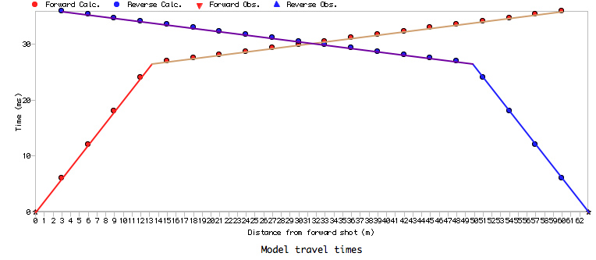
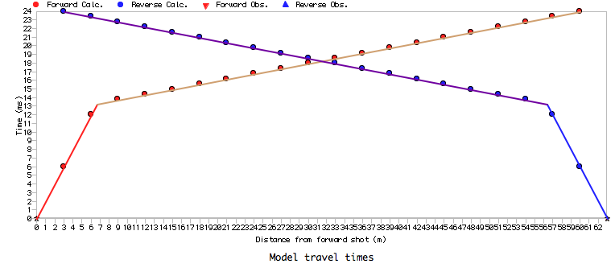
6 meter upper layer
3 meter upper layer
NOTE: Triangles are what you would
measure; lines & circles are a model!!!

Slide 13
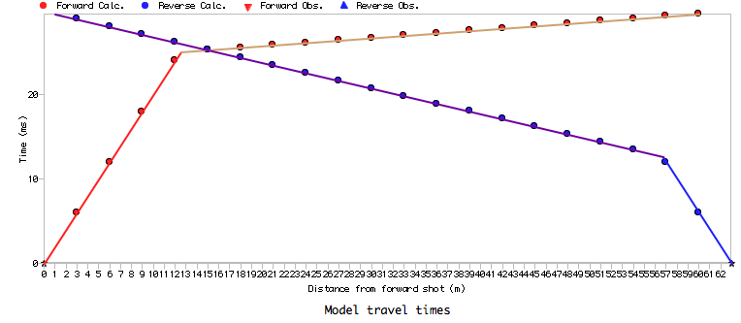
No dip on layer boundary
3 degree dip on layer boundary

Slide 14
How about this?
energy
source
Seismometers or “receivers”
Basalt:
V_{p} = 5 km/s
Loess:
V_{p} = 0.5 km/s

Slide 15
Your lab assignment (due at 2:30 pm on 28 Jan):
• Download the Benson Park-n-Ride (3-m forward and reverse)
data files from the course website
• Using the RAS-24 picking software, pick the travel-times at
each of the 24 geophones for both the forward and reverse
lines. (For this, you may either use the PCs in the Oldham
room computer lab, assuming they still have the software
installed, or you can download the software zipfile provided on
the Canvas page and try to install it on your own PC).
• In a plotting software of your choice (e.g., Xcel or Matlab),
plot time versus distance from the source for both the
forward and reverse experiments, and answer each of the
questions posed on the following slide:

Slide 16
Look carefully at your first arrival picks.
a. How many different “straight lines” can you distinguish
in the plots of travel-time vs distance?
b. What range of geophones corresponds to each straight
line?
c. What travel path would you interpret each straight line
to represent?
(2) a. Are the travel-times exactly the same in both directions?
b. What might that imply about the subsurface beneath the
survey?
Lab write-ups should include tables of your
travel-time picks, plots of travel-time vs distance,
clear answers to the questions posed above, and
and explanatory background where appropriate!

Slide 17
How to do a lab write-up (generic):
• A formal report is not necessary.
• But EVERYTHING must be in a single document!!! All of
you should be familiar with basic desktop publishing by
now (& if not, it’s time to get familiar).
• I will accept MSWord, PDF, even PowerPoint (but not
Xcel spreadsheets— Show all data as graphs or tables
in a document).
• Show work!!!!! Include equations you used (Use e.g.
Insert → Equation in MSWord).
• If you have a wrong answer without showing work, you
get 0 credit. If I can identify where you went wrong,
it will get you partial credit.
• Lab write-ups should be submitted to me for grading
<tony.lowry@usu.edu>

