Slide 1
Geology 5660/6660
Applied Geophysics
Review:
Lab 5 (GPR)
Lab 6 (Gravity)
© A.R. Lowry 2008–2026

Slide 2
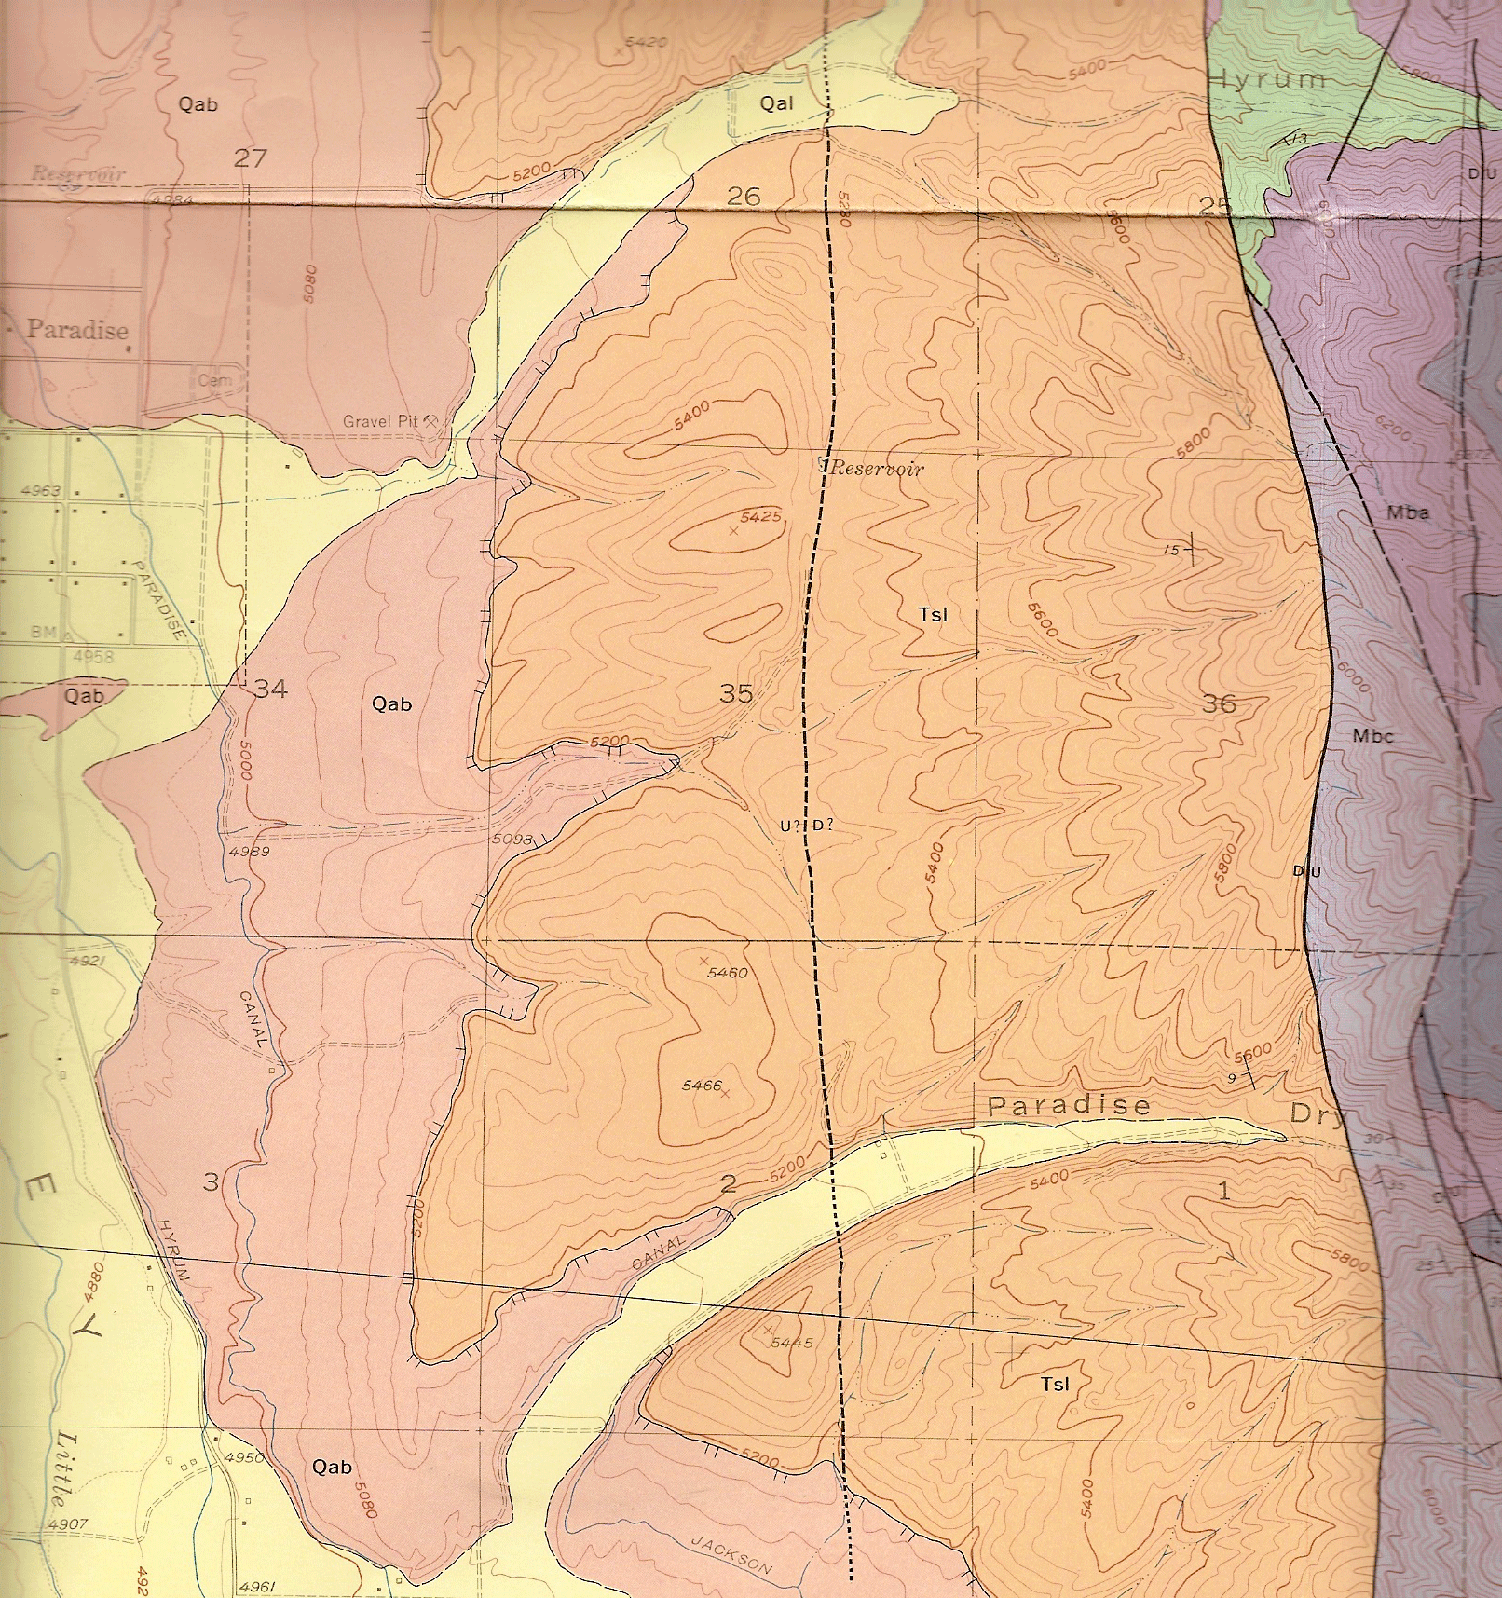
Review of Lab 5: Ground Penetrating Radar
Lab 5:
Correlative features?
Missing features?
Why trench there?
(2) Line drawing of
features
Offset beds, diffractions
Where add’l trench?
(3) Quasi-calculations
C
W
E

Slide 3
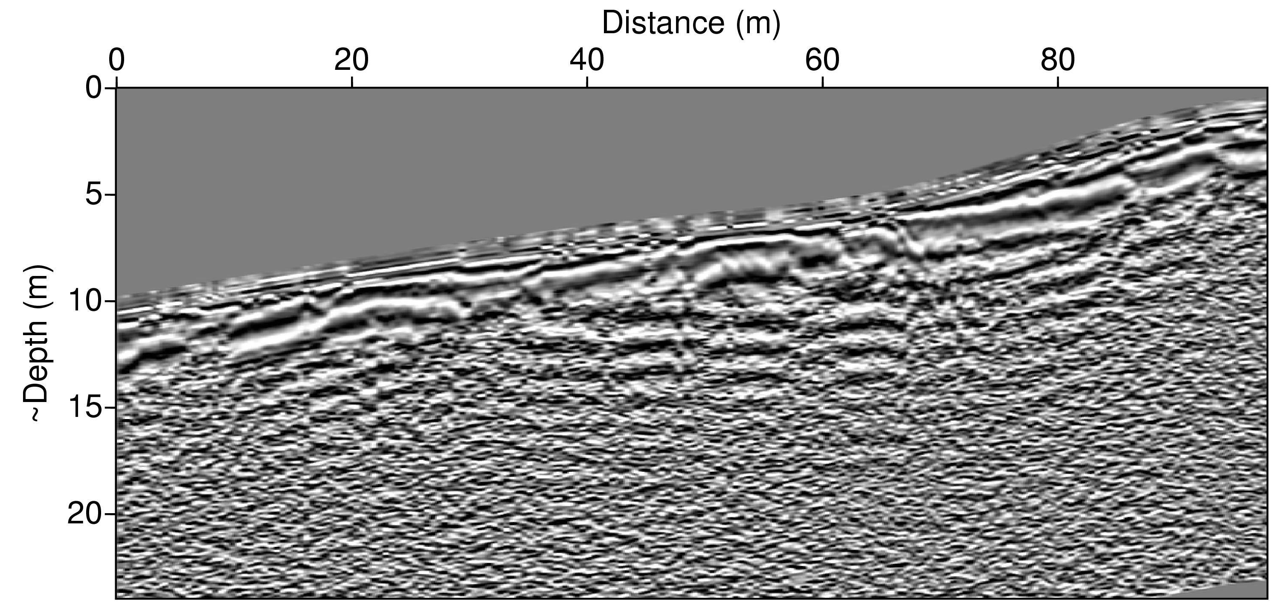
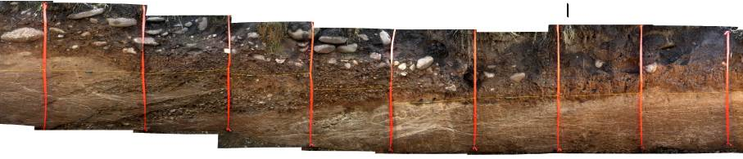
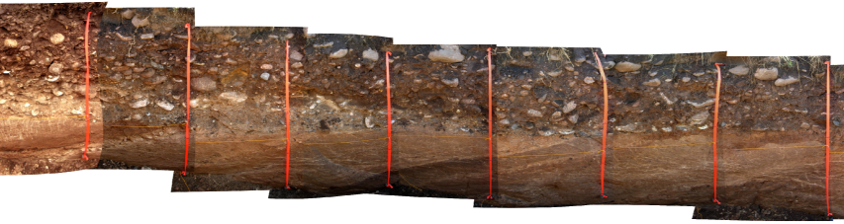
Western Fault Strand (“W”)
Possible to correlate with fm contact,
maybe? diffraction sources…
Antennae for
Paradise surveys
= 100 MHz!
East dipping layers of the Tertiary Salt Lake Formation (T_{SL})

Slide 4
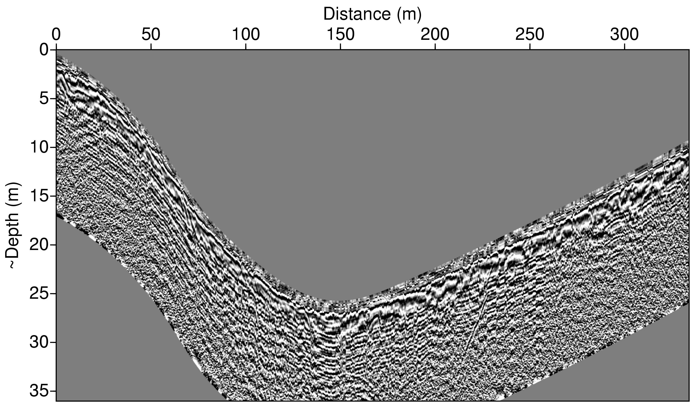
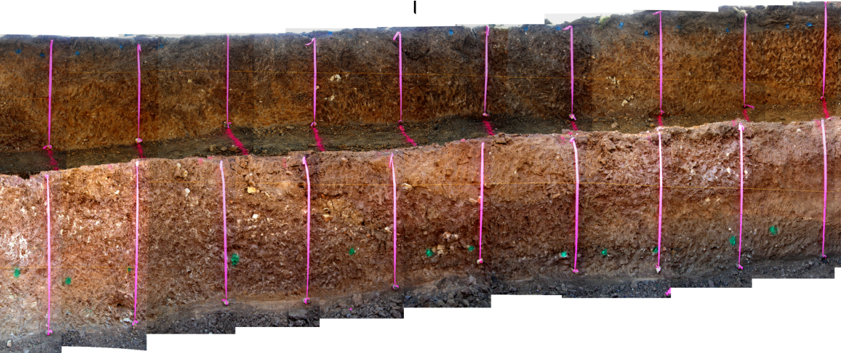
Trenches appear to be chosen from combination of geomorphology
& diffractions
Central Fault Strand (“C”)
Don’t see source of
diffraction here…
Note relatively poor data quality (ringing, poor trace correlation)

Slide 5
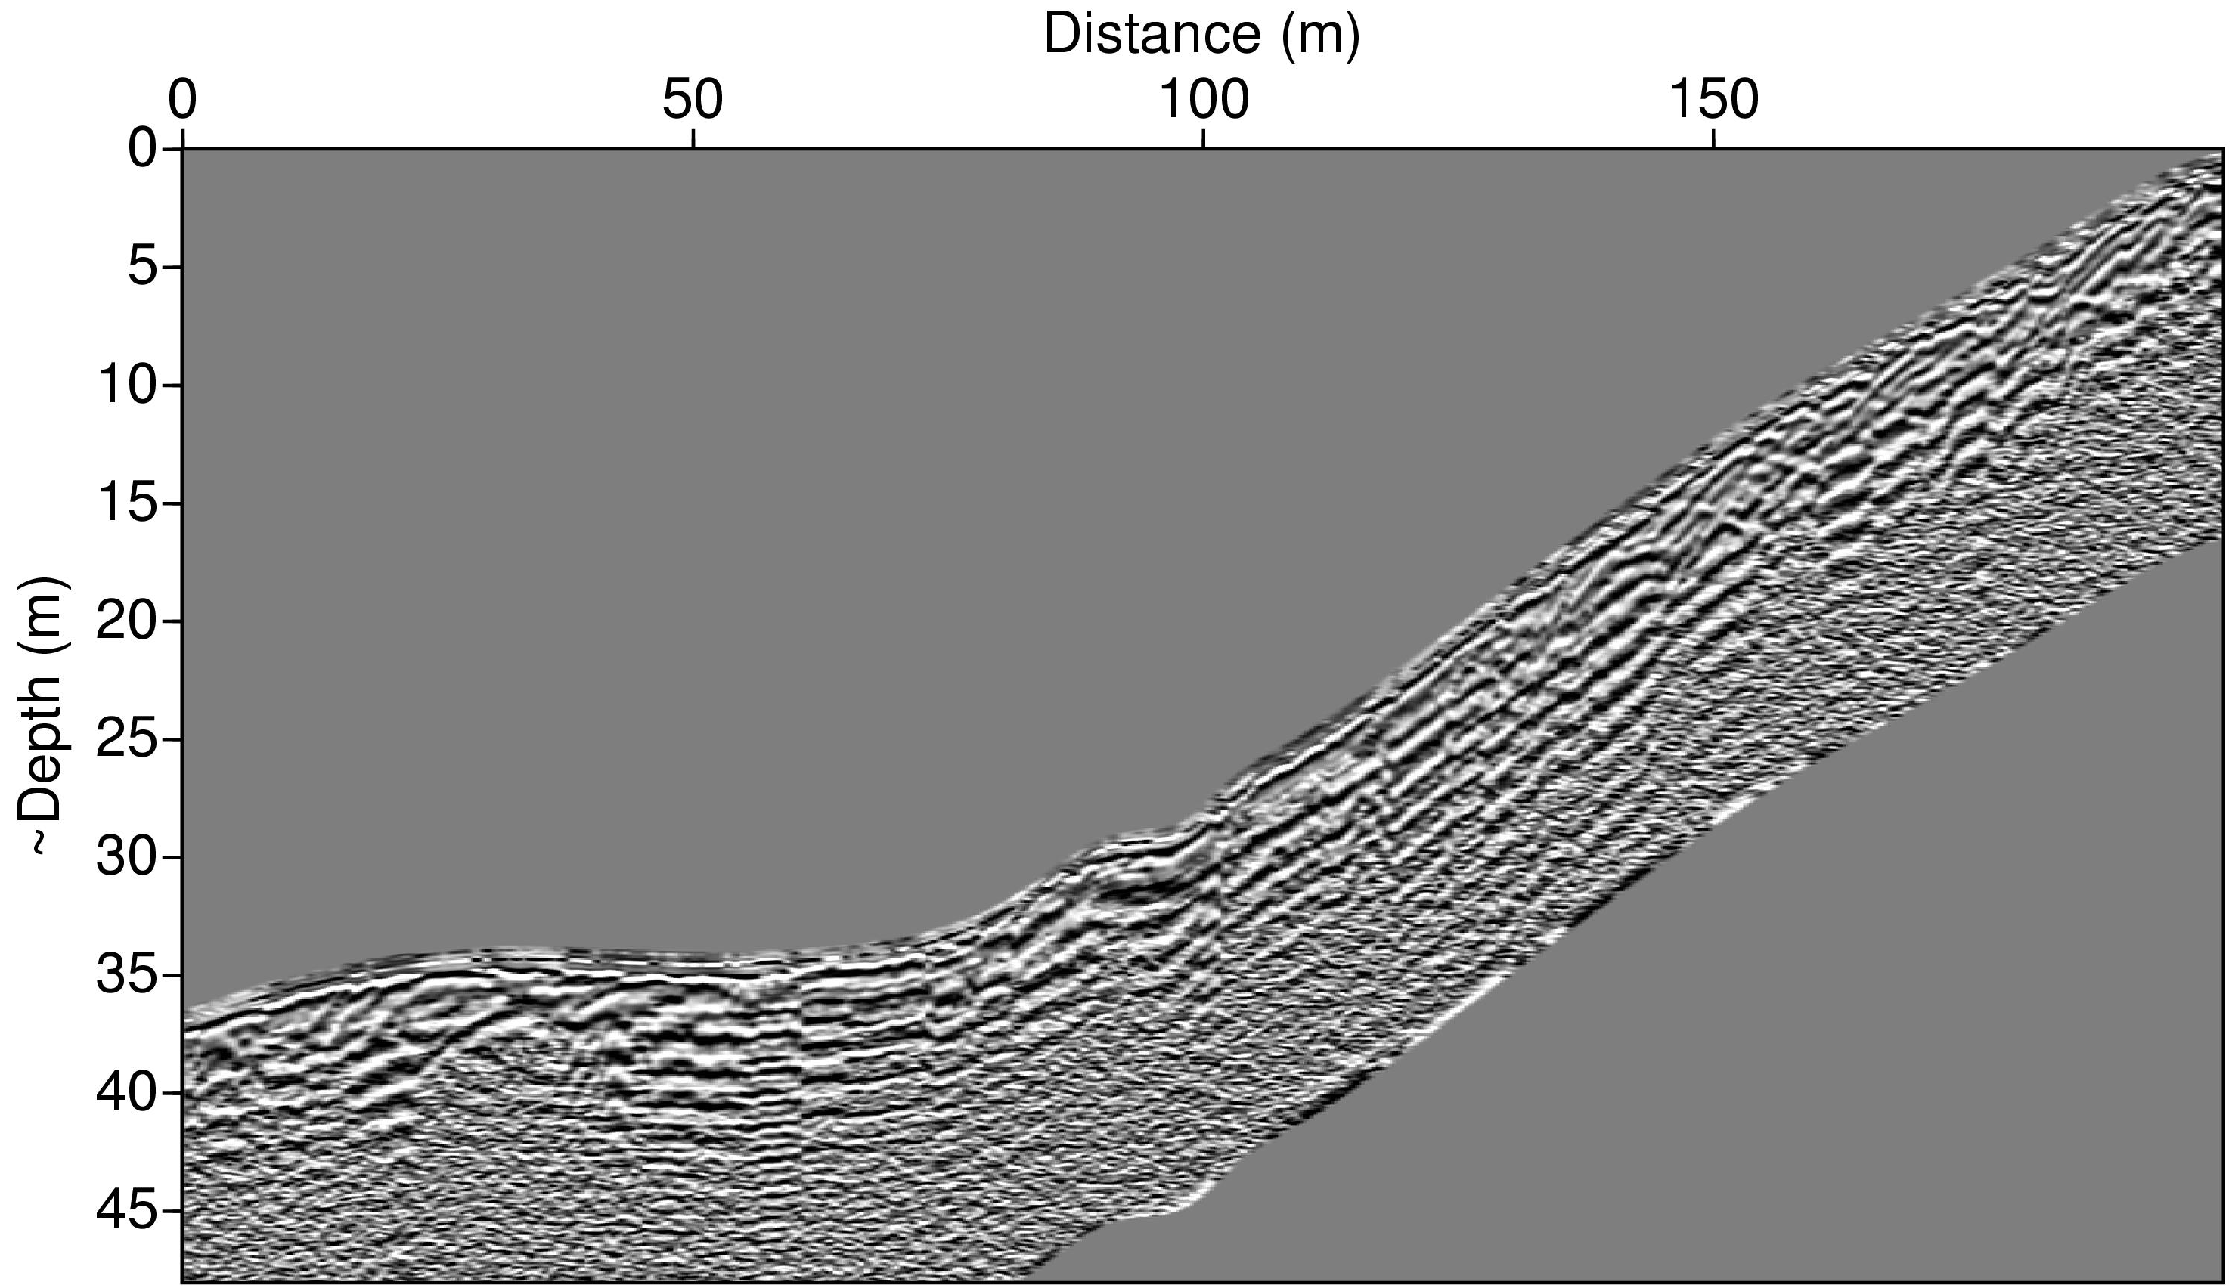
Eastern Fault Strand (“E”)
road
(No trench dug on this section)

Slide 6
(3) a. Estimate ε_{true}/ε_{assumed} given
, c & t are constants, μ = 1 so

Slide 7
Soil and Rock Properties:
Dielectric Constant
ε_{r}: (dry) (moist)
soil
4
30
sand
3
50
sandstone
5
12
clay
7
40
water
80
So, it appears that the assumed velocity was for materials
that are drier and/or less clay-rich than what we really
had…

Slide 8
(3) b. Estimate given measurements of a diffraction.
The diffraction travel-time equation will be given simply by
where h is the depth of the diffractor and
V_{t} is the true velocity in the medium above.
We can not observe t or h, because they have been converted
to apparent depth z_{a}, but substituting:

Slide 9
Western Fault Strand (“W”)
Using h_{a} = 0.2 m, z_{a} = 1.8 m at x = 2.2 m gives:
Note also that (which is very different from prior!)
Perhaps? because horizontal is so compacted, hard to follow.

Slide 10
Acquire & Reduce the Gravity Data
• Gravity spreadsheet is posted on the website
• Treat site 1 as the reference site, with value zero.
(& add all corrections at site 1 back to all sites to
keep it at zero).
• I have already corrected dial reading to relative gravity
using constants for the LR-meter that we used, and
also corrected for tidal effects
• You will need to do the rest…
a. Calculate drift (in mGal/hour) from repeated
measurements and do a drift correction
b. Calculate GRS67 reference gravity (see text) and
do latitude correction (Watch your units!!!)
c. Calc free air correction → free air anomaly
d. Calc Bouguer slab corr → simple Bouguer anomaly
e. Calc approximate 2D terrain correction using
GravMag and elevation data → complete
Bouguer anomaly.

Slide 11
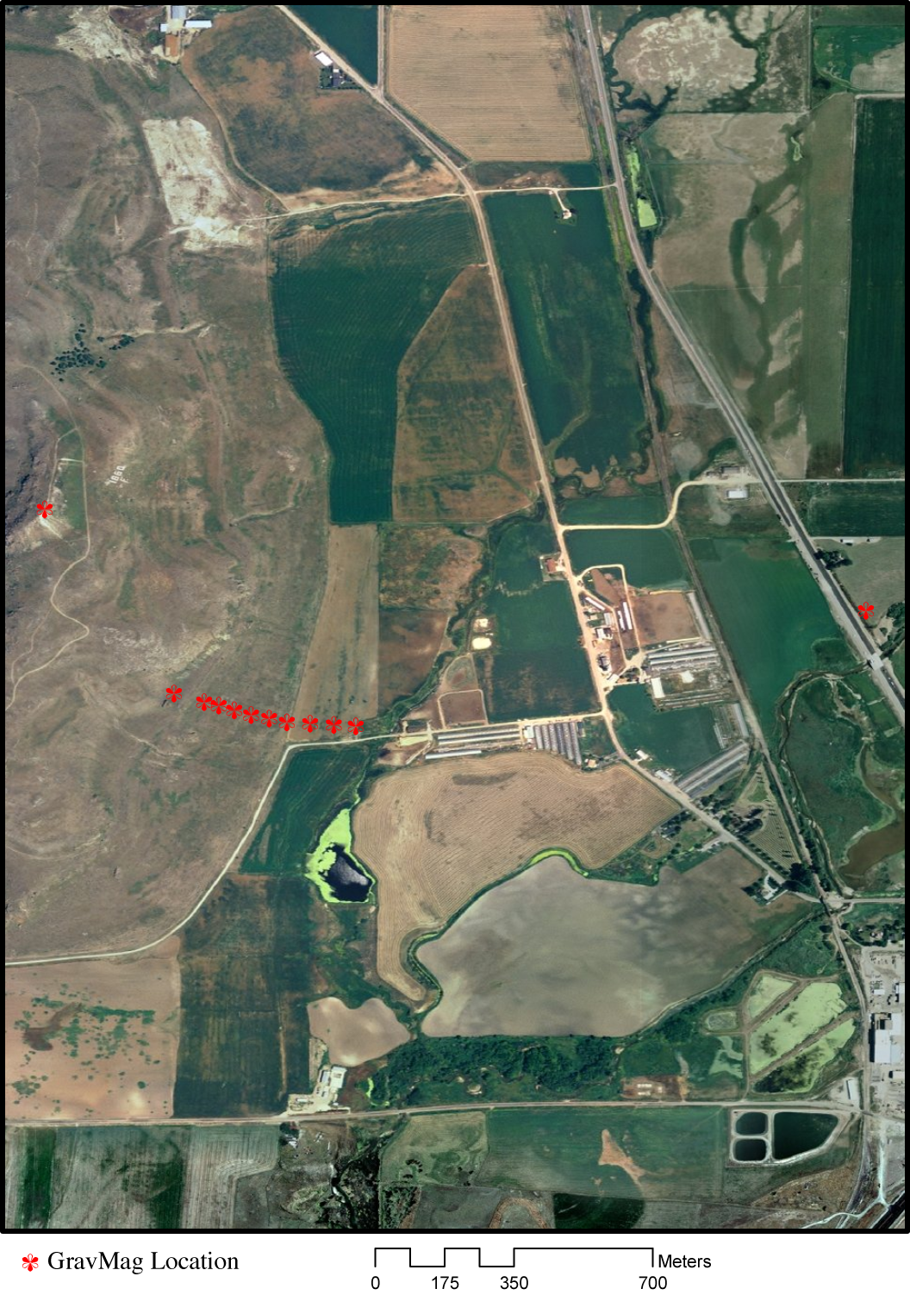
1(a): Drift/Atmospheric Correction
The drift correction assumes a constant
∂g/∂t due to changes in spring constant
+ atmospheric mass. The only repeated
measurements were at the base site,
and were separated by only 51 minutes.
Moreover the sites were observed in an
odd order (see left). In combination
these imply that the drift correction is the
dodgiest we will do, because
A 73 μGal change over 51 minutes
is somewhat large, and we have
repetition at only one site;
(2) The drift is extrapolated over a time-
span of 2.7 hours;
(3) The dial readings at the base site
apparently were recorded
incorrectly, and the correct readings
may have been mis-remembered.
17:18
16:19
16:12
15:13
16:04
17:45
16:08
15:58

Slide 12
1a: Drift/Atmospheric Correction
Drift Correction
Tidal Correction
Interestingly, the drift correction is consistently about twice the
(previously applied) tidal correction, so may be reasonable.

Slide 13
1a: Drift/Atmospheric Correction
Significantly, the drift correction is small (<2%) relative to the
measured gravity variation.

Slide 14
1b: GRS67 Latitude Correction
The latitude correction is similarly very small (~5%) relative to
the measured gravity (but in this case error is not a concern).

Slide 15
1c: Free Air Correction
The Free Air correction on the other hand is VERY significant
(larger in fact than the variation of uncorrected gravity!!)

Slide 16
1c: Free Air Anomaly
The Free Air Anomaly has roughly the same total variation as
the raw gravity measurements, but opposite sign.

Slide 17
1(d): Bouguer Slab Correction
The Bouguer slab correction is also a significant fraction of the
remaining Free Air gravity anomaly.

Slide 18
1d: Simple Bouguer Anomaly
The Simple Bouguer anomaly is smaller than the raw gravity
variation, but begins to exhibit some interesting features.

Slide 19
The terrain corrections used the measured elevations
in the el_prof.xls spreadsheet provided on the website
(plus the arcinfo and memory of topography) to
approximate 2D topo variation relative to each site.
Location of site for correction
+2670 kg/m³
–2670 kg/m³
For this calculation needed to do 12 GravMag models– one for
each site– with polygons representing the mass attraction of
topography below the site and topography above the site.

Slide 20
1e: Terrain Correction
The terrain correction has ~20% of the variation of the simple
Bouguer anomaly, so is small but not insignificant.

Slide 21
1e: Complete Bouguer Anomaly
The final corrected gravity anomaly, ready for modeling...

Slide 22
(2) Evaluate possible errors.
• Recall that there is some uncertainty regarding whether
the dial readings from site 1 are correct! This calls into
question both the measurements at site 1 and the
estimate of drift correction. Plot your data at the following
steps with and without the drift correction:
Free air anomaly, simple Bouguer anomaly, complete
Bouguer anomaly. Are the values at site 1 consistent
with the other measurements? Does the profile of data
seem cleaner with or without the drift correction? Does
this help us determine whether our dial reading edits
were reasonable?
• Recall also that the position at site 10 was not measured
but approximated (by interpolating between adjacent
sites. Do you see any evidence this estimate of position
might be off? If so, by about how much?

Slide 23
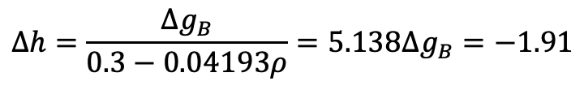
The various gravity anomalies with and
without drift correction (shown left)
indicate that (1) the difference in site 1
measurements is negligibly small
relative to the signal, and (2) the site 1
anomaly lies near the trend defined by
neighboring points, suggesting that the
amended dial readings are reasonable.
If the drift correction were in error, it
would be most evident at site 4, which
is an “outlier” in the drift corrections
(slide 3). Site 4 anomalies may be very
slightly more consistent with their
neighbors in the uncorrected data, but
not enough so to be concerned about.
Site 10 does appear to be in error by
~ –0.36 mGal (relative to a line through
neighboring points); if all due to height
error this would imply an error of
m.
$$Δh=\frac{Δg_{B}}{0.3−0.04193ρ}=5.138Δg_{B}=−1.91$$

Slide 24
(3) Model the Complete Bouguer Gravity Anomaly
Using GravMag
• Recall that we have three possible end-member
models to explain why Little Mountain is there:
a. A horst associated with active normal faulting
b. An allochthonous remnant from Laramide thrusting
c. Paleotopographic surface that was never buried by
Cache valley normal faulting & sedimentation
• Create a GravMag prismatic model for each end
member, and vary the density contrasts/prism
endpoints as needed to optimize fit for that model type
• Remember that the RMS residual is key to
evaluating the validity of your model!
• Discuss your results. Can any of the end member
models be ruled out based solely on the gravity data?
Why, or why not?

Slide 25
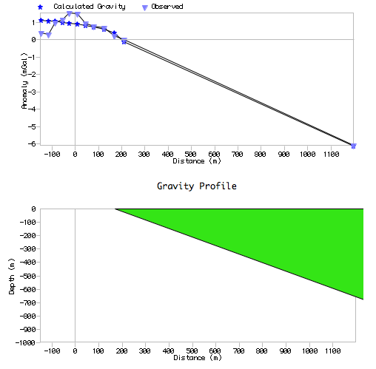
Horst model: A
simple horst model
does a pretty good
job of modeling the
data, reducing RMS
from 1.9542 mGal to
0.404. The density
contrast is
reasonable for
unconsolidated
sediments and
limestone, and the
best-fit polygon
intersects the
surface near the
break in slope, but
RMS = 0.4040 mGal
Δρ = –390 kg m⁻³
the fault dip is low (<35°!). The far-field site and lowest five sites
on Little Mtn are well-fit; sites higher up are poorly matched.

Slide 26
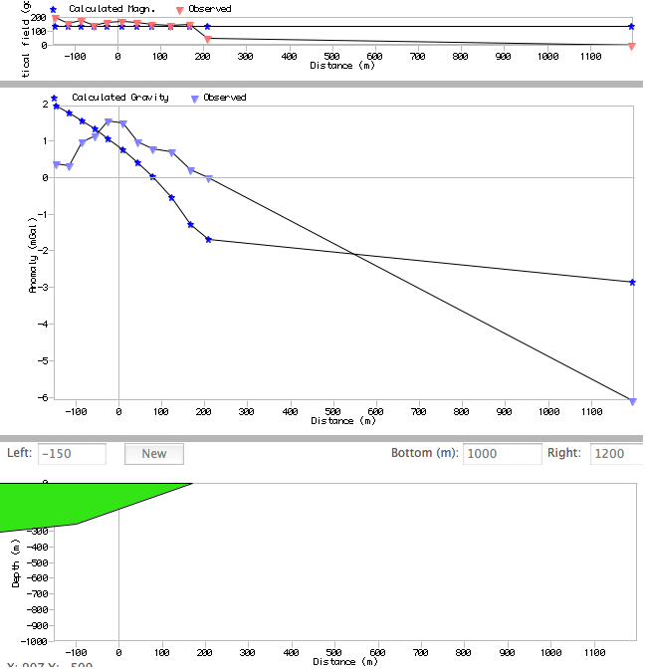
b. Allochthon model:
I limited thrust fault dip to
35° (plus topo under
sites) and fault contact to
<170 m (slope break is
~100 m). This drastically
limits the data fit, and so
the best I could do was
an RMS of 1.4069 mGal.
The density contrast is
large, implying footwall
rocks would have to be
unconsolidated despite
their Laramide age.
Realistically there is just
RMS = 1.4069 mGal
Δρ = 460 kg m⁻³
no way to adequately fit the far-field point without invoking low
density (unconsolidated sediment) to significant depth there, so I
would say this rules out the allochthonous remnant end member.

Slide 27
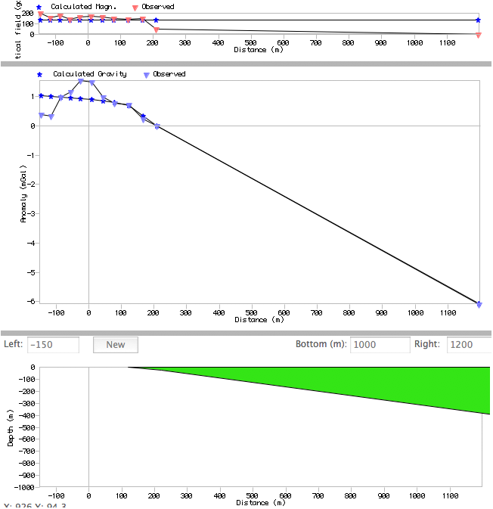
c. Palaeotopography
model: Here I limited
slopes to <20°and
contact for the basement/
sediment drape to <170
m, but allowed for
additional points in the
polygon. The best-fit
model had RMS of
0.3743 mGal. This is
essentially the same as
for the horst model (the
slight improvement
comes from the pt slope
break allowed by an extra
RMS = 0.3743 mGal
Δρ = –580 kg m⁻³
point in the model). Limiting the dip on palaeotopography forces a
shallower basement contact and larger density contrast; 580 kg
m⁻³ strains the edges of credibility but is still possible.

