Slide 1
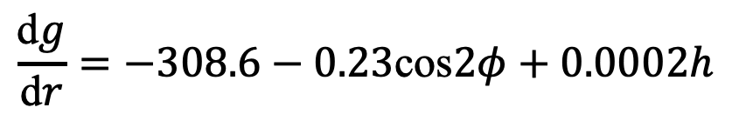
Geology 5660/6660
Applied Geophysics
22 Mar 2024
Last Time: Gravity Reduction
• For terrestrial measurements, we record measurement time
and atmospheric pressure; correct for lunar, solar,
planetary & solid Earth tides + atmospheric mass
• Measurement latitude ⇒ correction for ellipsoidal height and
centrifugal force of Earth’s rotation (see text eqn 6.12)
• Free air correction is ~ –308.6 μGal/m:
• Free air anomaly :
• Bouguer slab correction :
• Complete Bouguer anomaly :
(D_{corr} is instrumental drift; ρ = 2670; T_{corr} is terrain correction)
$$\frac{\text{d}g}{\text{d}r}=−308.6−0.23\text{cos}2φ+0.0002h$$
For Mon 25 Mar: Burger 349-378 (§6.5-6.8)
© A.R. Lowry 2008-2024

Slide 2
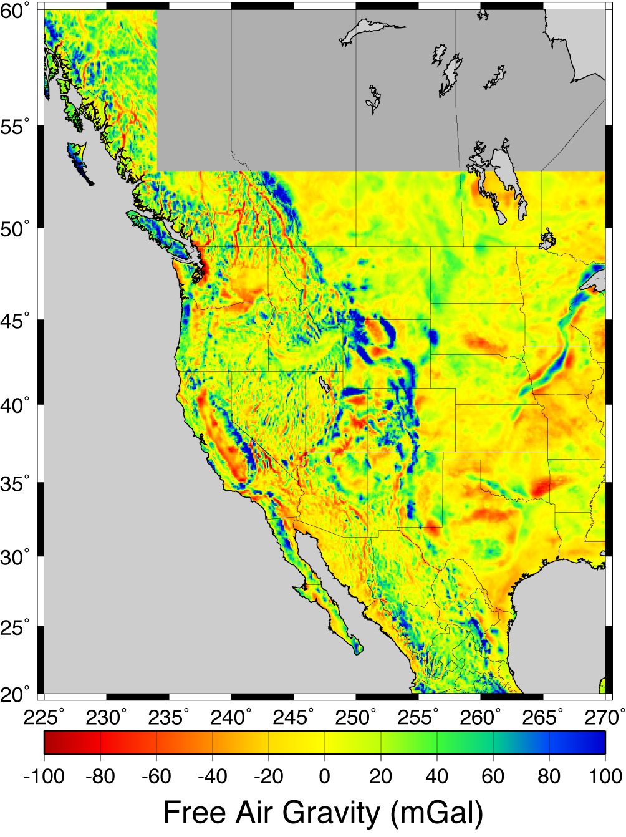
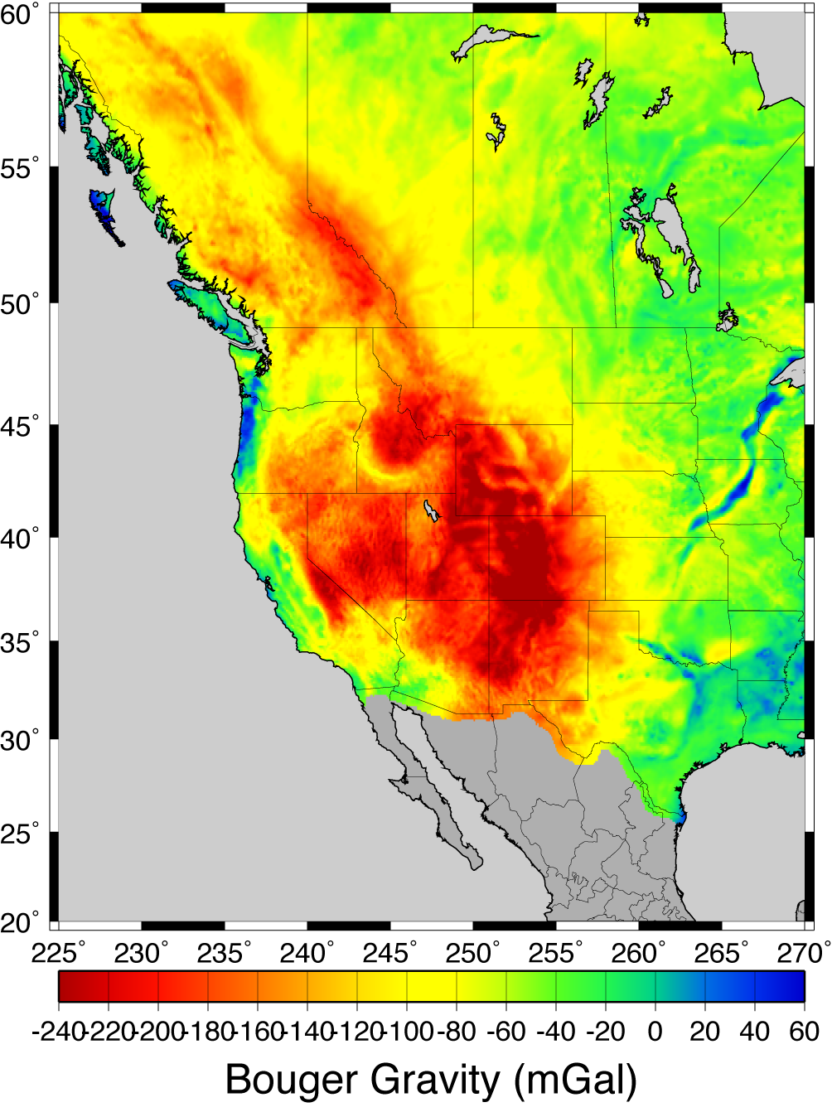
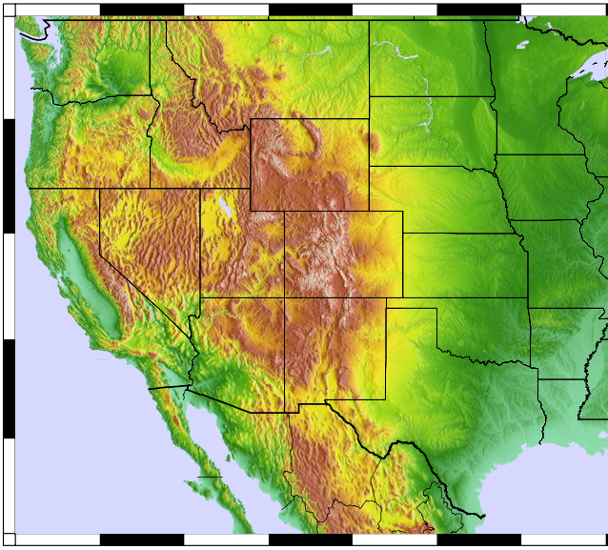

Slide 3
Some applications take a
further step and calculate
a correction for mass that
isostatically compensates
topography…
Implicitly assumes that all
loading is topographic mass
“piled on” at the surface,
and also assumes a
lithospheric plate strength
(usually local isostasy ⇒
no strength)
Explicitly wrong!!!– better to
model the true strength
and loading…

Slide 4
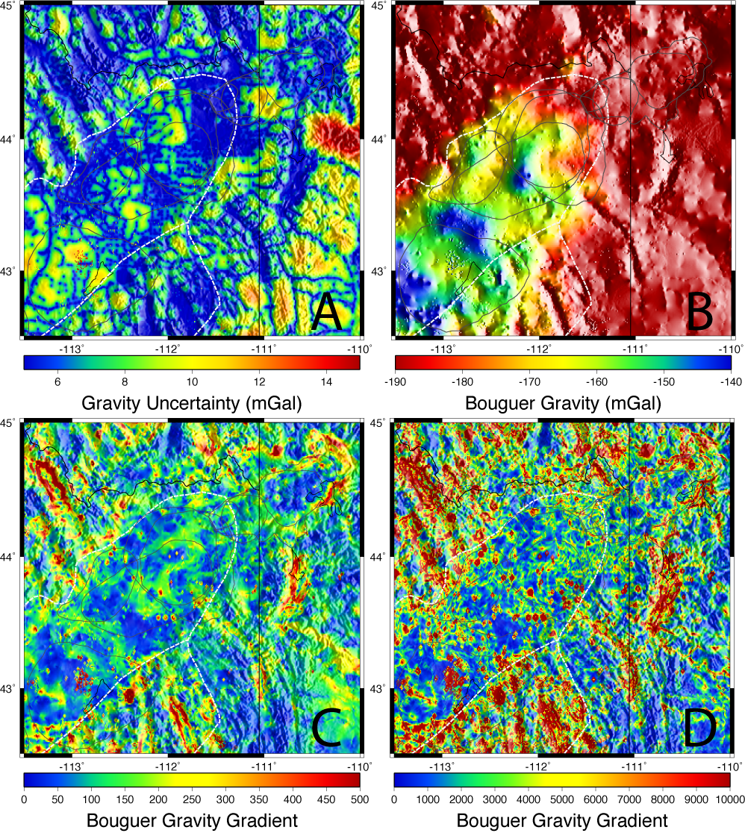

Bouguer gravity
from PACES data
set for the region
around Yellowstone
& Snake River
Plain (shaded
relief is gravity in
B; terrain for all
of the others).
Note “outlier”
measurements
(=> position error,
poor reduction,
or incorrect network
reference value);
high uncertainty
away from meas.
This is why careful gravity reduction and network adjustment is important!
Curvature

Slide 5
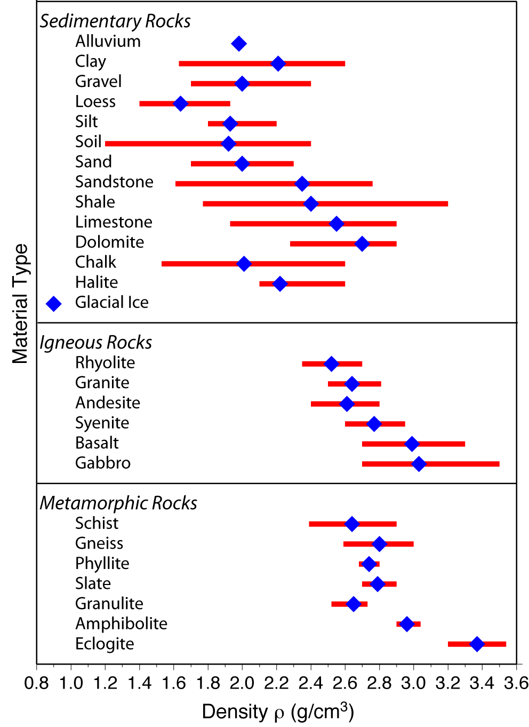
Gravity Modeling
seeks to characterize
subsurface structures
via geometry of
variations in mass
density ρ…
ρ depends on rock
type, porosity and
pore fluids,
temperature
Generally ρ lowest for
soils/seds, higher for
lithified sed rx, highest
for crystalline rx,
increases with depth

Slide 6
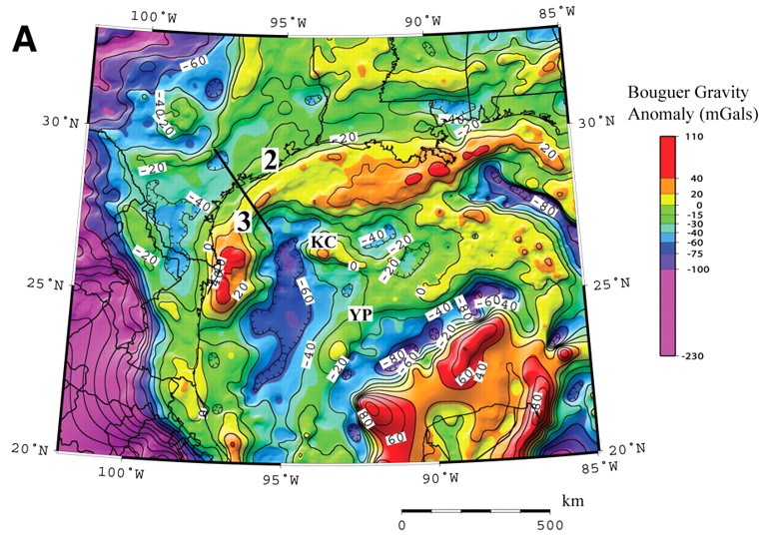
Mafic complexes
from past
continental
rifting?
Mickus et al., Geology 37 (2009)

Slide 7
Gravity Anomaly Due to a Spherical Source:
Recall gravitational acceleration from a spherical source
is given by
We measure Δg along a ~flat
(ground) surface (i.e., x varies but
d is fixed) so
This is small relative to total
(< 10⁻⁴!!) and the gravimeter
measures only the component of
the anomaly in the ~ direction:
Δg
x = 0
Δg_{z}
d
θ
r
R
Δρ

