Slide 1
Geology 5660/6660
Applied Geophysics
23 Feb 2024
Reflection Data Processing Cont’d
• Step V : Time Migration returns reflection energy to its
“true” location on the two-way travel-time image… Depth
migration uses velocity structure (from NMO analysis)
to convert travel time to depth (improving image resolution)
• Step VI : Reform amplitude stacks of source-receiver pairs
using Common Depth Point (CDP) instead of Common
Mid Point (CMP) and repeat Step V
• Sometimes additional steps as well:
→ Amplitude adjustments
→ Frequency adjustments
→ Transmission adjustments
Read for Mon 26 Feb: Burger 200-253 (§4.4-4.7)
© A.R. Lowry 2008-2024

Slide 2
Last Time: Reflection Seismic Interpretation
• Data collection: Huge quantities of data! Redundancy is key!
• 2D profiling still used for initial reconnaissance, but 3D is
industry standard for prospects
• Deep crustal imaging is only done in 2D; shows “reflectivity” in
crystalline basement from low angle faults & foliated minerals

Slide 3
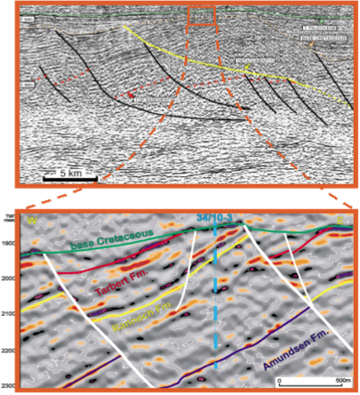
Haakon Fossen 2010
3-D seismic “data cubes”
• Better resolution
• Better positioning
• 3D view options

Slide 4
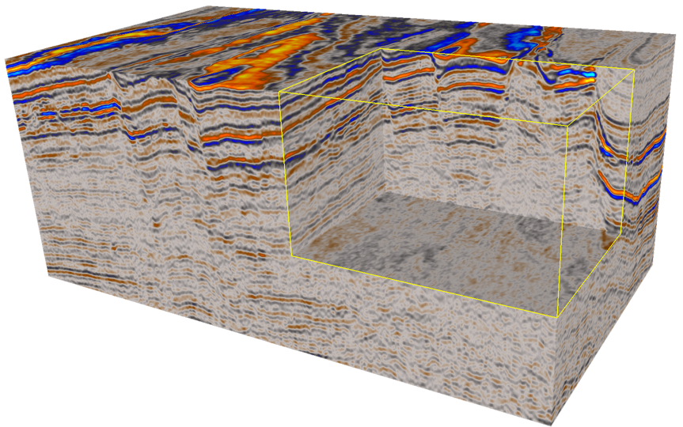
3D Seismic
Haakon Fossen 2010
3D Data:
• Collect by shooting many parallel lines ~25 m (!) apart
• Migrate together to increase accuracy and to create a
coherent data volume (or “cube”)
• Collected over all offshore oil and gas fields
• Underpins the geometric understanding of an oil/gas field

Slide 5
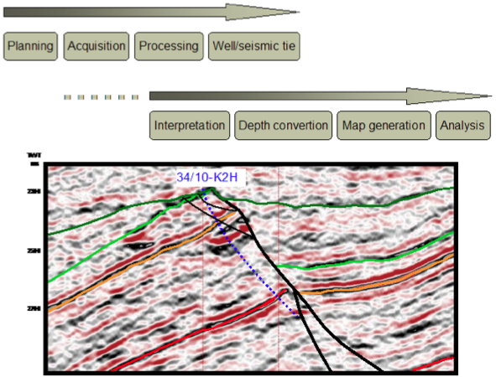
Haakon Fossen 2010

Slide 6
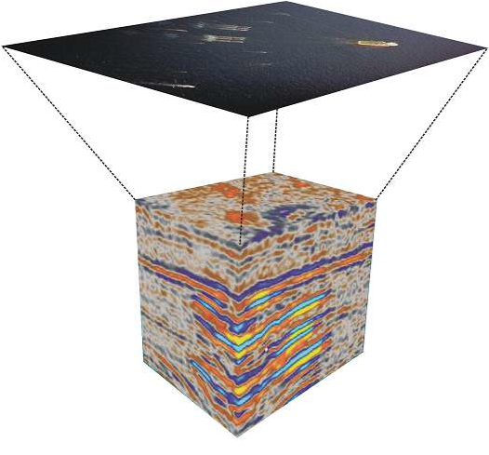
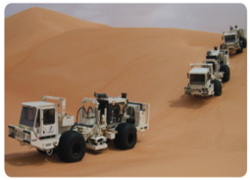
Haakon Fossen 2010
Data acquisition

Slide 7
Haakon Fossen 2010
Resolution
• Vertical
• Lateral

Slide 8
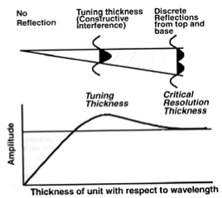
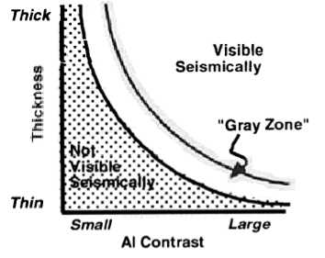
Haakon Fossen 2010
Vertical resolution
Relationship between bed
thickness and acoustic
impedance (AI) contrast
for seismic resolution of
a layer.
Vertical seismic resolution in terms of
tuning thickness: When top to base
of a layer is less than 1/4 wavelength,
constructive/destructive interference
results in apparent single wavelet.

Slide 9
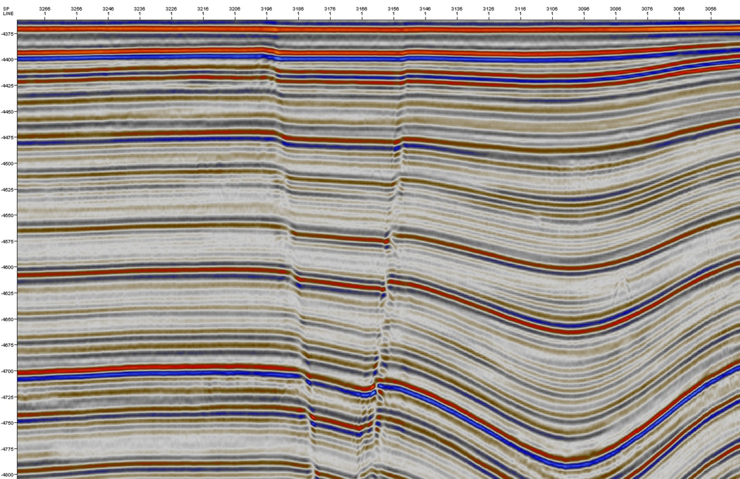
Color convention: Blue for positive amplitude, red for negative…
Haakon Fossen 2010
Note how some (weaker) synclinal layers fade out as they thin!

Slide 10
Haakon Fossen 2010
Lateral resolution: Layer boundaries are relatively diffuse near faults…

Slide 11
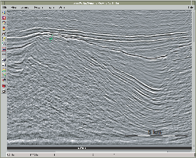
Haakon Fossen 2010

Slide 12
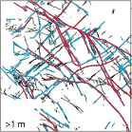
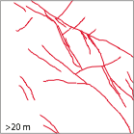
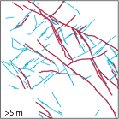
Haakon Fossen 2010

Slide 13
Haakon Fossen 2010
Lateral positioning
• Choice of migration velocities affects
horizontal positioning of signals
• Horizontal resolution typically 50-100 m
• Can be a limitation when drilling high-precision
wells, e.g. close to faults
• Resolution may depend heavily on pilot wells;
can be aided by “seismic-while-drilling”

Slide 14
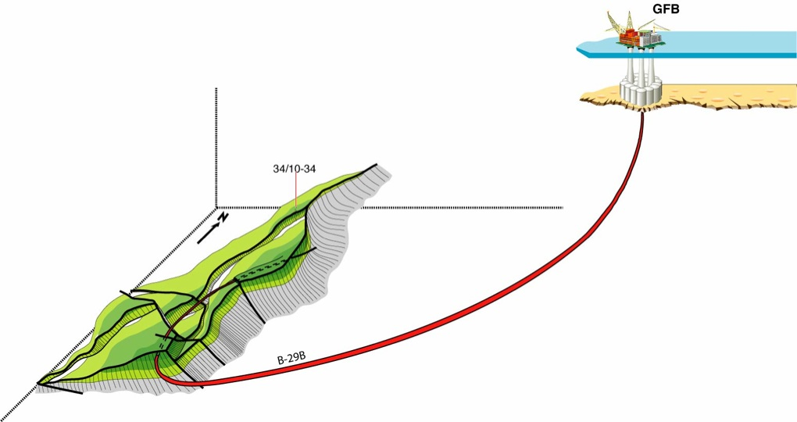
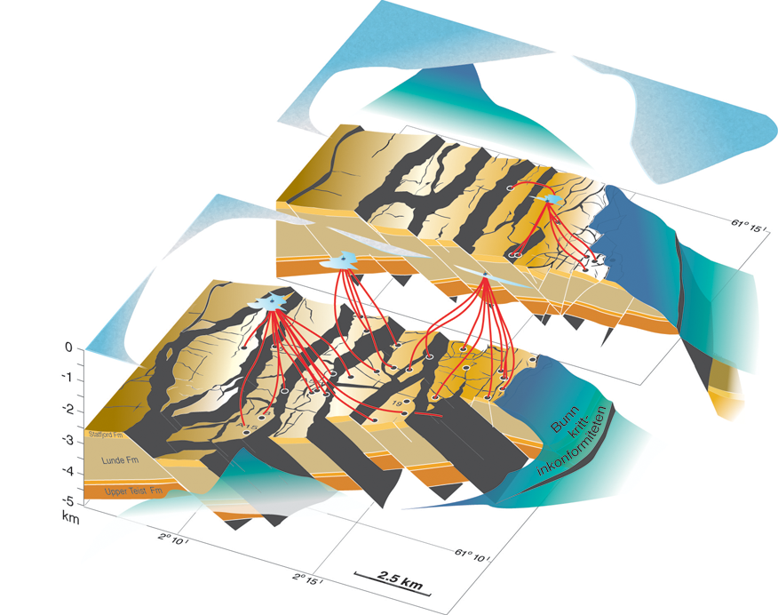
Haakon Fossen 2010
Directional drilling/steering technology is another reason for
accurate depth migration!

