Slide 1
Geology 5660/6660
Applied Geophysics
23 Feb 2026
Reflection Data Processing Cont’d
• Step V : Time Migration returns reflection energy to its
“true” location on the two-way travel-time image… Depth
migration uses velocity structure (from NMO analysis)
to convert travel time to depth (improving image resolution)
• Step VI : Reform amplitude stacks of source-receiver pairs
using Common Depth Point (CDP) instead of Common
Mid Point (CMP) and repeat Step V
• Sometimes additional steps as well:
→ Amplitude adjustments
→ Frequency adjustments
→ Transmission adjustments
Read for Wed 25 Feb: Burger 200-253 (§4.4-4.7)
© A.R. Lowry 2008-2026

Slide 2
Last Time: Reflection Seismic Interpretation
• Data collection: Huge quantities of data! Redundancy is key!
• 2D profiling still used for initial reconnaissance, but 3D is
industry standard for prospects
• Deep crustal imaging is only done in 2D; shows “reflectivity” in
crystalline basement from low angle faults & foliated minerals

Slide 3
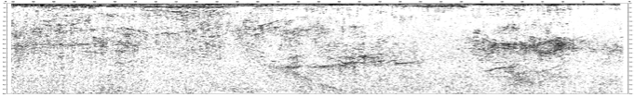
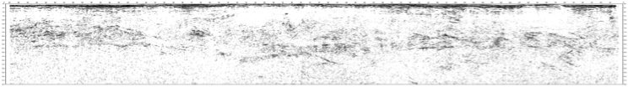

Haakon Fossen 2010
Deep seismic profiling
• Imaging depth ranges from 0-50 km
Strongest & most continuous impedance contrasts below
sedimentary cover are lithologic changes ~mid-crust
and at the Moho

Slide 4
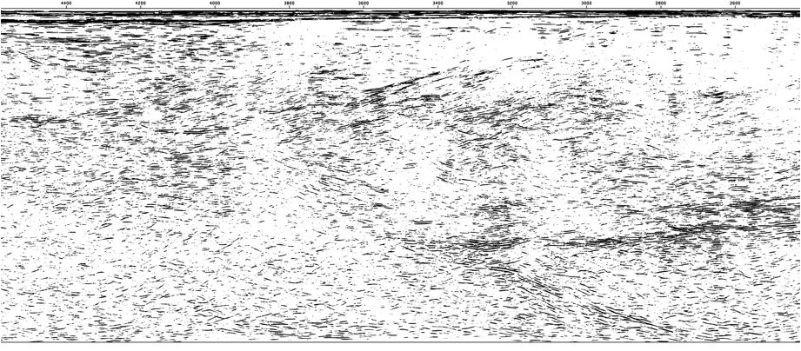
Haakon Fossen 2010
Other reflectivity within crystalline crust can relate to lithologic
changes (e.g. across a low-angle normal fault) but
often represents mineral alignment (anisotropy!) in ductile
shear zones

Slide 5
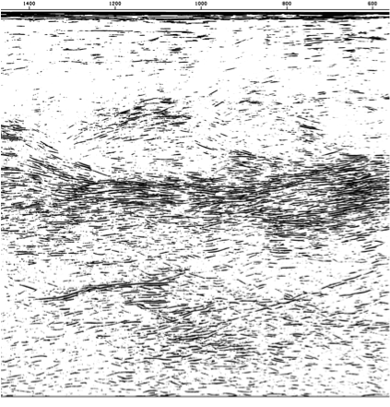
Haakon Fossen 2010

Slide 6
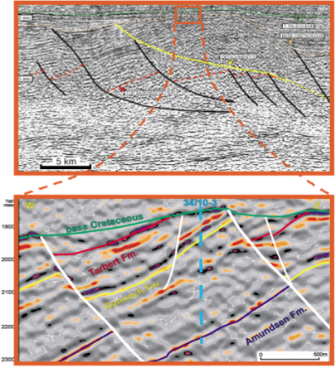
Haakon Fossen 2010
3-D seismic “data cubes”
• Better resolution
• Better positioning
• 3D view options

Slide 7
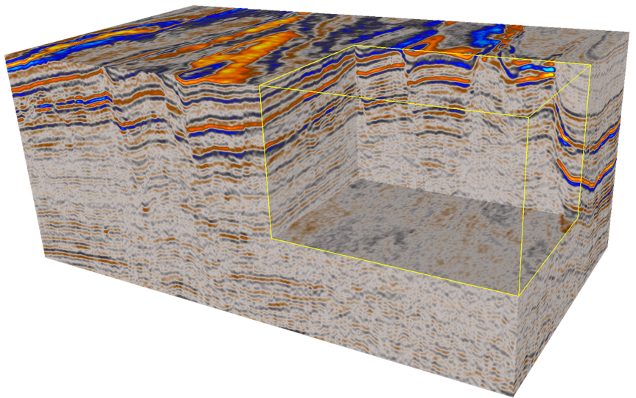
3D Seismic
Haakon Fossen 2010
3D Data:
• Collect by shooting many parallel lines ~25 m (!) apart
• Migrate together to increase accuracy and to create a
coherent data volume (or “cube”)
• Collected over all offshore oil and gas fields
• Underpins the geometric understanding of an oil/gas field

Slide 8
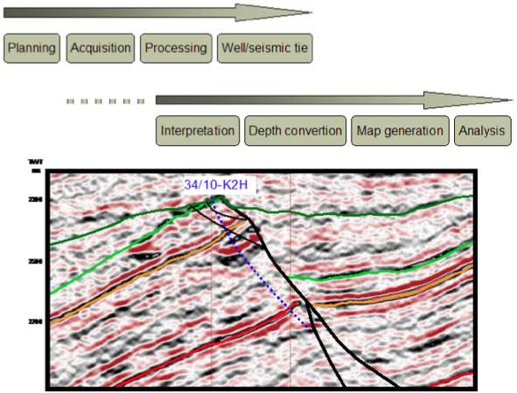
Haakon Fossen 2010

Slide 9
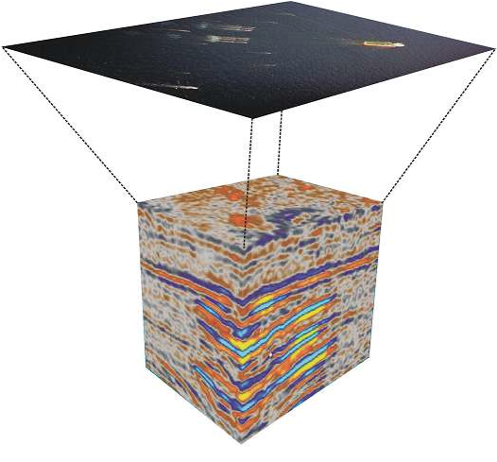

Haakon Fossen 2010
Data acquisition

Slide 10
Haakon Fossen 2010
Resolution
• Vertical
• Lateral

Slide 11
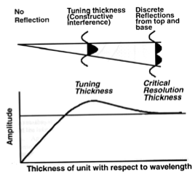
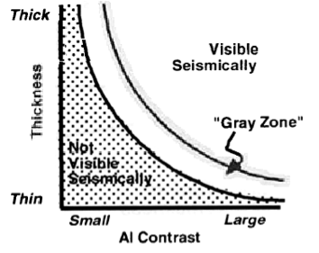
Haakon Fossen 2010
Vertical resolution
Relationship between bed
thickness and acoustic
impedance (AI) contrast
for seismic resolution of
a layer.
Vertical seismic resolution in terms of
tuning thickness: When top to base
of a layer is less than 1/4 wavelength,
constructive/destructive interference
results in apparent single wavelet.

Slide 12
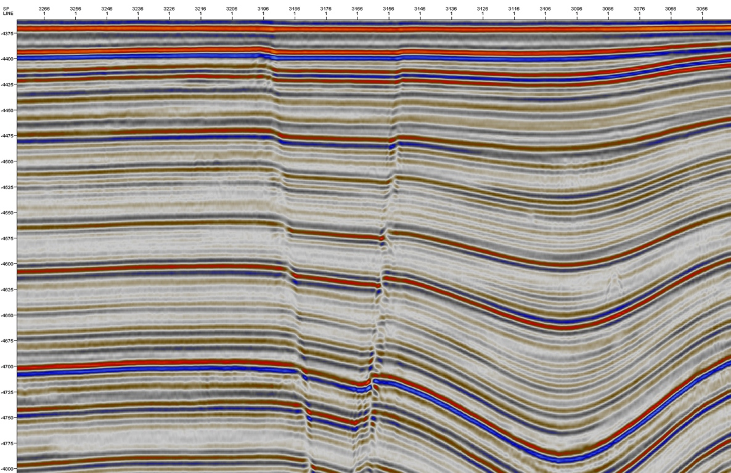
Color convention: Blue for positive amplitude, red for negative…
Haakon Fossen 2010
Note how some (weaker) synclinal layers fade out as they thin!

Slide 13
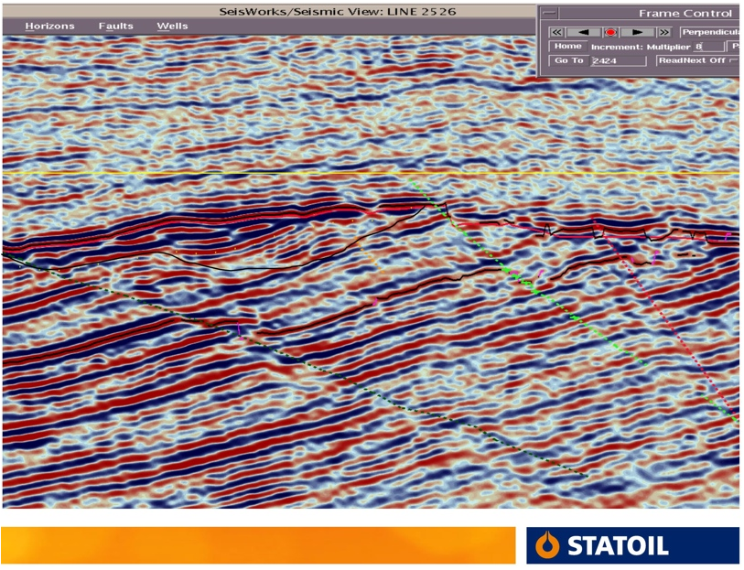
Haakon Fossen 2010
Lateral resolution: Layer boundaries are relatively diffuse near faults…

Slide 14
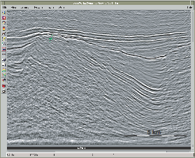

Haakon Fossen 2010

Slide 15
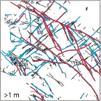
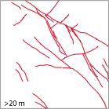
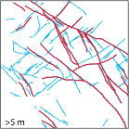
Haakon Fossen 2010

Slide 16
Haakon Fossen 2010
Lateral positioning
• Choice of migration velocities affects
horizontal positioning of signals
• Horizontal resolution typically 50-100 m
• Can be a limitation when drilling high-precision
wells, e.g. close to faults
• Resolution may depend heavily on pilot wells;
can be aided by “seismic-while-drilling”

Slide 17
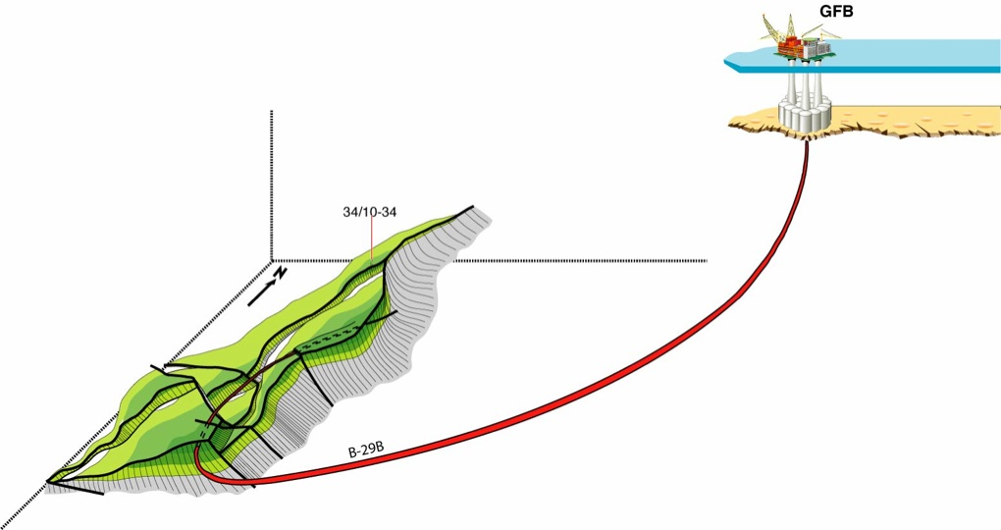
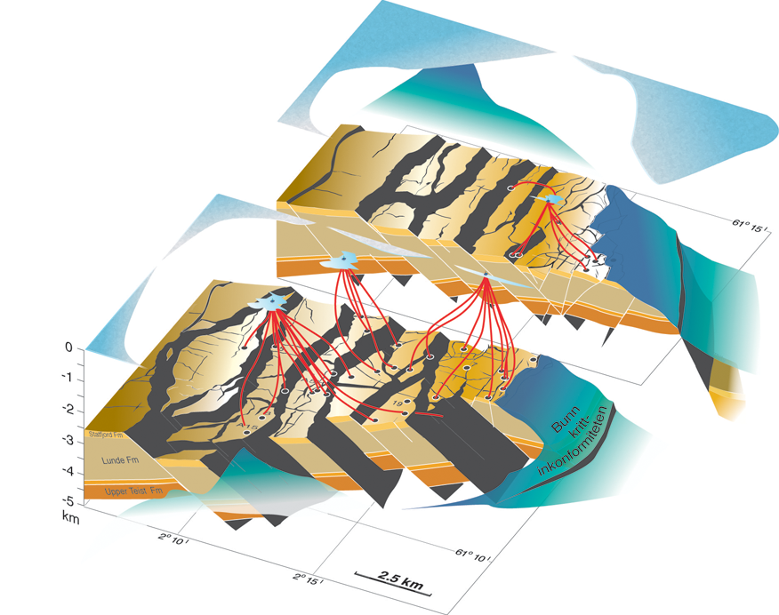
Haakon Fossen 2010
Directional drilling/steering technology is another reason for
accurate depth migration!

Slide 18
Haakon Fossen 2010
Seismic quality
Depends on:
• Acoustic impedance contrast
• Depth (⇒ frequency)
• Layer thickness (⇒ interference)
• Properties of overlying layers
• Source energy
• Processing parameters
• Acquisition direction
• Instrumentation

Slide 19
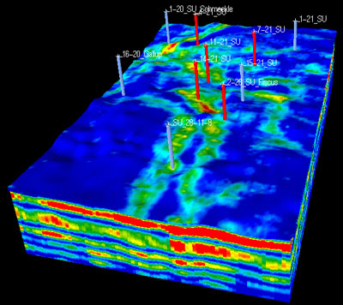
Haakon Fossen 2010
Seismic inversion
In industry parlance, the process of determining
physical properties of rocks and pore
fluid that could have produced a given
seismic image/
data set

Slide 20
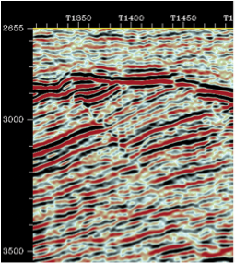
Haakon Fossen 2010
Correlation
One approach to imaging
structure is to focus on
one particular impedance
horizon (often representing
a particular formation of
interest) and mapping the
depth or two-way travel time
of that horizon as a surface
using cross-correlation
techniques

Slide 21
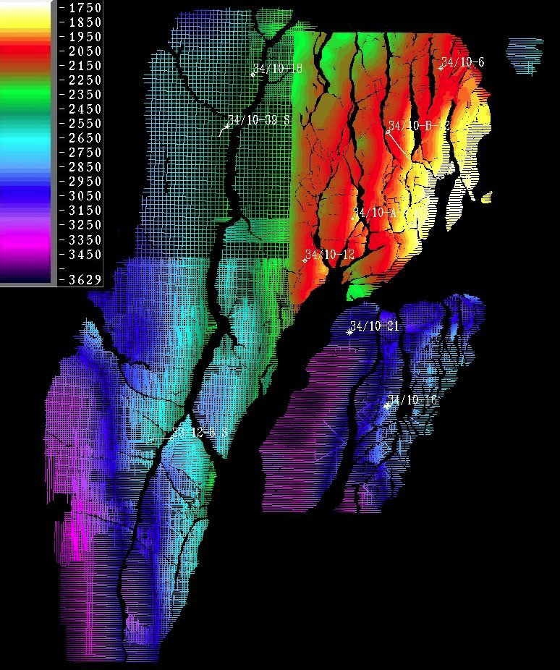
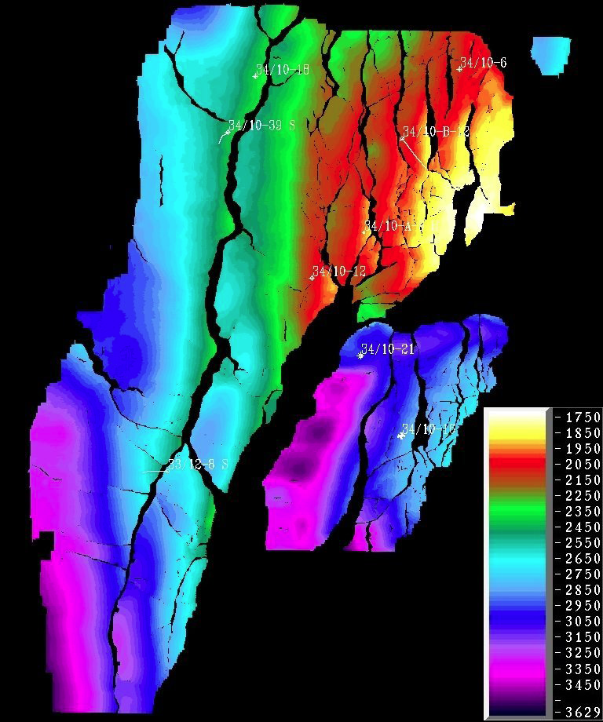
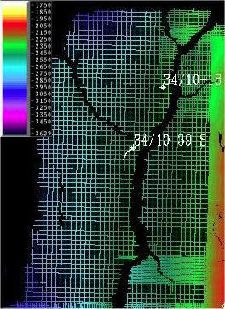
Haakon Fossen 2010

Slide 22
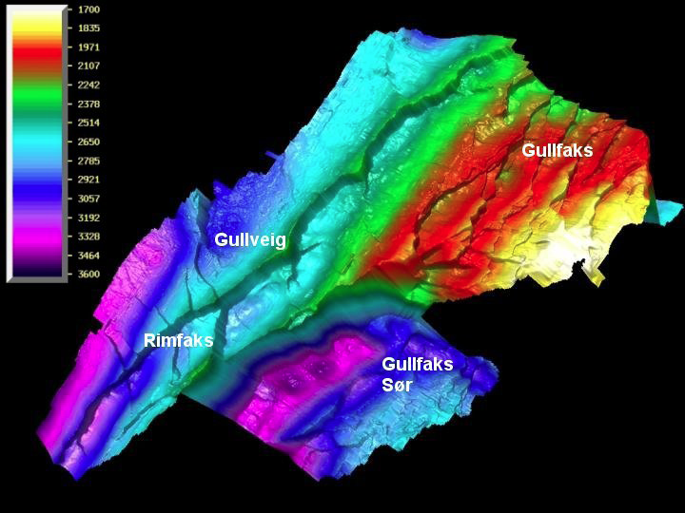
Haakon Fossen 2010

Slide 23
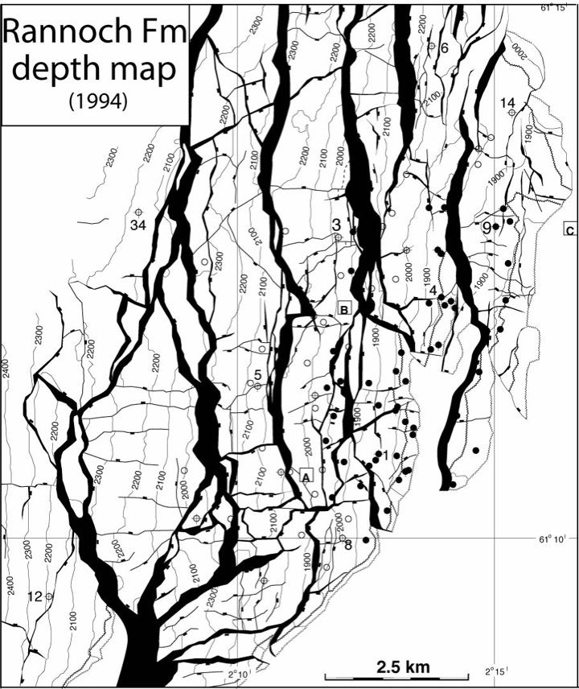
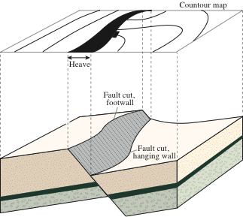
Haakon Fossen 2010

Slide 24
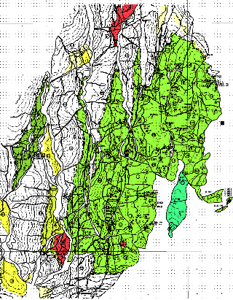
Haakon Fossen 2010

Slide 25
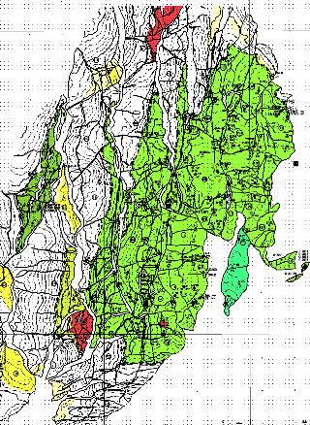
Haakon Fossen 2010
Depth conversion
Requires a velocity model, based on well
information and/or stacking velocities
(from processing of the seismic data)
Time
Depth

Slide 26
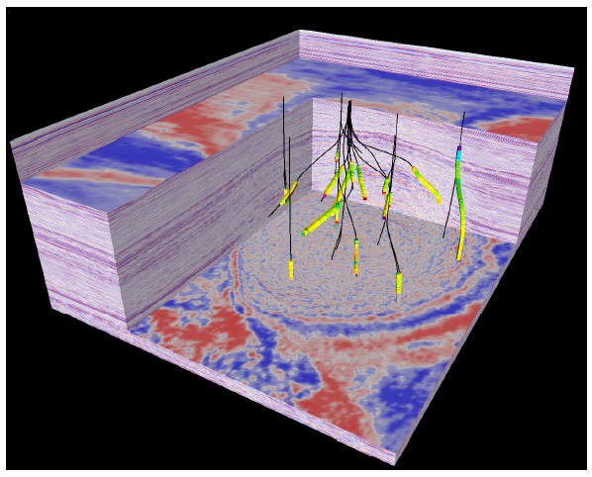
Haakon Fossen 2010
Depth migration
• Some 3D seismic is depth migrated, which
gives a more realistic image (geometrically)
• May not be easy to manage in a field with new
wells being drilled

Slide 27
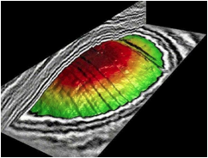
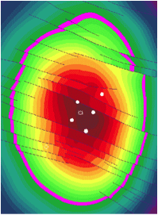
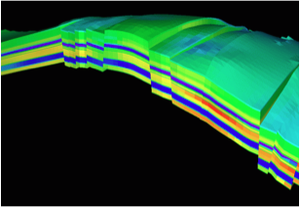

Slide 28
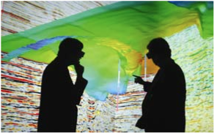
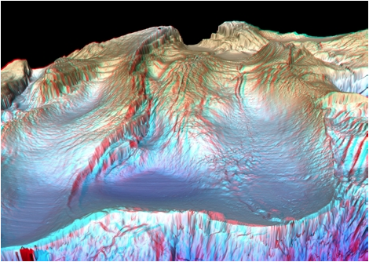
Haakon Fossen 2010
3-D visualization

Slide 29
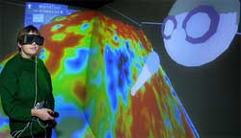
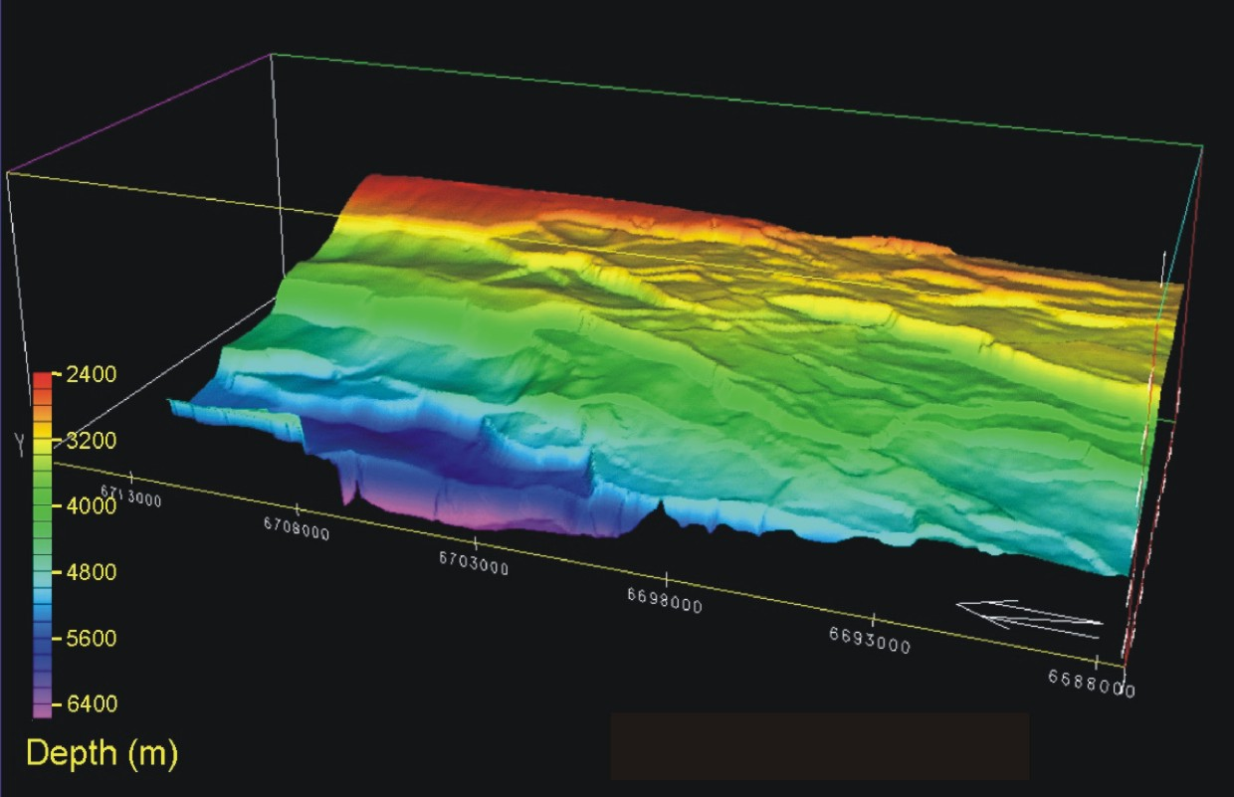
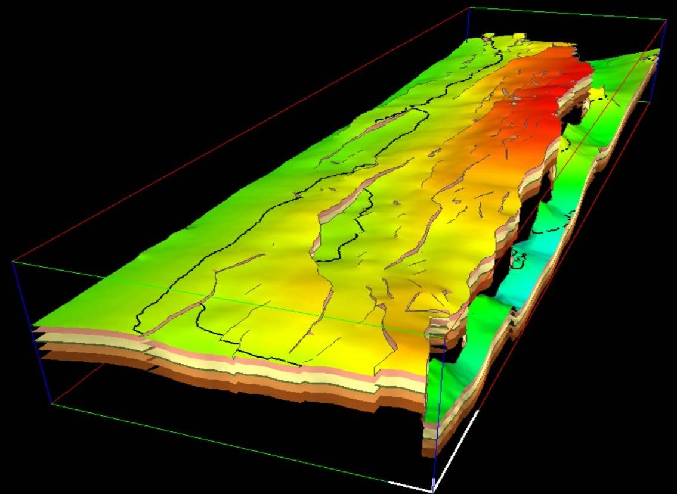
Haakon Fossen 2010

Slide 30
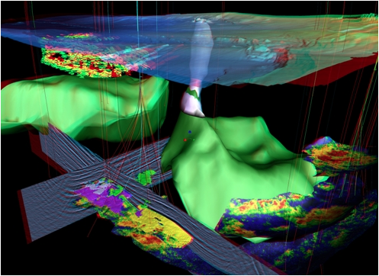
Haakon Fossen 2010
3-D visualization
A complete 3D picture of the subsurface near two producing oil fields in the Gulf of Mexico not only shows the sea bed at some 1,000 m water depth, but features such as salt structures in green and a salt diapir that penetrates the sea bed (white). Thin lines show the paths of wells drilled to over 2000m below the sea bed to develop the fields, fanning out to penetrate various reservoirs. Shallow bodies in front of the well paths on the left hand side may provide hazards to drilling. Oil field reservoirs can be seen in colour (yellows and reds) at deeper levels. Most features are extracted from the actual data, though parts of two seismic profiles are shown in black and white near the base of the display.

Slide 31
Haakon Fossen 2010
4-D seismic
• 4D seismic data is the combination of several 3D datasets collected at different times and collected/processed in the same way
• The difference tells us where and how changes have occurred in the reservoir during production in the time interval.
• This information is used for optimal positioning of new wells

Slide 32
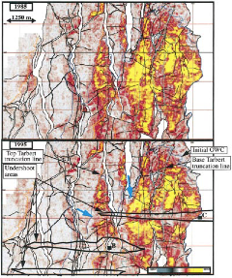
Haakon Fossen 2010
1988
1995

Slide 37
Geology 5660/6660
Applied Geophysics
26 Feb 2024
Last Time: Reflection Seismic Interpretation
• 3D gives higher resolution, better positioning (because it
enables migration of “out-of-plane” seismic reflection energy)
• Vertical resolution : Whether or not a layer is “visible”
to seismic reflection depends in part on properties of the layer
(including both thickness and impedance contrast)
• Lateral resolution : Faults are not directly imaged but
inferred from both layer offsets and “blurring” caused by
near-fault scattering of seismic energy
Read for Wed 28 Feb: Burger 524-539 (§8.4)
© A.R. Lowry 2008-2024

