Slide 1
Geology 5660/6660
Applied Geophysics
23 Jan 2026
Fermat’s Principal & Snell’s Law:
• Fermat’s principle (the propagation path or raypath is
always the path requiring least time) leads to Snell’s
Law :
Snell’s law predicts (for example) that a ray entering a slower
medium bends away from the boundary
• Reflections & Refractions: A wave traveling across a
boundary conserves energy ; has continuous stress
& displacement ⇒ reflects some energy, transmits some
energy, and often converts some energy to another
phase (e.g. P to S).
• All are governed by Snell’s Law!
Here, θ is the angle of incidence between the raypath and the normal to a boundary separating two media (1, 2) with different velocities V₁ and V₂
Read for Mon 26 Jan: Burger 65-81 (Ch 3-3.2)
© A.R. Lowry 2008-2026

Slide 2
Last time continued:
• The Critical Angle is the angle of incidence for which the
refraction parallels the interface:
(and at > angles, no refraction!)
• Diffractions occur at “scatterers” or non-ideal
boundaries; are predicted by Huygen’s Principle but not by
ray theory/Snell’s Law.

Slide 3
Some basic concepts of seismic amplitude:
Impedance Contrast:
Thus far we’ve focused much of the discussion on concepts
related to velocity & travel-time, but seismic waves also have
amplitude, A, of the particle displacements:
Amplitudes of reflections &
refractions are determined by
energy partitioning at the
boundary. A normal-incidence (θ = 0)
P-wave with amplitude A_{i} produces a
reflected P-wave with amplitude:
incoming P
A
θ = 0
(reflection
coefficient)
(refraction
coefficient)
and a refracted P:
where Z_{i} = ρ_{i}V_{i} is the impedance in layer i

Slide 4
Important to note:
Many seismology methods focus on travel-time &
hence are parameterized by velocity (e.g., tomography,
the refraction method, …). Reflection seismic uses
amplitude so it responds to impedance!
2. The relations for reflection get much more complicated
when θ ≠ 0. We will introduce Zoeppritz’ equations
for the non-trivial case later…

Slide 5
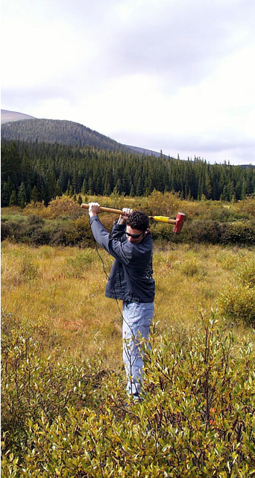

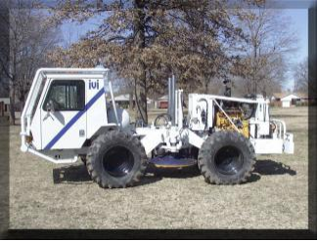
In addition to energy partitioning at impedance boundaries,
seismic amplitudes depend on geometrical spreading,
absorption attenuation & source amplitude:
Source Amplitudes relate to the initial energy
released by the source and the coupling of the source
to the medium:

Slide 6
In addition to energy partitioning at impedance boundaries,
seismic amplitudes depend on geometrical spreading,
absorption attenuation & source amplitude:
Spherical spreading is
the redistribution of constant
energy in expanding volume:
Strain energy (per unit area)
averaged over one period or
wavelength is (e.g., for an
S-wave):
Area of the wavefront is 2π r²
so
r₀ = 1
A = A₀
r = 2
A = A₀/2

Slide 7
Consider a head wave (or “critically refracted” wave):
Area of the wavefront is “cylindrical” rather than a half-sphere
so increases proportional to 2π r instead of 2π r² for a half-sphere
Hence cylindrical spreading

